Slide 1
HAZOP Study
Bitumen Handling Facility
For T no 7 at VVF Limited, Sewree
Conducted on 01.03.2017

Slide 2




Process Flow Diagram
Bitumen tanker comes with unloading pump & heating arrangement
T No 7
1347KL, 140C
10000kg/h, 140C
20000kg/h, 140C
MPS
LPS
Bitumen Unloading
Trolley
10000kg/h, 140C
Cond.
20000kg/h, 140C
P-101A
Cond.
Node-1
P-101B
Node-2
Node-3
40000kg/h, 140C
Bitumen Loading

Slide 3
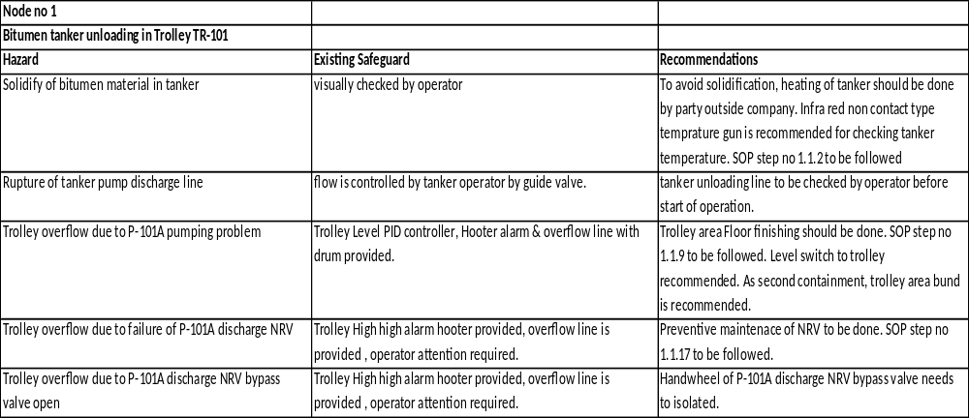
Hazop recommendations

Slide 4
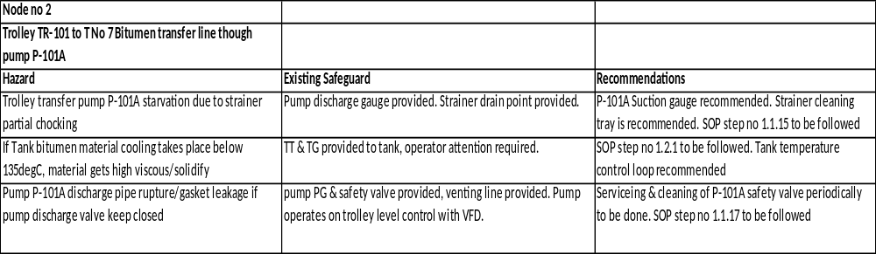
Hazop recommendations

Slide 5
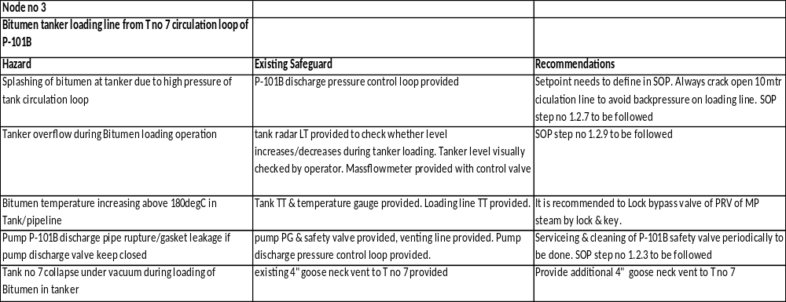
Hazop recommendations

Slide 6
Hazop recommendations
Additional points discussed:
Both the gear pumps vendor to be called and check regarding procedure to ensure that inbuilt safety valve is working ok during every startup
T no 7 avoiding overflow: Alarm at high level of tank to be provided in instrument panel
T no 7 avoiding overflow: interlock to be provided to trip P-101A whenever high-high level of tank reaches
T no 7 avoid overheating: steam flow control loop with tank temperature is recommended
T no 7 inside fire hazard when bitumen level goes below steam coil and HSD/like material catching fire: The properties of Bitumen to be studied regarding amount of fire material present in bitumen. If it is severe, then Nitrogen blanketing to tank can be considered
Carcinogenic fumes at Trolley & tank area: Scrubber system is suggested with water. Check where to drain acid water at site.

Slide 7
Thank you

