Slide 1
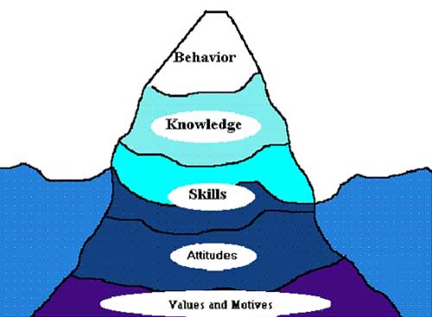
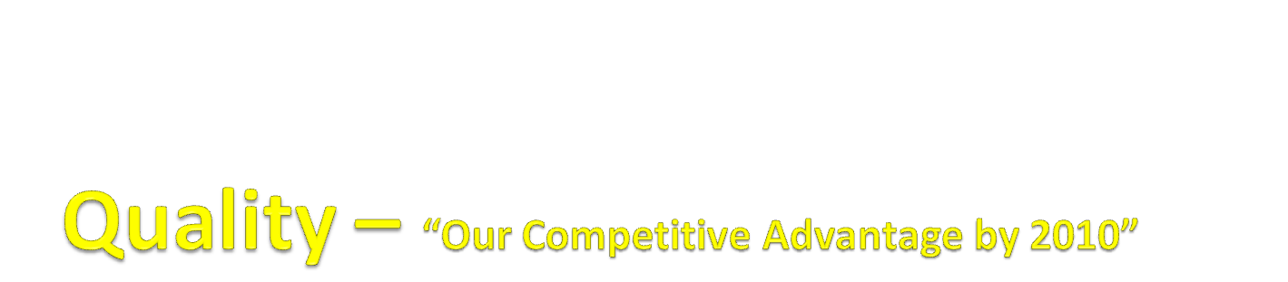
COMPETENCY MAPPING
PILOT - QUALITY

Slide 2
PROCESS FLOW
QA
JD, Stake holders
Interview,
business need
Identify Critical Position
Identify Competency Required
Behavioral – HR/HOD
Defining each Competency –
level by level
Functional –Best in class/ SME
Freeze on Required Competency
levels for that Role
In Progress
Prepare Training Module for the
incumbent to develop
Supply Chain & Logistics
Do it for all Critical Roles
Integration with IT

Slide 3

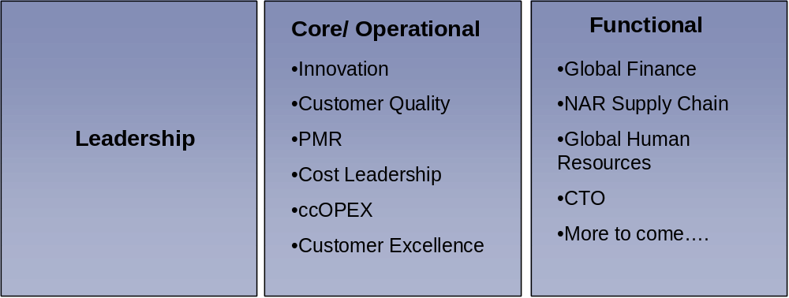
PDCA Cycle
Step 2: Earlier
To identify competencies required, we prepared a JD/ activity chart and then derived on competencies after discussion with the HOD.
To identify behavioral competency, we took interview of all the stakeholders and asked them about their expectations from that role Identified top 4 competencies.
Step 2: Now - After taking inputs from
NAR- CTO
We Clubbed the CTO material.
Taken Whirlpool generic competency also into
consideration and list down all the competency
required for that role.
Analytical & Critical Thinking | QMS | Product Knowledge | Foaming
Why Why analysis | Compliance to QMS | Controls | Process knowledge – input/output relation
Failure mode analysis & building correlation | Implementing QMS | Sealed system (Refrigerator) | Equipment – critical controls
Process mapping |  | Air flow | Chemical knowledge - brief
Building up thought map

Slide 4
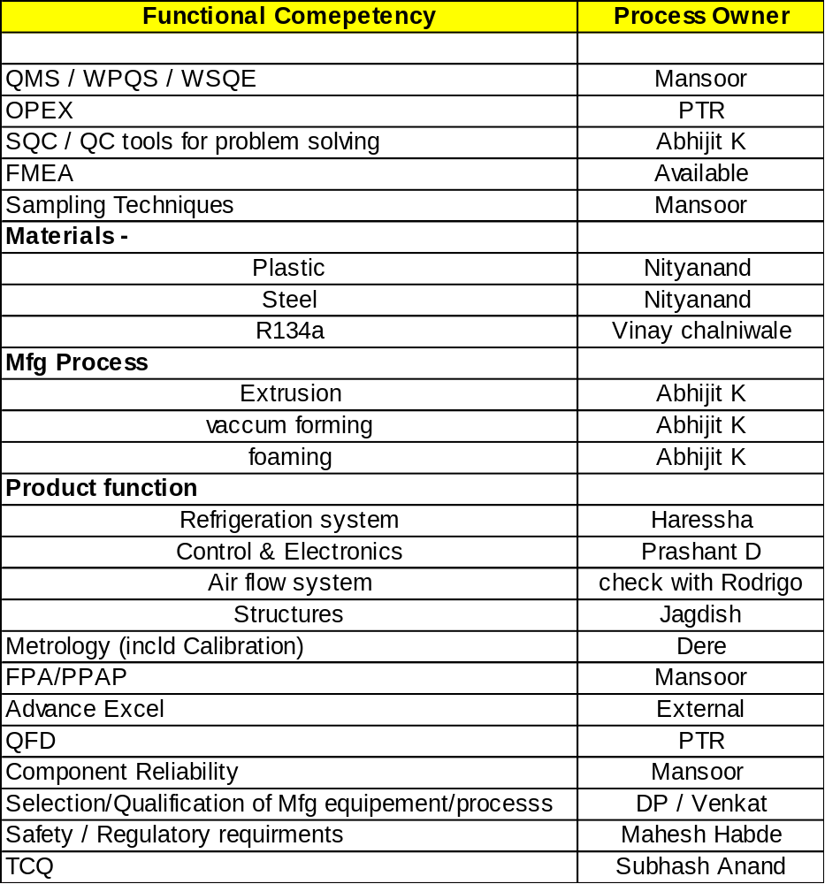
BEHAVIORAL COMPETENCY Leadership Skill Resource planning Decision making Assertiveness Influencing skill Change management Thought Leadership Strategic thinking Challenging status quo Customer Centric Team working Interpersonal skill Working cross functionally Knowledge sharing & learning | WHIRLPOOL COMPETENCY
 | Innovation C2C Cost Leadership

Slide 5



EXAMPLE: Problem Solving

Slide 6
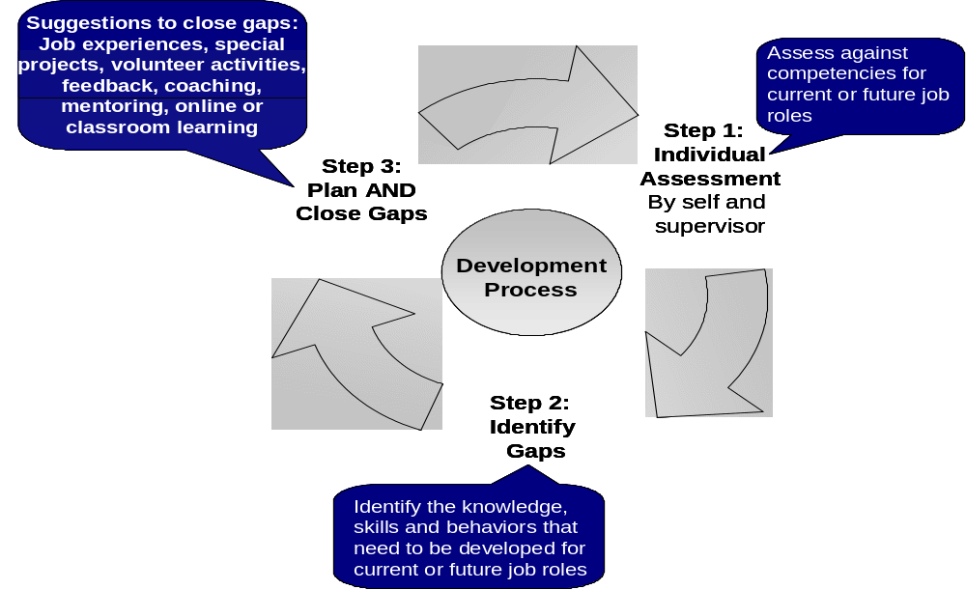

Slide 7
COMPETENCY MODEL
PILOT - QUALITY

Slide 8
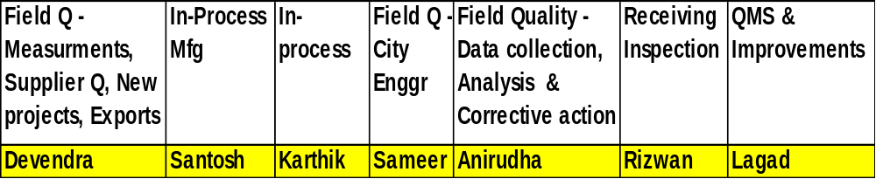
Quality Roles

Slide 9
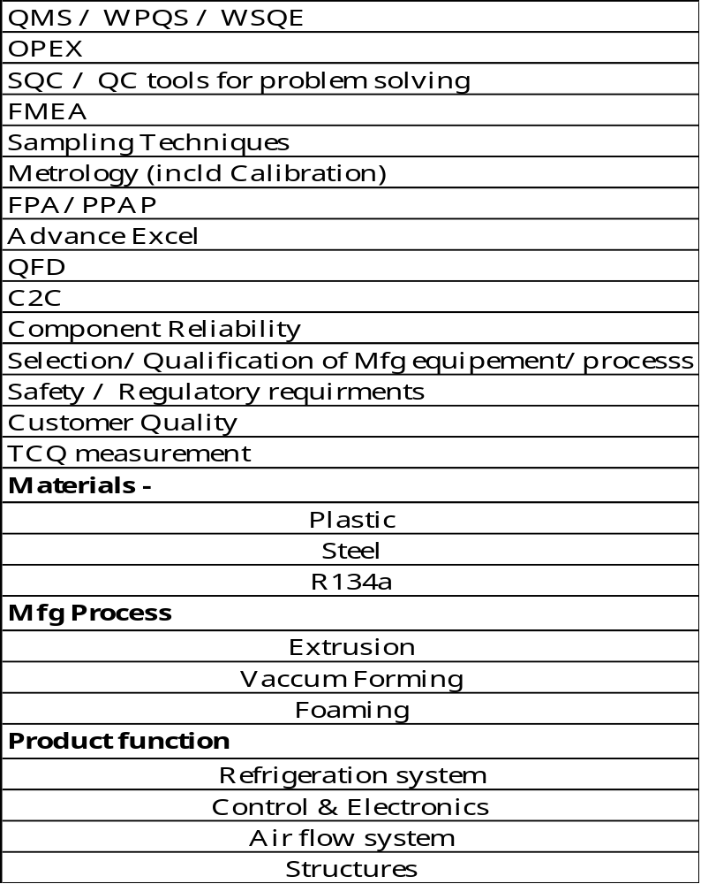
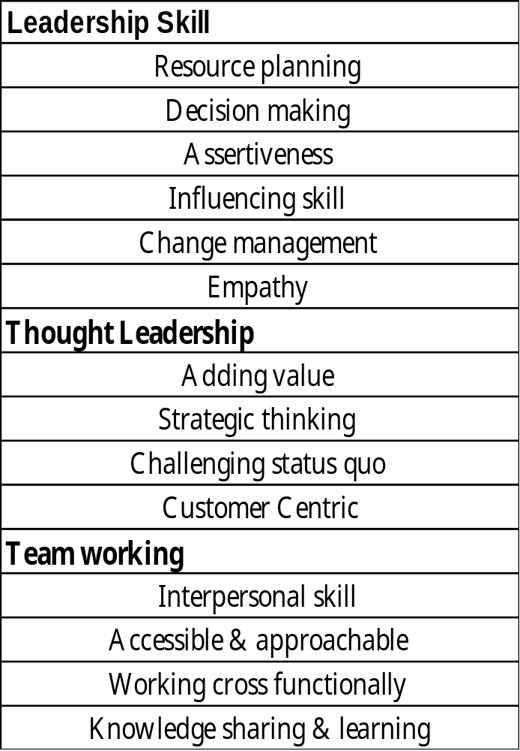
Competency Table
Functional | Behavioral

Slide 10
COMPETENCY DEFINITIONS
BEHAVIORAL

Slide 11
Definition: Demonstrating support for innovation and for organizational changes needed to improve the organization’s effectiveness; supporting, initiating, sponsoring, and implementing organizational change; helping others to successfully manage organizational change.
Proficiency Level | Assessment | Learning opportunity
Master | Comfortable with ambiguity and frequent change and provides positive support during changes. Values and seeks out diverse inputs to decision making. Clearly communicates direction of the business & required performance. Sets tasks for teams and individuals which are achievable, yet challenging and motivating. Is comfortable with delegating autonomy and provides support to empower employees to make decisions. Can communicate the need for change and inspire commitment from team members to the process. Counsels others through difficult issues or new territory. Has the credibility to influence others across the organization Uses multiple arguments to persuade using reason or rationale. Anticipates the need for change/transformation before it becomes critical Engages cross-functional teams to implement change Facilitates groups or teams through the problem solving and creative thinking processes leading to the development and implementation of new approaches, systems, structures and methods
Proficient | Maintenance of product / service quality and reliability through assurance of internal design and operations activities, thereby to decrease operating risk.
Basic | ----------------
Change Management

Slide 12
Definition: Effectively and efficiently allocates all human, financial, and material resources of the organization to meet business objectives.
Proficiency Level | Assessment | Learning opportunity
Master | Willingness to delegate responsibility and to work with others and coach them to develop their capabilities. Reviews and frequently updates operational activities to ensure responsiveness to changing internal and external conditions. Specifies critical resources needed to meet business objectives. Ensures resource availability, and removes blockages and conflicts for teams. Consistently runs effective meetings
Proficient | Ensures timely resource availability for all the activities and removes blockages.
Basic | -------------------
Resource Planning

Slide 13
Definition: Identifying and understanding issues, problems, and opportunities; comparing data from different sources to draw conclusions; using effective approaches for choosing a course of action or developing appropriate solutions; taking action that is consistent with available facts, constraints, and probable consequences.
Proficiency Level | Assessment | Learning Opportunity
Master | Identifies issues, problems, and opportunities, Gathers information, Integrates information from a variety of sources; detects trends, associations, and cause-effect relationships. Creates relevant options/alternatives for addressing problems/opportunities and achieving desired outcomes. Formulates clear decision criteria; evaluates options by considering implications and consequences; chooses an effective option. Makes decisions within a reasonable time. Includes others in the decision-making process as warranted to obtain good information, make the most appropriate decisions, and ensure buy-in and understanding of the resulting decisions. Recommend changes in policies, processes, procedures, or operations. Determine the true cause of an issue/problem before applying a solution.
Proficient | Anticipate the consequences of decisions. Take action or generate alternative solutions to resolve problems or situations. Inform manager/supervisor/team leader of important issues or problems. Consider multiple factors (e.g., customers’ needs, feasibility, due dates, costs, etc.) when making decisions. Consider the impact of decisions on other departments or areas. Gather information from several sources to understand problems, trends, or opportunities.
Basic | Understands industry and market trends affecting the organization’s competitiveness Possesses knowledge and skill in a technical area
Decision Making

Slide 14
Definition: Intent to persuade others to follow ones wishes, decisiveness, taking charge, sets limits, says no when necessary, confronts problem behavior, sets standards, demands performance,
Proficiency Level | Assessment | Learning opportunity
Master | Should be high on achievement orientation and taking initiatives. Put across his thought firmly without getting aggressive. Taking a strong and positive stance i.e. well thought out and takes into consideration all possible outcomes of various actions.
Proficient | You are capable of standing up for your personal rights and expressing your thoughts, feelings and beliefs in a direct, honest and helpful way that do not violate the rights of others. Characterized as strategic influence, impression management, targeted persuasion, and collaborative influence Establishes credibility by using direct persuasion/facts/figures Communicative and attempts to constructively bring about a happy resolution to a problem.
Basic | Intention to persuade, convince, influence or impress others, to get support for any specific agenda.
Assertiveness

Slide 15
Definition: The ability to gain others’ support for ideas, proposals, projects, and solutions. Acts to persuade, convince in order to have a specific impact or effect. commanding attention and respect, showing an air of confidence.
Proficiency Level | Assessment | Learning opportunity
Master | Presents arguments that address others’ most important concerns and issues and looks for win-win solutions, Involve others in a process or decision, to ensure their support. Offers trade-offs or exchanges, to gain commitment. Structures situations (e.g., the setting, persons present, sequence of events) to create a desired impact and to maximize the chances of a favorable outcome. Seeks out and builds relationships with others who can provide information, intelligence, support, potential business, and other forms of help. Develop, maintain, and strengthen partnerships with others inside or outside of the organization who can provide information, assistance and support.
Proficient | Identifies and proposes solutions that benefit all parties involved in a situation. If own efforts to enlist support have not succeeded, Identifies and targets influence efforts at the real decision makers and those who can influence them. Accurately anticipates the implications of events or decisions for various stakeholders in the organization and plans strategy accordingly. Shows an interest in what others have to say; acknowledges their perspectives and ideas. Speaks with a self-assured tone of voice. Is aware of the differences in style among people and adapts one’s own style to better work with others with differing styles.
Basic | Recognizes the business concerns and perspectives of others. Takes time to get to know co-workers, to build rapport and establish a common bond. Enlists experts or third parties to influence others
Influencing skill

Slide 16
Definition: Develops and uses effective strategies, change management and interpersonal skills to influence others toward the accomplishment of identified objectives
Proficiency Level | Assessment | Learning opportunity
Master | Develops and uses subtle, positive approaches or strategies to influence others Serves as a role model to others, demonstrating commitment and a vision of challenging goals and objectives Is approachable and establishes rapport with employees Establishes measurable and achievable results expectations Holds self and others accountable for achieving established performance expectations Communicates a vision to pull others through a changing environment effectively Sets priorities with an appropriate sense of what is most important Realistically anticipates obstacles when planning Plans with an appropriate and realistic sense of the time demand involved Establishes measurable, challenging, and achievable expectations. Provides feedback regarding actual performance against goals. Serves as role model to others, demonstrating commitment to achieving challenging objectives. Builds support and enthusiasm for the accomplishment of stated goals. Leadership of projects to improve operational and staff efficiency, thereby to decrease operating margins.
Proficient | Establishes a systematic course of action for oneself or others to ensure accomplishment of a specific objective. Determines priorities and allocates time and resources effectively. Gathers information from those who will be affected before finalizing plans. Solicits input of others who are affected by plans, actions or proposed changes Tracks progress and completion of activities to accomplish stated objectives Modifies planned actions when necessary to achieve desired results Develops systems to organize workflow to ensure quality, precision and timeliness of outputs. Holds self and others accountable for achieving established performance expectations. Identifies the critical factors that block or hinder improved organizational performance and/or customer service
Basic | Works effectively under short deadlines Established rapport with people easily, developing and maintaining a network of contacts that can provide information, help and access to others. Manages time effectively to accomplish what needs to get done Converts or translates objectives into workable activities
Leadership Skill

Slide 17
Definition:
Proficiency Level | Assessment | Learning opportunity
Master | Makes a systematic comparison of two or more alternatives, Notices discrepancies and inconsistencies in available information. Identifies a set of features, parameters or considerations to take into account, in analyzing a situation or making a decision, Weighs the costs, benefits, risks, and chances for success, when making a decision. Identifies many possible causes for a problem. Add value to others thought Foresightedness Actively seeks out different viewpoints and leverages the benefits of different perspectives Improves quality of meetings and decisions through thinking Demonstrates innovative, strategic and big picture thinking Engages the best thinking of others Makes others “smarter” through his/her interactions Produces thoughtful decision of high quality by at time-certain date
Proficient | Consistently challenges the status quo Possesses a strong level of business acumen Acts as a change agent Give out of the box ideas Demonstrates innovative and creative thinking Approaching a problem by using a logical, systematic, sequential approach.
Basic | Consistently adds value with his/her thinking Demonstrates intelligence by actively participating in business discussions Knows the right questions to ask
Thought Leadership

Slide 18
Definition: Obtaining information and identifying key issues and relationships relevant to achieving a long-range goal or vision; committing to a course of action to accomplish a long-range goal or vision after developing alternatives based on logical assumptions, facts, available resources, constraints, and organizational values.
Proficiency Level | Assessment | Learning opportunity
Master | Gathers information—Identifies and fills gaps in information required to understand strategic issues. Organizes information and data to identify/explain major trends, problems, and causes; compares and combines information to identify underlying issues. Generates and considers options for actions to achieve a long-range goal or vision; develops decision criteria considering factors such as cost, benefits, risks, timing, and buy-in; selects the strategy most likely to succeed. Identifies the key tasks and resources needed to achieve objectives. Modify team or unit activities and procedures to be consistent with major new directives and Translate major new directives into individual performance expectations. Develops competitive, innovative strategies that drive short and long-term growth Establish department or group priorities in implementing major new directives. Translate organizational goals into practical goals and a strategy for own department. Support for risk assessments such as audit programs across the enterprise, thereby to decrease operating and reputation risk. Provides clarity of plans and goals & Translates vision and strategy to action
Proficient | Makes sure strategies are carried out; monitors results and makes adjustments as needed. Analyzing the organization’s competitive position by considering the market and industry trends, existing and potential customers (internal and/or external), and strengths and weaknesses as compared to competitors. Has an in-depth understanding of competitive products and services within the marketplace Develops and proposes a long-term (3-5 year) strategy for the organization, based on an analysis of the industry and marketplace and the organization’s current and potential capabilities as compared to competitors Recognize alternative technologies or methods for delivering or producing services or products. Take a broad or long-term view of business or technical opportunities. Notices trends in the industry or marketplace and develops plans to prepare for opportunities or problems. Anticipates how individuals and groups will react to situations and information and plans accordingly Quickly identifies the central or underlying issues in a complex situation Applies a theoretical framework to understand a specific situation, Executes vision and strategy with speed and sense of urgency
Basic | Anticipating the implications and consequences of situations and taking appropriate action to be prepared for possible contingencies. Finding effective solutions by taking a holistic, abstract or theoretical perspective
Strategic Thinking

Slide 19
Definition:
Proficiency Level | Assessment | Learning opportunity
Master | Consistently thinks about whether an approach, process or service is inefficient, outdated or incomplete. Publicly defines a specific area where change is needed, but does not describe what those changes should be. Development and management of policies, procedures and systems to support standard process adherence, thereby to decrease operating risk.
Proficient | Seeks to understand the perspective of others when he or she disagrees with them and responds appropriately.
Basic
Challenging Status Quo

Slide 20
Definition: Making customers and their needs a primary focus of one’s actions; developing and sustaining productive customer relationships & delivering high quality services which meet their needs.
Proficiency Level | Assessment | Learning opportunity
Master | Actively seeks information to understand customers’ circumstances, problems, expectations, and needs. Verification of the integrity of product specifications during product development to drive customer satisfaction and loyalty, thereby to grow revenue or market share. Considers how actions or plans will affect customers; responds quickly to meet customer needs and resolve problems; avoids overcommitments. Share information with others on the direction of the organization. Consider customer needs when developing products or services to ensure that needs are met. Invite customers to participate in social activities to establish better relationships. Seek input from customers at key project, product, or decision points. Takes time to question and understand the real, underlying needs of customers, beyond those initially expressed. Establishes systems to collect customer feedback. Takes the initiative in developing policies to meet customer needs. Objective monitoring of customer experience touch points to drive incremental product, service and process improvements thereby to grow revenue to market share.
Proficient | Makes decisions with the customer in mind., Thinks about the customer when undertaking day-to-day work & questions ‘how is this adding value for the customer?’ Takes pride in delivering a high quality product or service. Investigates service delivery and provides solutions to problems. Tries to see things from customers’ points of view - finds out about the pressures of their world so as to relate to their concerns. Requests feedback from customers to ensure satisfaction, and shares the results with customers to build their understanding of issues and capabilities. Builds rapport and cooperative relationships with customers. Analysis of customer data from one or more internal database (s) to aid customer insight generation, thereby to grow revenue or market share.
Basic | Knows when, and how, politely to decline an inappropriate customer request. Makes extra effort to meet customer needs Keeps customers up to date and informed. Follows up on customer complaints/questions/requests Acts promptly to ensure customer problems are resolved. Makes him- or herself available to the customer. Understands that each customer is different. Delivers what is expected, not what they think the customer wants or needs. Responds to customer requests promptly. Does not make assumptions about customer needs, but asks lots of questions to clarify them. Plan on how to meet needs quickly and effectively
Customer Centric

Slide 21
Definition: As a team member, the ability and desire to work cooperatively with others on a team; as a team leader, interest, skill, and success in getting groups to learn to work together cooperatively. Team working is about working co-operatively, across cultures and organizational boundaries to achieve shared goals.
Proficiency Level | Assessment | Learning opportunity
Master | Creates the conditions that enable the team to perform at its best (e.g., setting clear direction, providing appropriate structure, getting the right people). Reinforces team members for their contributions. Gives honest and constructive feedback to other team members, Provides opportunities for people to learn to work together as a team. Recognizes and encourages the behaviors that contribute to Teamwork. Encourages and empowers others, makes them feel strong and important. Solicits ideas and opinions to help form specific decisions or plans. Expresses positive expectations of others in terms of their abilities, expected contributions, etc. Speaks of team members in positive terms. Proactively shares information and learning with colleagues. Addresses conflicts or issues within the team in a positive and open manner. Provides clear feedback to team members & Publicly credits others who have performed well.
Proficient | Uses emotional intelligence to understand team dynamics and to harmonize and synergies energies of the team Expresses disagreement constructively (e.g., by emphasizing points of agreement, suggesting alternatives that may be acceptable to the group). Uses understanding of different interests and agendas to achieve positive outcomes. Is willing to learn from others (including subordinates and peers). Promotes cooperation with other work units, Ensures that all team members are treated fairly. Provides assistance, information, or support to others, to build or maintain relationships with them. Shares his expertise with others. Works for solutions that all team members can support. Credits others, may require group management/group facilitation/conflict resolution skills and/or motivating others. Commits time and resources to team-based projects. Recognizes that the ways of getting things done in different departments, organizations and communities are not the same. Takes specific actions with the intent of enabling the team to function optimally.
Basic | Offers support for others’ ideas and proposals and Is open with other team members about his concerns Genuine interest in working cooperatively with others and being part of a formal/informal team, value others opinions, Participates willingly, is a “good team player,” does his share of the work. As a member of a team, keeps other team members informed and up-to-date about the group process, individual actions, or influencing events; shares all relevant or useful information. Listens and responds constructively to other team members’ ideas Is not afraid to seek advice from others. Puts in extra effort when needed to help others.
Team working

Slide 22
Definition: The ability to notice, interpret, and anticipate others’ concerns, feelings/nonverbal behavior, attitudes/ interests/needs/ diagnostic understanding, understanding strengths/ limitations of others and to communicate it empathetically to others.
Proficiency Level | Assessment | Learning opportunity
Master | Understands the interests and important concerns of others Notices and accurately interprets what others are feeling, based on their choice of words, tone of voice, expressions, and other nonverbal Behavior. Anticipates how others will react to a situation. Listens attentively to people’s ideas and concerns Understands both the strengths and weaknesses of others. Finds non-threatening ways to approach others about sensitive issues. Makes others feel comfortable by responding in ways that convey interest in what they have to say Relationship building listening/responding to others information seeking teamwork and cooperation Says or does things to address others’ concerns
Proficient
Basic
Interpersonal skill (Accessible & approachable)

Slide 23
Definition:
Proficiency Level | Assessment | Learning opportunity
Master | Ability to understand power and decision makers within own organization and/or in other arenas impacting the organization. Ability to predict how events may impact the organization or its position. Building/maintaining friendly relationships/networks with people who are or might be useful in achieving work-related goals. In taking action, demonstrates an understanding and consideration of how it will impact stakeholders and other areas in the organization. Makes remarks and gestures in politically charged situations that move the group or situation toward a productive outcome. Uses the "informal" ways to obtain information or accomplish something when the formal method can't meet the need, without creating problems with the formal methods Fosters an environment in which people who are culturally diverse can work together cooperatively and effectively in achieving organizational goals.
Proficient | Extent of network of relationships, Finds agreement on issues and follows through on implementation. Deals effectively with others in an antagonistic situation. Awareness of decision makers and who can influence others or the
Basic | Ensures cross team collaboration to contribute to organizational effectiveness, such as providing information to other areas of the organization in an effort to make decisions collaboratively and share resources to solve mutual problems.
Working Cross Functionally

Slide 24
Definition:
Proficiency Level | Assessment | Learning opportunity
Master | Identification and spreading of internal best practices to drive process harmonization and increase efficiency, thereby to increase operating margins.. Drive to reduce/manage uncertainty in the surrounding environment, seeks clarity of roles/information, checks quality of work/information, . Pursues self-development. Seeks opportunities to master new knowledge. Makes use of quality tools to improve processes. Shares information and explanations & Makes sure the group has the information it needs to continue working well Individually or in groups explains the causes, origins, and consequences of decisions that will impact them.. Gets others’ input for purposes of promoting the effectiveness of the group and/or process. Leads and manages an inclusive workplace that maximizes the talents of each person to achieve sound organizational results. Consulting and training support to promote a culture of quality across the enterprise and decrease cost of quality, thereby to increase operating margins. Support and management of programs to educate customers and /or consumers about product and / or service features and functionality, thereby to retain and increase market share. Identification and adaptation of cross-industry best practices to drive business excellence, thereby to increase operating margins.
Proficient | Keeps records, underlying curiosity that implies not limiting oneself to routine questions/information, desire to know more. effort involved in seeking additional information Builds on ideas of others to come up with new ways to address Acts to build team spirit for purposes of promoting the effectiveness of the group and/or process Shares information, advice and suggestions to help others to be more successful.
Basic | Seeks feedback from others and is receptive to new ideas and perspectives. Builds on strengths and addresses weaknesses. Curious. Desire to know more about things/people/issues, enhances problem definition/diagnosis, consults many sources. interpersonal understanding, technical expertise.
Knowledge Sharing & Learning

Slide 25
COMPETENCY DEFINITIONS
FUNCTIONAL

Slide 26
OPEX
Proficiency Level | Areas of knowledge & Skill | Experience | Training
Master | Reference Training to determine proficiency level. | MBB that achieves level I or II certification. | Master Black Belt Candidate 18-month Certification Program
Proficient Engineers and Above | Reference Training & Experience to determine proficiency level. | Project Application Black Belt Certification (mandatory) Note1: BB certified on previous DMAIC or other regional 6 sigma programs prior to global OpEx, were moved to "basic level" of proficiency. The intent of this definition is to promote that those engineers take a refresh training on OpEx, insuring we will keep a common approach, language and certification criteria across the regions. Note2: "certification" is the recognition that the "concepts, tools, methods" are part of the individual's DNA. By taking a training does not make anybody proficient alone. | 4 week ccOPEX/OPEX Blackbelt Candidate Program (certified)
Basic All employees | Reference Training to determine proficiency level. | Note 1: Individuals who took the 2 or 4 week OpEx training (not yet OpEx BB certified). These individuals will appear as short term proficient candidates (ones who might be certified within current year) or long term proficient candidates (ones who might not be certified within current year). Note 2: BB and GBs trained or certified from previous DMAIC or other regional 6 sigma programs prior to global OpEx; Individuals who took the OpEx fundamentals training or OpEx introduction Training | ccOPEX Basics eLearning course I & II, 4 week ccOPEX/OPEX Blackbelt Candidate Program (not yet certified), OpEx fundamentals

Slide 27
PROBLEM SOLVING
Definition:
Proficiency Level | Assessment | Learning opportunity
Master Identified special resources | Should be able to study the “Noise” part in the process & filter it out to find out significant factors (causes) Should be able to apply “business angle” to weigh the solutions coming forward, in optimum way. Should be able to teach / demonstrate, the concepts of problem solving leading complex problem solution, driving business results | DOE analysis Innovative thinking
Proficient Senior mfg/process/Quality Engineer Project Engineer | Should be able to list the critical inputs, outputs of the process. Should be able to apply critical thinking / thought map about the problem Should be able to study the relationships between various inputs & the problems Detailed Knowledge of product or the process or the system, to develop Hypothesis on technical grounds. Validation of hypothesis on statistical terns, based on trials/confirmation runs Effective monitoring of the implemented solution Core member of problem solving teams. Product / Process technical exposures | Functional knowledge of the product / process Product / Process mapping tools COV analysis / Co-relation studies / ANOVA tools Hypothesis studies SPC – controlling techniques Teamwork, influencing skills
Basic Engineer Shop floor operator | define the problem, basically in three aspects Quantification, prioritization Preliminary nature Consequence / Pain due to this problem Define baselines with little more insights, such as problem occurs When, Where, to what extent, Do the Root cause analysis, by asking the right questions, taking few trials to answer the asked questions Zero down on most effective trials Implement the tried out solution & put in control process to monitor the effectiveness Involvement in shop floor’s Day-day problem solving, | Product / process operational knowledge 7 QC tools Why-Why analysis Teamwork / people engagement

Slide 28
Definition:
Proficiency Level | Assessment | Learning opportunity
Master | I have successfully coached FMEA facilitators through challenging FMEA sessions ensuring relevant product/process failure modes are captured and actioned. I have applied the FMEA process across multiple projects, multiple levels (product, system, component), and have participated in both Design and Process FMEA sessions. I have championed the FMEA process and it’s value across multiple projects. I have accurately explained the relationship between Whirlpool’s FMEA and Safety process. I have had a conversation and received approval by current Whirlpool master | Whirlpool’s 2-Day Global FMEA Training or 4-Hour Refresher if experienced with FMEAs – Required *(link below) OPEX (preferably BB) - Suggested Proficient Safety Competency Level House of Quality
Proficient | I have used the FMEA process on a project to predict potential issues and put prevention plans in place to improve product/process quality. I have used the FMEA process to define more robust product specs, subsystem specs, component specs, and process specs. I have facilitated multiple FMEA project sessions and have captured relevant product/process failure modes and defined plans to address the highest severity and occurrence failure modes. I have diligently investigated internal and external customer’s experiences with this product and/or similar products to ensure we have captured relevant product failure modes. | Whirlpool’s 2-Day Global FMEA Training or 4-Hour Refresher if experienced with FMEAs – Required *(link below) _x0001_ eRPD _x0001_ Basic Safety Competency Level _x0001_ OPEX Training
Basic | I can describe the relationship between FMEA and our product/process quality I understand what a failure mode is and know it is my responsibility to communicate product/process failure modes that I may discover. | eFMEA101 on Whirlpool’s Virtual University **(link below)
FMEA
*Link to Global FMEA Training Materials:
http://adc-quickp1.whirlpool.com/QuickPlace/fmeaglobal/Main.nsf/h_Toc/20099C4689F016D68525718D00696306/?OpenDocument

Slide 29
MANUFCTURING PROCESS - THERMOFORMING / EXTRUSION / FOAMING
Proficiency Level | Areas of knowledge & Skill | Training
Master | Make / function of key components and Auxiliary equipment Design and operating Fundamentals of Tooling Understanding about Tooling Selection Criteria Relation of output parameters to Performance of Product Should have the ability to Develop / improvise the test Methods as per output requirements. Understanding about Key customer requirements and process /input parameters affecting those requirements Ability to Relate Output / Design / Process parameters to customer requirements Changes / Trends in Expectations in Customer Requirement / Expectations
Proficient | Feeding / Support Processes - Knowledge and Understanding Understanding about Core Process Capabilities Understanding about Output requirements from feeding / Support Processes Test methods and testing criteria for all inputs Understanding about Core Process Capabilities Knowledge and understanding about the Theories /Chemistry /Applications of the critical process parameters. Mixing Proportions for Inputs as applicable Process noises and influence of Environmental factors like Temp, Humidity, Time etc.. Tooling Constraints / Limitations Trouble shooting parameters Relation of output parameters to Process / input parameters Understanding / Knowledge of the Customer / Next stage requirements
Basic | Information about Raw Material & Equipment Supplier Knowledge about Material Specifications (input) Quaity and Inspection parameters for Raw Materials Activities and Process Sequence Understanding about Process setting and Control Parameters Process Control and Feedback Mechanism Knowledge about Equipment Capacity Awareness about Maintenance Issues Knowledge about Quality / Processing Issues Process auditing Functioning of the tooling Understanding about Output Quality & Productivity Parameters Measurement of Output Parameters Understanding about Testing / validation Criteria for output parameters

Slide 30
PRODUCT FUNCTION - STRUCTURES
Definition:
Proficiency Level | Areas of knowledge & Skill | Experience | Training
Master
Proficient
Basic

Slide 31
REFREGARATON SYSTEM
Definition:
Proficiency Level | Areas of knowledge & Skill | Experience | Training
Master
Proficient
Basic

Slide 32
CONTROL & ELECTRONICS
Definition:
Proficiency Level | Areas of knowledge & Skill | Experience | Training
Master
Proficient
Basic

Slide 33
AIR FLOW SYSTEM
Definition:
Proficiency Level | Areas of knowledge & Skill | Experience | Training
Master
Proficient
Basic

Slide 34
METROLOGY
Proficiency Level | Areas of knowledge & Skill | Experience | Training
Master ( Teaches) | - Calibration of All I , M & Tes - Gauge R & R ( MSE)
Proficient ( Applies) | G , D & T , - Measurement methods of both Destructive & Non- destructive type ( Dimensional , Pressure , Temperature , Surface finish , Hardness , Density , etc) - Calibration of Gauges , Instruments & equipments , - Knowledge of standards for I, M & TE , - Gauge R & R ( MSE) | Experience in handling the Measuring & testing equipments like micrometer , vernier caliper , Profile projector , height micrometer , pressure gauge tester ,etc . - experience in interpreting the G, D & T symbols in performing the measurements . - Experience in conducting the Gauge R & R. - Experience in calculating Measurement uncertainty . | - ISO 9000 requirements for Metrology ( Calibration) . - Gauge R & R ( MSE) - Measurement uncertainty - Tolerance analysis
Basic (Understand) | - G , D & T , - Measurement methods of both Destructive & Non- destructive type ( Dimensional , Pressure , Temperature , Surface finish , Hardness , Density , etc) - Calibration of I, M & TE , |  | - G , D & T - Calibration of I ,M & TE

Slide 35
First Part Approval
Proficiency Level | Areas of knowledge & Skill | Experience | Training
Master Senior Enggr, quality, DOH, Quality | Should be able to deal cross functionally for efficient value addition in FPA process Should be able to teach / demonstrate, the n/commitment need during FPA process | Interpersonal skills PPAP process generally followed in automobiles | Metrology esp. in automotive sectors. (senior level, dealing with cross functions)
Proficient Senior Enggr , Quality function (metrology) | Should able to make a comprehensive fpa plan, wrt internal / external customers needs/issues faced, besides drawing specifications. Should know the Repeatability & reproducibility assessment techniques, while doing dimensional measurement & other Material & performance testing. Should be able put rigor in evaluating adequacy & compliance in the various documentation applied in the process. Esp. Control plan & FMEAs | Receiving inspection Metrology Experience in above functional area in auto motive sector is preferred | FMEA process. Gauge R & R . Process capability needs. Product functional knowledge / mfg process knowledge
Basic Shop floor operators (Quality as well as cross functional) | Need? System Requirement? Why FPA? Objective need When FPA? Which are the triggers? Reaction in case of non-conformance to FPA needs. Basic Requirements to satisfy FPA process, Dimensional, Reliability / test conformance for material & product performance Capability assessments Process control plans Documentation Needs Dimensional measurement – Drawing inferences & measurement techniques (selection, usage of instruments & actual measurement consistency) | Receiving inspection Metrology Experience in light engineering sector | FPA QMS process Geo-metric dimensional tolerance

Slide 36
C2C
Proficiency Level | Areas of knowledge & Skill | Experience | Training
Master •Anyone who will lead a Mega or Major Project •PDT / PBT & OPT Leaders | •Able to work with major complexity •Brings Credibility based on achieving Results •Enterprise View of Whirlpool Business •Leadership Vision, Discipline, Motivating •Advanced Project Management Skills •PMI Certification •Strong Facilitation skills •Team Building skills & experience •Master level of C2C Proficiency •People Evaluation/PMP | •Project Leader on multiple Major and Minor projects •Project Team Member on Mega Project •Teach C2C Refresh and/or Project Activation | •Advanced Project Management •Proj Mgmnt Skills •Creating High Performing Teams •Making Projects Work •Facilitation Skills & Techniques
Proficient •Anyone who is a team member on a Mega or Major Project •Apply Project Management Daily on Minor and Micro Projects •PDT / PBT & OPT Members | •Application of C2C Disciplines, Process and Tools •Application of Functional Process from their area •Interactions/linkages between all Functional Processes •Understand Consumer Focus tools and methodologies •Basic Project Management skills •WBS, Estimation, Manage people, time, or money •Communication skills •Teaming Skills (ability to work within team structure) •Effective Functional representative •Understanding of Change Management •Understanding of Innovation process | •Experience working with C2C Website •Applied C2C disciplines on at least one Major Project and nominated by Project Team Lead | •Effective Project Management Skills •Functional Process Training (home function) •C2C - Project Activation •Microsoft Project
Basic •Individuals who support or interact with project teams | Whirlpool Process Terminology & philosophy (C2C) Impacts to employee & their functional area Linkage to other processes | •Passing (80%) on eC2C testing | •eC2C Fundamentals •C2C Process Training
Training Material Site: - https://access.whirlpool.com/www1online/C2C/

Slide 37
SAFETY & REGULATORY REQUIREMENT
Proficiency Level | Areas of knowledge & Skill | Experience | Training
Master Possesses the deepest level of competency subject matter knowledge and the ability to solve new and complex problems while embedding the competency by coaching and teaching others. | In the context of a global project, I’ve applied our approach and application of the Design for Safety process, PHMs, CPS Standards and their interpretation. I have executed a fault-tree analysis used to evaluate safety of specific failure modes. I have technical experience related to the product, system, or component under consideration I am qualified to interpret forced failure test results I understand PHM precedents on a Global basis I have had a conversation and received approval by current Whirlpool master | Teaching & Mentoring Proficient Candidates at different organization levels / functions Reactive PHM leadership Multiple product group work Development of FFT procedures and compliance criteria FFT test interpretation Product specific experience Team building experience | FMEA Master Level proficiency OpEx BB training Field Investigation Simulation Facilitation
Proficient Applies and delivers results through Application | I have executed each step of the design for safety process. I understand the CPS standards, the reasoning behind them and understand how to design to them. I know about the Restricted Materials List (RML) and how to ensure compliance of the products. I have reviewed safety precedence history of my product group. I have successfully executed the Product Hazard Management (PHM) process | CPS-10 – PHM CPS-13 – Safety Audits Fault Tree Analysis Work between regions within product group Proactive PHM leadership Forced Failure Testing | FMEA Proficiency Safety Audit Simulation course Field Investigation Simulation Hazard Communication
Basic Understands and if required, performs a limited range of tasks with supervision | I understand the reason for following the safety hierarchy when determining the appropriate closure of potential safety hazards for the consumer. I can describe the major steps required under the Design for Safety process. I understand the connection between Design for Safety, Failure Modes and Effects Analysis (FMEA), and Technical Design Preview (TDP) and where they fit inside the Consumer to Consumer (C2C) process I can identify when to use and not to use the PHM process. | PHM Support Safety Audit TDP Participation | E-FMEA Process Safety Tools

Slide 38
TCQ
Proficiency Level | Areas of knowledge & Skill | Experience | Training
Master | •Knowledge on Product Quality, Quality KPI, After sale service process. •CRM •Data Mining / Data Warehouse (e.g. SAP, BEx, Web BEx, RPM, Trends, Topps, etc •Accruals Accounting •Actuarial Valuation Technique
Proficient | Knowledge on cost categories like P&L, Rework/Recall, Product Exchange, Policy Adjust, Product Liability, Call Center, Warranty Other/Admin, Trade Partner Penalties, Damage. [Eg The costs associated with replacing an entire product (due to dissatisfaction, repeated service attempts, lack of part availability, etc)]
Basic

Slide 39
COMPONENT RELIABILITY
Proficiency Level | Areas of knowledge & Skill | Experience | Training
Master Possesses the deepest level of competency subject matter knowledge and the ability to solve new and complex problems while embedding the competency by coaching and teaching others. | I have applied my understanding of reliability program requirements, planning, definitions, training, and organizational resources to achieve those requirements within the constraints of life-cycle issues and costs. I have an understanding of basic probability and statistical tools to analyze product life cycle. This includes the proper application of probability distributions, Pareto concepts, tolerance and confidence intervals, sample-size determination, and regression analysis to improved reliability of a module or product. I develop models and predict, analyze, and interpret the reliability system using block diagrams, apportionment, and simulations to compare results with available field data for modules and module sets. I have collected appropriate data to define, identify, analyze, correct, and prevent potential system failures. I have established product reliability requirements and to understand and use the reliability tools listed in the BOK. I understand the principles of maintainability and availability over the life cycle of the product or system. I have developed reliability test plans that cover the expected customer use environment and operational conditions. I have identified appropriate acceleration stresses and methods, analyze and interpreted the results of these development tests. I have had a conversation and received approval by current Whirlpool master. | Teaching & Mentoring Proficient Candidates at different organization levels / functions Continual external benchmarking Multiple “product” experience Develop class notes for training Lead design of system, sub-system, component systems | CRE examination preparation training Advanced reliability training – reviewed with GCO, RCO, Master, or line manager
Proficient Applies and delivers results through application | I have translated the voice of the customer into engineering reliability requirements and test procedures. I have developed a plan for module set reliability prediction and have integrated it into the modular system reliability prediction and validation plan I understand when to use reliability tools (FMEA, Physics of Failure, HALT, FMVT, ALT, Demonstration testing, MEOST) in the development process to grow reliability in design. I have interpreted the results produced by reliability analysis, allocation, RGA, and ‘tests to learn’ to improve a design I have calculated the total cost of ownership from my reliability prediction models. I have developed test/sampling plans for reliability analysis. | Use of Risk assessment tools – FMEA, PHMs, FTA, etc Preview team membership Lead development of system, sub-system, component systems | Reliability 101 and Reliability 202 And/or training on the following: o ALT training o RGA concept Training o Reliasoft master the tools or eq. training
Basic Understands and if required, performs a limited range of tasks with supervision | I can explain the difference between reliability, robustness, and quality I am aware of the tools used to test for reliability at Whirlpool and can state the impact that these tools can have (allocation=reliability target at component level to meet product level goal, reliability life analysis i.e. Weubull=data analysis, reliability diagram=model used to predict reliability) | Work on cross functional teams | Reliability 101 course

Slide 40
SELETION/QUALIFICATON OF MFG EQUIPMENT
Proficiency Level | Areas of knowledge & Skill | Training
Master | Formulate equipment data sheets and specify key construction & be able to influence on critical parameters of the data sheets Be able to influence on critical parameters of Equipment Selection Interpretation of capability indices and deciding on acceptance of the process Should be able to understand finer points and be able to predict about the long term capability
Proficient | Measurement of short term capability and Long term capability indices for the equipment / Process Comparison of alternatives based on objectives to decide the optimum / best suited process / Equipment to suit the requirements Formulate equipment data sheets and specify key construction / Performance parameters of the equipment to suit the requirements Ability to specify customer / Product requirements from the process or equipment
Basic | Ability to understand functioning of Process / Equipment & relate it to customer requirements Identification of key Process capability parameters with respect to Product and Process Understand the critical factors - Assembly / Alignments / Locations etc for correct Installation of the equipment Understanding of Short term and Long term variation and its sources Interpretation of capability indices and deciding on acceptance of the process Preparation of Quality Plan based upon process capability studies and the Critical parameters related to the product.

Slide 41
QFD (Quality Function Deployment)
Definition: Understanding the VOICE OF CUSTOMER and converting it into engineering specifications
Proficiency Level | Assessment | Learning opportunity
Master | An expert who can teach the concept and tool required to convert VOC into ES Expert in sampling and surveying techniques Lead mega projects in this regard Can Mentor project teams working on mega projects | https://access.whirlpool.com/www1online/cted/QFD%20Training%20Materials/QFD.htm
Proficient | Expert in using tools and techniques of capturing VOC Aware of sampling and survey methodology on how to select customer base (Strata) Expert in converting VOC to ES Worked on more than one project in this aspect
Basic | Understand the basic concepts of capturing VOC Awareness on how to sample customer base.

Slide 42

MATERIALS- PLASTIC, STEEL & R134a
Plastic :
Steel:
R134a:

Slide 43
SAMPLING TECHNIQUE
Proficiency Level | Areas of knowledge & Skill | Experience | Training
Master Senior Quality / Process Enggr | •Understanding of various sampling methods & their objective. •Relevance of Sampling method, ‘ inspection levels’ , ‘ acceptance Quality levels’ with, •Theory of probability •Confidence interval or level of discrimination needed •Theory of variation •O-C curve, Consumer’s & Producer’s risk. How OC curve analysis can help in defining sampling levels. •Usage of Sampling methods for various SPC tools. | •Inspection experience of 5+ years | •Statistical sampling techniques
Proficient Quality / Process Engineer | •What is ‘inspection levels’ & ‘acceptance Quality levels’? •Selection of sampling methods, IL & AQL? •Various objective based sampling methods ? | •Industry experience of ~ 3+ years. Esp. at receiving inspection •Knowledge of mfg process •Knowledge of Part complexity - functional | •AQL inspection manual – training
Basic Engineer Inspection opeartors | Define What is Sampling ? Need of sampling? Understand what is Homogenity of the lot, it’s neeed? Application of the sampling plans / tables Application of the Control plans | •Inspection experience for 1+ years | •IS 2500 sampling tables

Slide 44
QMS
Proficiency Level | Areas of knowledge & Skill | Experience | Training
Master MR, Senior departmental resources | •Understanding of Business processes, it’s deliverables & it’s linkages to QMS. •Should be able to teach / demonstrate the Need & practical benefits of the QMS. •Should be able to develop operational process addressing all the needs adequacy & compliance. •Detailed understanding of Key processes – •Internal audit •MRM | •Certified internal auditor / lead auditor. •Industry experience of ~ 10+ years •Communication with external parties. | •ISO lead auditor’s training
Proficient Quality / Process Engineer | •Understanding of relevant operational procedure as well as linkages to relevant cross functional procedure •Understanding & application of Key procedures – •Corrective & preventive actions •Control of Non-conforming products •Monitoring & Measurement •Analysis of data | •Industry experience of ~ 3+ years | •QMS requirements
Basic Shop floor operator Supervisors / engg | Define Quality, Customer (internal & External) Understanding Need of continuous improvements Understand & demonstrate the Organization's Quality Policy Understanding & application of the Basic process Relevant operational procedures Document control & Record controls Measurement of product & process Identification & traceability Control of measuring equipments | •Industry experience for 1+ years | •QMS requirements

Slide 45



ROLE WISE COMPETENCY MODEL
PROBLEM SOLVING MODULE
SEALED SYSTEM MODULE

Slide 46
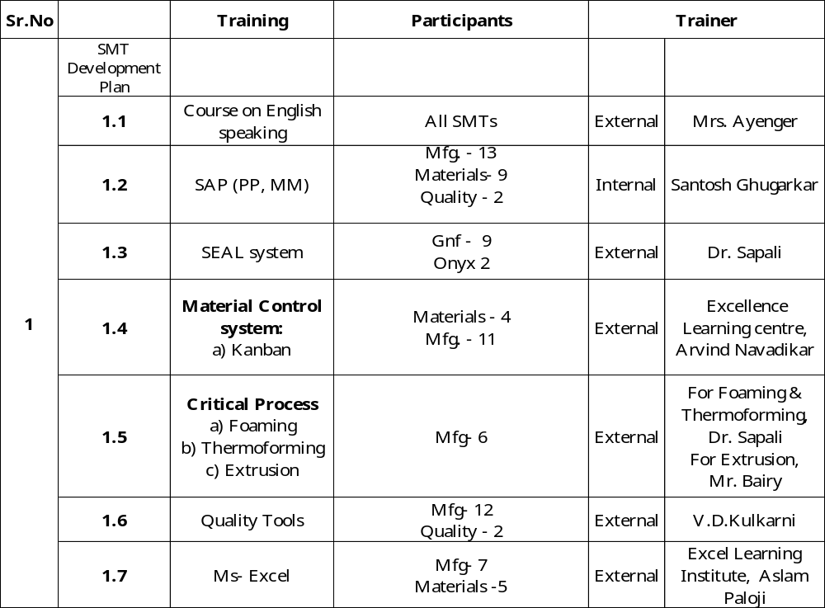

Slide 47
