Slide 1
CIT-260
Week One

Slide 2
Objectives for this week
At the end of this week, students should be able to
Explain the contents of the syllabus
Explain what a high level programming language is
Describe the steps to build and execute a Java program
Install and configure IntelliJ IDEA
Describe the structure of a Java program
Write, compile, and execute a simple Java program

Slide 3
What You Will Learn This Week
What this course is all about
What is in the Course Syllabus
A little about computer programs
What a simple Java program looks like
Who your classmates are and something about them

Slide 4
What You Will Do This Week
Study this set of slides
Review the course syllabus
Get to know your class-mates
Sign up for a Zoom account
Install IntelliJ IDEA
Write a short Java program and submit it

Slide 5
This is an introduction to object-oriented programming. At
the end of this course you should have a solid grasp of the basic principles of object-oriented programming. These include
* Reading and writing data to the Console
* Using primitive data types and operators
* Thinking algorithmically
* Changing the flow of control in a program
- with selection statements
- with loops
* Using object-oriented design principles
- abstraction, encapsulation, inheritance, polymorphism
* Using methods to break problems into smaller pieces
* Handling exceptions
* Reading and writing data to a file

Slide 6
At the end of this course you should be able to
design, construct, test, debug and document simple
object-oriented programs using the Java programming
language.

Slide 7
No matter what anyone else tells you, programming
is an art. It is an extremely creative process that requires both passion and dedication.

Slide 8
“The computer programmer is a creator of
universes for which he alone is the lawgiver.
No playwright, no stage director, no emperor,
however powerful, has ever exercised such
absolute authority to arrange a stage or
field of battle and to command such unswervingly
dutiful actors or troops.”
--Joseph Weizenbaum

Slide 9
A computer is just a dumb machine. On its own, a computer is not capable of doing anything. We have to tell a computer what to do by giving it a set of instructions called a program. Computers do not understand human languages, so we have special computer languages that we have to learn to write our programs. These languages are called programming languages.

Slide 10
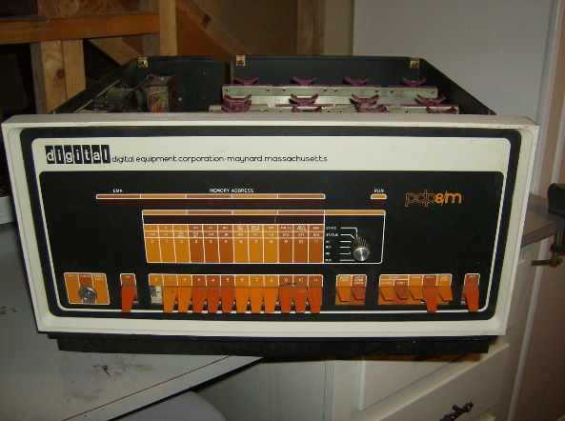
Machine Language
The most primitive form of programming language is machine language. Every computer has a built in set primitive instructions, which are entered in binary. Entering binary instructions into the computer is a tedious process. The picture here shows a Digital Equipment PDP-8 computer, a popular computer in the early 1970s. Programs could be entered on the front panel by flipping
switches. When the switch was up it
represented a zero. When it was down
it represented a one.

Slide 11
Assembly Language
Assembly languages were developed to make programming easier. A program called the assembler is used to convert assembly language programs into machine code. This conversion is very fast, since there is usually a one-to-one relationship between assembly language code and machine code. Here is an example of a PDP-8 assembly language program that adds the contents of two memory addresses and leaves the sum in the accumulator
00200 CLA / Clear the accumulator
00201 TAD A / Add contents of memory location A to the accumulator
00202 TAD B / Add the contents of memory location B to the accumulator
00203 HLT / Stop the CPU
00204 JMP I, 7600 / return control to the operating system
00205 A, 0003 / define memory location A and store the value of 3 there
00206 B, 004 / define memory location B and store the value of 4 there

Slide 12
High Level Languages
High-level programming languages are English-like and are much easier to learn and to use than assembly language. For example, the following is a high-level language statement that adds the values of a and b, and stores the sum in c.
c = a + b

Slide 13
Procedural Programming
In procedural programming languages, like C, statements such as
c = a + b
are combined together into units known as procedures, functions,
or subroutines. Procedures can be called from anywhere in a
program and they operate on the data values (like a, b, and c) in the
program. Much of the data in a procedural program is defined in a way
that it can be seen and operated on by any procedure in the program.
This separation of data from the procedures that work it makes programs
that are difficult to maintain, and there is limited re-use of procedures.

Slide 14
Object
Methods
In an object-oriented programming language data
and the procedures that operate on that data are
put into a software package called an object. In
Java, we refer to the procedures that are
associated with an object as methods.
Data

Slide 15
Object
Methods
The data inside of the object is typically declared
as private, so that entities outside of the object
cannot directly access the data. This is called
data hiding.
private
Data

Slide 16
Object
The methods inside of the object are typically
declared as public, so that entities outside of
the object can use them to access and manipulate
the data in the object.
Packaging the data and methods together this
way is called encapsulation.
public
Methods
private
Data

Slide 17
Programming Languages that primarily deal with
objects are called object-oriented programming
languages.
One of the most popular object-oriented programming
languages is Java.
In this course we will use Java to illustrate the
important principles of object-oriented programming.
Java is a very rich language. We will only discuss the
parts of Java necessary to explain the programming
concepts presented in this course.

Slide 18
Java was developed by James Gosling at Sun Microsystems.
It was introduced in 1995 as part of Sun’s Java platform.
Java derives much of its syntax from C and C++, but unlike
C and C++, Java is compiled into bytecodes that allow it to
run on any computer that supports the Java Virtual Machine.
With Java you only need to write a program once and then
you can run it on any machine that has a Java Virtual Machine.

Slide 19
Creating, Compiling and Executing Java Programs
In this class, you will use a software package called
IntelliJ IDEA to create, compile, and execute your programs.
INTELLIJ IDEA is what is known as an integrated development
Environment, or IDE.
IntelliJ IDEA contains a complete set of tools to create,
compile, test, debug, and execute Java programs.

Slide 20
Creating, Compiling and Executing the Program
Source
Code
Using the code editor in IntelliJ IDEA,
we create the source code. The source
code is written in Java.

Slide 21
Creating, Compiling and Executing the Program
Source
Code
compile
Byte
Codes
The compiler converts Java source
code into an intermediate language
called bytecodes.

Slide 22
Creating, Compiling and Executing the Program
Source
Code
compile
Byte
Code
execute
Java
Virtual
Machine
Java bytecodes are
executed on a Java
Virtual Machine.
The Java Virtual Machine (JVM) is a software program
that runs on your computer. It interprets the byte
codes by converting them into machine language
code that is executed as it is converted.

Slide 23
A Simple Java Program
// This program displays the message
// Welcome to Java
public class Welcome {
public static void main(String[] args) {
System.out.println(“Welcome to Java”);
}
}

Slide 24
Every java program must have at least one class.
Each class has a name. By convention class names
are capitalized. We will talk more about classes
later in the course.
// This program displays the message
// Welcome to Java
public class Welcome {
public static void main(String[] args) {
System.out.println(“Welcome to Java”);
}
}
Everything that belongs
to the class is enclosed
in these curly braces.

Slide 25
The keyword public is an access modifier. It tells
us that this class can be seen by parts of the program
code that are outside of this class.
// This program displays the message
// Welcome to Java
public class Welcome {
public static void main(String[] args) {
System.out.println(“Welcome to Java”);
}
}

Slide 26
Every java program must also have exactly one method
named main. Method names are not capitalized.
The main method defines the entry point for the program,
This is where the program will begin executing.
// This program displays the message
// Welcome to Java
public class Welcome {
public static void main(String[] args) {
System.out.println(“Welcome to Java”);
}
}

Slide 27
These are the arguments that are being passed to the
main( ) method. We are not going to concern ourselves
with these arguments, because the programs we write
will never use them.
// This program displays the message
// Welcome to Java
public class Welcome {
public static void main(String[] args) {
System.out.println(“Welcome to Java”);
}
}

Slide 28
Methods are made up of statements. A
statement is an instruction that tells the
computer to do something. A statement
ends with a semi-colon.
// This program displays the message
// Welcome to Java
public class Welcome {
public static void main(String[] args) {
System.out.println(“Welcome to Java”);
}
}
All of the statements that
belong to a method are enclosed in curly braces.
This is called the body of the method.

Slide 29
// This program displays the message
// Welcome to Java
public class Welcome {
public static void main(String[] args) {
System.out.println(“Welcome to Java”);
}
}
This statement tells the computer to display the string of
characters inside the quotation marks. System.out is an
object that represents the display screen on your computer.
The display screen and the keyboard are often referred to as
the computer’s console.

Slide 30
// This program displays the message
// Welcome to Java
public class Welcome {
public static void main(String[] args) {
System.out.println(“Welcome to Java”);
}
}
println is the name of a method that outputs
the string in the parenthesis to the display.
The text in between the quotation marks is
known as a string literal.

Slide 31
Comments at the beginning of a program tell others
what the program does. The characters // mark this
as a single line comment.
// This program displays the message
// Welcome to Java
public class Welcome {
public static void main(String[] args) {
System.out.println(“Welcome to Java”);
}
}

Slide 32
Programming Style
Programming style deals with what a program looks like.
It is possible to write a program that works, but because
of bad programming style it is hard to read, and therefore
hard to maintain. Most software development organizations
will require their programmers to follow a set of style
guidelines when writing their source code.

Slide 33
Naming Conventions
Choose meaningful and descriptive names.
Class names: Capitalize the first letter of each word in the name, for example,
WelcomeToJava.
This is called title case.
Method names: The first letter is not capitalized. For example,
computeArea()
This is called camel case.

Slide 34
Indentation and Spacing
Indentation:
everything inside of a block should be indented.
Normally Eclipse takes care of indentation for you.
Spacing:
use a blank line to separate segments of the code.

Slide 35
Programming Errors
Syntax Errors
Detected by the compiler –the language has been used incorrectly.
Runtime Errors
Cause the program to abort – the computer cannot do something you told it to do.
Logic Errors
Produces incorrect results – the program works but there is something wrong in your logic

Slide 36
Learning to program requires
Time
Patience
Good language skills
The ability to think abstractly
Good math skills
The ability to solve problems
Practice – Program, program, program
A sense of curiosity

Slide 37
Learning to Program Takes Time
Researchers have shown that learning to do anything well
(playing the piano, painting, playing tennis, etc) takes
about 10 years. Learning to be a good programmer is no
different.
To become proficient at programming
Practice
Practice
Practice …

Slide 38
Preparing For This Week’s Assignment
The following slides illustrate how to download and install
the Java JDK and IntelliJ IDEA. These slides show the
install on a Windows computer, but installing on a Mac
computer will be similar.

Slide 39
The Java Development Kit (JDK)
The JDK contains a package of tools that are required
for developing Java programs. You may already have the
JDK installed on your computer, but you will want to
download and install the most recent Long Time Support
(LTS) edition. This is currently JAVA SE 11.

Slide 40
Downloading and Installing The JDK
Downloads for the JDK are located at
https://www.oracle.com/technetwork/java/javase/downloads/index.html

Slide 41
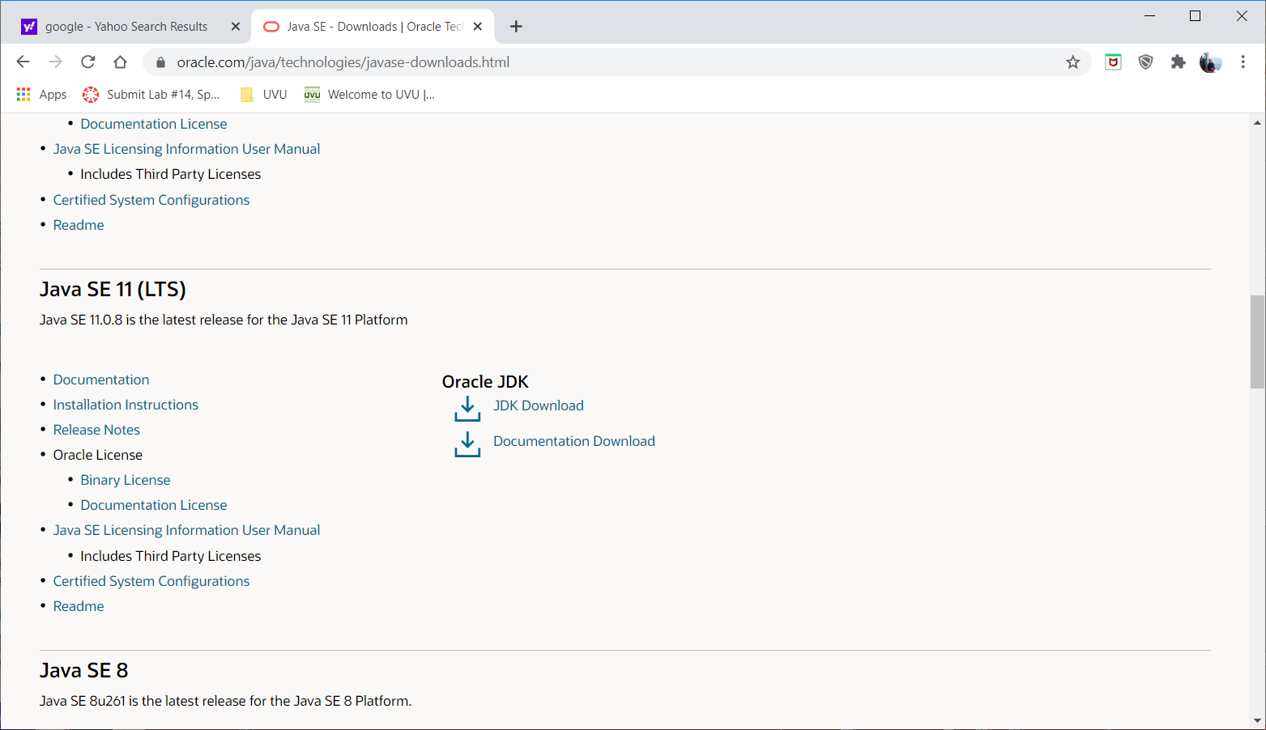
When you arrive at the landing
page for the JDK downloads,
scroll down until you find the
information for Java SE 11 (LTS).
This is the current long term
support version of the JDK that
you should download and use for
this class. This is the current
industry standard version.
click here

Slide 42
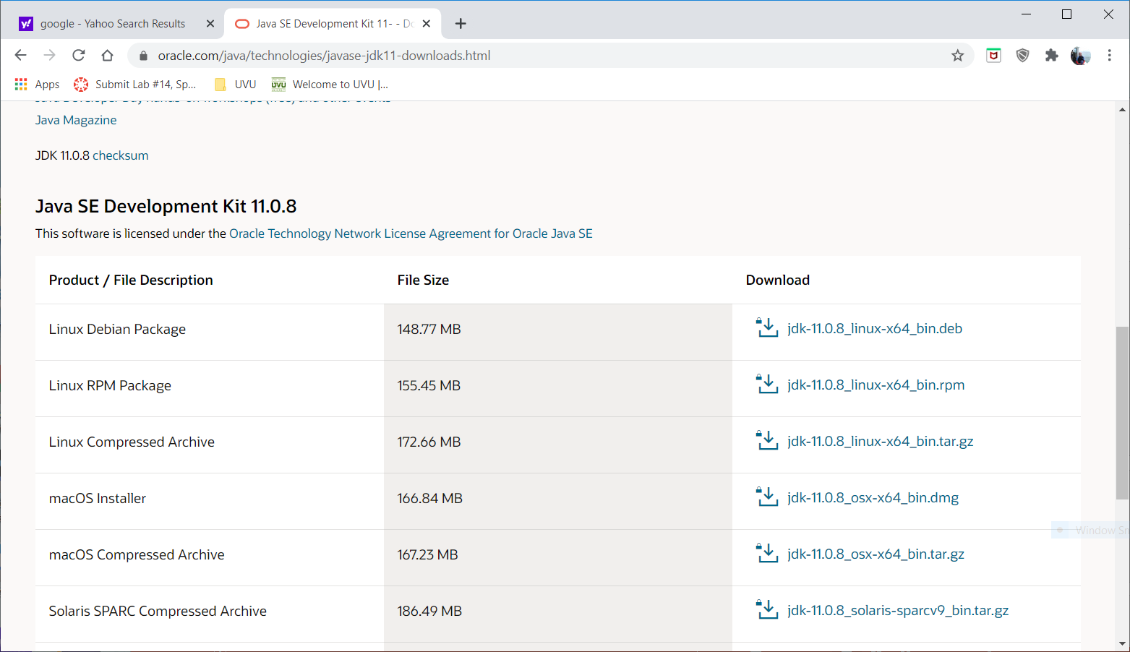
On this page, click on the
download for your operating
system.

Slide 43
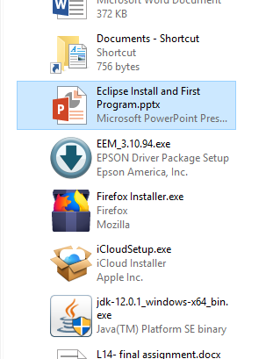
Find the downloaded file
in your download folder
and double-click on it to
start the install process.
Follow the prompts.

Slide 44
Where did the install put the JDK?
Windows: C:/Program Files/Java/
MacOS: Macintosh HD/Library/Java/JavaVirtualMachines/

Slide 45
Download and install IntelliJ IDEA

Slide 46
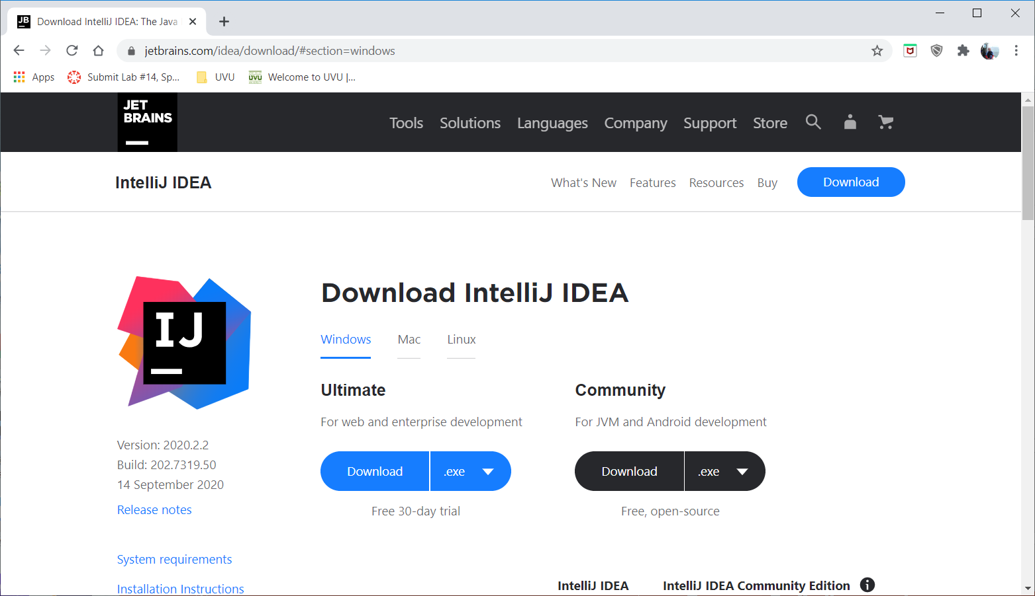
Go to https://www.jetbrains.com/idea
Download the free
Community edition
here.

Slide 47
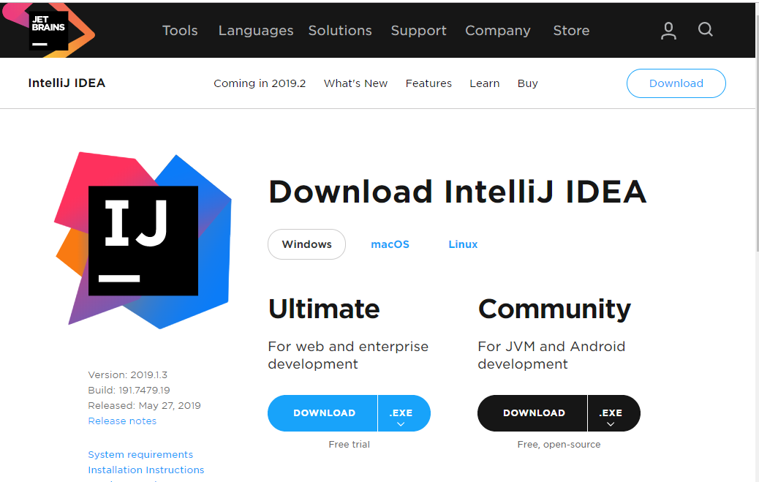
Click on the
Community
download.

Slide 48
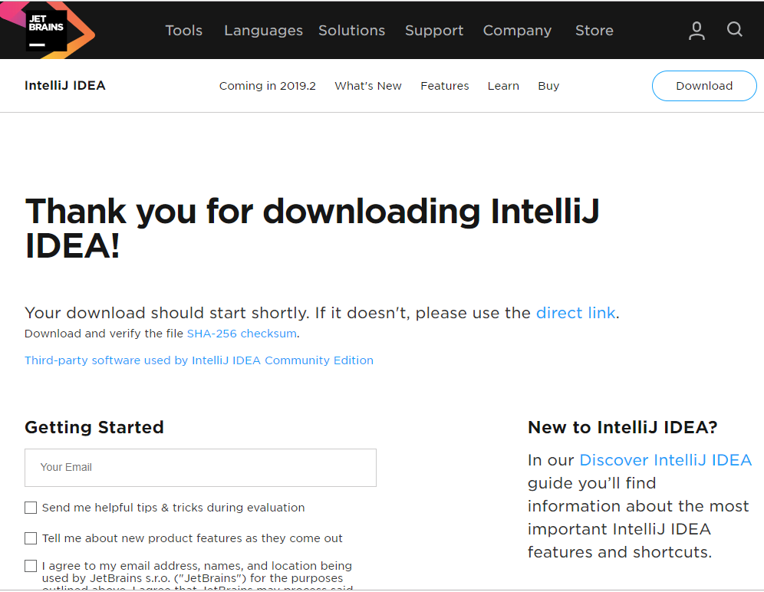
The download should start
automatically. You do not
need to provide an email
unless you want to get
emails from JetBrains.

Slide 49
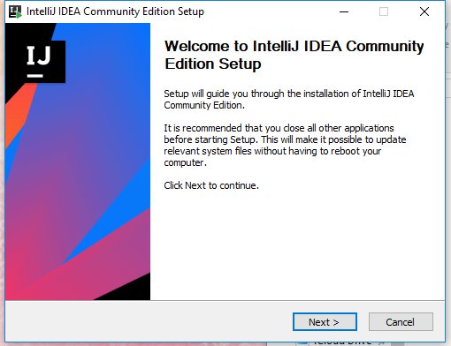
Double click on the downloaded
file to start the install process.
Follow the prompts.

Slide 50
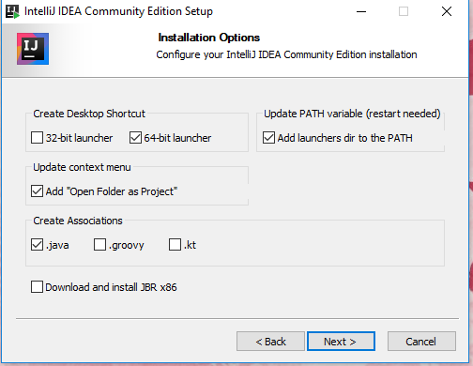
Select these options.
(Windows only):

Slide 51
Click on the IntelliJ icon to launch IntelliJ IDEA.
When you first start IntelliJ IDEA, there are
some configuration options you can choose. You
can ignore these.

Slide 52
Writing Your First Java Program

Slide 53
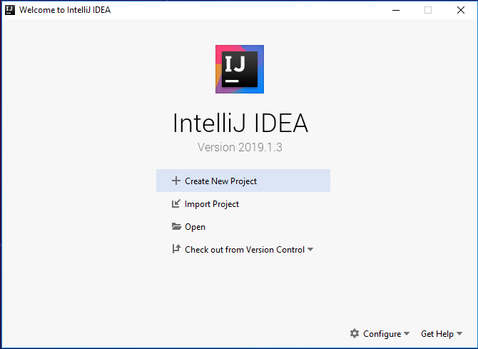
Click on Create
New Project

Slide 54
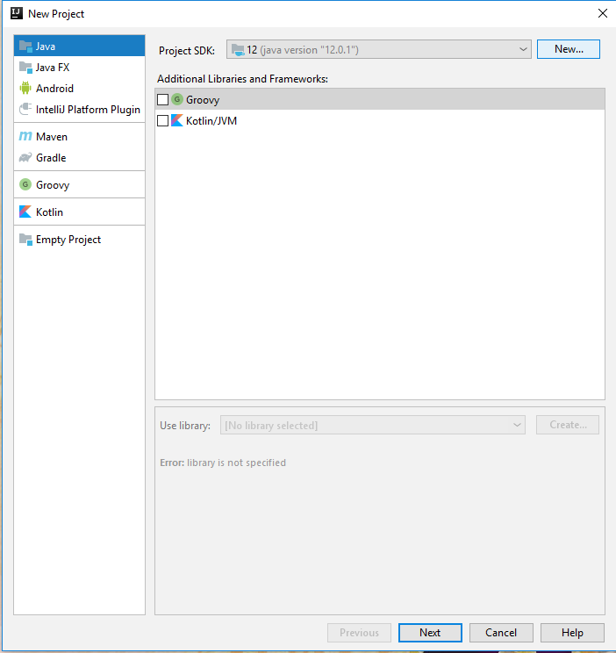
Select Java
If the JDK you installed
does not show up here,
click on the New button
and find the installed JDK
Click on Next.

Slide 55
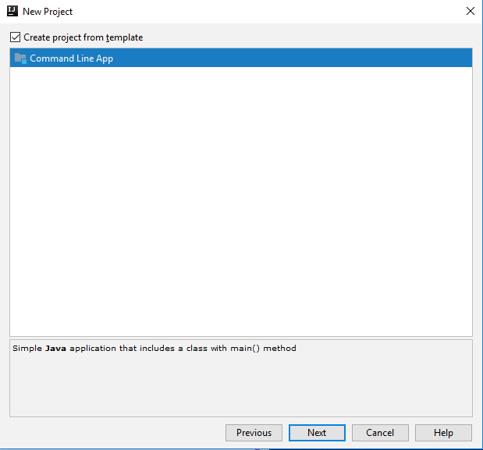
Click on the Create project
from template box
Pick Command Line App
Click on Next

Slide 56
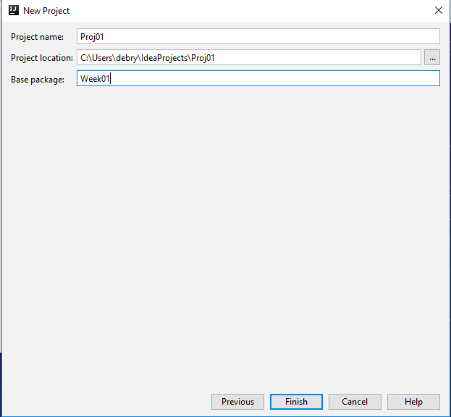
Use the default location
or type a different location.
Type in a project name
Type a package name
Click on
Finish

Slide 57
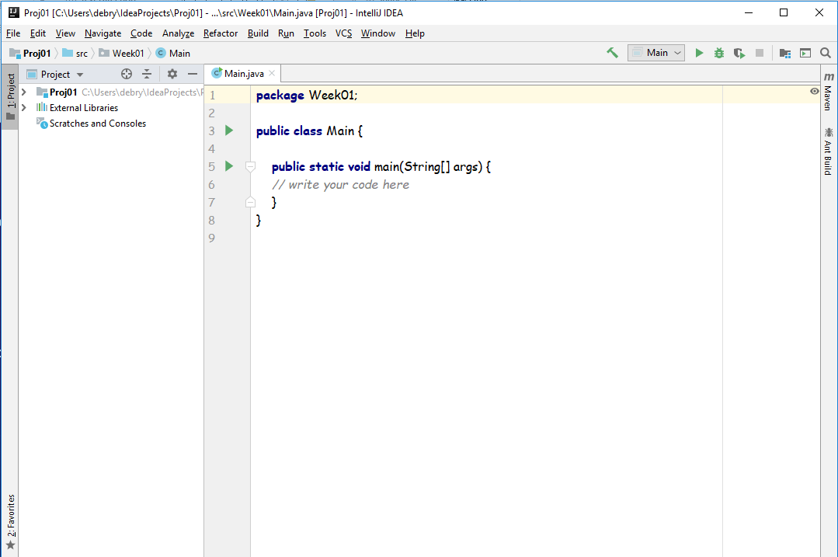
Add your code here

Slide 58
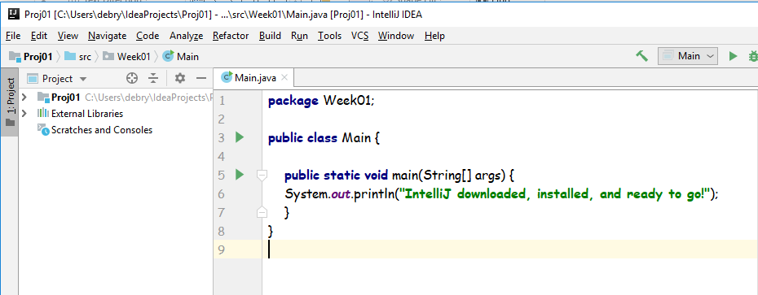
Add this line of code

Slide 59
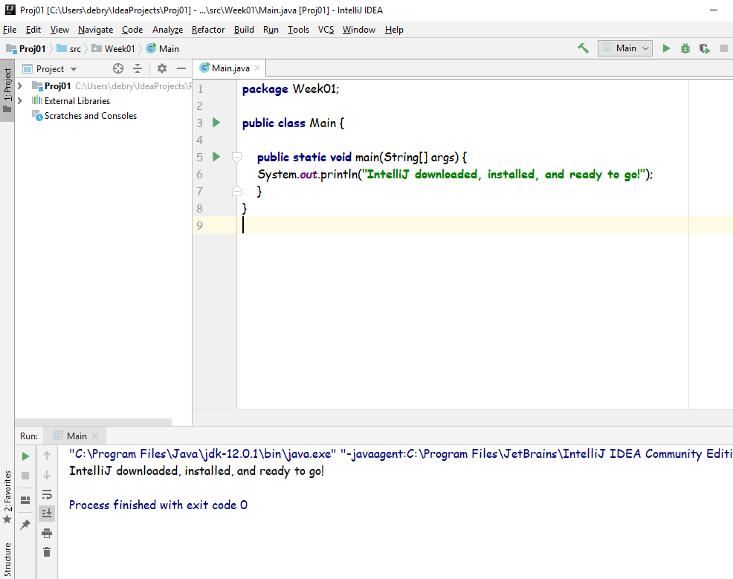
Click on Run->Run Main on the menu bar
or click on this green triangle to run your
program.
The output of your
program appears
here

Slide 60
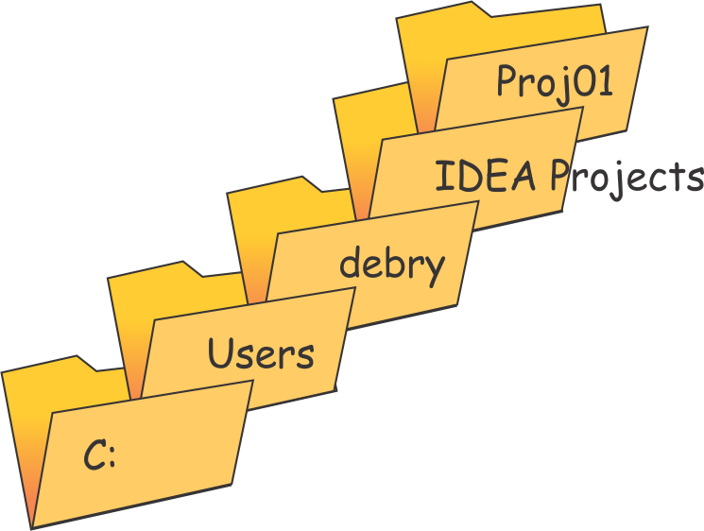
Where are my files (Windows)?
This would be your
user name.
If you use the default location for your files,
your program will be in a folder with the project
name, in a directory tree like this:

Slide 61
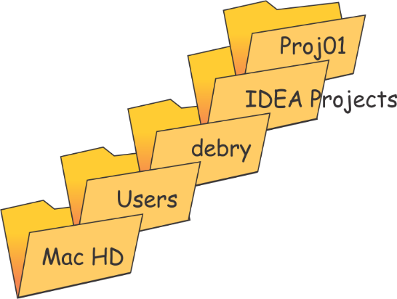
Where are my files (Mac)?
This would be your
user name.
If you use the default location for your files,
your program will be in a folder with the project
name, in a directory tree like this:

Slide 62
Video presentation on running Intellij
IDEA for the first time
https://youtu.be/c0efB_CKOYo

Slide 63
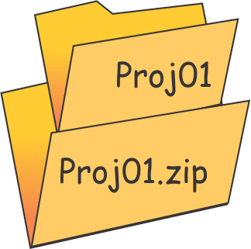
To Submit Your Program
Create a zip folder
Drag the entire project folder and drop it into the zip folder
- If the assignment has two programs, you will have two project folders
Submit the zip folder

Slide 64
Don’t wait until late in the week to download
and install IntelliJ IDEA. You will need it
to complete this week’s assignment. If you
have problems downloading and installing
IntelliJ IDEA, post a message on the discussion
board for help.

