Slide 1
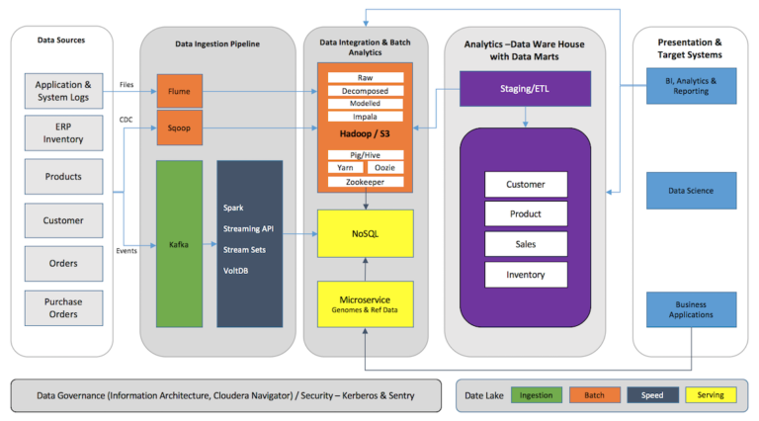

Slide 2
The modeled data is available to the DWH and BI/Reporting tools to create reports from batch analytical data. Thus, the Data Hub may serve as the main ETL component for the enterprise.
Data Warehouse needs to further model the data. The data in DWH is not mutable and needs to be transformed into relational data format forming data cubes and marts to run complex SQL queries on in a performant way.
Unstructured data flow in and get through stages of transformation

