Slide 1
Lamdba architecture:
Batch layer controls master datasets , which are immutable,
append-only.
Speed Layer ingests streaming data, micro-batches. Some databases directly imbibe
streaming data
Serving layer amalgamates both

Slide 2
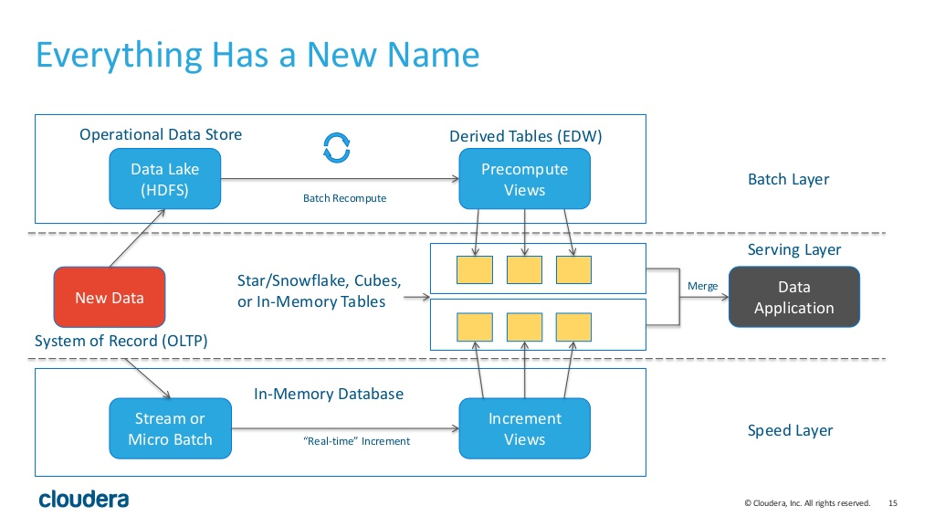
Lambda Architecture
Immutable
New Data
Eg: Spark

Slide 3
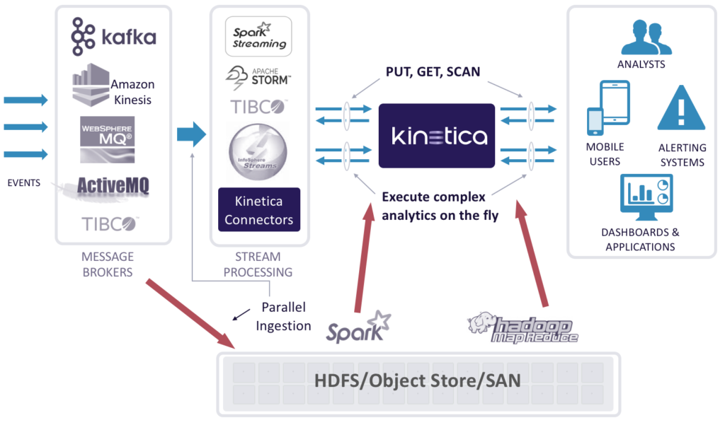

Slide 4
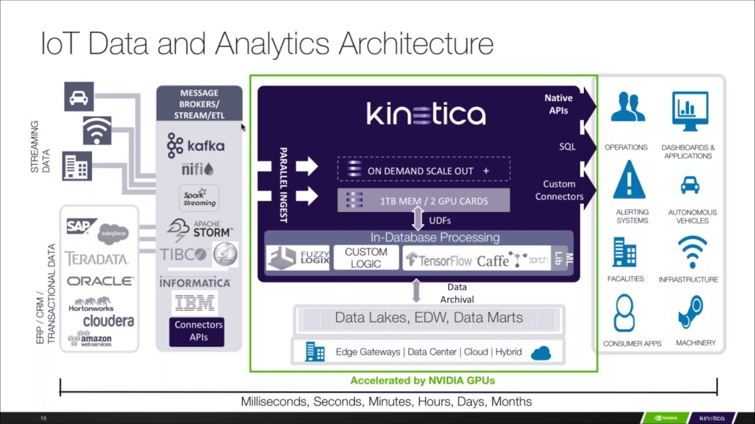

Slide 5
Lamdba architecture advantages:
Combines different strengths of existing open source into a unified architecture
Provides scalability via batch layer
Provides real-time performance via speed layer.

