Slide 1
Writing a Simple Device Driver
Braden Roberts and Katrina Mehring

Slide 2
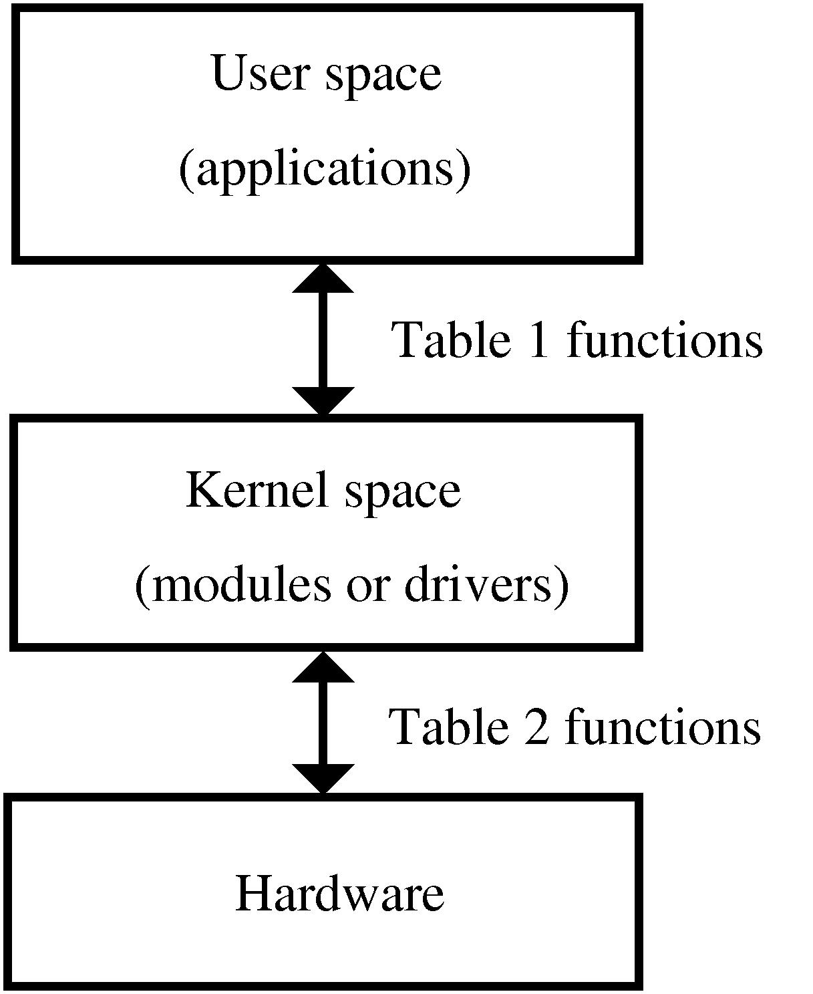
User Space vs. Kernel Space
End-user programs
Connects through kernel supported functions
manages the hardware
simple and efficient
forms a bridge between user and hardware
Subroutines, modules, drivers
Notes:
I’m not sure where ours sits because it doesn’t directly use kernel functions, but it does use the libusb to speak directly to the hardware

Slide 3
Simple?
What does simple mean?
Who can accomplish/follow it?
How low-level is it?
Can it be made simpler?
Is it well explained.

Slide 4
Challenges
Searched Tutorials
Nothing was “simple”
Not prepared
Modules, Ports, Pins
Specifications/Versions
Driver for each of these
USB Controller vs. Motherboard Controller

Slide 5
libusb
“a C library that provides generic access to USB devices”
“intended to be used by developers to facilitate the production of applications that communicate with USB hardware”
It is:
Portable (Cross platform API)
User-mode (No Sudo)
Version-agnostic (USB 1.0-3.1)

Slide 6
libusb
No Kernel space
Abstractions
Hardest part: which version
Libusb.info
Documentation
Examples
Application programming interface
Linking the library:
After install where was it?
How to link to the file?

Slide 7
Step 1. Setting Up Variables
Libusb_device ** - list of the usb devices that we can find
Libusb_context - “Structure representing a libusb session”
Returnval - Functions take variable addresses and return codes
numDevs - Function takes devs’s address and returns device count

Slide 8
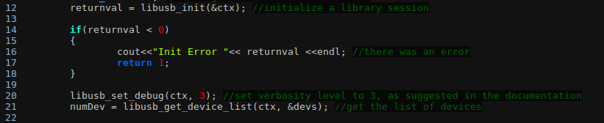
Step 2. Initialization
libusb_init() - initializes the libusb library and is required to work properly
libusb_set_debug() - sets the verbosity level
libusb_get_device_list() - stores a list of all devices connected to the bus

Slide 9
Step 3. Opening the Device
Opening device with a device pointer, takes and sets a handle
Instead opening with vendorID and productID returns a handle
Handle: “used to perform I/O and other operations”
Free list space: takes list and boolean int to determine unreferencing

Slide 10
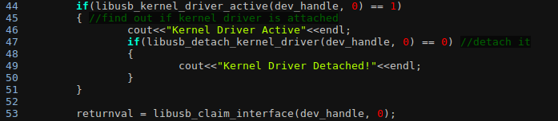

Step 4. Interfacing with the device
libusb_detach_kernel_driver() - check and detach kernel drivers
libusb_claim_interface() - assigns the mouse interface to the program
libusb_interrupt_transfer() - retrieves data from the device

Slide 11
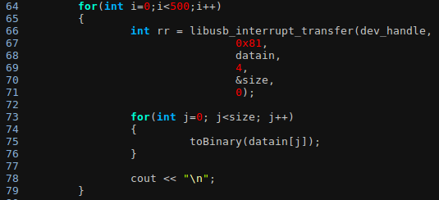
Step 5: Displaying output
4 bytes of data sent from the mouse.
xxxxxcba- button click data
left click
right click
wheel click
xxxxxxxx - change in X direction
0 - no change
1xxxxxxx - mouse moved left
xxxxxxx1 - mouse moved right
xxxxxxxx - change in Y direction
0 - no change
1xxxxxxx - mouse moved up
xxxxxxx1 - mouse moved down
xxxxxxxx - Change in wheel
0 - no change
1xxxxxxx - mouse moved down
xxxxxxx1 - mouse moved up

Slide 12
Step 6: Cleanup
Release: takes handle and interface number
Same interface number given when interface claimed
Reattach the kernel driver
Without, it will take time for usb to work again
Close the device
Memory will be freed up
No dangling pointers
Exit: deinitializes given context

Slide 13
Terms and Questions
User Space: space in which end-user programs
Kernel Space: Space in which hardware is managed
Libusb: a C library used for managing usb devices
Why is the list of devices in libusb a double pointer? Because we don’t have a device item, but we have a pointer to a device.
Why is the value given from the device interrupt of pushing 2 mouse buttons 0000011? Because it ORs the values given when each mouse button is clicked

Slide 14
References
http://freesoftwaremagazine.com/articles/drivers_linux/
http://libusb.sourceforge.net/api-1.0/api.html
http://www.dreamincode.net/forums/topic/148707-introduction-to-using-libusb-10/
https://sourceforge.net/p/libusb/mailman/message/31238975/
https://sites.google.com/view/simple-usb-driver-tutorial

