Slide 1

Berkeley Packet Filters

Slide 2
Berkeley Packet Filters (BPF)
BPF is a machine language providing raw access to data link layers
BPF has a simple, human query language to filter on network primitives
Extremely efficient when run in kernel space
Extensions vary by operating system

Slide 3
BPF Examples
host 8.8.8.8
net 10.0.100.0/24
Notes:
The BPF language allows you to do simple queries on a PCAP or network capture, like filter on known IP address or network.

Slide 4
BPF primitives (a taste)
(dst|src) host IP
ether (src|dst|host) ETHER
(dst|src) net NET
net NET netmask MASK
net NET/CIDR
Notes:
The first example allows us to take the `host` keyword and specify a direction of the packet
We can also filter on MAC address instead of IP
Similarly we can filter on the direction using the `net` keyword
We can specify networks with a mask
or CIDR notation
From the pcap-filter manpage regarding the specification of NET:
Net may be either a name from the networks database (/etc/networks, etc.) or a network number. An IPv4 network number can be written as a dotted quad (e.g., 192.168.1.0), dotted triple (e.g., 192.168.1), dotted pair (e.g, 172.16), or single number (e.g., 10); the netmask is 255.255.255.255 for a dotted quad (which means that it's really a host match), 255.255.255.0 for a dotted triple, 255.255.0.0 for a dotted pair, or 255.0.0.0 for a single number. An IPv6 network number must be written out fully; the netmask is ff:ff:ff:ff:ff:ff:ff:ff, so IPv6 "network" matches are really always host matches, and a network match requires a netmask length.

Slide 5
BPF primitives (cont.)
proto PROTONUM
tcp, udp, icmp
negation: ! or not
concatenation: && or and
alternation: || or or
Example: proto 17 && !port 53
Notes:
The example would select all UDP traffic (proto 17) that is not on port 53 (usually DNS traffic).
NOTE: It’s important to use single quotes to wrap your BPF string since && and ! both have special meaning to the shell.

Slide 6
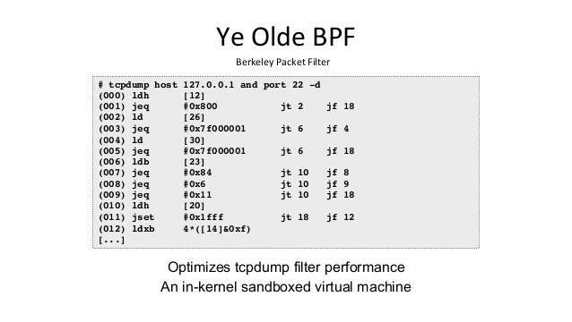
IT’S A SECRET TO EVERYBODY.
Notes:
Pulling back the curtains, tcpdump actually just compiles a commandline friendly string into assembly. This is what makes it so efficient, because it is optimized at the machine code level.
Translation, if interested:
[12] is loading the 12th byte of the Ethernet frame, the Ethertype
0x800 is the Ethertype of IPv4, we’re checking if it’s equal
[26] is the location of the source IP of an IPv4 packet
0x7f000001 is the hexadecimal value of 127.0.0.1
[30] is the location of the destination IP of an IPv4 packet
0x7f000001 is the hexadecimal value of 127.0.0.1
[23] is the IP protocol header
0x84 is proto 132 == SCTP (a protocol similar to TCP)
0x6 is proto 6 == TCP
0x11 is proto 17 == UDP
[20] is the IP flags and fragment offset
0x1fff is making sure we’re not analyzing a packet fragment, which may not have layer 4 information
4*([14]&0xf) is loading the base offset for src port and dst port, which will be compared next

Slide 7
BPF Exercise
CTF Key: “bees”

Slide 8




linkedin.com/company/perched/
github.com/Perched
inquiries@perched.io

