Slide 1



Slide 2
Motivation
RockNSM aims to reduce analyst overhead
Pulling PCAP sucks
Hopping from sensor to sensor is the worst
Notes:
It's expensive to productivity to constantly switch apps to do your job
It's time consuming

Slide 3

Docket Idea
Build query link
for Stenographer
automatically
Notes:
Note:
Five Three problems:
We can't grip it by the husk
It uses HTTP POST, not a GET (can't just build a link)
It's not a normal HTTP POST with form variables

Slide 4
Docket Idea #2, Proxy translation
Translate GET requests into a Stenographer POST
Translate normal POSTs into Stenographer POST
While we’re at it, let’s hit multiple sensors!

Slide 5
GET API
/host/1.2.3.4/ -> 'host 1.2.3.4' /host/1.2.3.4/host/4.5.6.7/ -> 'host 1.2.3.4 and host 4.5.6.7' /net/1.2.3.0/24/ -> 'net 1.2.3.0/24' /port/80/ -> 'port 80' /proto/6/ -> 'ip proto 6' /tcp/ -> 'tcp' /tcp/port/80/ -> 'tcp and port 80' /before/2017-04-30/ -> 'before 2017-04-30T00:00:00Z' /before/2017-04-30T13:26:43Z/ -> 'before 2017-04-30T13:26:43Z' /before/45m/ -> 'before 45m ago' /after/3h/ -> 'after 180m ago' /after/3h30m/ -> 'after 210m ago' /after/3.5h/ -> 'after 210m ago'
Notes:
This lets us use a normal GET request to pull back PCAP

Slide 6
Let’s Get Nuts
What is the equivalent stenographer query?
curl http://docket/api/uri/host/1.2.3.4/udp/port/53/
stenoread 'host 1.2.3.4 udp port 53'
Notes:
This GET request is the same as running the show stenoread command. All the terms are essentially ANDed together.

Slide 7
POST API
host=1.2.3.4 -> 'host 1.2.3.4' host=1.2.3.4, host=4.5.6.7 -> 'host 1.2.3.4 and host 4.5.6.7' net=1.2.3.0/24 -> 'net 1.2.3.0/24' port=80 -> 'port 80' proto=6 -> 'ip proto 6' proto-name=tcp -> 'tcp' proto-name=tcp, port=80 -> 'tcp and port 80' before=2017-04-30T00:00:00Z -> 'before 2017-04-30T00:00:00Z' after=2017-04-30T13:26:43Z -> 'after 2017-04-30T13:26:43Z' before-ago=45m -> 'before 45m ago' after-ago=3h -> 'after 180m ago' after-ago=3h30 -> 'after 210m ago' after-ago=3.5h -> 'after 210m ago'
Notes:
This API is used for form-encoded POST requests. This is used by standard HTML forms, or could also be used by curl. Alternatively, you can use the same format, but as JSON key-values. This is helpful for doing things like jQuery API access. The Docket graphical front-end uses this JSON API.

Slide 8
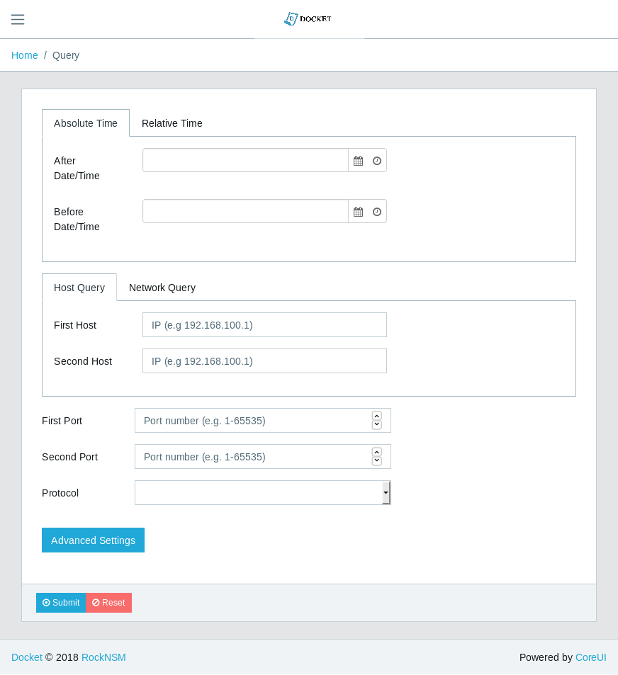
Don’t worry we made a front end!!
Browse to https://classroom.perched.io/app/docket

Slide 9
Docket Exercise
Pull back the packets from the 104.207.159.249 on AUG 1st 2018 and answer the following
What domain was used in the SSL traffic?
How many different domains were in the HTTP get requests
How many files are on the FTP server
Is the FTP server internal or external?
What file is being upload to the FTP server?
How many attempts does it take to upload the file?
Notes:
Note:
What domain was used in the SSL traffic? blog.disintertingdomain.com filter: tcp.stream eq 1
How many different domains were in the HTTP get requests? 4 Filter: http.host && !(http.host == "domain")
How many files are on the FTP server? 18 tcp.stream eq 15
Who's FTP server is this? Hint: Internal Network is 172.16.100.0/24 the adversary 104.207.159.249 is the server
What file is being uploaded to the FTP server? Too_many_secrets.docx filter: tcp.stream eq 16
How many attempts does it take to upload the file? 3 2 failed tcp.streams 12,13 and then 16

Slide 10
Docket Exercise 2
Pull back the packets from port 110 on AUG 1st 2018 and answer the following
What user appears to be having trouble logging in?
What is this users actual password?
How many Messages did this user receive?
Who were these emails from?
Where there any attachments?
Notes:
Note:
What user appears to be having trouble logging in? guy.smiley tcp.stream eq 4
What is this users actual password? password1234 tcp.stream eq 8
How many messages did this user receive? 8 tcp.stream eq 8
Who were these emails from? root@104 and support@hugemultinational.com tcp.stream eq 8
Where there attachments? yes tcp.stream eq 8

Slide 11




linkedin.com/company/perched/
github.com/Perched
inquiries@perched.io

