Slide 1
PCAP Overview
Notes:
PCAP or “Packet Capture” is a programming interface and file format for capturing, storing, and analyzing raw network data. It is the foundation of all network analysis tools we use.

Slide 2
“Packets don’t lie.”
~ Ancient NSM proverb
Notes:
Discuss. Similar phrases are “PCAP or it didn’t happen.” Is that to say the converse is also true? “If there is PCAP, it must have happened.”

Slide 3
“Packets don’t sometimes lie.”
~ My NSM proverb
Notes:
BLUF: Know where your PCAP came from and keep an eye on the performance of the collection.
PCAP is just a data format. What goes in the data depends on how that data was recorded or fabricated. You can use tools like Scapy and tcprewrite to modify packet data to make it look like something else happened. If you’re passing around PCAP and need definitive ground truth, you should keep a chain of custody and use cryptographic hashes and signatures to ensure no tampering was performed.
Lastly, even if your sensor is 100% trustworthy, performance problems could lead to gaps or errors in the packet capture.

Slide 4
Why Packets?
Allows complete reconstruction of network events
Contains all the raw data
Allows humans to analyze and tell the machine what to do
Notes:
SPAN ports - originally designed for troubleshooting
lowest priority process on a Cisco switch

Slide 5
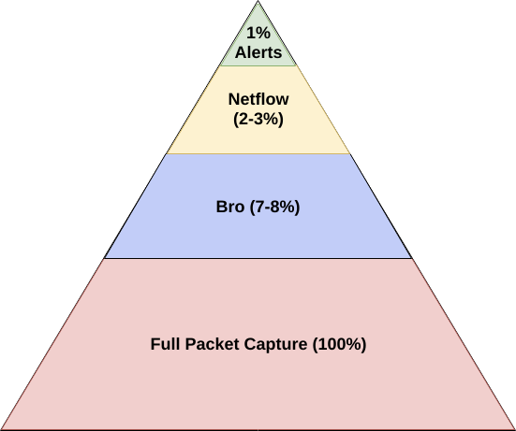
Pros and Cons of PCAP
Notes:
Full packet capture is 100% of the data. Huge pro. But networks operate at gigabit, 10 gig, 40 gig, 100 gig. It’s sooo much data.
Bro is an order of magnitude less data. It decodes protocols and records metadata about network events.
Netflow is still less than that since it’s just metadata about connection-level events
Alerts, like from a traditional IDS, should ideally be less than 1% of your total data. 1% of a Gigabit would still be about 10 Megabits, so 1 in every 1 Megabits would be an alert. It’s gonna be hard to keep up, so keep it even less.

Slide 6
Some Traffic Capture Tools
tcpdump¹
Wireshark/tshark
netsniff-ng
Moloch
Stenographer¹
¹ Used in RockNSM
Notes:
netsniff-ns
Used on older Security Onion distros
dump to disk as fast as possible (intent)
Moloch
Uses libnds to index pcaps
Can be a beast with resource requirements
Stenographer
builds off the principles of netsniff-ng
auto cleanup on disk space
index the pcaps (IPs, timestamp, ports) - less than Moloch, so needs to be used with other tools for indexing

Slide 7

Back of Napkin Math
1 day @ saturated 1 Gbps = 21,600 GB file storage
B_{Avg} is the average link speed
Notes:
This
Formula generated using “Math Equations UI” Google Slides extension using the following formula:
Storage = 2 \times {{B_{Average} \times 86400} \over 8}

Slide 8
tcpdump
Created in 1988 by researchers at Lawrence Berkeley Labs
Literally dumps TCP packets
Can capture from interface or "capture" from file
Can write summary data to screen or full PCAP to file
Notes:
Written to help design the next generation of the TCP/IP stack - debugging usecase
Vern Paxson
Author of many things including Zeek/Bro

Slide 9




linkedin.com/company/perched/
github.com/Perched
inquiries@perched.io

