Slide 1
Stenographer
[INSERT LOGO HERE]
[INSERT LOGO HERE]
¯\_(ツ)_/¯
Notes:
Stenographer doesn’t have a logo. It’s a project with a name, but it’s still awesome.

Slide 2
Google Stenographer
80/20 project by Graeme Connell
High speed packet capture and index
Manages Disk space
Never seen it drop a packet
Notes:
I've never had it drop a packet with speeds up to 15 Gbps across 2 NICs on a single box
Caveats:
There's a race condition between disk free space and the speed of your net
On an empty network, it still eats space
Result: Put stenographer on its own partition
Performance design is based on assumption that you rarely need PCAP

Slide 3

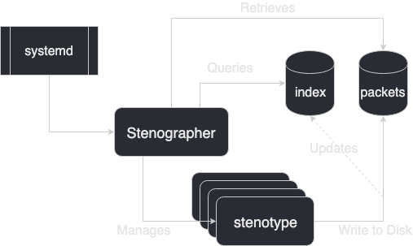

Process Architecture
Notes:
Stenographer is run as a service by systemd
The Stenographer service is written in Go, and is responsible for managing incoming requests, indexing packets, and managing the child process(es) of stenotype

Slide 4
Stenographer: User Interface
Stenographer query language is a subset of bpf with a couple of additions
Stenoread is the command line tool used to query data
stenoread [stenographer Query] [tcpdump arguments]

Slide 5
Stenographer: Query Language
host 8.8.8.8 # Single IP address (no hostnames) net 1.0.0.0/8 # Network with CIDR net 1.0.0.0 mask 255.255.255.0 # Network with mask port 80 # Port number (UDP or TCP) ip proto 6 # IP protocol number 6 icmp # equivalent to 'ip proto 1' tcp # equivalent to 'ip proto 6' udp # equivalent to 'ip proto 17'
Notes:
You'll notice there's no direction here. In practice, when you're looking at PCAP, you generally want to see both sides of the conversation. If you truly only want one side, tcpdump can do the additional filtering.

Slide 6
Stenographer: Query Language
before 2012-11-03T11:05:00Z # Packets before specific time after 2012-11-03T11:05:00-07:00 # Packets after a specific time before 45m ago # Packets before a relative time before 3h ago # Packets after a relative time
Notes:
In the specific time the addition of the Z is to designate using zulu time or UTC
In the specific time the addition of the T is just used to designate that Time follows the T. Its just used as a seperator and is optional

Slide 7
Stenographer: Boolean operators
stenoread ‘host 1.1.1.1 and host 2.2.2.2’
stenoread ‘net 10.0.0.0/8 && (udp and port 123) && after 30m ago’
Notes:
Can use the word or the symbolic representation

Slide 8
Stenographer: Add in tcpdump
# Print all packets for source IP 1.1.1.1 without # DNS resolution (-n). stenoread 'host 1.1.1.1' -n src host 1.1.1.1 # Print all PSH packets between 1.1.1.1 and 2.2.2.2: stenoread 'host 1.1.1.1 and host 2.2.2.2' \ -n 'tcp[tcpflags] & tcp-push != 0' # Write all packets between 1.1.1.1 and 2.2.2.2 to disk. stenoread 'host 1.1.1.1 and host 2.2.2.2' -w /tmp/out.pcap
Notes:
First one uses tcpdump to further filter the pcap down to only source host and tells tcpdump to not dns resolve
Second one filters down to only push tcp flags
Third uses the tcpdump option to write it out to a file

Slide 9
Stenographer: Exercise
Retrieve all UDP DNS queries from 172.16.100.3 for all of September 4, 2018
How many are there?
How many ftp packets were sent between these 2 hosts on September 4, 2018?
172.16.100.3
85.93.20.10
Notes:
Question 1: 189
Question 2: 92
Retrieve all UDP DNS queries from 172.16.100.3 for the entire day of September 4, 2018.
How many are there? 59
How many FTP packets were sent between 172.16.100.3 and 85.93.20.10 on September 4, 2018?
284
Retrieve all UDP DNS queries from 10.0.1.95
How many are there?
How many packets were sent between these 2 hosts?
10.0.1.95
23.73.31.19

Slide 10
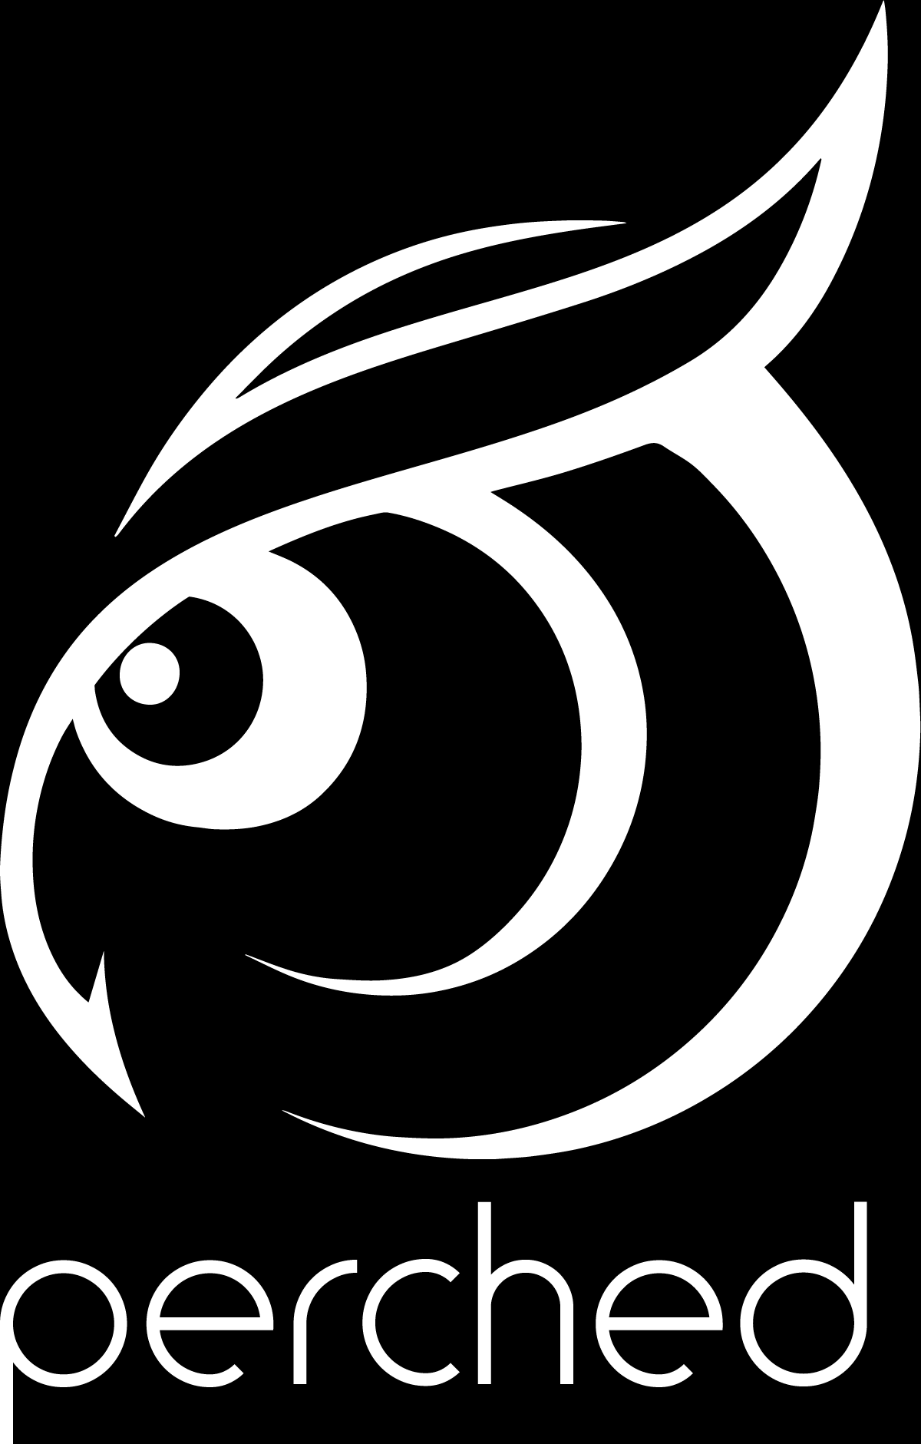



linkedin.com/company/perched/
github.com/Perched
inquiries@perched.io

