Slide 1

Wireshark
Notes:
This is Wireshark’s sweet new logo.

Slide 2

Wireshark
Formerly known as...
Notes:
This is Wireshark’s sweet new logo.

Slide 3

Ethereal
Formerly known as...
Notes:
This is Wireshark’s sweet new logo.

Slide 4
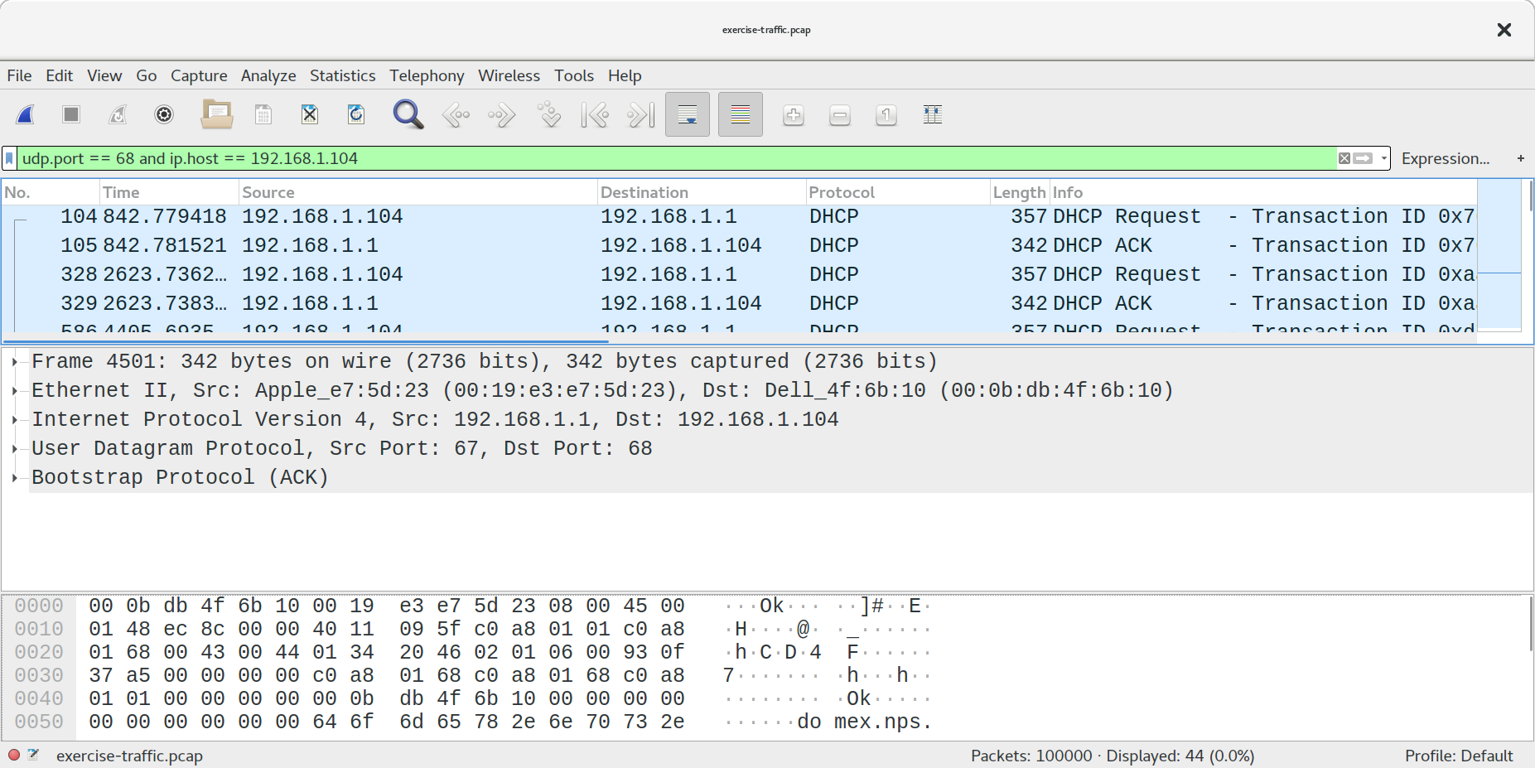
Notes:
Here’s what the user interface looks like. In this example, we’re doing some filtering, looking for DHCP packets. The search syntax should seem a little familiar to the tcpdump exercise we did, except, this isn’t a BPF filter.
- Wireshark is a GUI tool for analyzing PCAP that complements tcpdump well
- Wireshark does _not_ use BPF in the query box shown here. That is called a "display filter". Wireshark can use BPF when capturing from the interface.
- Not going into detail on Wireshark. You just need to know how to poke at a file with it. It's worth your time to explore its features, however.

Slide 5
Wireshark Basic Intro
Great GUI tool but could leave you swimming in an ocean of packets
Very basic intro enough to keep you floating in the ocean
Notes:
- Goal is to not use this everywhere.
- There are cases where bro will not be able to give you everything you need
- for example, http body is not an extracted field in bro and only tells you the number of bytes not the data it self

Slide 6
Wireshark Filter Bar (a sample)
ip.addr == 1.2.3.4
ip.src_host == 1.2.3.4
ip.dst_host == 1.2.3.4
http (or other protocols)
negation: ! or not
concatenation: && or and
alternation: || or or

Slide 7
Wireshark: Right-Click to Win
Follow stream
TCP
UDP
HTTP
SSL
Apply as Filter
Selected
Not Selected
Notes:
- Can right click just about anywhere and do one of these things
- Following a stream will pull up a new window and apply a filter to the original
- Applying filters allows you to either filter on the selected, or negate it out.
- You can then combine those with `AND`, or `AND NOT`, or `OR` or `OR NOT`.

Slide 8
Wireshark Statistics
Capture File Properties
Resolved Addresses
Protocol Hierarchy
Conversations
Endpoints
Packet Lengths
Notes:
- Click through each of these and just talk about them. Pretty straight forward
- Capture file properties: Overall data overview
- Resolved Addresses: Hosts and services that can be converted to a human readable name
- Protocol Hierarchy: Breaks it down each level of the protocol Frame->Eth->IPv4-ECT
- Conversations: Converstation on different layers, mac address, IPv4/6, TCP, UDP
- Endpoints: Shows a list of Clients/Servers represented as endpoints, Mac, IPv4/6, TCP, UDP
- Packet Lengths: Groups packet lengths in grouped ranges

Slide 9
Encapsulation Exercise
CTF Key: “frame”

Slide 10
Statistics Exercise
CTF Key: “ethereal”

Slide 11
More PCAP!
CTF Key: “capture”

Slide 12




linkedin.com/company/perched/
github.com/Perched
inquiries@perched.io

