Slide 1
Pair selection for statistical arbitrage by pair trading using clustering
GROUP 2
Nguyen Khanh Trung 20205133
Nguyen Kim Tuyen 20205196

Slide 2
Table of Contents
1
2
3
Overview
Input & Output
Approach

Slide 3
1
Overview

Slide 4
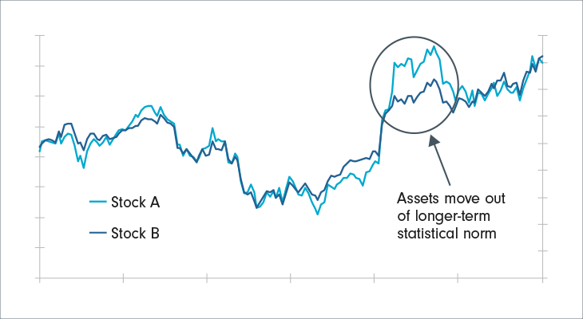
What is pair trading?
Pair trading is a popular trading strategy used in financial markets. The logic behind pairs trading is to trade pairs of stocks which are deemed cointegrated.
Cointegration is used to identify stocks that have a long-term relationship where their prices move in tandem over time, even though they may diverge in the short-term.
When two stocks are cointegrated, they tend to revert to their long-term relationship after any short-term divergence. This provides an opportunity for a pair trader to take advantage of any short-term price discrepancies between the two stocks.

Slide 5
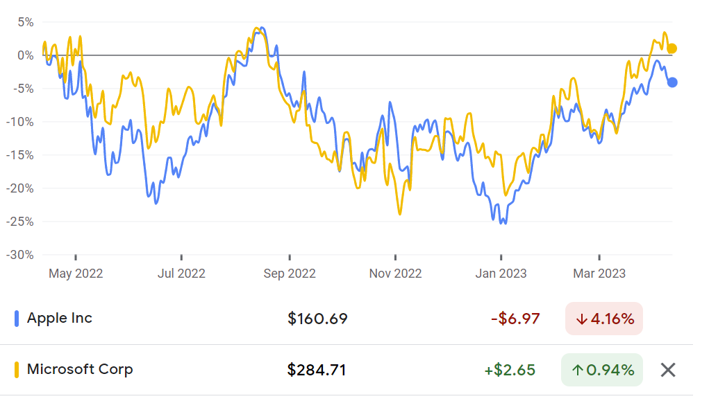
Example of trading pair
Historical Returns of Apple Inc and Microsoft Corp (Source: Google Finance)

Slide 6
About the project
In this project, we investigate the application of clustering algorithms to find appropriate pairing in the stock market for pair trading strategy.
Our aim for the project is to demonstrate the potential of data mining techniques for improving the performance of pair trading strategies and provides a valuable contribution to the field of financial engineering.
Note: The scope of this project does not include generating trading signals (shorting and longing stocks).

Slide 7
2
Input & Output

Slide 8
Input
● Daily prices of the stock universe constrained to the HNX and HOSE.
● Domain prior knowledge: industry, financial health, market cap.
Output
List of eligible pairs for the pair trading strategy. (With visualization)

Slide 9
Domain Prior Knowledge
Industry
Market Cap
Financial Health
Which industry a company is in?
How big a company is?
How well a company is managing its debt payments and generating profits?

Slide 10
3
Approach

Slide 11
Clustering Algorithms
Cointegration Discovery
Centroid-based: KMeans
Density-based: DBSCAN
Augmented Dickey-Fuller (ADF) statistical test

Slide 12
The End

Slide 13
Thanks!
Do you have any questions?
ktrung1709@gmail.com
0344130983

