Slide 1
Distributed Systems 2020
June 11th, 2020
Tsakos Konstantinos
Tzavaras Aimilios

Slide 2



Tools, frameworks and libraries
Tools we used:
Visual Studio Code, Sublime
phpMyAdmin
Postman
Docker
Docker Compose
Mongo Express
FileΖilla
Putty
Git
Zookeeper
Apache Bench
Artillery

Slide 3
Tools, frameworks and libraries
We used Flask web framework (Python) for Authentication service, PlayMaster service and GameMaster service.
Libraries for these services:
jsonify, redirect, mysql.connector, flash, render_template, jwt, datetime, dateparser, logging, Flask-SocketIO, json, pymongo, etc.
We used HTML, CSS, Javascript (and some AJAX) for the web interface and for the games (chess, tic-tac-toe).
We used PHP for Application Logic (User Interface) service and CURL library.
We also used Kazoo library (Zookeeper).

Slide 4
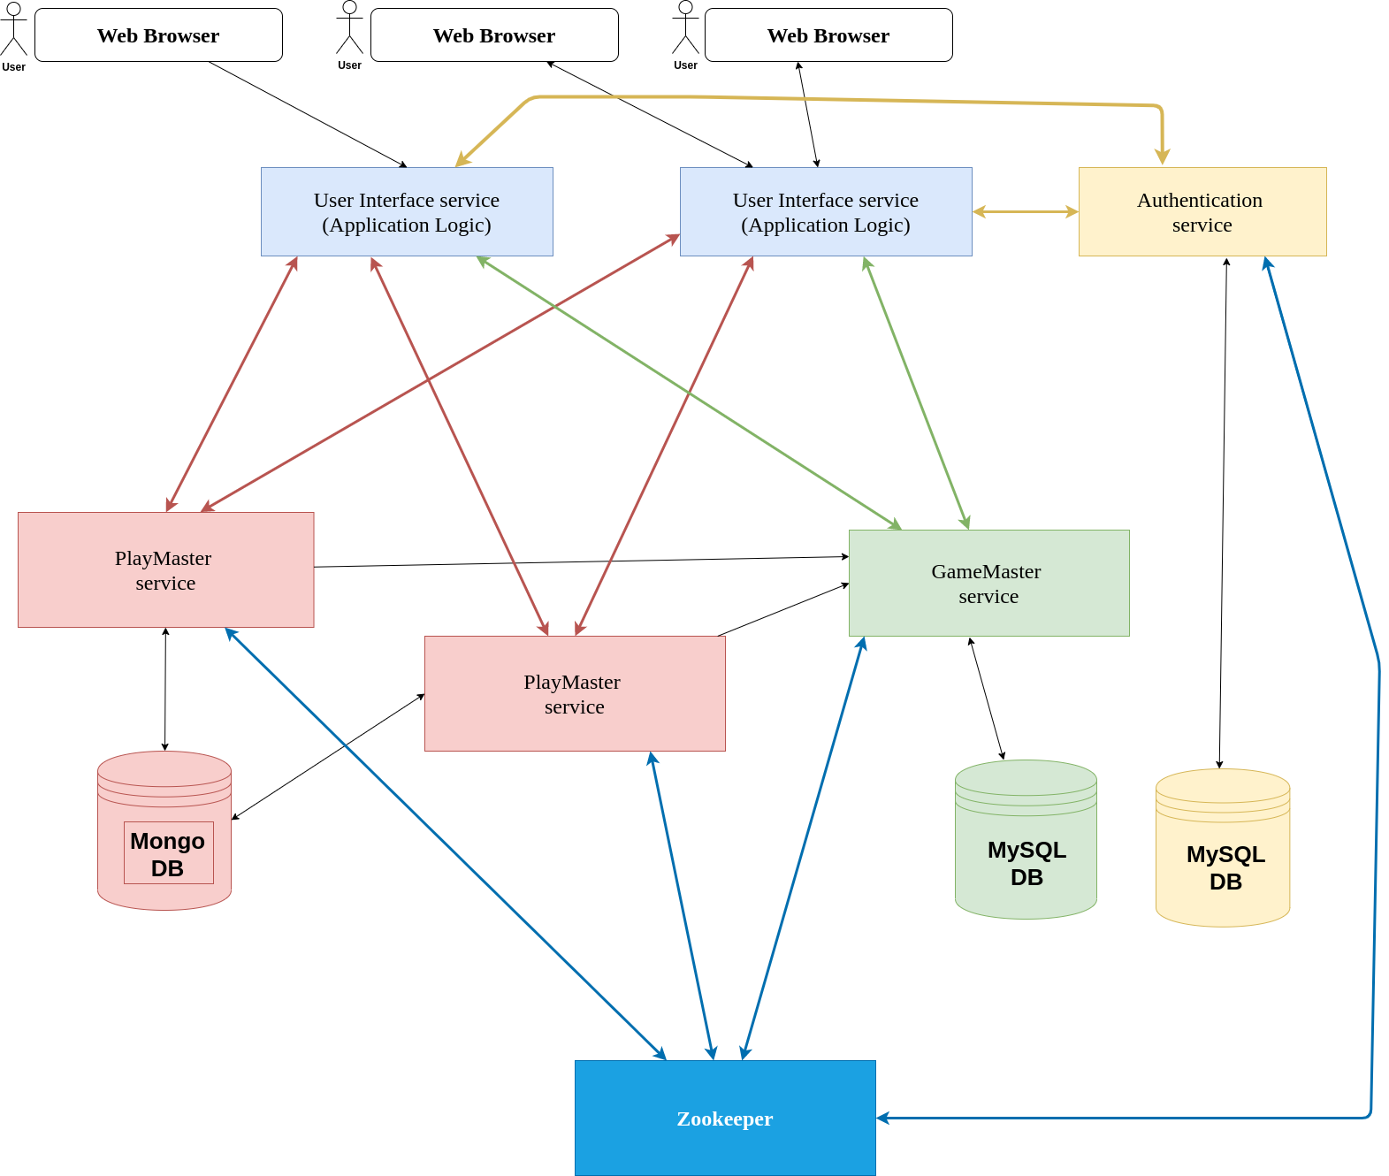
ARCHITECTURE
DIAGRAM

Slide 5
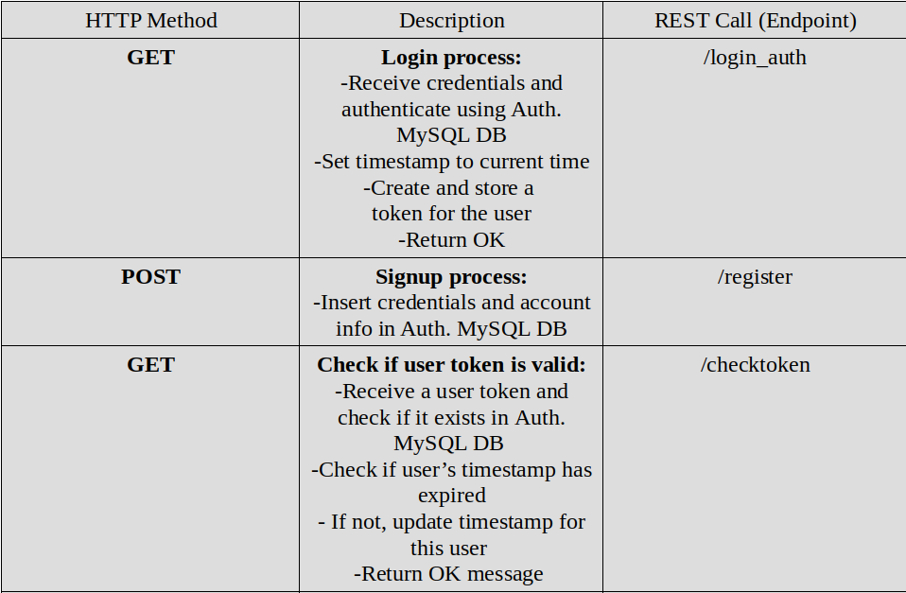
Authentication service

Slide 6
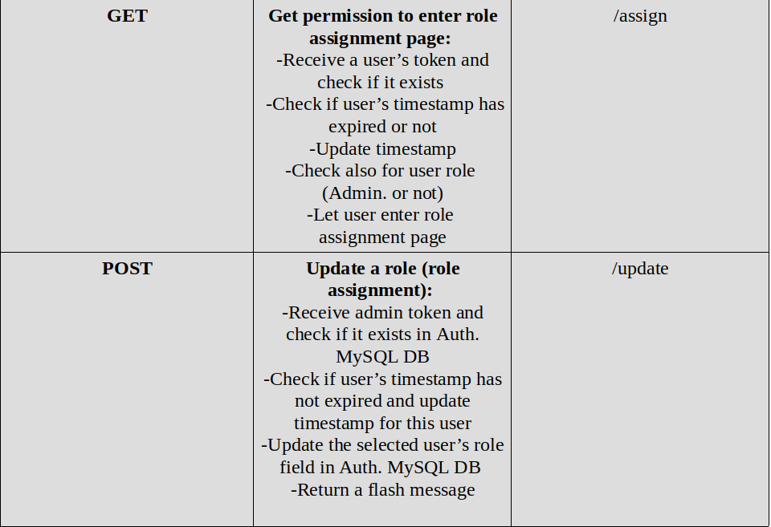
Authentication service

Slide 7
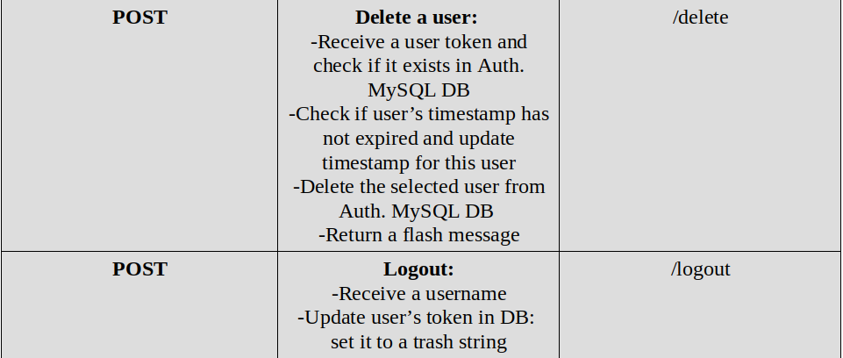
Authentication service

Slide 8
PlayMaster service
Connectionack event
Get the client’s info and the tournament info
Store them in Mongo DB
Check for tournament game if a playID exists in the info
Check if another user has already joined the playmaster for the same tournament match (same playID) or for a practice match of the same gametype and match them updating that row of Mongo with the infos of the second player, and inform them for the game start, inform the first connected player to play first
Else make a new insertion into Mongo DB and leave the client waiting for a second player to connect

Slide 9
PlayMaster service
Receivemove event
Retrieve the position that was updated after a player’s turn
Pass it to the other client
Inform the other client to make a move
Receivemovechess event
Retrieve the state of the chess board after a client’s turn
Pass the updated board to the other client
Inform the other client to make a move

Slide 10
PlayMaster service
WinCase event
Receive a wincase from a client that wins the game
Inform him that he wins
Inform the other that he loses
Send the result to the Game Master and delete the match from Mongo
WinCaseChess event
Receive a defeat case from a client that his King is threatened and there are no movements to protect him
Inform him that he loses the game
Inform the other that he wins
Send the result to the Game Master and delete the match from Mongo

Slide 11
PlayMaster service
DrawCase event
Receive a drawcase event after a client’s move
Inform both of them for the draw result
Send the result to the Game Master and delete the game from Mongo
Disconnect event
Receive an event of a client disconnect
If there is another one in the same match inform him that the other client left the game and disconnect him
Delete the game from Mongo

Slide 12
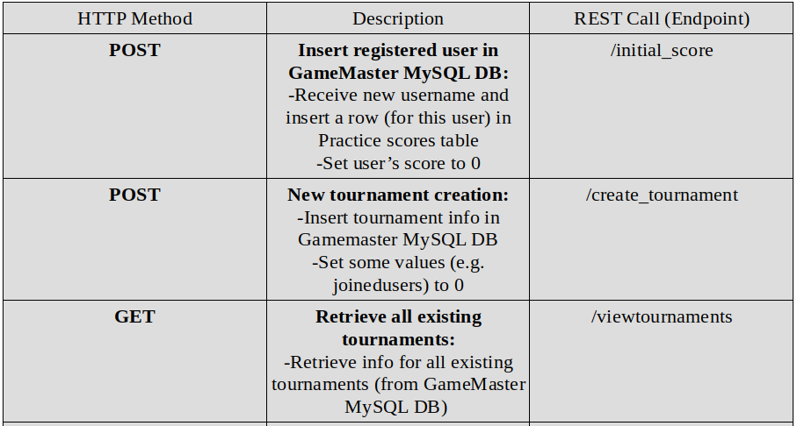
GameMaster service

Slide 13
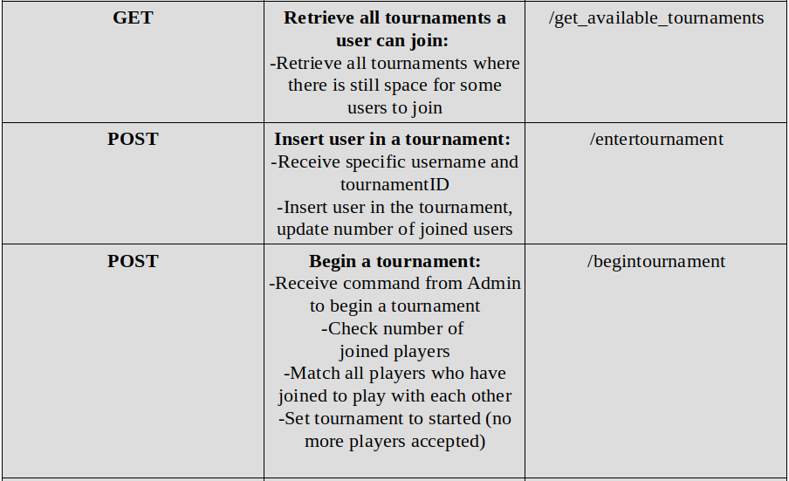
GameMaster service

Slide 14
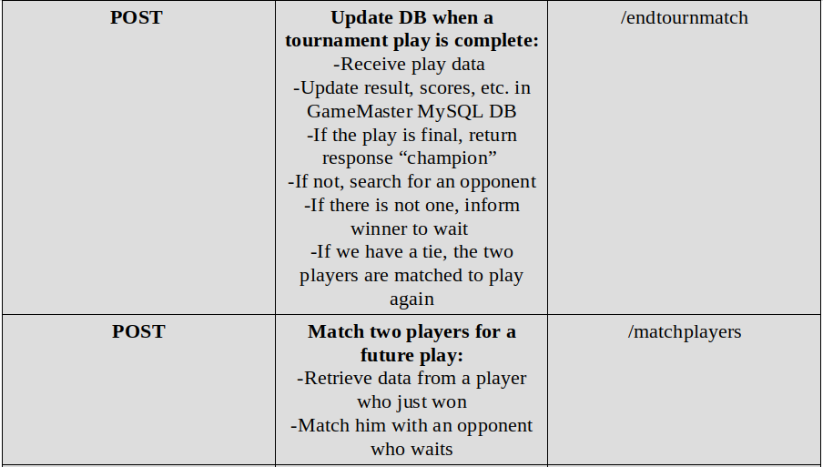
GameMaster service

Slide 15
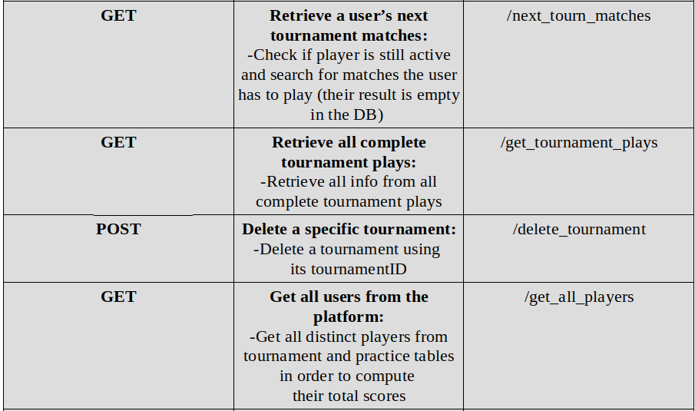
GameMaster service

Slide 16
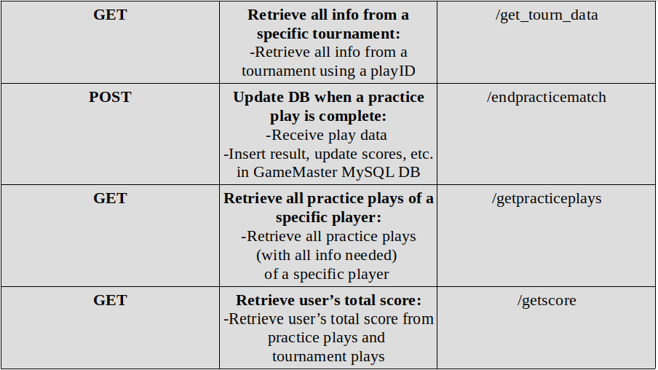
GameMaster service

Slide 17
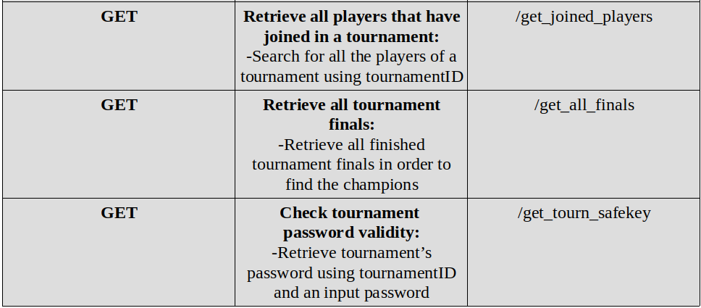
GameMaster service

Slide 18

Zookeeper (fault tolerance?)
We deployed 3 Zookeeper servers
We register every service (Authentication, PlayMaster, GameMaster) as a znode successfully
Unfortunately, we didn’t manage to succeed fault tolerance
That’s because we didn’t accomplish state migration
It is the only weakness of our system
It could be solved by Docker Swarm
Use of many container replicas for every service
deployed on multiple nodes

Slide 19
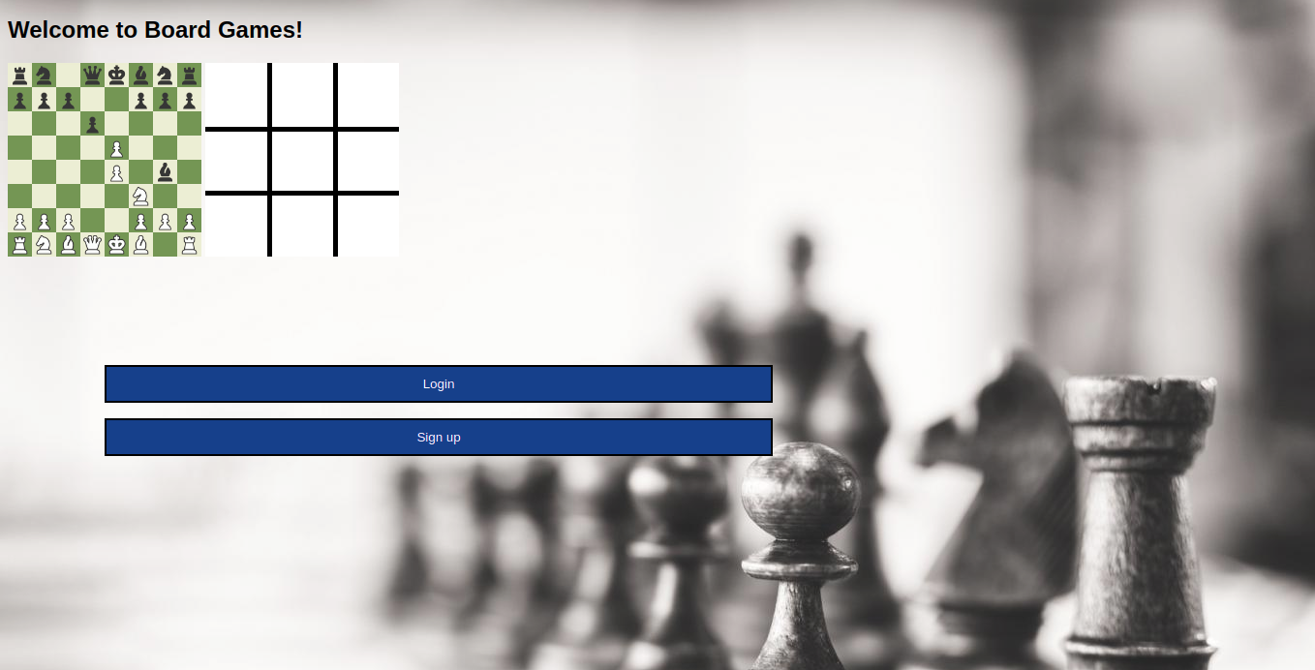

Slide 20
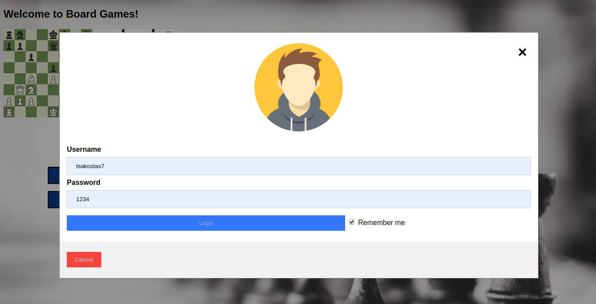

Slide 21
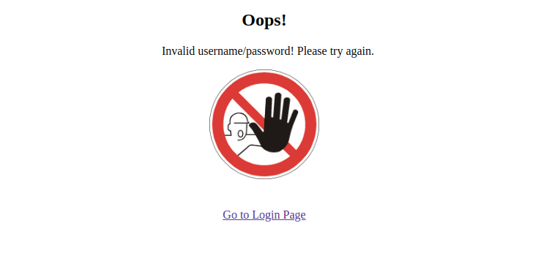

Slide 22
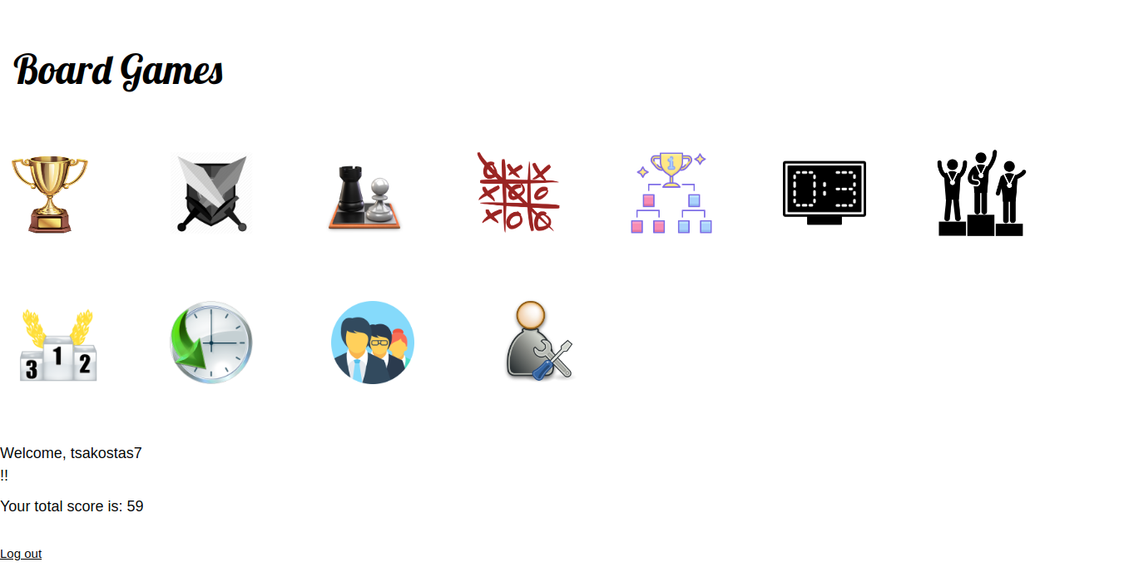

Slide 23
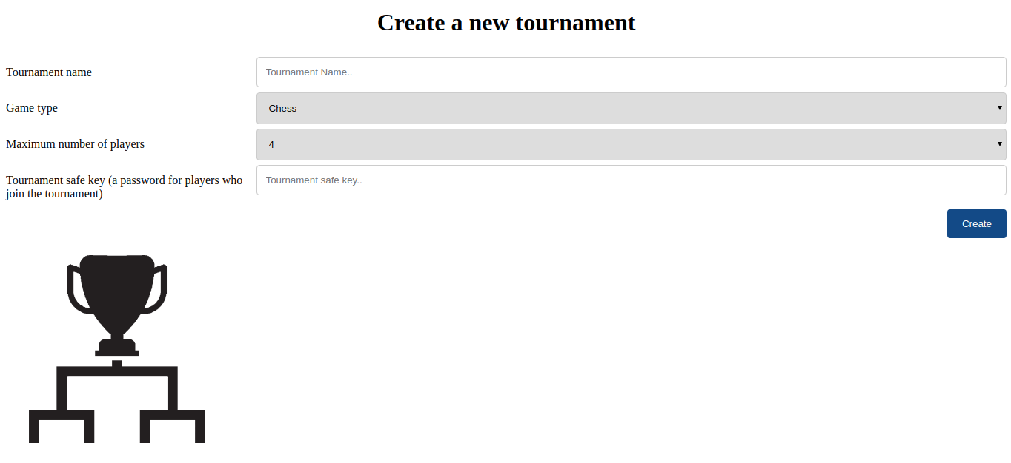

Slide 24
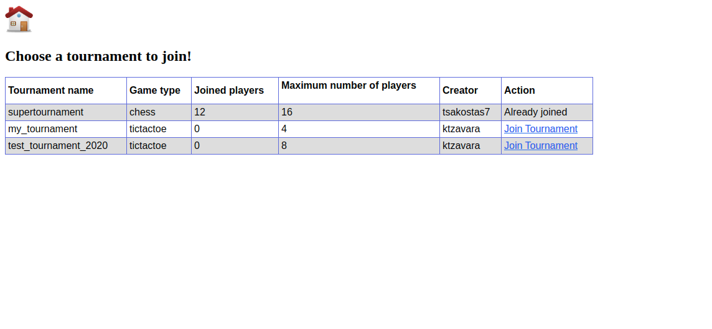

Slide 25
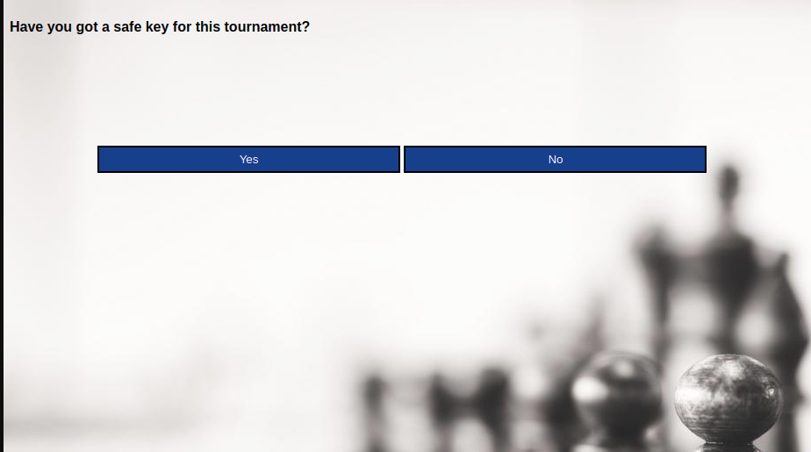
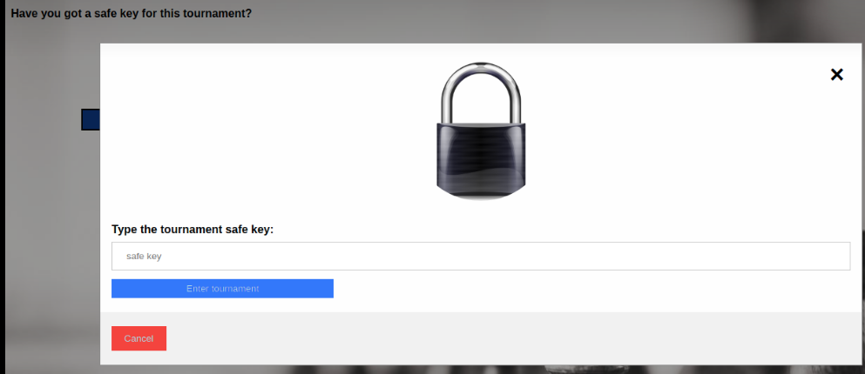
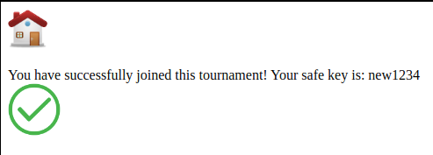

Slide 26
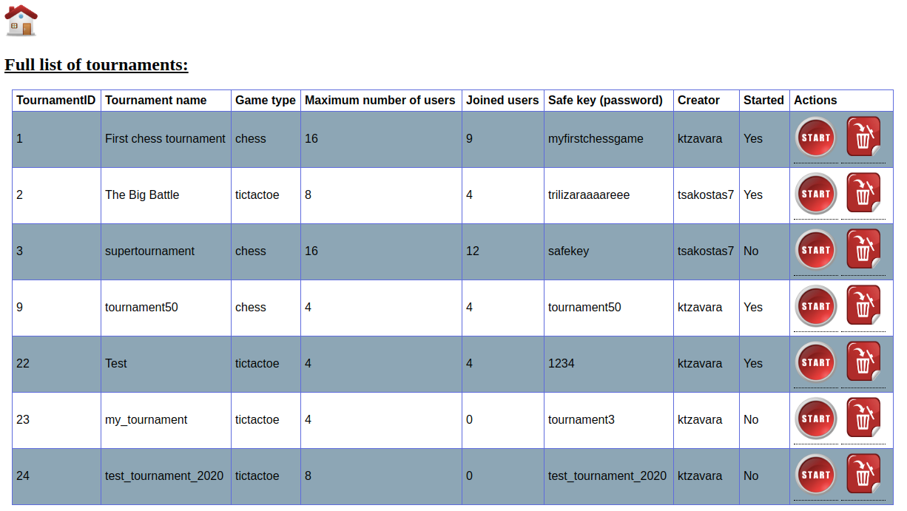

Slide 27
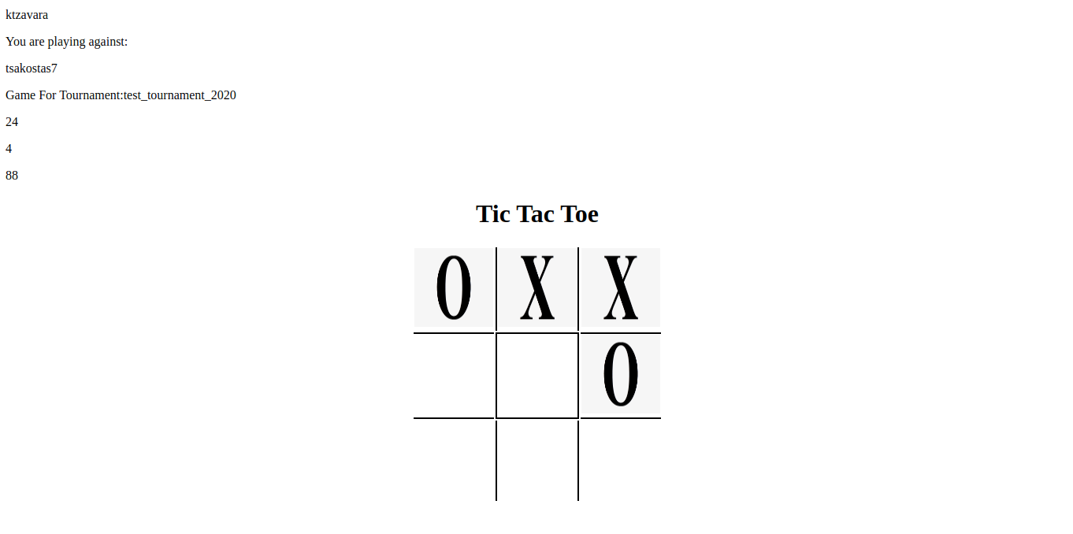

Slide 28
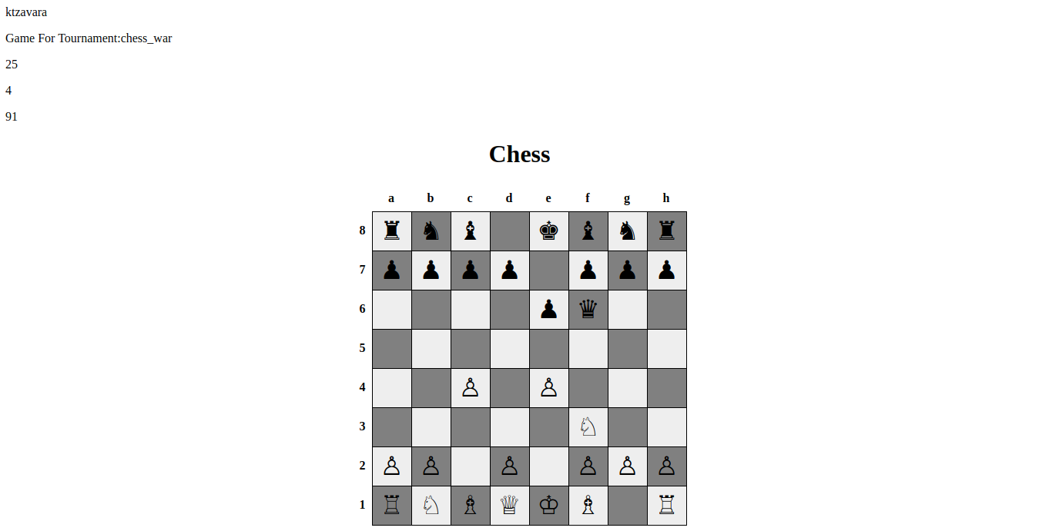

Slide 29
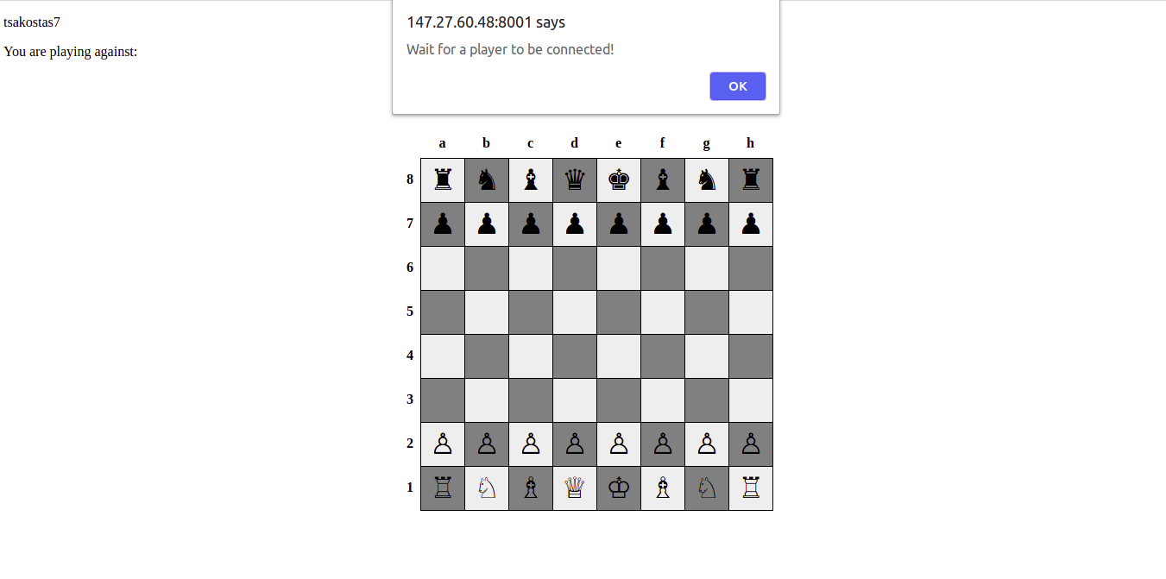

Slide 30
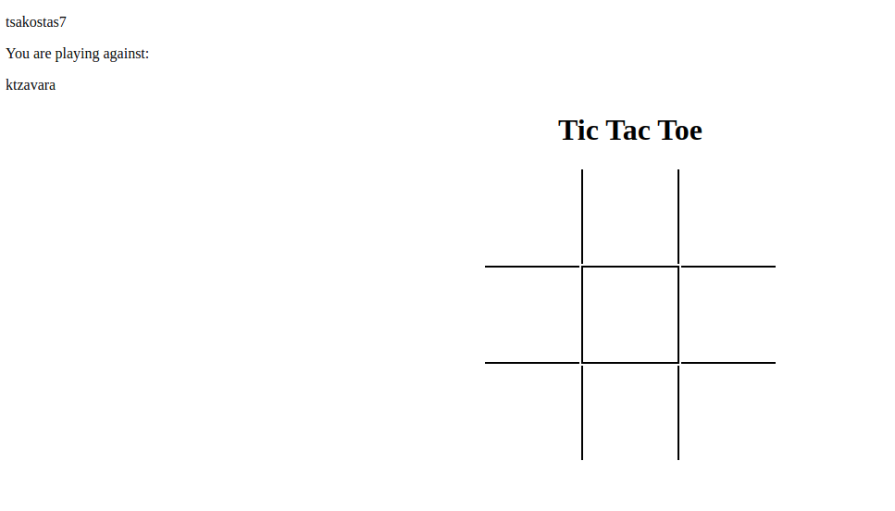

Slide 31
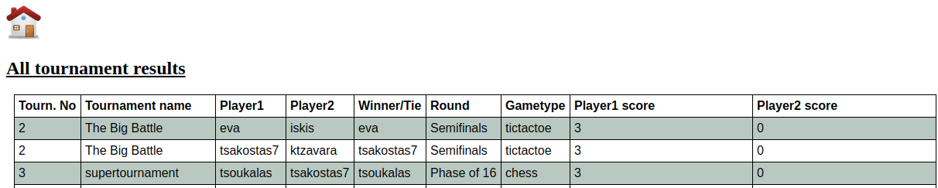
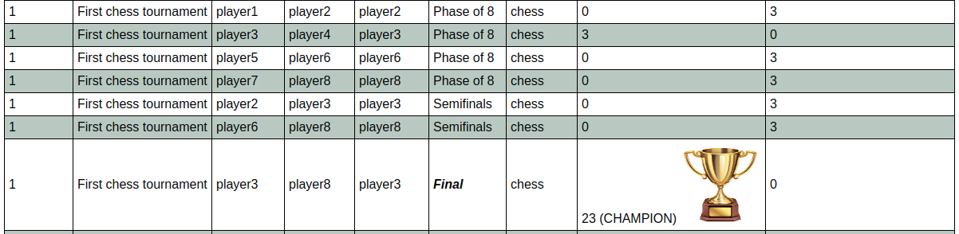

Slide 32
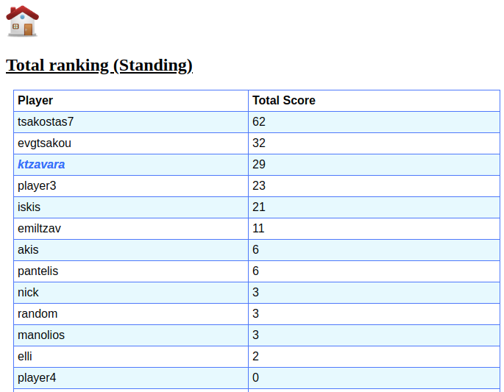

Slide 33
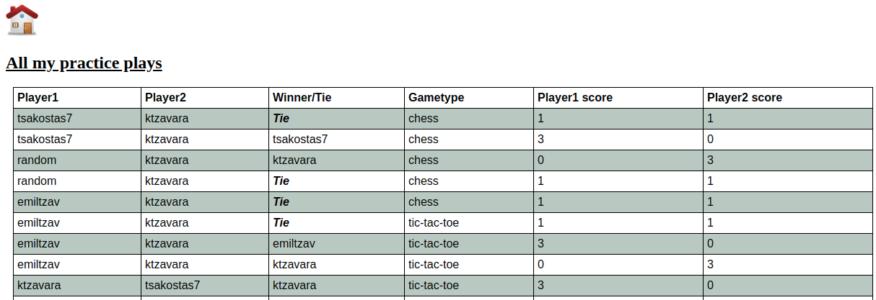
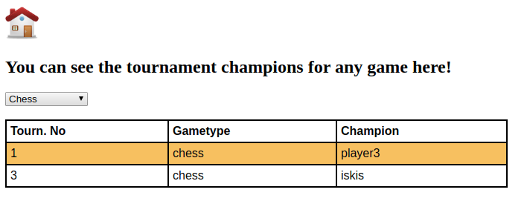
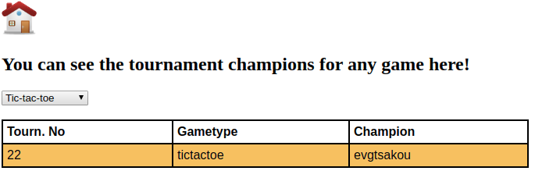

Slide 34
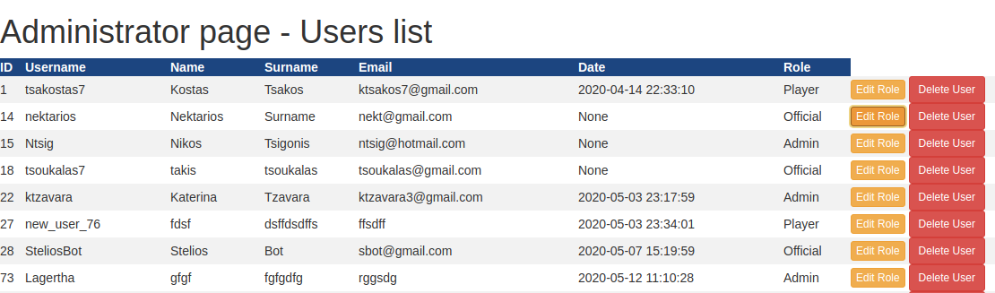
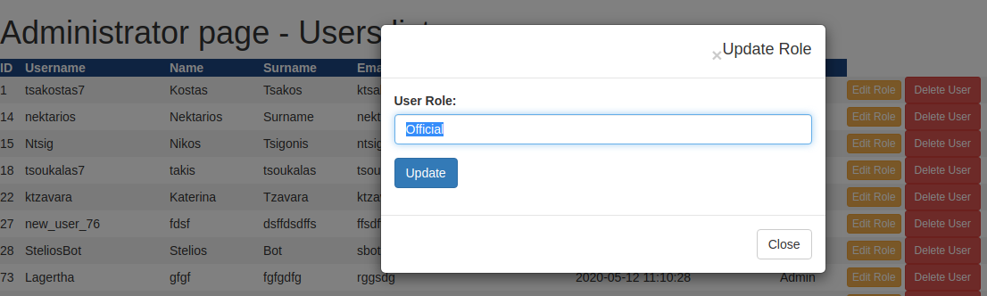

Slide 35
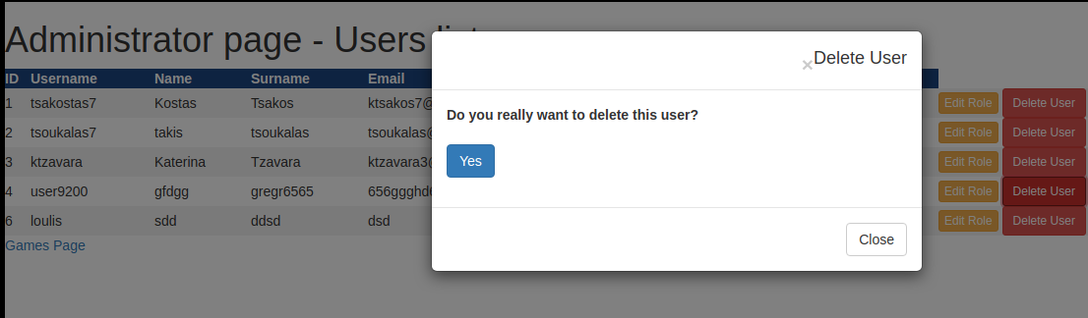
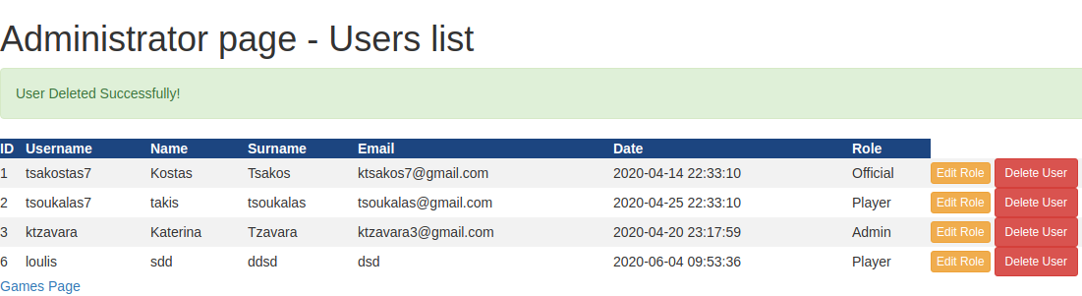

Slide 36

Apache Bench - System performance
We are going to measure the system’s performance again after the project deployment and execution in 8 or more nodes (Okeanos services).

Slide 37
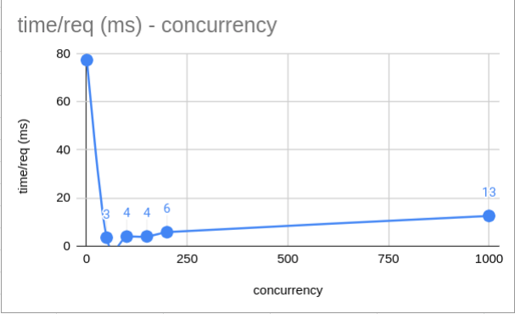
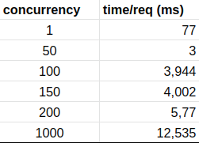
Apache Web Server
GET request: http://147.27.60.48:8001/index.php (our index page)

Slide 38
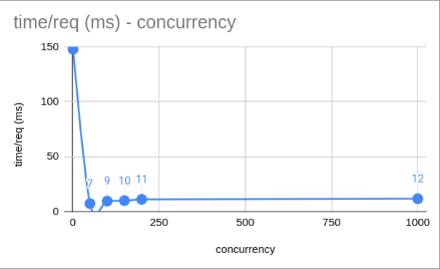
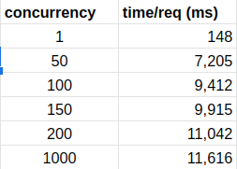
Authentication service
POST request: http://147.27.60.48:5000/register (user registration)

Slide 39
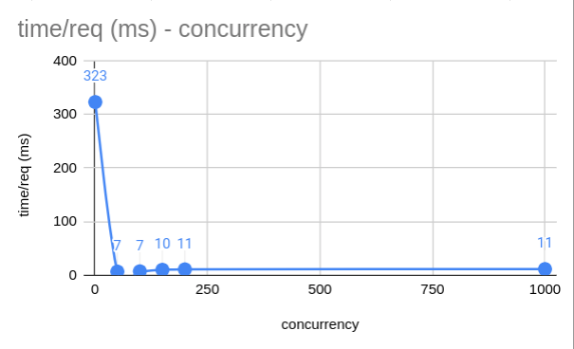
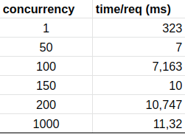
GameMaster service
POST request: http://147.27.60.48:5002/endtournmatch (updates in GameMaster DB when a tournament match is complete)
Important: For concurrency equal to 1 (c=1), the response time is very high but it decreases to the desired levels for greater concurrency (50, 100, etc.). We came to the conclusion that this happens due to the network latency and the fact that we have a lot of database disconnections and new connections when c = 1 (that does not happen in the concurrent requests).

Slide 40

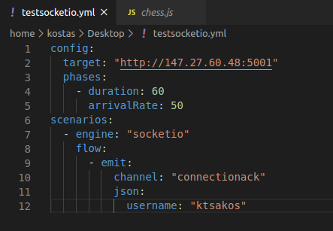
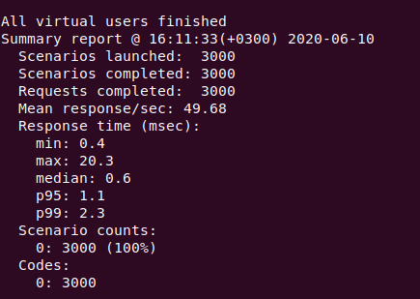
PlayMaster service
http://147.27.60.48:5001

Slide 41
Some extensions of ours
Retrieval of all tournament champions, based on the game type (AJAX)
Password-protected tournaments (using a safe key that users may give to each other privately)
Users deletion by administrators

Slide 42
Future Work
Fault tolerance (Zookeeper or game state store in Mongo)
Games user interface enhancement (clocks, previous moves, etc.)
Connected (logged in) users visible in home page

Slide 43

Thank you!
Let’s see a demo now.

