Slide 1
YOLO-Based Object Detection for 3D Printing
Defect Identification
Authors: Tomiris Murzagali,
Zeynep Galymzhankyzy, Milana Muratova
Department of Mathematics and Computer Science
Lawrence Technological University

Slide 2

Key Objectives
Quality assurance in 3D printing is critical for industries like aerospace and healthcare. This study uses YOLOv11 and YOLOv10l to detect defects like Spaghetti, Stringing, and Warping, which affect reliability and waste resources.
Objectives:
Develop automated defect detection using YOLO models.
Evaluate model performance with metrics like precision, recall, and mAP.

Slide 3
Problem Statement
3D printing quality suffers from defects, while traditional inspections are slow and error-prone. Automated systems promise scalability and real-time detection but face challenges like class imbalance and overlapping features.
Challenges:
Manual inspections are inefficient and unscalable.
Defects such as Spaghetti, Stringing, and Warping vary in occurrence and severity.
Research Gap:
Existing models struggle with imbalanced datasets and overlapping defect characteristics, highlighting the need for robust, automated solutions.

Slide 4
Methodology
The dataset, comprising 4,385 images, was augmented using techniques such as rotations and brightness adjustments to address class imbalance. Two YOLO architectures—YOLOv11 (lightweight) and YOLOv10l (large)—were trained for 100 epochs. Evaluation metrics included precision, recall, and mean average precision (mAP).

Slide 5
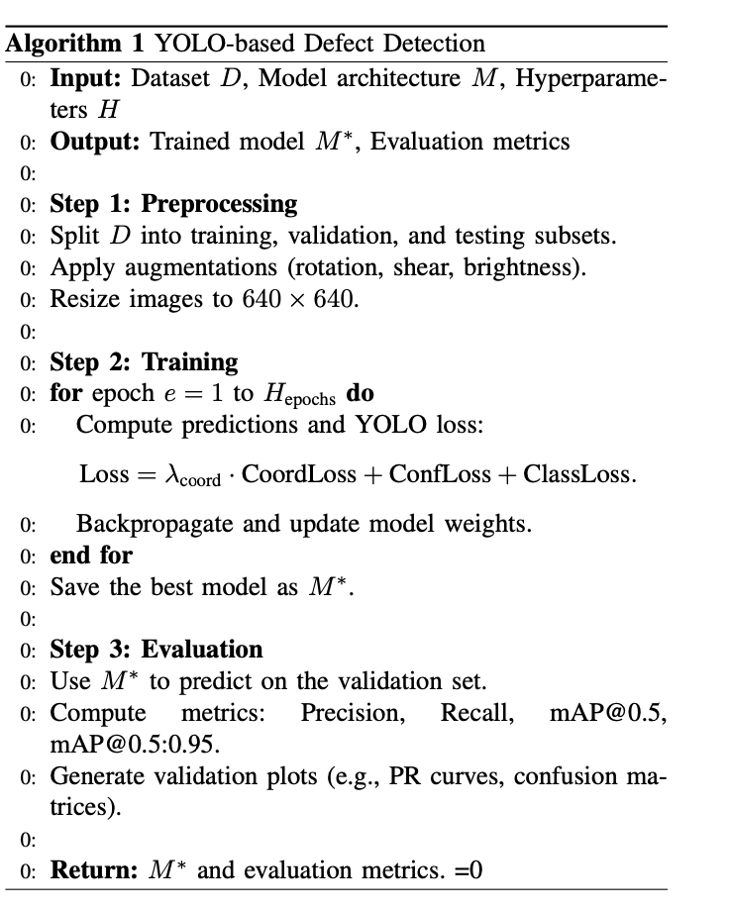
Algorithm
Key Steps:
1)Data Preparation:
Augmentation: Rotation, shear, and brightness changes.
Images resized to 640x640 pixels for YOLO compatibility.
2)Training:
Models optimized using SGD with a learning rate of 0.01.
Loss components included localization, classification, and confidence.
3)Evaluation:
Metrics: Precision, recall, mAP@0.5, and mAP@0.5:0.95.
Analysis via precision-recall curves and confusion matrices.

Slide 6
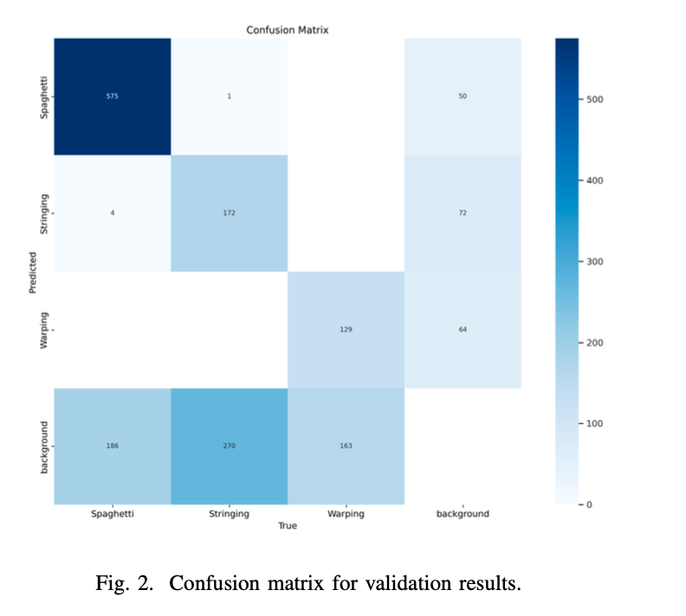
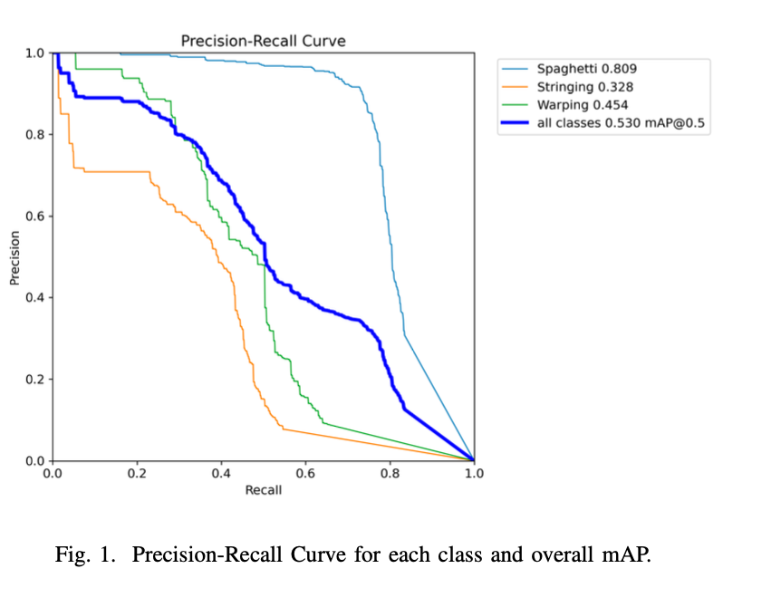
Experimental Setup
Spaghetti achieved high area under the curve and a class-specific mAP@0.5 of 0.809.
Stringing showed class-specific mAP@0.5 of 0.328.
Warping performed class-specific mAP@0.5 of 0.454.
Spaghetti was correctly identified in 575 instances.
Stringing showed 270 out of 443 instances incorrectly predicted as background.
Warping achieved 129 true positives but was often misclassified as either Stringing or background.

Slide 7
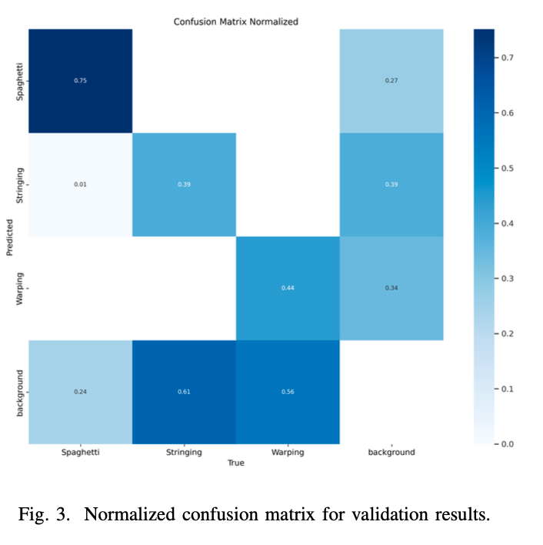
Experimental Setup
Hyperparameters:
Batch Size: 32
Learning Rate: 0.01, scaled dynamically with a warmup phase.
Optiizer: Stochastic Gradient Descent (SGD) with a momentum of 0.9.
Loss Function: Combined classification, localization, and objectness components.
Epochs: 100
Spaghetti maintained high recall across all thresholds.
Stringing dropped recall rapidly at higher thresholds.
Warping showed moderate recall but declined at higher thresholds.

Slide 8
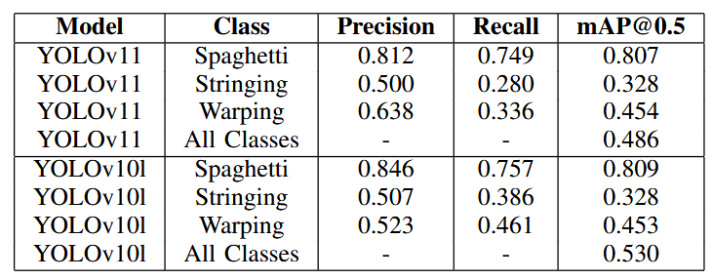
Key Findings
YOLOv10l achieved an overall mAP@0.5 of 0.530 compared to 0.486 for YOLOv11.
Spaghetti showed the best detection performance (mAP@0.5 = 0.809), while Stringing was the most challenging defect to identify (mAP@0.5 = 0.328).
Warping showed moderate results but suffered from misclassifications with other defect types.
The larger YOLOv10l model offers improved accuracy but requires more computational resources.

Slide 9
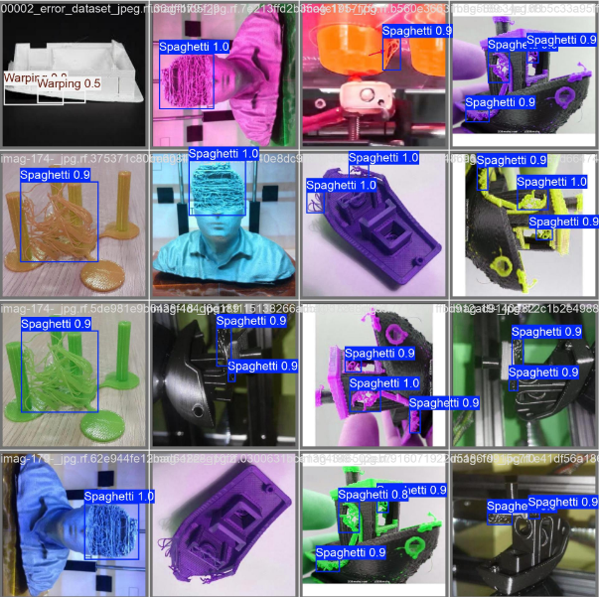
Ideas for Future Research
Dataset Enhancement: Increase real-world and synthetic samples for defects like Stringing and Warping.
Class-Specific Augmentation: Use specific augmentations (e.g., texture, occlusion) for challenging defects.
Advanced Architectures: Explore transformer-based or hybrid models for better feature extraction and overlap resolution.
Real-Time Optimization: Apply techniques like quantization and pruning for efficient edge deployment.
System Integration: Build a real-time detection pipeline with automated corrective actions.

Slide 10
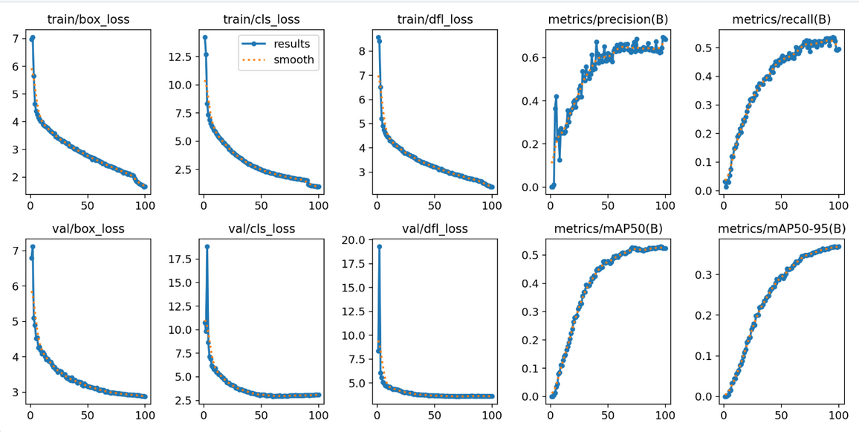
Conclusion
In conclusion, this study highlights the potential of YOLO-based models for detecting 3D printing defects, with YOLOv10l achieving the best results. However, challenges such as dataset imbalance and overlapping defect features persist. Future efforts should focus on dataset expansion, targeted augmentations, and advanced architectures to enhance detection accuracy and reliability.

