Slide 1
Open Economy Macroeconomics for Dummies
Pyry Lehtonen

Slide 2
IS-curve
IS (Investment Savings) curve
Independent variable is interest rate
Dependent variable is real income
If r changes -> curve shifts
If y changes -> movement on the shift
IS-curve represents the equilibria where total savings equal to total investments (S=I)
Every level of interest rate will generate a certain level of fixed investment
Goods market equilibrium
In this course, real exchange rate Q is included in the IS curve
Q have effect on net exports NX

Slide 3
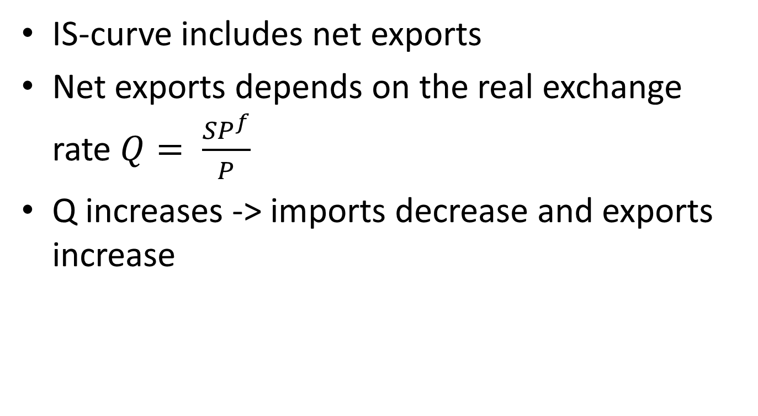
IS-curve
IS-curve includes net exports
Net exports depends on the real exchange rate $Q= \frac{SP^{f}}{P}$
Q increases -> imports decrease and exports increase

Slide 4
LM-curve
LM (Liquidity preference and Money supply)
Independent variable is real income
Dependent variable is interest rate
If r change -> movement on the shift
If money supply change -> curve shifts
The LM-curve shows the combinations of interest rates and levels of real income for which the money market is in equilibrium
Assumption in this course: openness of the economy does not affect to the supply side of the economy
Equilibrium in the (domestic) money market -> Money demand = Money supply

Slide 5

Monetary policy in a open economy depends on the exchange rate arrangements
Floating exchange rate -> Management of money supply
Fixed exchange rate -> Control of banking system lending (controlling domestic credit)
y = income , r = interest rate, k and l are behavioral parameters
When y increases, r has to increase too

Slide 6
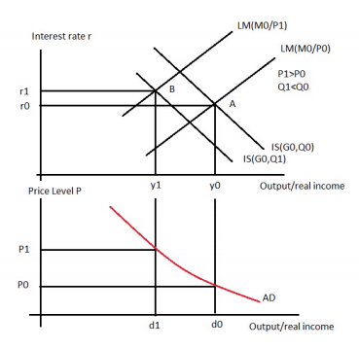
Derive the aggregate demand from IS-LM

Slide 7

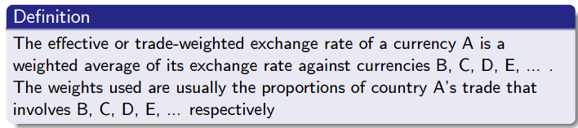
Exchange rates
Cross exchange rates
Spot rate: exchange happens immediately
Forward or future rate: exchange happens in the future

Slide 8
Bid rate = buy rate
Ask (or offer) rate = sell rate
Bid/Ask spread is the gap between these two
Supply and demand of currencies come from:
International trade
Investments (shares, estates etc.)
Speculation (profit from buying and selling currencies)

Slide 9
Different Exchange Rates
Floating exchange rate
Price of the currency (relative to other currencies) is determined by supply and demand
Fixed exchange rate
Tied to another country’s currency (or gold)
Purpose is to maintain country’s currency value stable
Foreign currency trade through central bank and/or private holdings of foreign currency banned or restricted
Managed Float
Fixed rates with fluctuation bands

Slide 10
Balance of Payments (BoP)
BoP gives information about the flow of demand and supply of the currency over any period
Current Account & Capital Account
Foreign currency reserves under fixed exchange rate
Current account surplus -> exchange rate of the currency will increase, ceteris paribus, and vice versa

Slide 11
Law of One Price
PPP is based on the notion of the Law of One Price (LOP)
Identical goods have the same price
Arbitrage and transaction costs
Speculation
Risky
Non-traded goods (non-tradeables)
Arbitrage is not possible

Slide 12
Law of One Price
In global law of one price exchange rates, tariffs and quotas should be taken into account

Slide 13
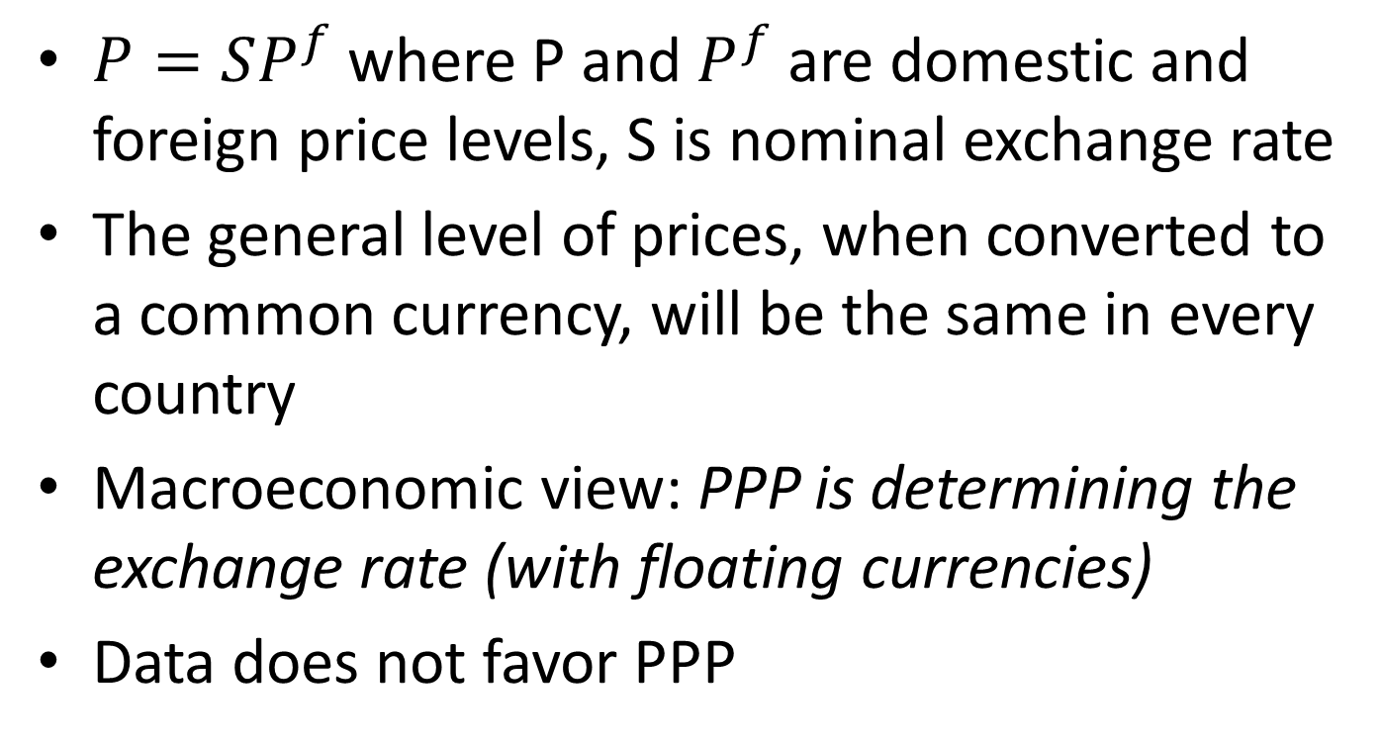
Purchasing Power Parity (PPP)
$P=SP^{f}$ where P and $P^{f}$ are domestic and foreign price levels, S is nominal exchange rate
The general level of prices, when converted to a common currency, will be the same in every country
Macroeconomic view: PPP is determining the exchange rate (with floating currencies)
Data does not favor PPP

Slide 14
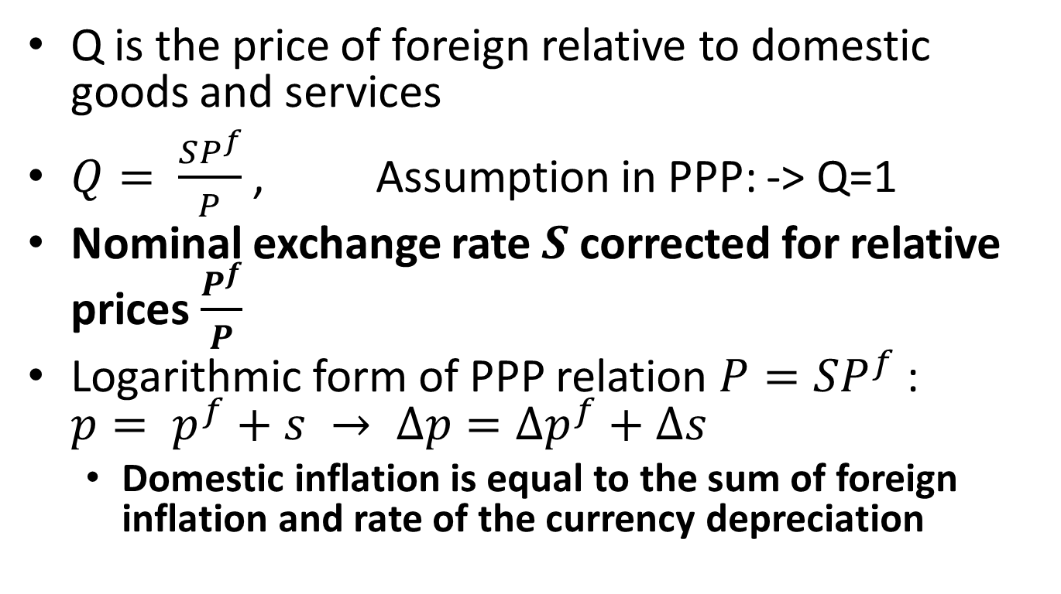
Real Exchange Rate Q
Q is the price of foreign relative to domestic goods and services
$Q= \frac{SP^{f}}{P}$ , Assumption in PPP: -> Q=1
Nominal exchange rate $S$ corrected for relative prices $\frac{P^{f}}{P}$
Logarithmic form of PPP relation $P=SP^{f}$: $p= p^{f}+s → ∆p=∆p^{f}+∆s$
Domestic inflation is equal to the sum of foreign inflation and rate of the currency depreciation

Slide 15
Pass-Through Effect
The exchange rate pass-through effect is the degree to which the prices of imported and exported goods change as a result of an exchange rate change
The pass-through from exchange movements to prices is usually incomplete
US exporter makes cars: 75% of inputs are priced in $, 25% in €
-> 10% appreciation of the euro will lead only to 7.5% increase in the car price in euros

Slide 16
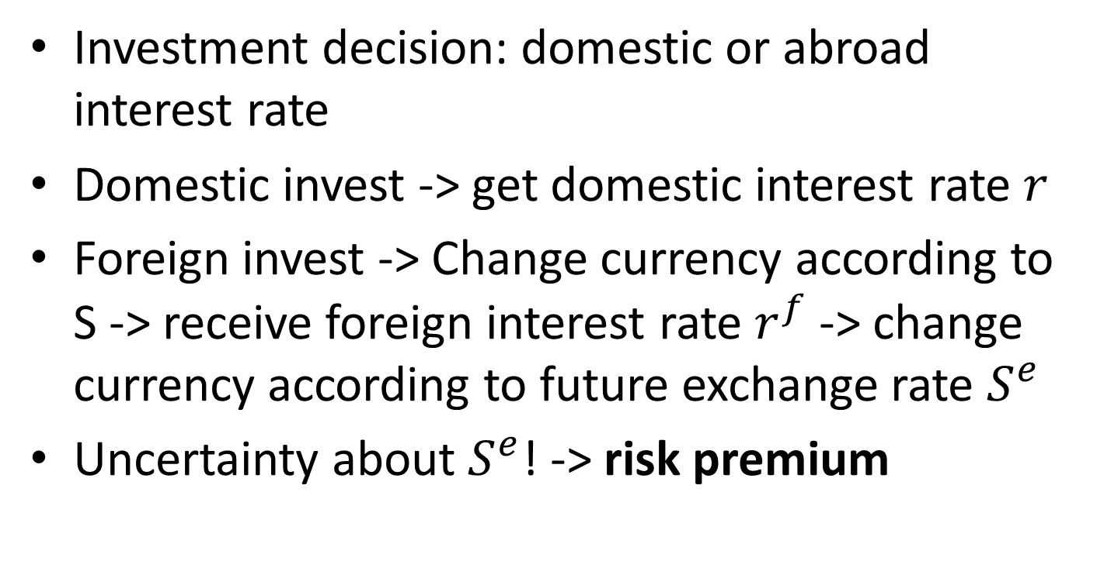
Uncovered Interest Rate Parity (UIP)
Investment decision: domestic or abroad interest rate
Domestic invest -> get domestic interest rate $r$
Foreign invest -> Change currency according to S -> receive foreign interest rate $r^{f}$ -> change currency according to future exchange rate $S^{e}$
Uncertainty about $S^{e}$! -> risk premium

Slide 17
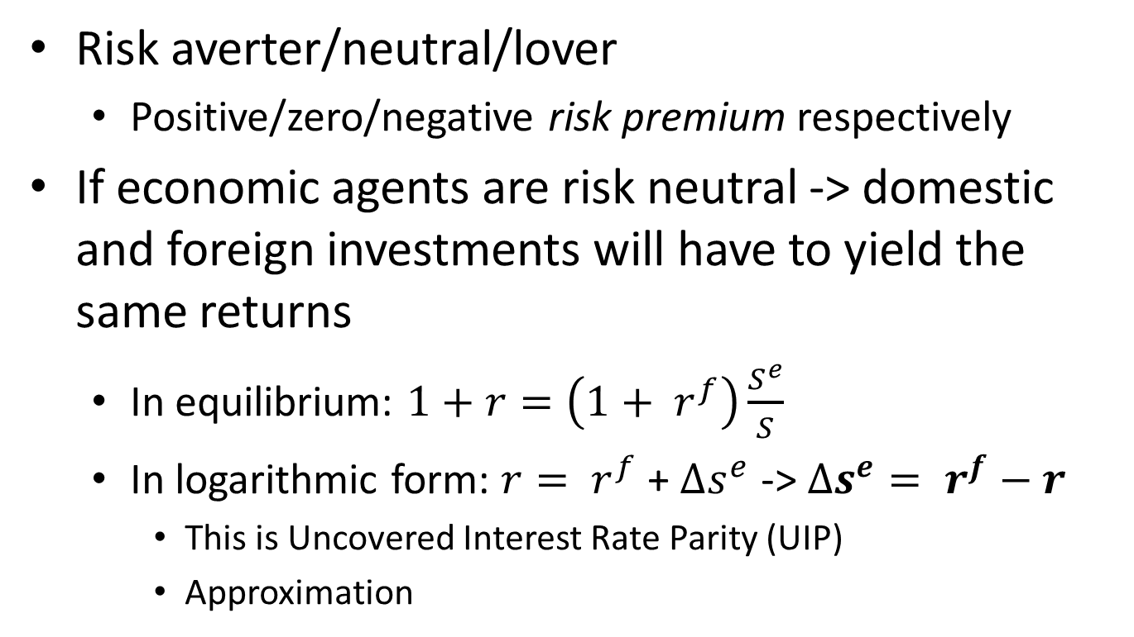
Uncovered Interest Rate Parity (UIP)
Risk averter/neutral/lover
Positive/zero/negative risk premium respectively
If economic agents are risk neutral -> domestic and foreign investments will have to yield the same returns
In equilibrium: $1+r=\left(1+ r^{f}\right)\frac{S^{e}}{S}$
In logarithmic form: $r= r^{f}$ + $∆s^{e}$ -> $∆s^{e}= r^{f}−r$
This is Uncovered Interest Rate Parity (UIP)
Approximation

Slide 18
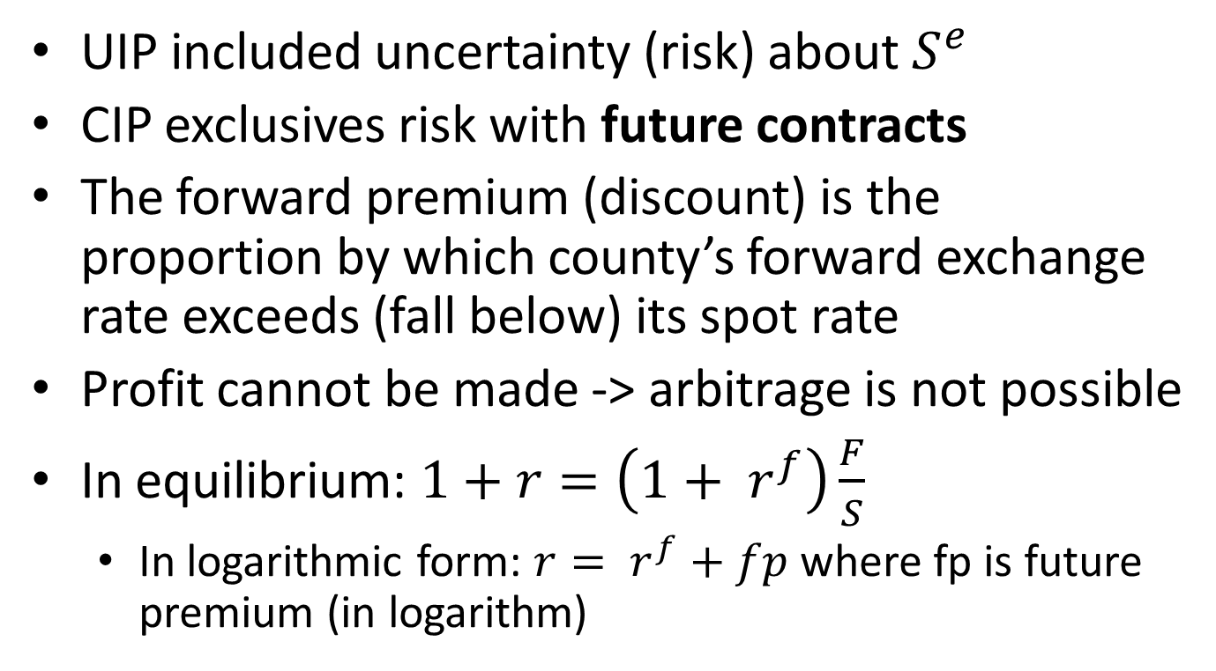
Covered Interest Rate Parity (CIP)
UIP included uncertainty (risk) about $S^{e}$
CIP exclusives risk with future contracts
The forward premium (discount) is the proportion by which county’s forward exchange rate exceeds (fall below) its spot rate
Profit cannot be made -> arbitrage is not possible
In equilibrium: $1+r=\left(1+ r^{f}\right)\frac{F}{S}$
In logarithmic form: $r= r^{f}+fp$ where fp is future premium (in logarithm)

Slide 19
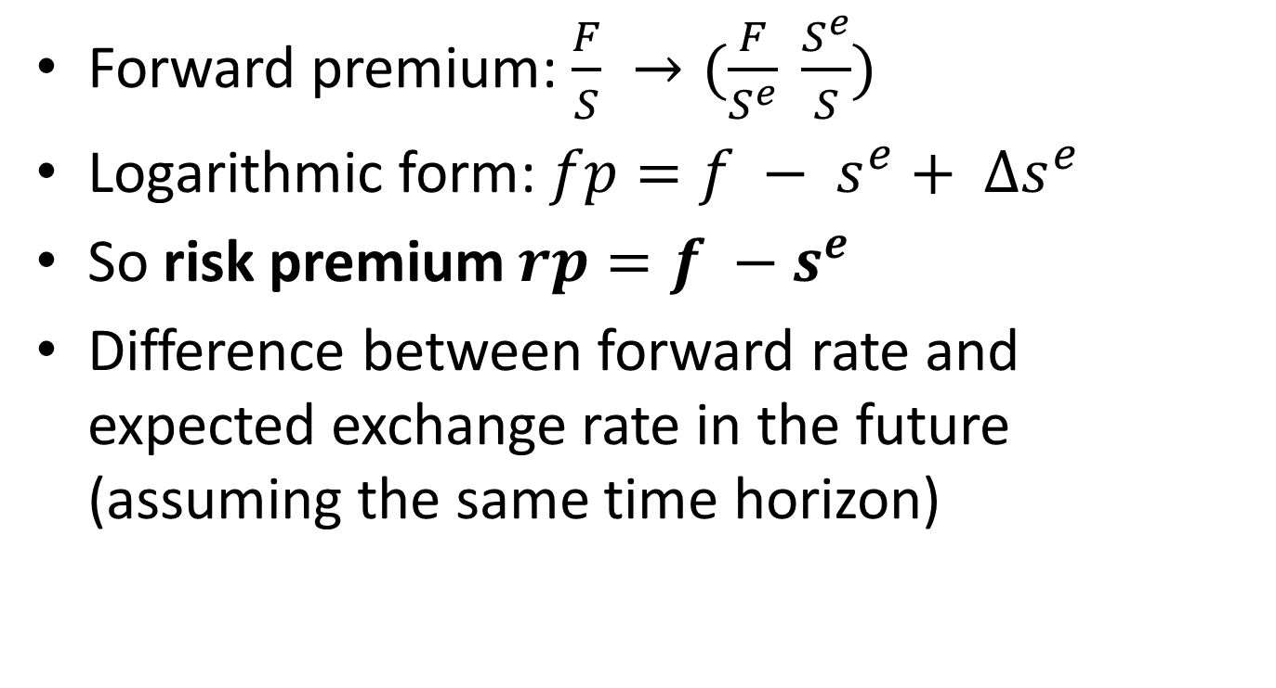
Risk Premium
Forward premium: $\frac{F}{S} →(\frac{F}{S^{e}} \frac{S^{e}}{S})$
Logarithmic form: $fp=f − s^{e}+ ∆s^{e}$
So risk premium $rp=f −s^{e}$
Difference between forward rate and expected exchange rate in the future (assuming the same time horizon)

Slide 20
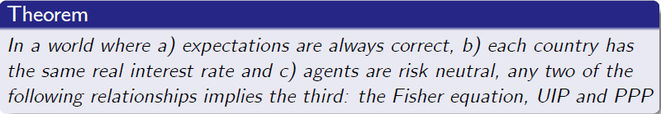
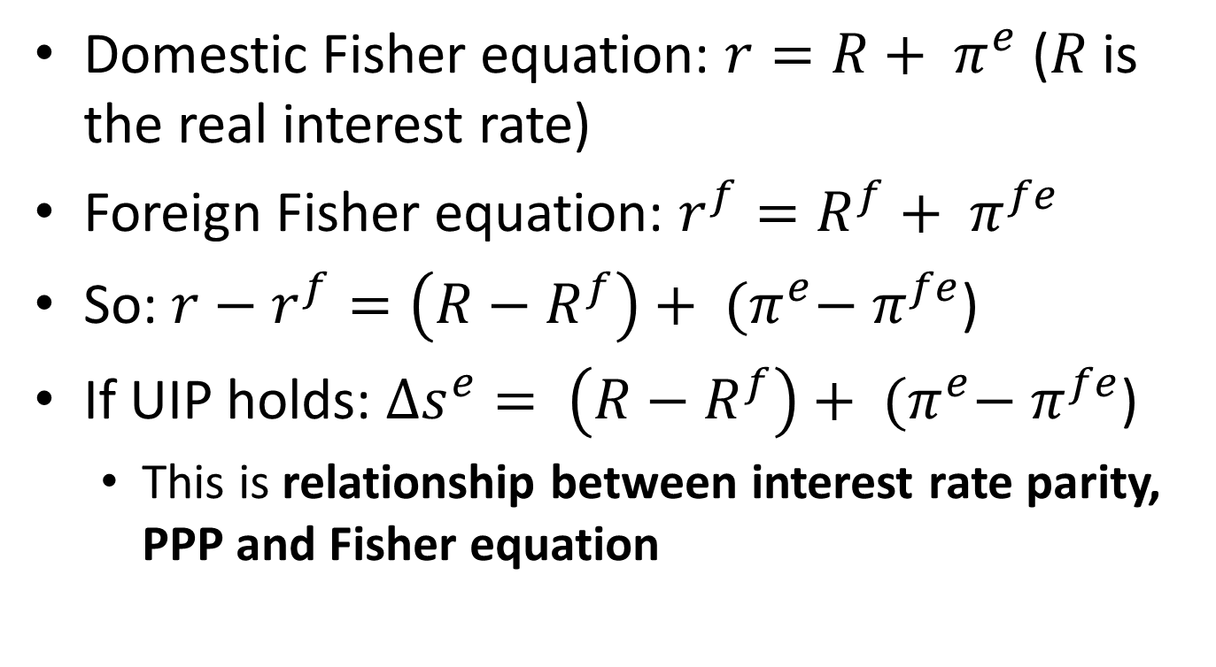
PPP in Expectations
Domestic Fisher equation: $r=R+ π^{e}$ ($R$ is the real interest rate)
Foreign Fisher equation: $r^{f}=R^{f}+ π^{fe}$
So: $r−r^{f}=\left(R−R^{f}\right)+ {(π}^{e}− π^{fe}$)
If UIP holds: $∆s^{e}= \left(R−R^{f}\right)+ {(π}^{e}− π^{fe}$)
This is relationship between interest rate parity, PPP and Fisher equation

Slide 21
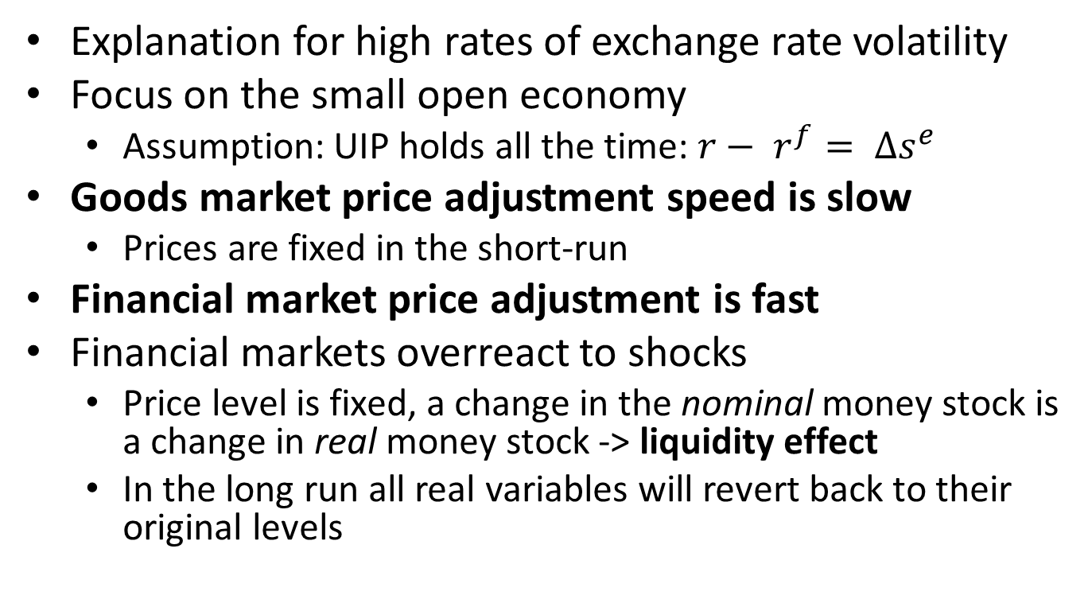
Dornbusch Model
Explanation for high rates of exchange rate volatility
Focus on the small open economy
Assumption: UIP holds all the time: $r− r^{f}= ∆s^{e}$
Goods market price adjustment speed is slow
Prices are fixed in the short-run
Financial market price adjustment is fast
Financial markets overreact to shocks
Price level is fixed, a change in the nominal money stock is a change in real money stock -> liquidity effect
In the long run all real variables will revert back to their original levels

Slide 22
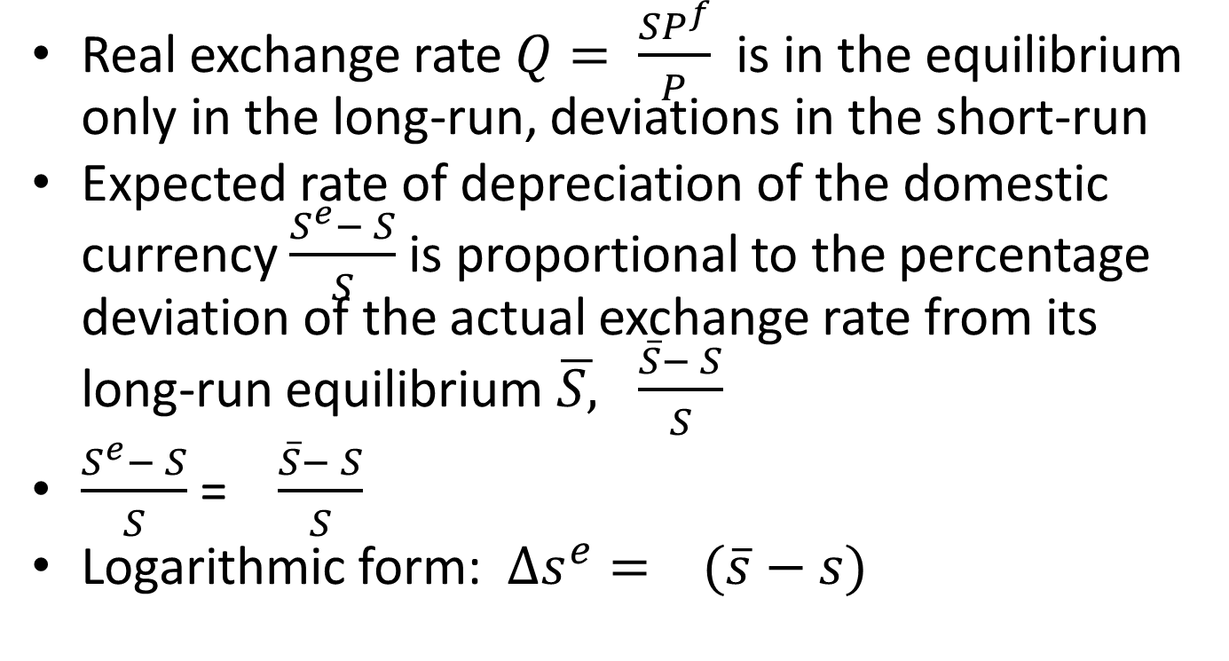
Dornbusch Model
Real exchange rate $Q= \frac{SP^{f}}{P}$ is in the equilibrium only in the long-run, deviations in the short-run
Expected rate of depreciation of the domestic currency $\frac{S^{e}− S}{S}$ is proportional to the percentage deviation of the actual exchange rate from its long-run equilibrium $\overline{S, } \frac{\overline{S}− S}{S}$
$\frac{S^{e}− S}{S}$ = $\frac{\overline{S}− S}{S}$
Logarithmic form: $∆s^{e}= (\overline{s}−s)$

Slide 23
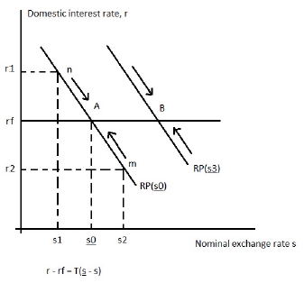
Dornbusch Model
Slope of the RP-curve: -
In the short-run, the price level is fixed, so shocks move to the nominal exchange rate and, hence, the real exchange rate

Slide 24
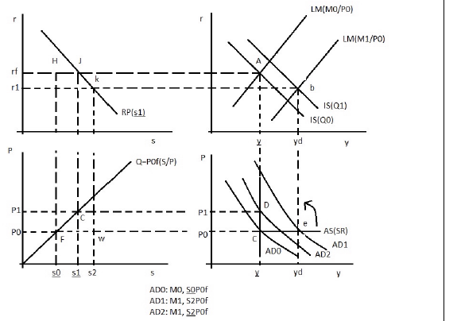
Effect of expansionary monetary policy
IS = C + I + G +NX(Q)

Slide 25
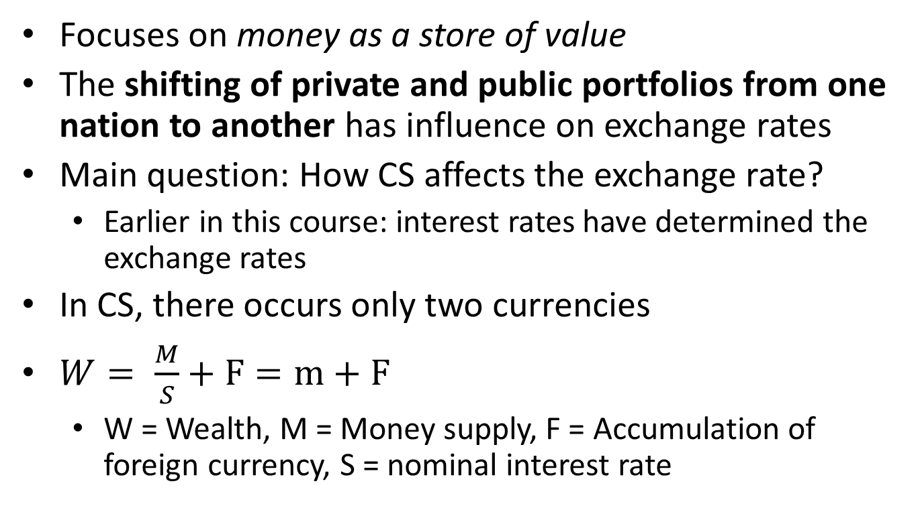
Currency Substitution (CS)
Focuses on money as a store of value
The shifting of private and public portfolios from one nation to another has influence on exchange rates
Main question: How CS affects the exchange rate?
Earlier in this course: interest rates have determined the exchange rates
In CS, there occurs only two currencies
$W= \frac{M}{S}+F=m+F$
W = Wealth, M = Money supply, F = Accumulation of foreign currency, S = nominal interest rate

Slide 26
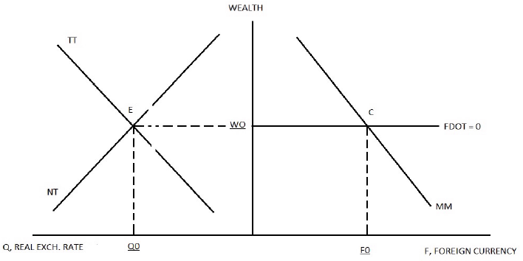
NT curve displays the equilibrium condition in the non-tradeables sector (when Q increases, W falls)
TT-curve describes the combination of Q and W that sustain zero current account balance in the long-run. Short-run excess supply (demand) are points below (above) the TT-curve. If there exists current account surplus/deficit, then there will be positive/negative accumulation of the foreign currency
In the long-run equilibrium E, there is equilibrium in tradeables and non-tradeables sector with zero current account balance (no inflow/outflow of foreign currency)

Slide 27

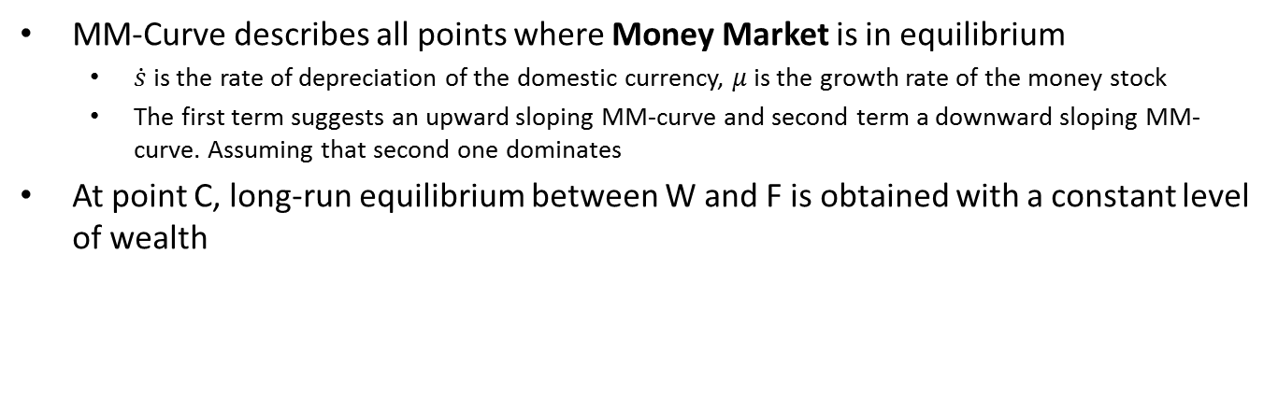

<- $\dot{F}=0$
MM-Curve describes all points where Money Market is in equilibrium
$\dot{s}$ is the rate of depreciation of the domestic currency, $μ$is the growth rate of the money stock
The first term suggests an upward sloping MM-curve and second term a downward sloping MM-curve. Assuming that second one dominates
At point C, long-run equilibrium between W and F is obtained with a constant level of wealth

Slide 28
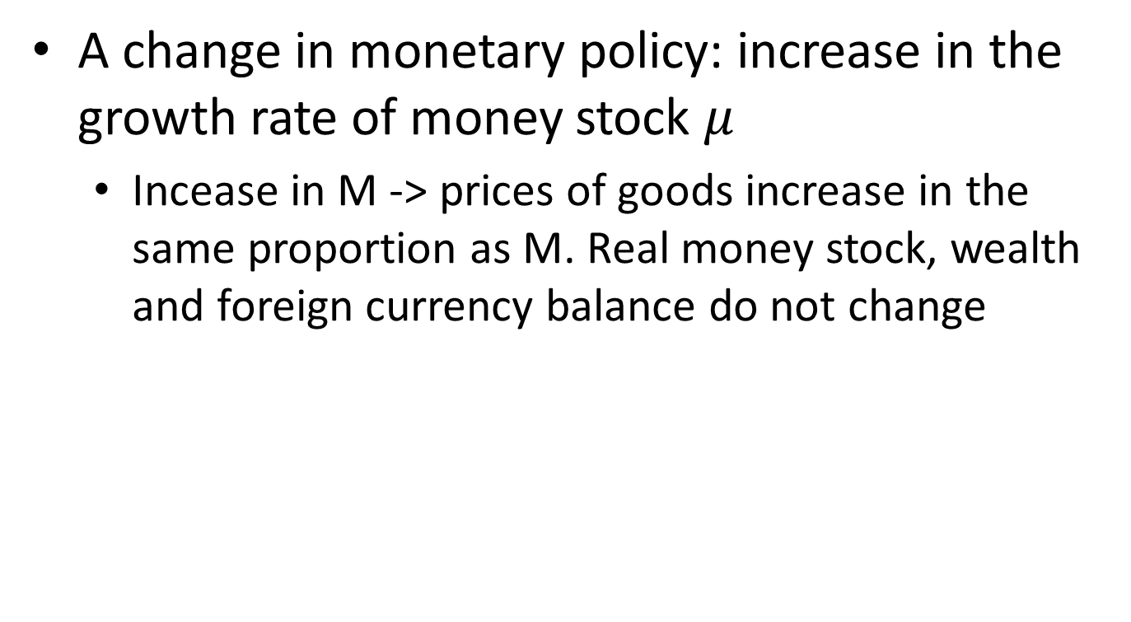
Currency Substitution (CS)
A change in monetary policy: increase in the growth rate of money stock $μ$
Incease in M -> prices of goods increase in the same proportion as M. Real money stock, wealth and foreign currency balance do not change

Slide 29
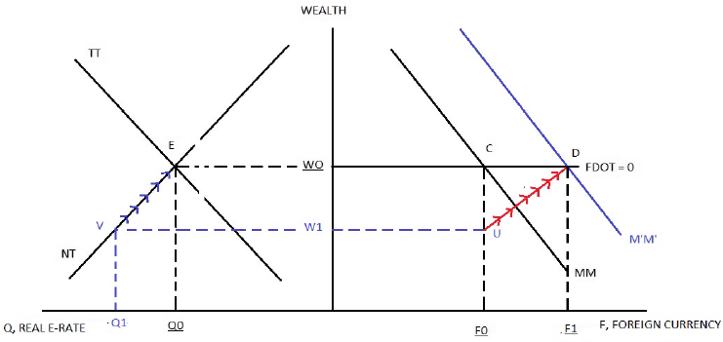
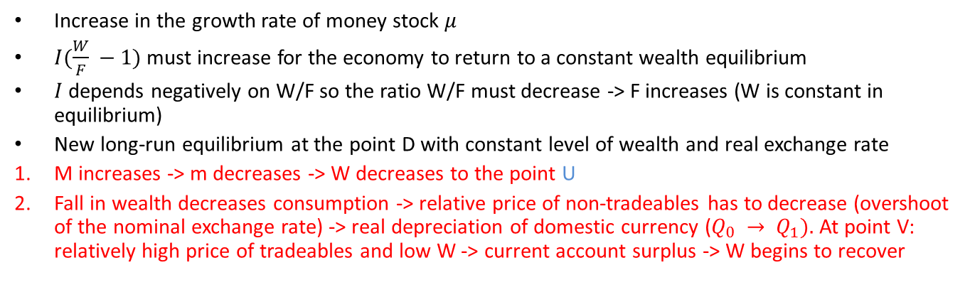
1.
2.
Increase in the growth rate of money stock $μ$
$I(\frac{W}{F} −1)$ must increase for the economy to return to a constant wealth equilibrium
$I$ depends negatively on W/F so the ratio W/F must decrease -> F increases (W is constant in equilibrium)
New long-run equilibrium at the point D with constant level of wealth and real exchange rate
M increases -> m decreases -> W decreases to the point U
Fall in wealth decreases consumption -> relative price of non-tradeables has to decrease (overshoot of the nominal exchange rate) -> real depreciation of domestic currency ($Q_{0} → Q_{1}).$At point V: relatively high price of tradeables and low W -> current account surplus -> W begins to recover

Slide 30

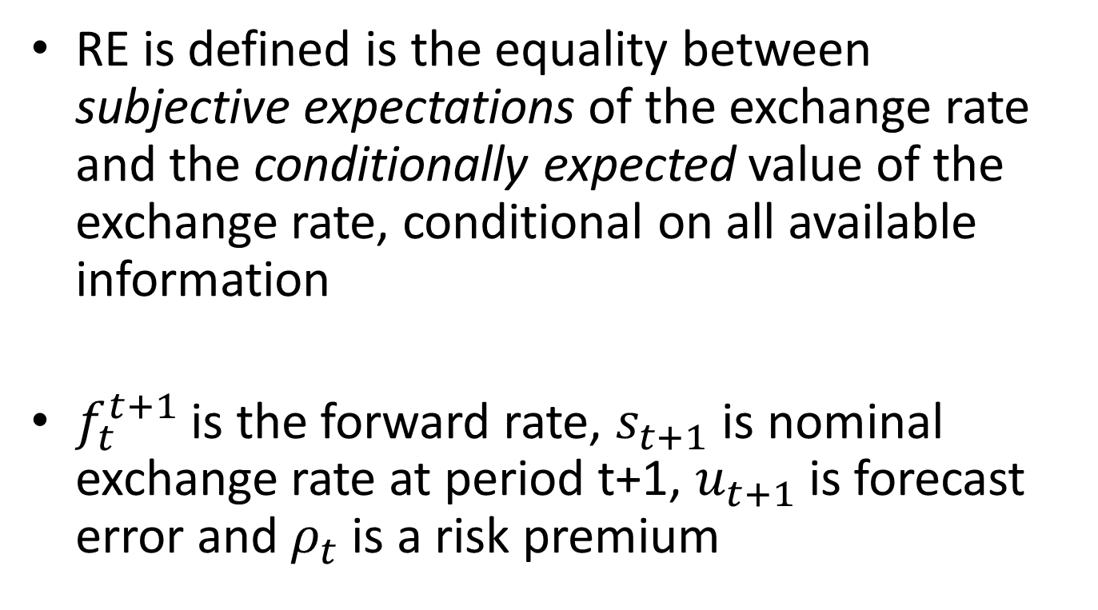
Rational Expectations (RE)
RE is defined is the equality between subjective expectations of the exchange rate and the conditionally expected value of the exchange rate, conditional on all available information
$f_{t}^{t+1}$is the forward rate, $s_{t+1}$is nominal exchange rate at period t+1, $u_{t+1}$is forecast error and $ρ_{t}$is a risk premium

Slide 31
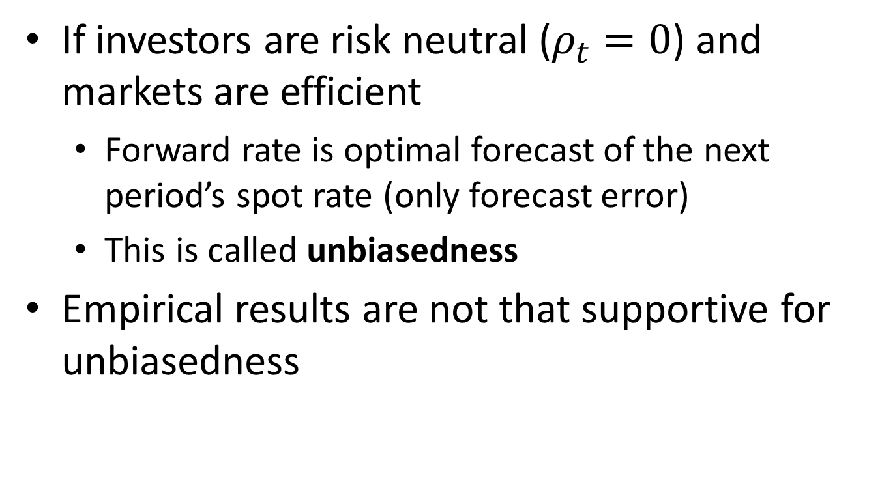
Rational Expectations (RE)
If investors are risk neutral ($ρ_{t}=0$) and markets are efficient
Forward rate is optimal forecast of the next period’s spot rate (only forecast error)
This is called unbiasedness
Empirical results are not that supportive for unbiasedness

Slide 32
News Model
Concentration on the random error in forecasting the future exchange rates
News model assumes rational expectations
Some information “news” are unforeseeable, thus random error exists
In the monetary model, the exchange rate depends on relative money stocks, income and interest rates
Also expected capital gain or loss from holding the currency should be taken into account
Current level of the exchange rate depend on its expected rate of change

Slide 33

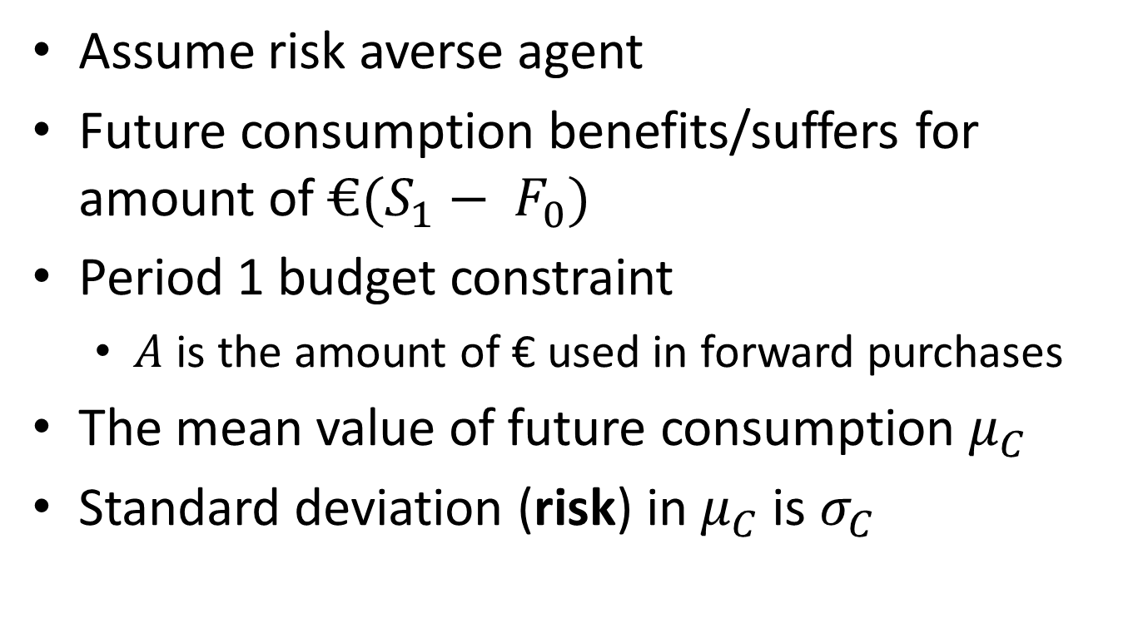
Risk Premium
Assume risk averse agent
Future consumption benefits/suffers for amount of $€(S_{1}− F_{0})$
Period 1 budget constraint
$A$ is the amount of € used in forward purchases
The mean value of future consumption $μ_{C}$
Standard deviation (risk) in $μ_{C}$ is $σ_{C}$

Slide 34
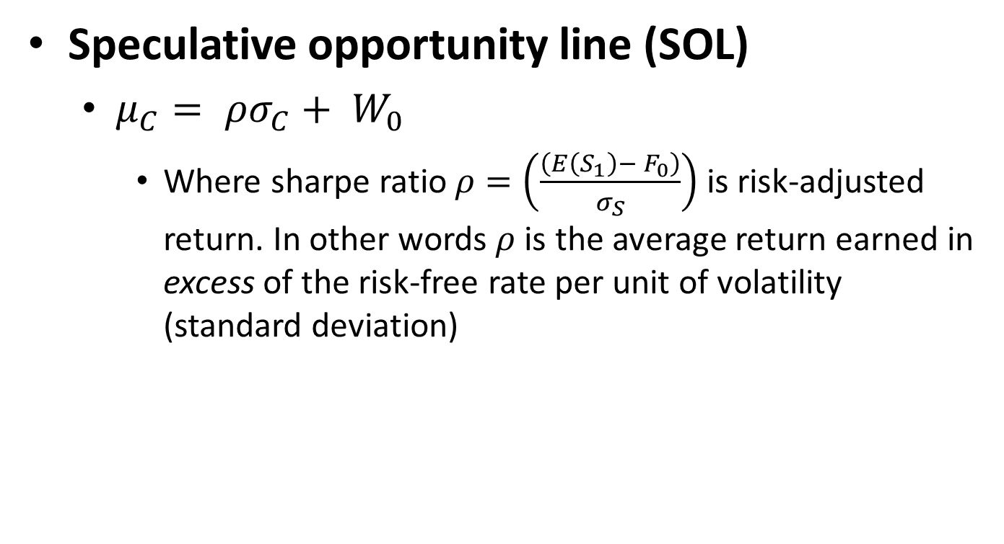
Risk Premium
Speculative opportunity line (SOL)
$μ_{C}= ρσ_{C}+ W_{0}$
Where sharpe ratio $ρ=\left(\frac{\left(E\left(S_{1}\right)− F_{0}\right)}{σ_{S}}\right)$ is risk-adjusted return. In other words $ρ$ is the average return earned in excess of the risk-free rate per unit of volatility (standard deviation)

Slide 35
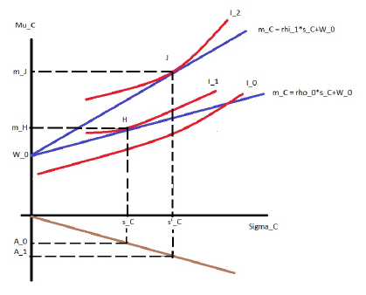
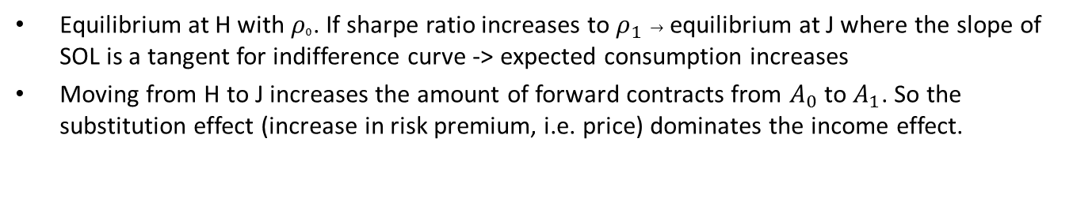



$$μ_{C}= ρσ_{C}+ W_{0}$$
$$μ_{C}$$
$$σ_{C}$$
Equilibrium at H with $ρ_{0}$. If sharpe ratio increases to $ρ_{1} →$ equilibrium at J where the slope of SOL is a tangent for indifference curve -> expected consumption increases
Moving from H to J increases the amount of forward contracts from $A_{0}$ to $A_{1}$. So the substitution effect (increase in risk premium, i.e. price) dominates the income effect.

Slide 36


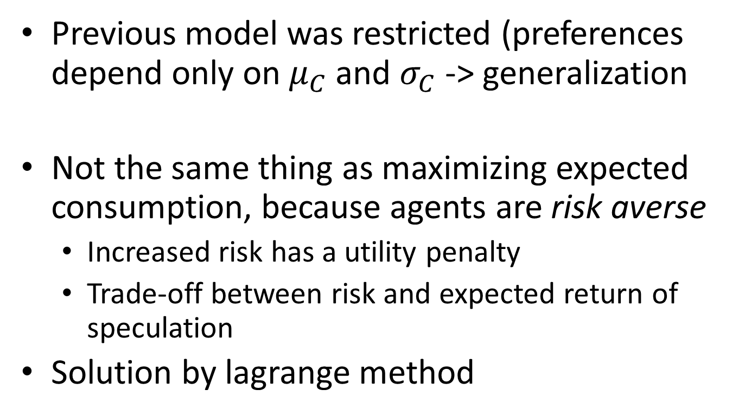
A General Model of the Risk Premium
Previous model was restricted (preferences depend only on $μ_{C}$ and $σ_{C}$ -> generalization
Not the same thing as maximizing expected consumption, because agents are risk averse
Increased risk has a utility penalty
Trade-off between risk and expected return of speculation
Solution by lagrange method

Slide 37


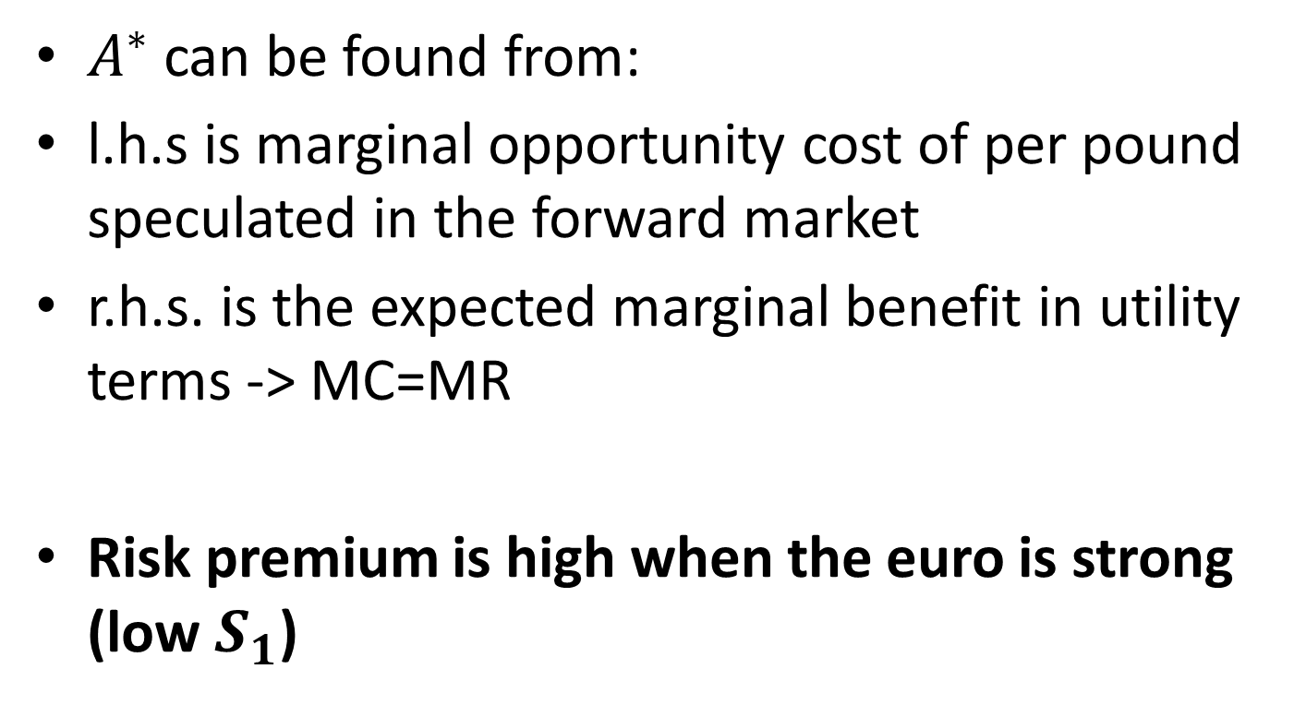
A General Model of the Risk Premium
$A^{∗}$ can be found from:
l.h.s is marginal opportunity cost of per pound speculated in the forward market
r.h.s. is the expected marginal benefit in utility terms -> MC=MR
Risk premium is high when the euro is strong (low $S_{1}$)

Slide 38
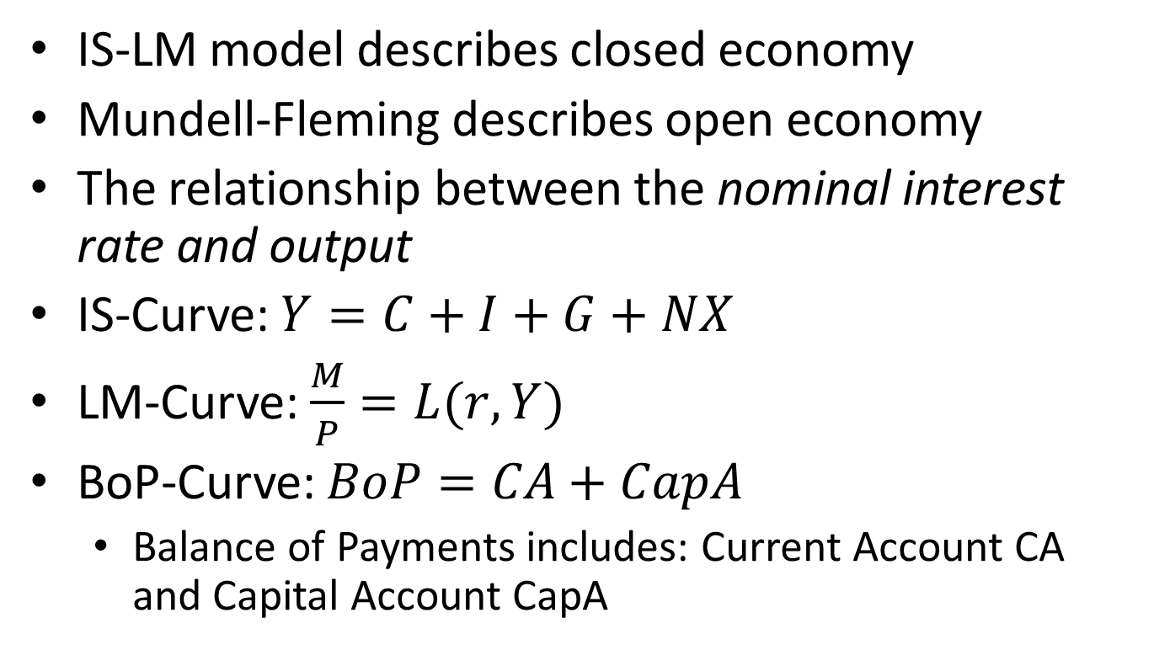
Mundell-Fleming Model (MF)
IS-LM model describes closed economy
Mundell-Fleming describes open economy
The relationship between the nominal interest rate and output
IS-Curve: $Y=C+I+G+NX$
LM-Curve: $\frac{M}{P}=L(r,Y)$
BoP-Curve: $BoP=CA+CapA$
Balance of Payments includes: Current Account CA and Capital Account CapA

Slide 39
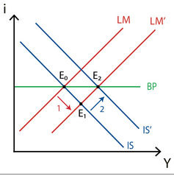
MF under flexible exchange rates
Expansionary monetary policy
LM shifts right
Local interest rate lower than global -> capital outflows because of the decreased interest rate -> depreciation of the local currency
Depreciation increases net exports and IS shifts right where local interest rate equal global interest rate (BoP is balanced)

Slide 40
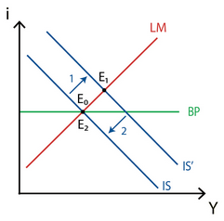
MF under flexible exchange rates
Expansionary fiscal policy
G increases -> IS curve shifts right
Local interest rate is above global interest rate -> capital inflow -> appreciation of domestic currency
Appreciation decreases net exports and IS shifts back where local interest rate equal global interest rate (BoP is balanced)

Slide 41
MF under flexible exchange rates
Increase in global interest rate
Capital outflow from the economy -> depreciation of currency -> Net exports increase
IS-curve shifts to right to the point where domestic and global interest rates are equal

Slide 42
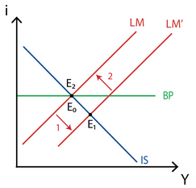
MF under fixed exchange rates
Expansionary monetary policy
LM-Curve shifts to right -> BoP deficit
Government has to buy domestic currency and sell foreign currency -> decrease in money supply
Back to original equilibrium -> monetary policy do not have effect under fixed interest rates

Slide 43
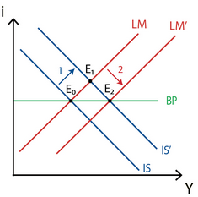
MF under fixed exchange rates
Expansionary fiscal policy
IS-curve shifts right (G increases)
Appreciation of the exchange rate, to maintain fixed rate -> government buy foreign currency and sells domestic currency -> increase in money supply -> LM-curve shifts right

Slide 44
MF under fixed exchange rates
Increase in global interest rate
Capital outflow
This would depreciate the domestic exchange rate
In order to keep the exchange rate stable government has to buy home currency and sell foreign currency -> decrease in money supply -> LM-curve shifts to left to the point where domestic and global interest rates are equal

Slide 45
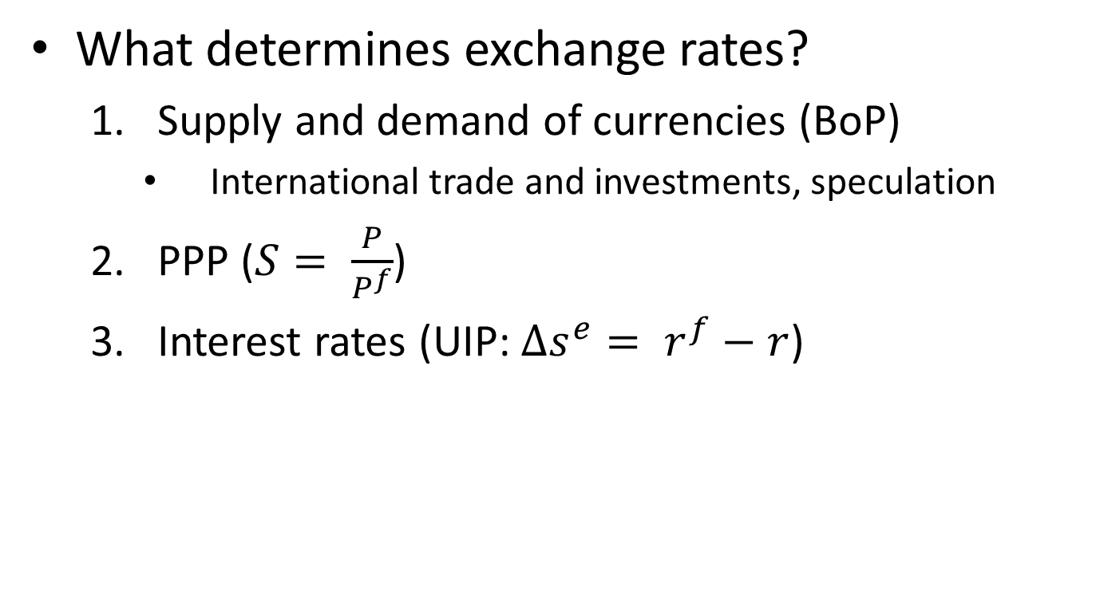
Summary
What determines exchange rates?
Supply and demand of currencies (BoP)
International trade and investments, speculation
PPP ($S= \frac{P}{P^{f}}$)
Interest rates (UIP: $∆s^{e}= r^{f}−r$)

Slide 46
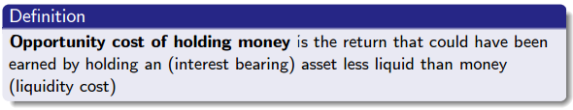
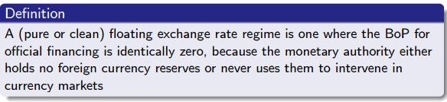
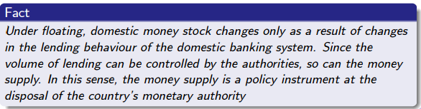
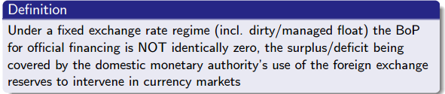

Slide 47
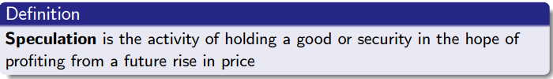




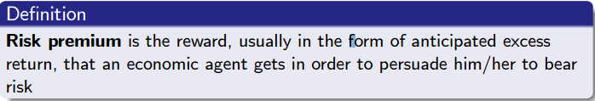
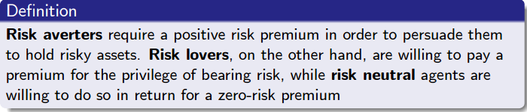

Slide 48
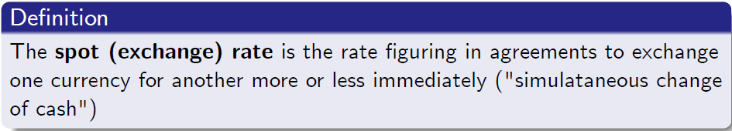
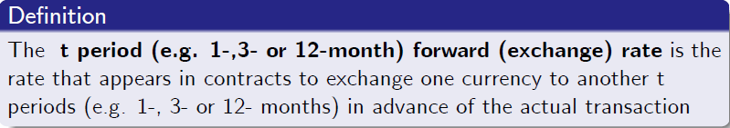

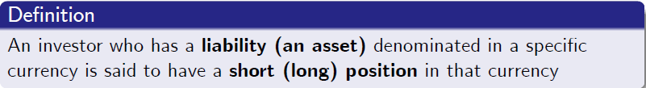
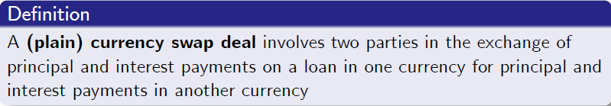

Slide 49
