Slide 1
Time Series for Dummies
Pyry Lehtonen
7.3.2017

Slide 2
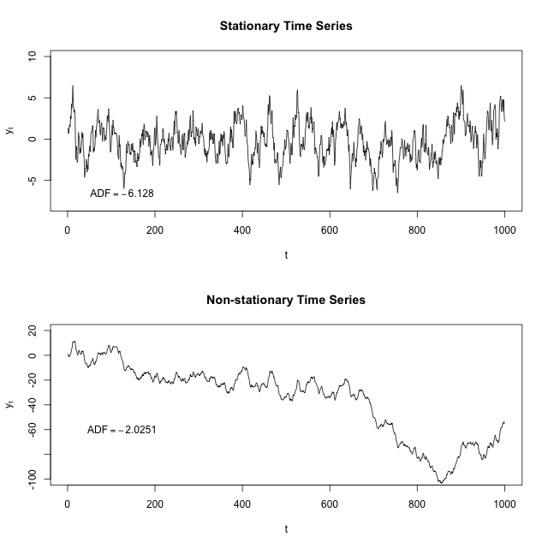
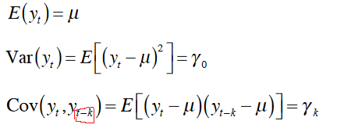
(Weakly) Stationarity
Mean do not change over time
Variance do not change over time
Covariance do not change over time
Notes:
Kovarianssi kertoo kuinka läheisesti muuttujat vaihtelevat yhdessä.

Slide 3
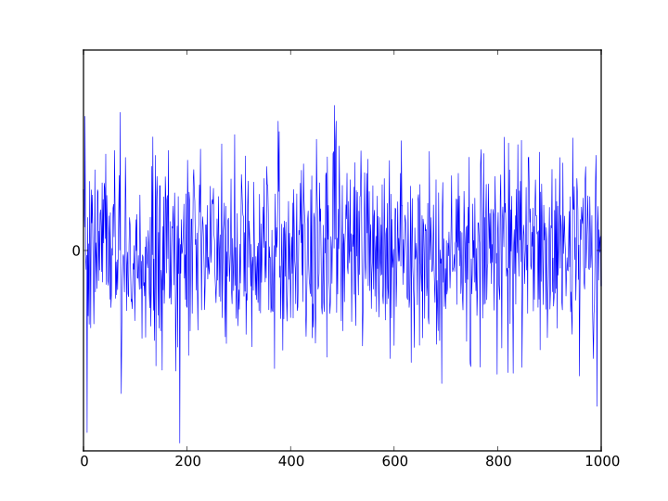
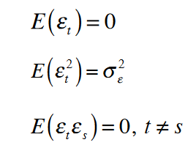

White Noise
Error term $ℇ_{t}$ is white noise (=random signal) if:
Expected value is 0
Variance is constant = homoskedasticity
No autocorrelation

Slide 4
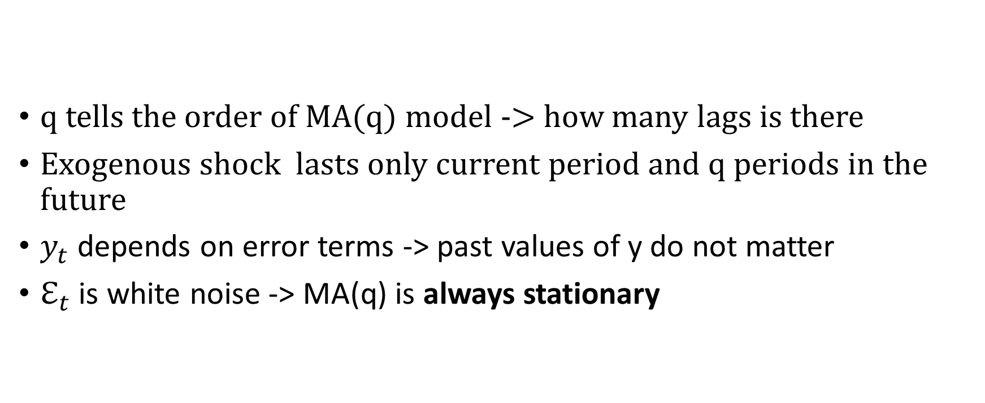
Moving Average MA(q) Model
q tells the order of MA(q) model -> how many lags is there
Exogenous shock lasts only current period and q periods in the future
$y_{t}$depends on error terms -> past values of y do not matter
$ℇ_{t}$ is white noise -> MA(q) is always stationary

Slide 5

Autoregressive AR(p) Model
$y_{t}$ depends linearly on its previous values
If AR(p) is not stationary, exogenous shock lasts forever
If AR(p) is stationary, exogenous shock converges to 0
Not always stationary, may have a unit root
Stationarity depends on roots of the lag polynomial
Notes:
Difference equation, sama kun matmenissä

Slide 6




Lag Polynomial
AR(p) model
MA(q) model
Solve roots of L
If all roots are greater than one in absolute value -> AR(p) is stationary
MA(q) is always stationary regardless of the roots

Slide 7
Impulse Response Function (IRF)
IRF is a measure of persistence
The more persistence the time series is, the longer will exogenous shock last
At the lag where IRF gets value of 0 -> shock do not have effect anymore

Slide 8




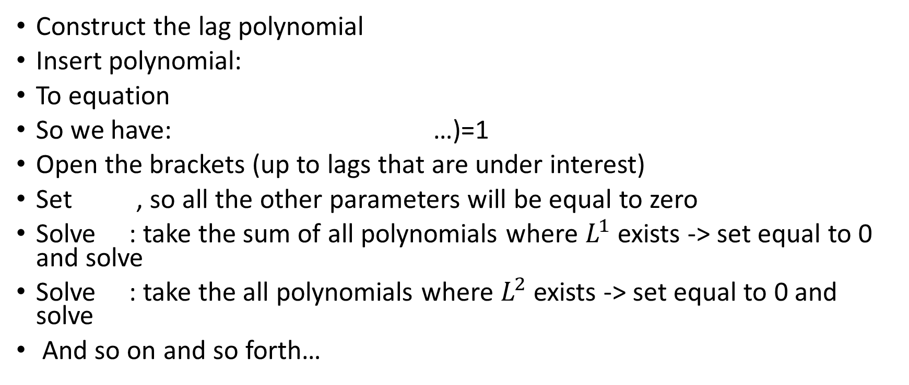
Cheat Sheet for Solving IRF
Example is for AR(p) model but same goes for MA(q) model, only lag polynomial is different
Construct the lag polynomial
Insert polynomial:
To equation
So we have: …)=1
Open the brackets (up to lags that are under interest)
Set , so all the other parameters will be equal to zero
Solve : take the sum of all polynomials where $L^{1}$ exists -> set equal to 0 and solve
Solve : take the all polynomials where $L^{2}$ exists -> set equal to 0 and solve
And so on and so forth…

Slide 9
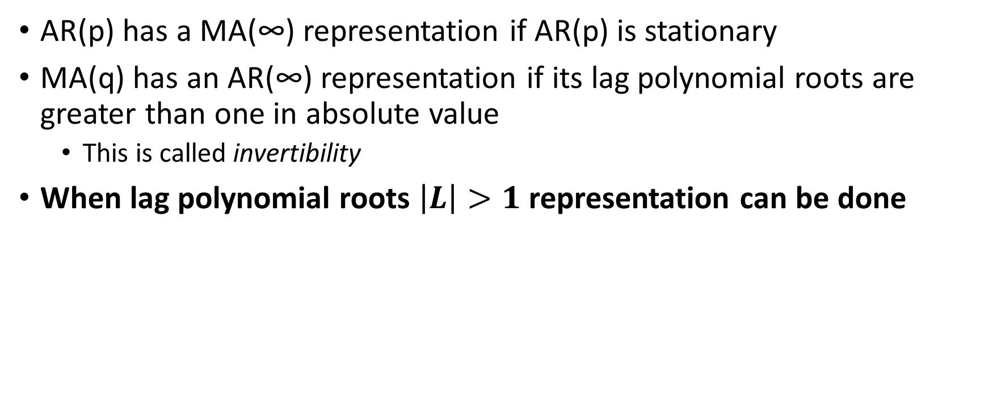
Representations in Other Models
AR(p) has a MA(∞) representation if AR(p) is stationary
MA(q) has an AR(∞) representation if its lag polynomial roots are greater than one in absolute value
This is called invertibility
When lag polynomial roots $\left|L\right|>1$ representation can be done

Slide 10

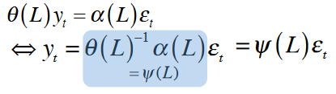
Autoregressive-Moving-Average ARMA(p,q)
ARMA combines AR and MA models
ARMA model is stationary if AR part is stationary (roots greater than one in absolute value)
MA part is always stationary
If ARMA is stationary, it has a MA(∞) representation:

Slide 11
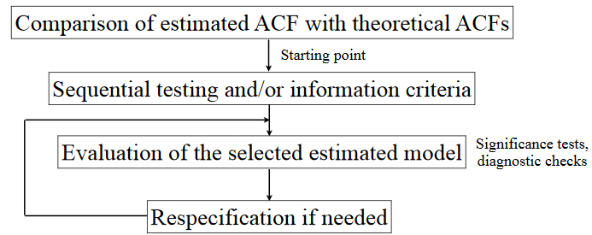
Model Selection
Goal: Find simplest ARMA model that sufficiently captures dynamics of a time series
1.
2.
3.
4.

Slide 12
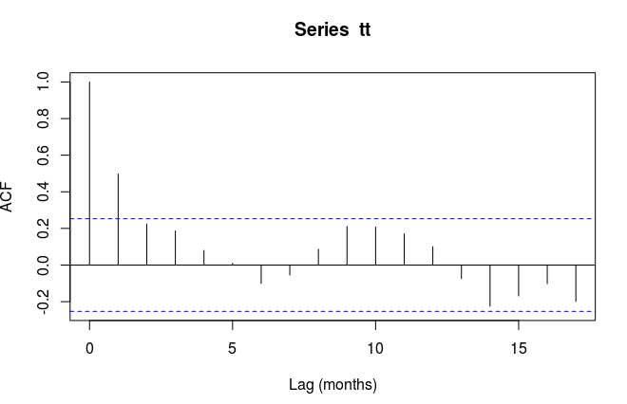
Model Selection
Comparison of autocorrelation functions
AR(p) -> Autocorrelation last to infinity
MA(q) -> Autocorrelation lasts q periods, then go to 0
ARMA(p,q) -> Autocorrelation lasts something between these two
Look at autocorrelation function and how long autocorrelation last
Predict which model is adequate

Slide 13
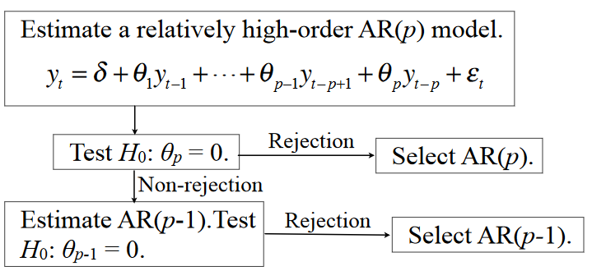
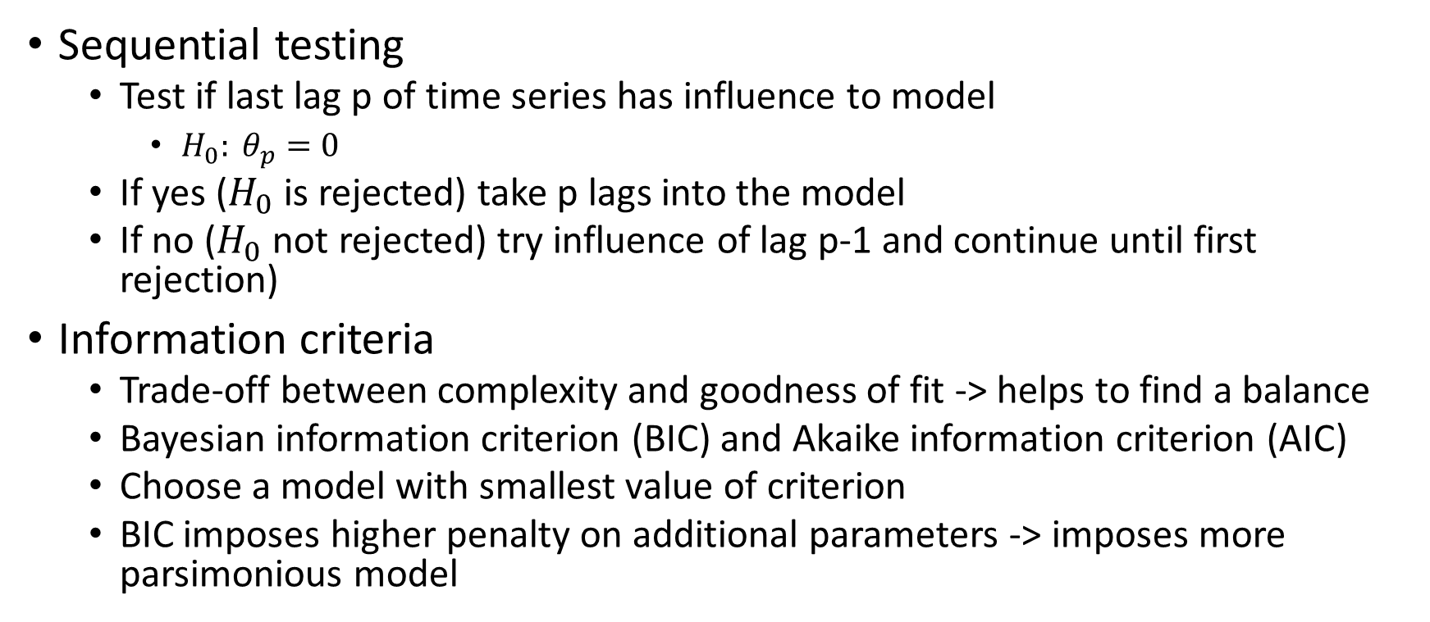
Model Selection
Sequential testing and information criteria
Sequential testing
Test if last lag p of time series has influence to model
$H_{0}: θ_{p}=0$
If yes ($H_{0}$ is rejected) take p lags into the model
If no ($H_{0}$ not rejected) try influence of lag p-1 and continue until first rejection)
Information criteria
Trade-off between complexity and goodness of fit -> helps to find a balance
Bayesian information criterion (BIC) and Akaike information criterion (AIC)
Choose a model with smallest value of criterion
BIC imposes higher penalty on additional parameters -> imposes more parsimonious model

Slide 14
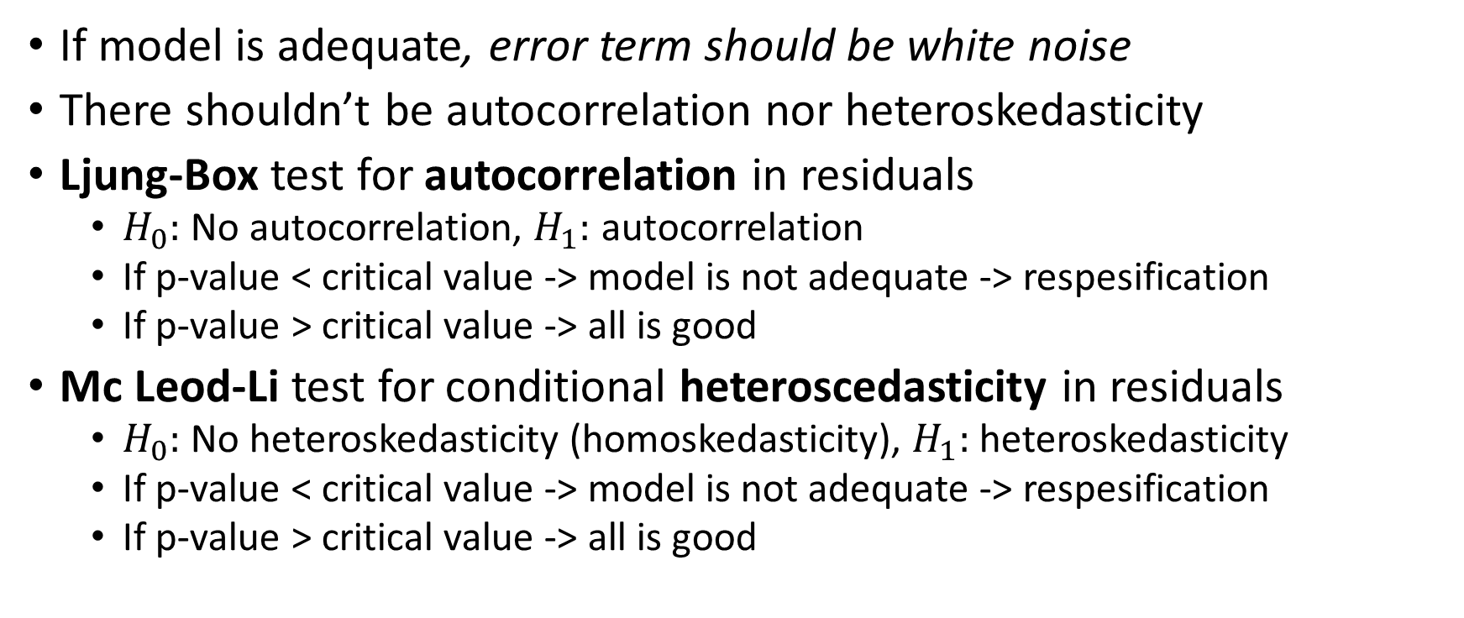
Model Selection
Diagnostic checking
If model is adequate, error term should be white noise
There shouldn’t be autocorrelation nor heteroskedasticity
Ljung-Box test for autocorrelation in residuals
$H_{0}:$ No autocorrelation, $H_{1}:$ autocorrelation
If p-value < critical value -> model is not adequate -> respesification
If p-value > critical value -> all is good
Mc Leod-Li test for conditional heteroscedasticity in residuals
$H_{0}:$ No heteroskedasticity (homoskedasticity), $H_{1}:$ heteroskedasticity
If p-value < critical value -> model is not adequate -> respesification
If p-value > critical value -> all is good

Slide 15
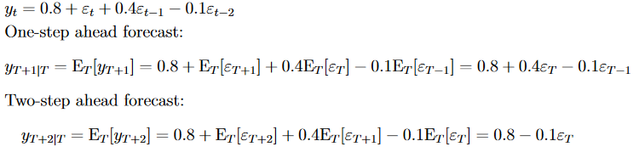
Forecasting MA(q)
Forecasting can be done only up to q lags
If forecast horizont h > q, forecast yields only constant (if no constant -> 0)
Error terms of the future can not be forecasted & past values are known

Slide 16
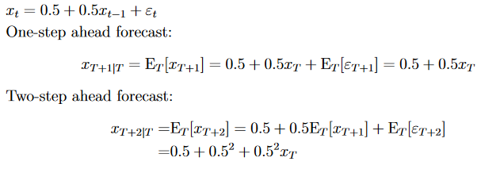
Forecasting AR(p)
Forecasting can be done to infinity
Example: AR(1) with intercept
Intercept has effect more than once

Slide 17

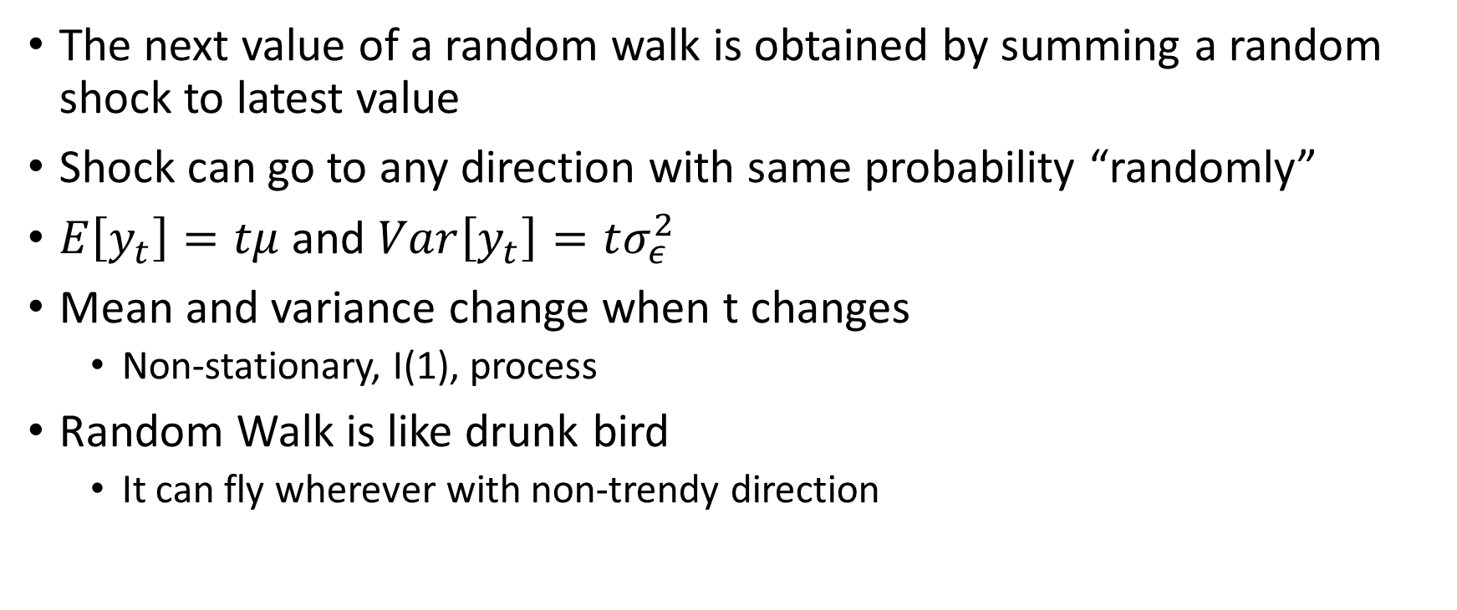
Random Walk
The next value of a random walk is obtained by summing a random shock to latest value
Shock can go to any direction with same probability “randomly”
$E\left[y_{t}\right]=tμ$ and $Var\left[y_{t}\right]=tσ_{ε}^{2}$
Mean and variance change when t changes
Non-stationary, I(1), process
Random Walk is like drunk bird
It can fly wherever with non-trendy direction

Slide 18

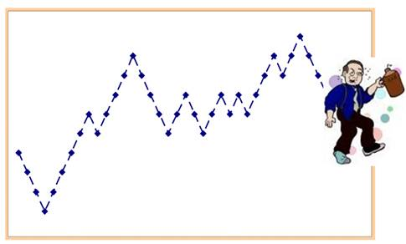
Random Walk with Drift
Random walk exhibits trending behaviour
Constant term is included -> makes the drift as seen from equation
Random walk with a drift is like drunk student heading back to home: it has clear direction where to go but every step is random

Slide 19

I(0) and I(1) Processes
I(0) means stationary process
I(1) is a process that becomes I(0) after differencing once
Differencing means changing data points to changes
Helps to stabilize time series
Many economic data is not stationary, but differencing ones make them stationary (GDP, inflation, production etc.)
I(1) processes is like random walk with drift, but I(0) is stationary
Effect of an error/shock to I(0) is temporary, but in I(1) infinite
Stationary data is easier to handle -> this is why differencing is done
$$∆X_{t}= X_{t}− X_{t−1}$$

Slide 20
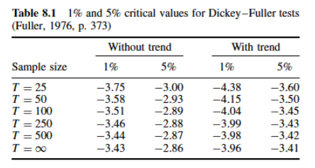
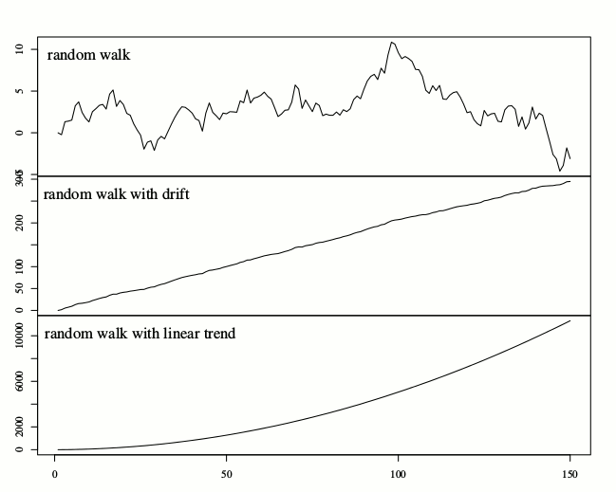
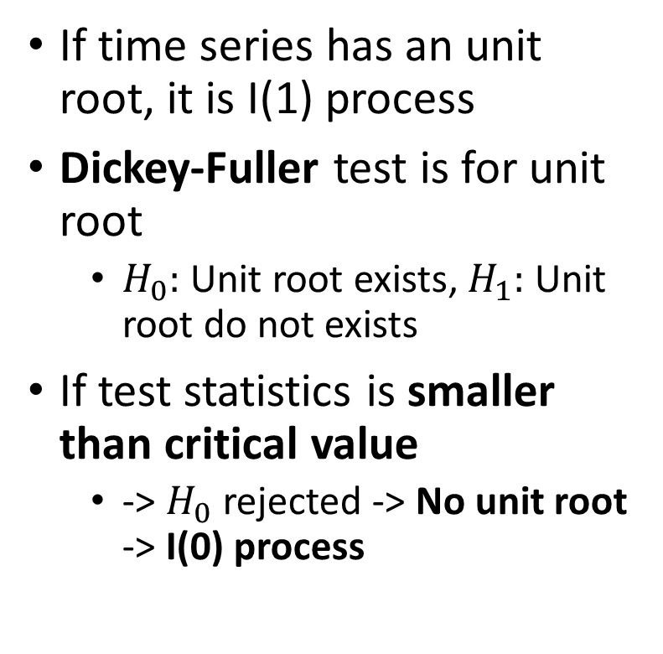
Testing for an Unit Root
If time series has an unit root, it is I(1) process
Dickey-Fuller test is for unit root
$H_{0}:$ Unit root exists, $H_{1}:$ Unit root do not exists
If test statistics is smaller than critical value
-> $H_{0}$ rejected -> No unit root -> I(0) process
No growth
Linear growth
Exponential growth

Slide 21
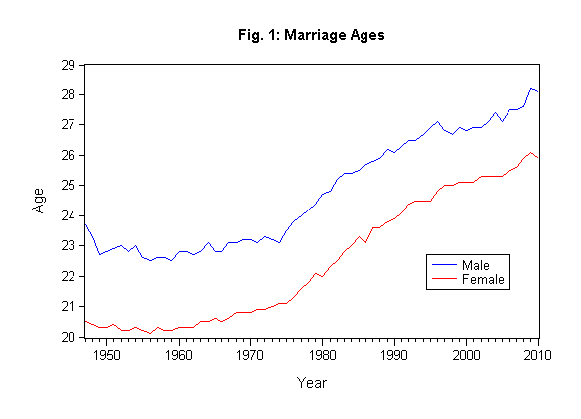
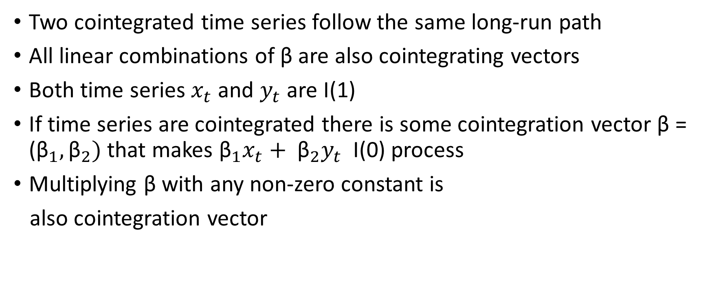
Cointegration
Two cointegrated time series follow the same long-run path
All linear combinations of β are also cointegrating vectors
Both time series $x_{t}$ and $y_{t}$ are I(1)
If time series are cointegrated there is some cointegration vector β = (${\text{β}}_{1},{\text{β}}_{2})$ that makes ${{\text{β}}_{1}x}_{t}+ {{\text{β}}_{2}y}_{t}$ I(0) process
Multiplying β with any non-zero constant is
also cointegration vector

Slide 22
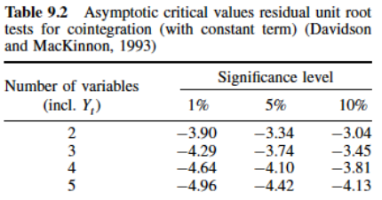
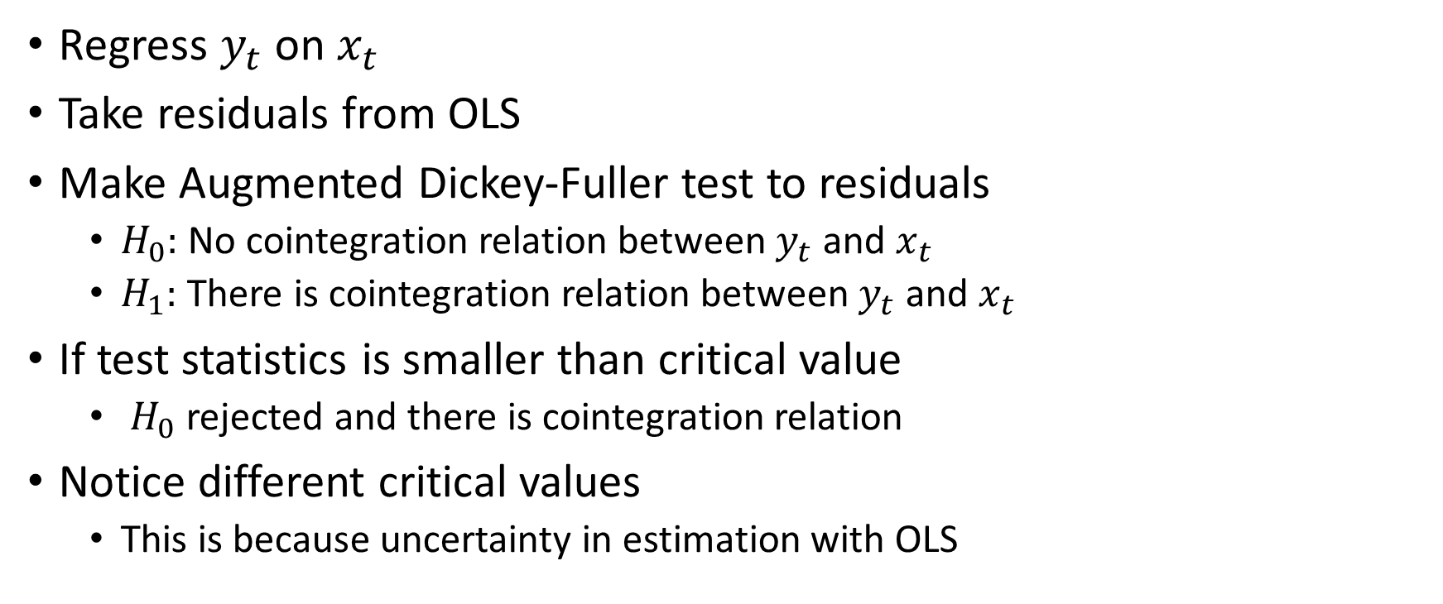
Testing for Cointegration
Regress $y_{t}$ on $x_{t}$
Take residuals from OLS
Make Augmented Dickey-Fuller test to residuals
$H_{0}:$ No cointegration relation between $y_{t}$ and $x_{t}$
$H_{1}:$ There is cointegration relation between $y_{t}$ and $x_{t}$
If test statistics is smaller than critical value
$H_{0}$ rejected and there is cointegration relation
Notice different critical values
This is because uncertainty in estimation with OLS

Slide 23


Vector Autoregression VAR
Same as AR but multivariate case
Weakly stationary if roots of the following equation greater than unity in absolute value
Diagnostic checks etc. can be done the same way as in univariate AR case

Slide 24
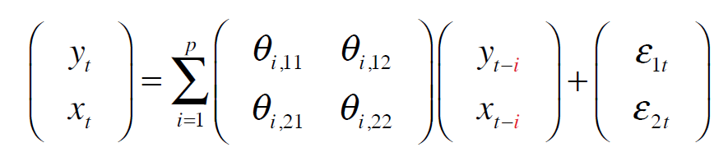
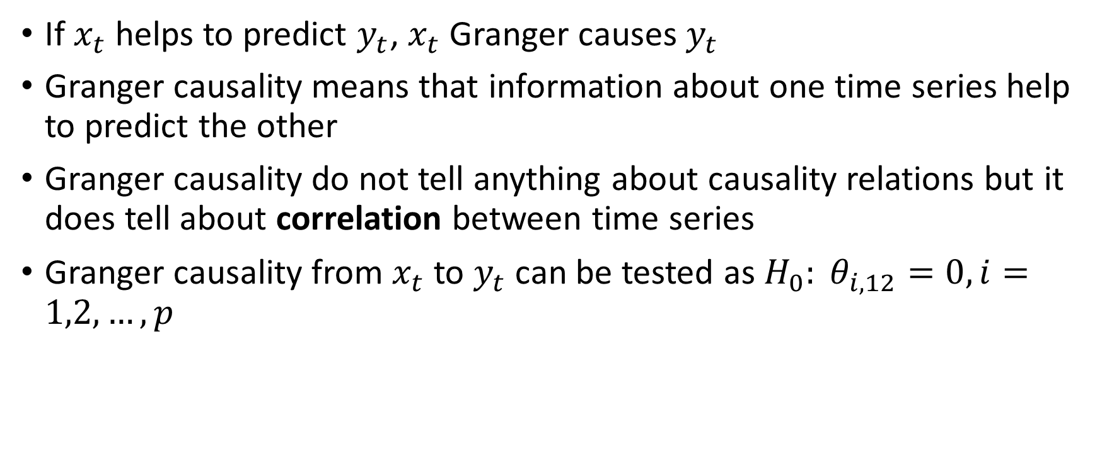
Granger Causality
If $x_{t}$ helps to predict $y_{t}$, $x_{t}$ Granger causes $y_{t}$
Granger causality means that information about one time series help to predict the other
Granger causality do not tell anything about causality relations but it does tell about correlation between time series
Granger causality from $x_{t}$ to $y_{t}$ can be tested as $H_{0}: θ_{i, 12}=0, i=1,2,…,p$

Slide 25


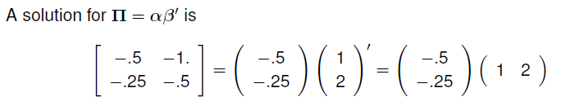
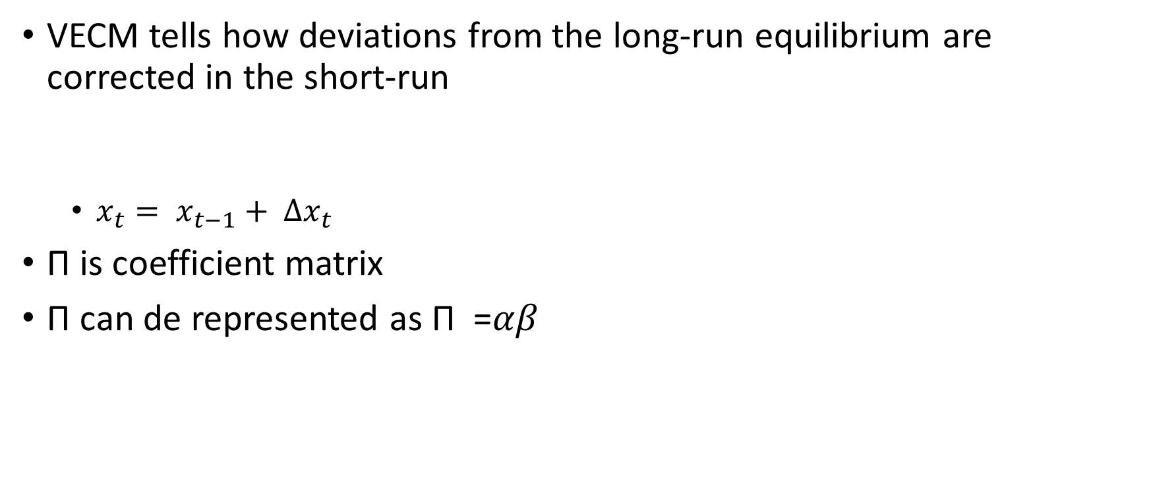
Vector Error Correction Model VECM
VECM tells how deviations from the long-run equilibrium are corrected in the short-run
$x_{t}= x_{t−1}+ ∆x_{t}$
Π is coefficient matrix
Π can de represented as Π =$αβ$

Slide 26
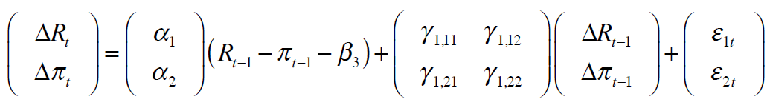
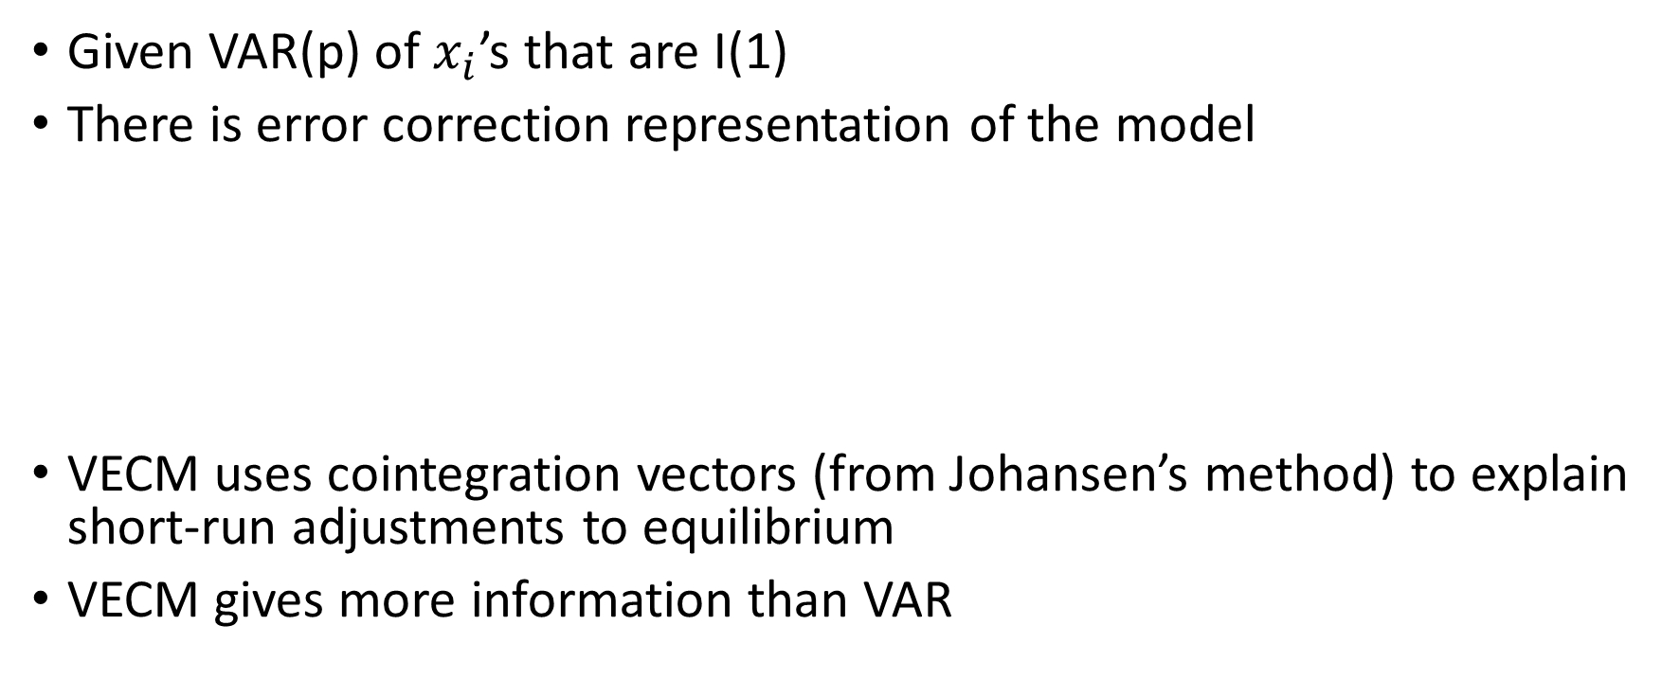
Vector Error Correction Model VECM
Given VAR(p) of $x_{i}$’s that are I(1)
There is error correction representation of the model
VECM uses cointegration vectors (from Johansen’s method) to explain short-run adjustments to equilibrium
VECM gives more information than VAR
Adjustment vector
Error correction term

Slide 27
Vector Error Correction Model VECM
VECM enables you to use non-stationary data (but cointegrated) for intepretation. This helps retain the relevant information in the data (which would otherwise get missed if data would be differenced)

Slide 28
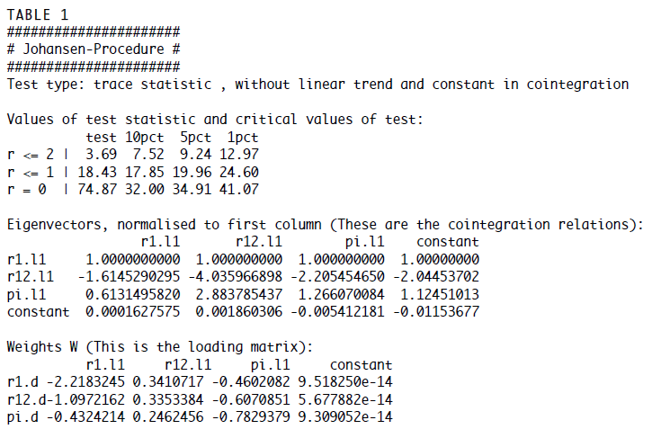



Estimation and testing of cointegration
Determine cointegration rank $r$ with Johansen’s trace test
When test value is greater than critical value -> reject $H_{0}$of no cointegration and move forward. Start from r=0 and go until test value is smaller than critical value
$$β$$
$$α$$

Slide 29

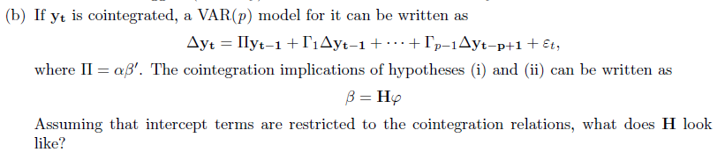

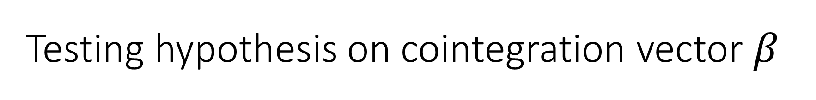




Testing hypothesis on cointegration vector $β$
Hypothesis can be expressed as:
Suppose we have
H can be interpret as:
$$r_{12t}− r_{1t}$$
$r_{12t}−$ $π_{t}$
Intercept
$$r_{1t}$$
-1 | 0 | 0
1 | 1 | 0
0 | -1 | 0
0 | 0 | 1
$$r_{12t}$$
$$π_{t}$$
Intercept

Slide 30
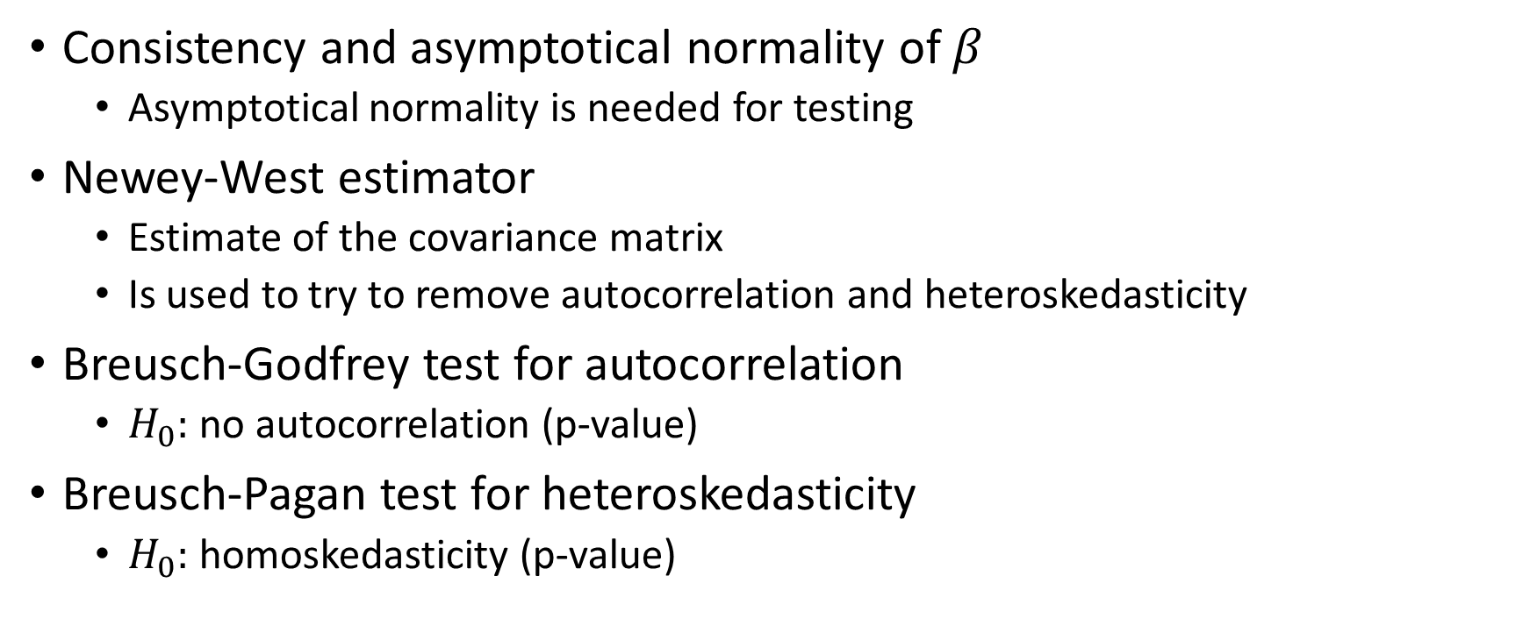
OLS with Time Series
Consistency and asymptotical normality of $β$
Asymptotical normality is needed for testing
Newey-West estimator
Estimate of the covariance matrix
Is used to try to remove autocorrelation and heteroskedasticity
Breusch-Godfrey test for autocorrelation
$H_{0}:$no autocorrelation (p-value)
Breusch-Pagan test for heteroskedasticity
$H_{0}:$homoskedasticity (p-value)

Slide 31
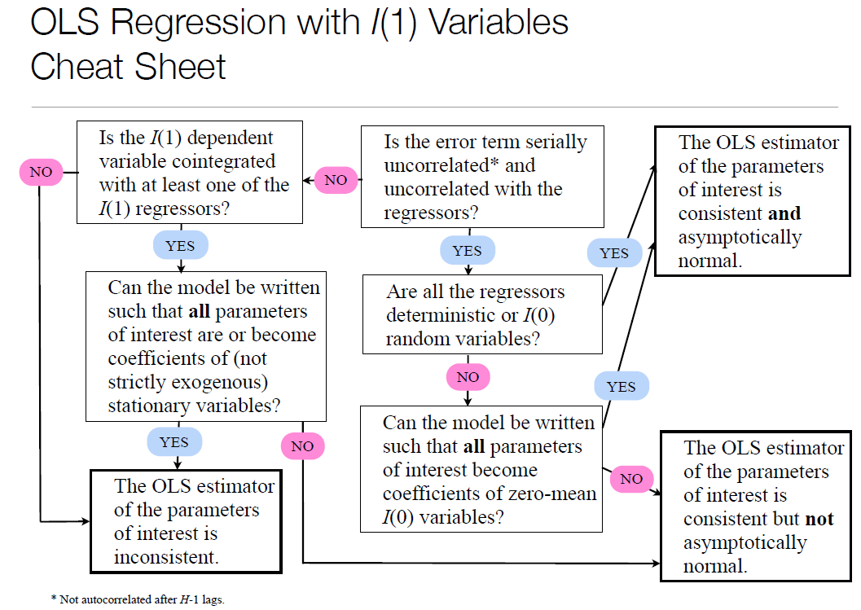

$β$

Slide 32
Test | What we are testing? | Null hypothesis | Alternative hypothesis | Critical values
Sequential testing | last lag p of time series has influence to model | No influence | Has influence | p-values
Ljung-Box test | Autocorrelation of residuals | No autocorrelation | Autocorrelation exists | p-values
Mc Leod Li test | Heteroskedasticity of residuals | Homoskedasticity | Heteroskedasticity | p-values
Dickey-Fuller | Unit roots | Unit root exists | No unit root | H0 rejected, if test result < critical value
Augmented Dickey-Fuller | Cointegration of time series | No cointegration | Cointegration exists | H0 rejected, if test result < critical value
Johansen Procedure | Cointegration rank | No cointegration at rank r | Cointegration at rank r | Start from r=0 and stop when test statistic < critical value

