Slide 1

Copyright Protection of Digital Image
2006. 1. 11.
Sung-Ho Bae
baesh@tit.ac.kr
Tongmyong University of
information technology

Slide 2
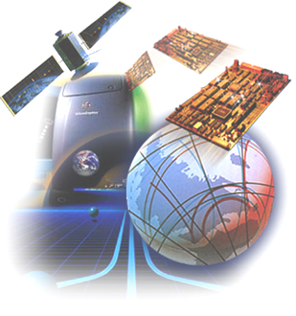
Contents
Introduction
Generic Watermarking Scheme and Purpose
Watermarking Requirements
Watermarking Properties and Techniques
Attacks of Watermarked Image
Application Field of Watermarking
Image Watermarking Techniques
Summary

Slide 3
Introduction(1)
Digital technologies present new threats for Intellectual properties and contents :
  Easy access to information
  Modification/falsification facilities
  Redistribution facilities
  Perfect copies
Methods that prevent unauthorized access to copyrighted digital contents are required in wide ranges of applications

Slide 4


Introduction(2)
Three methods for copyright protection
  Cryptography
    Transform digital contents into unperceivable format
    Encryption/Decryption
  Watermarking
    Hide the copyright control information into digital content by modification the content itself
Embedding
Extracting
Extracted
Watermark
Original Image

Slide 5
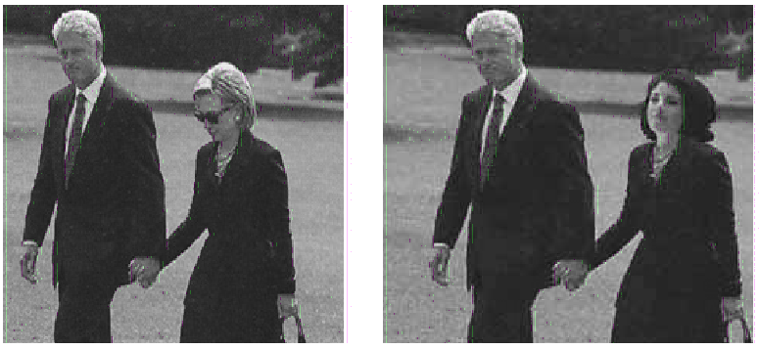
Introduction(3)
  Authentication
    Watermark is used to detect modification applied to cover work

Slide 6
Introduction(4)
Steganography vs. Watermarking
  Steganography
    Covert point-to-point communication between two parties
    Interpreted to means of information hiding in other information
    Example : sending a message to a spy by marking certain letters in a newspapers using invisible ink
  Watermarking
    Has the additional requirement of robustness against possible attacks

Slide 7
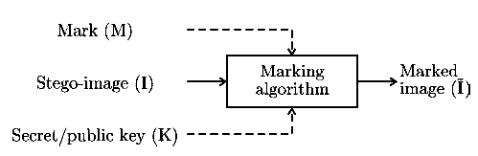
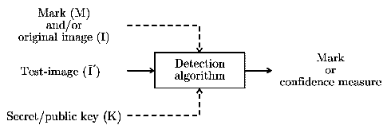
Generic Watermarking Scheme
Generic watermark embedding scheme
Generic watermark recovery scheme

Slide 8
Watermarking History
Watermarks are used to keep track of paper provenance and thus format and quality identification in the art of handmade papermaking nearly 700 years ago
  1993
    First use of the term “Watermark”
    Tirkel et al.,“Electronic watermark”, DICTA 1993
  1993-1994
    First papers on digital watermarking
  1995
    First special session on image watermarking at NSIP’95, Neos Marmaras, Greece.
  1995
    One of the first image watermarking algorithms
    “Patchwork algorithm”, Kaskalis, Pitas, Bender et al

Slide 9
Purpose of Watermarking
Copyright Protection
    Copyright owner wants to check for illegal copies of her works
Fingerprinting
    Hidden serial numbers. It enable the intellectual property owner to identify which customer broke his license agreement.
Copy Control
    Copyright owner wants to control the terms of use of her work
      Example : DVD protection(Copy once, Copy many, No copy)
Broadcast Monitoring
    Monitor when and whether content is transmitted over broadcast channels, such as TV or radio(Verify advertising broadcasts, Verify royalty payments, Catching instances of piracy)
Data Authentication
    Watermark is used to detect modification applied to cover work
      Example : Checking for fraud passport photographs

Slide 10
Watermarking Requirements(1)
Perceptual transparency
  Watermarked content has the same subjective quality as the original contents
Robustness
  Nobody is able to remove, alter, or damage the watermark without a secret key
Security
  Secret key determines the value of watermark and the locations where the watermark is embedded
Payload of the watermark
  Amount of information to be embedded
Capacity
  Multiple watermark can be embedded/extracted

Slide 11
Watermarking Requirements(2)
Invisibility/robustness and cost are conflicting requirements
Invisibility limits the
energy of watermark
Robustness increase when
watermark energy increases
Invisibility and robustness
require costly processes
Cost rapidly increases
with processes complexity

Slide 12
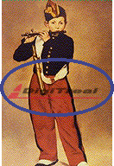
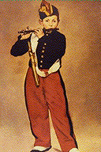
Types of Watermarks
Perceptibility
  Visible/audible
  Invisible/inaudible
Robustness
  fragile
  semi-fragile
  robust
Necessary Data for Extraction
  blind
  Informed
Inserting Watermark Type
  noise
  image
Inserted media
  text
  audio
  video
Processing Method
  spatial
  spectral

Slide 13
Digital Watermarking Properties
Properties related to the embedding process
  Embedding Effectiveness
  Fidelity
  Data Payload
Properties related to the detection process
  Blind/Informed Detection
  False Positive Rate
  Robustness
Properties related to the embedding and detection
  Security
  Cost

Slide 14
Digital Watermarking techniques
Text-based Watermarking
    Line shift coding, word shift coding, feature coding
Image Watermarking
    Watermark design(meaningful watermark)
    Watermark embedding(time domain, transformed domain)
    Watermark detection(blind, informed)
Audio Watermarking
Video Watermarking
3D Watermarking

Slide 15
Image Watermarking techniques
Spatial-domain techniques
Transform-domain techniques
  DCT-based
  DFT-based
  Wavelet-based
  Other transforms
Compressed stream-domain techniques
  Watermarking MPEG bit streams

Slide 16
Levels of Robustness
Spatial-domain watermarks
  Watermark embedded in lower order bit planes
  Transparent mark
  Visually pleasing, not robust to compression
Transform-domain watermarks
  Watermark added to frequency coefficients
  Watermark location and strength based on perceptual rules
Watermark insertion based on utilizing formal HVS model in order to provide the strongest watermark while guaranteeing transparency

Slide 17
Attacks of Watermarked Image
Unintentional Attacks
  A/D, D/A conversion, resampling
  Cropping
  Compression
  Geometric distortions(Synchronization)
  Additive noise
Intentional Attacks
  IBM attack
  Collusion
Software for Attacks
  Checkmark
  StirMark
  AIIAmark

Slide 18
Removal attacks
Remove the watermark from host image or decrease its relative energy
  Mean/median/Gaussian filtering, Wiener-Lee filtering
  Averaging N instances of the same image, bearing different watermarks
  Lossy compression (JPEG, JPEG2000)
  Sharpening, Contrast enhancement (histogram equalization)
  Gamma correction, Color quantization/subsampling
  Additive/multiplicative noise : Gaussian, uniform, or salt-pepper
  Multiple watermarking

Slide 19
De-synchronization attacks
The watermark is still there, but cannot be detected : loss of synchronization
  Global geometric transforms
    Translation, rotation, mirroring, scaling, shearing, cropping
  Local geometric transforms
    Random bending : local shifting, rotation, scaling
  Stirmark attack
    Slight global stretching, shifting, shearing, and rotation
  Mosaic attack
    Cutting the image into pieces
  Template removal attack
    Estimate and remove the synchronization template, apply a geometric transform

Slide 20
Protocol attacks
Attacks that try to render the watermarking concept unreliable
  Copy attack : estimate the watermark from one image and embed it to other image
  IBM attack : Creation of a fake original by adding a watermark in watermarked image. The attacker can claim that he has both the original and watermarked image .

Slide 21
Application Field of Watermarking(1)
Application field in technological side
  Copyright and contents protection
  Authentication and integrity verification
  Digital contents tracking
  Security(e.g. passport photos)
  Metadata tagging(annotation)
  Usage control
  Secret communication
  And many more

Slide 22
Application Fields of Watermarking(2)
Application field by target contents
Internet
Newspaper
Internet
Magazine
Internet
TV
VOD
AOD
Internet
Radio
Education
Material
Image
Video
Audio
Document
e-Book
Watermarking
Technology
Text
Graphics
Certificates

Slide 23
Companies
Digimarc
  Image watermark
Bluespike
  Giovanni still image watermark
ARIS
  Audio watermark
MediaSec
Signafy
Signum
Intertrust
  DRM
IBM
HP
NEC
MarkAny
Digital-Innotech
SealTronic Technology
DigiTreal Technology

Slide 24
Related Sites
Watermarking and data hiding
  http://www-nt.e-technik.uni-erlangen.de/~hartung/watermarkinglinks.html
WatermarkingWorld
  http://www.watermarkingworld.org/
Digital Copyright Protection & Digital Watermarking Technology
  http://www-sal.cs.uiuc.edu/~l-qiao/watermarking.html
Imprimatur
  http://www.imprimatur.net
Digimarc’s extractor
  http://www.digimarc.com
KAIST’s KAIMark
  http://www.digital-innotech.com
MarkAny’s MAIM
  http://www.markany.com

Slide 25
Image Watermarking
Spatial-domain watermarking
Transform-domain watermarking
Perceptual-based watermarking
Object-based watermarking
Robust to JPEG compression
Robust to geometric distortions

Slide 26
Spatial-domain Watermarking
Van Schyndel et al(1994)
  Alter least significant bits
Caronni(1995)
  Low-level geometric patterns
Pitas(1996)
  Add small luminance value to random set of pixels
Maes and Overveld(1998)
  Watermark embedded in geometric feature

Slide 27
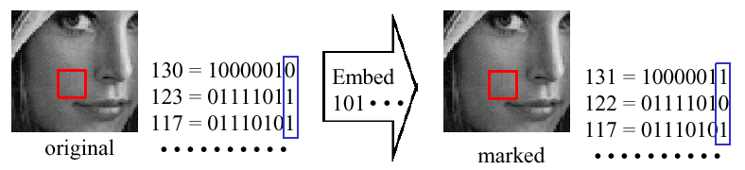
Least Significant Bit Modulation
Imperceptible: modify only LSBs
Secure
Not Robust: radom change of LSBs

Slide 28
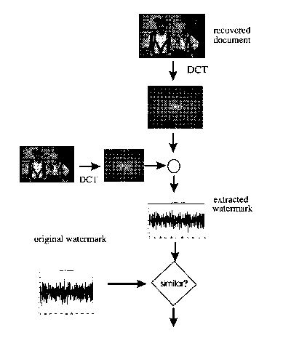
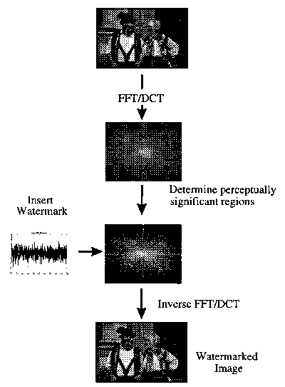
Transform-domain Watermarking(1)
Stages of watermark insert and extract

Slide 29
Transform-domain Watermarking(2)
Description of watermarking procedure
  Let D is document and V=(v₁, v₂, … ,v_{n}) is a sequence of values extracted from D
  Let X=(x₁, x₂, …,x_{n}) is watermark to be inserted
  Let D’ be a watermarked data and D* be attacked data
Insertion of the watermark X into D
  Insert X into V to obtain V’ as
    v’_{i} = v_{i} + ax_{i}
    v’_{i} = v_{i}(1+ax_{i})
    v’_{i} = v_{i}(e^{ax}_{i})
Choosing the length n

Slide 30
Transform-domain Watermarking(3)
Extract the watermark and evaluating the similarity
  Extract the X* from the V* in D*
  The measure of similarity
    sim(X, X*) = (X X*)/sqrt(XX*)
    Decision by considering the sim(X, X*) > Threshold
    The detection threshold based on the goal of minimizing false negatives and minimizing false positives

Slide 31
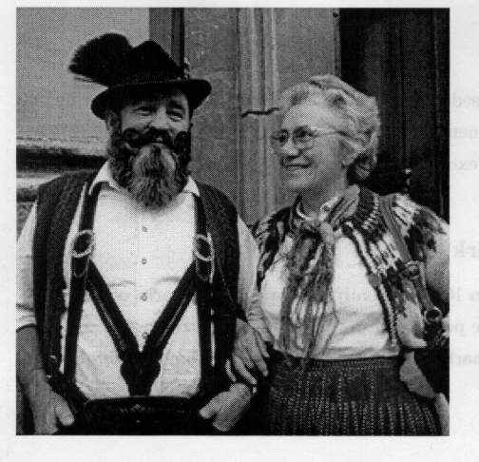
Transform Domain Watermarking(4)
Simulation
  Test image : Bavarian couple
  Modifying 1000 of the more perceptually significant components of the image spectrum in DCT domain
  Used equation : v_{i}’ = v_{i}(1+ax_{i}), a = 0.1

Slide 32

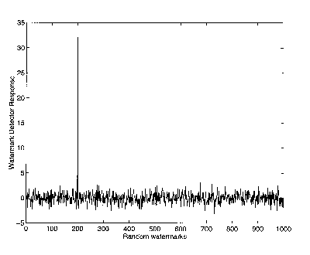
Transform Domain Watermarking(5)
Uniqueness
  Watermarked image and watermark detector response
  Detector response : 32.0

Slide 33
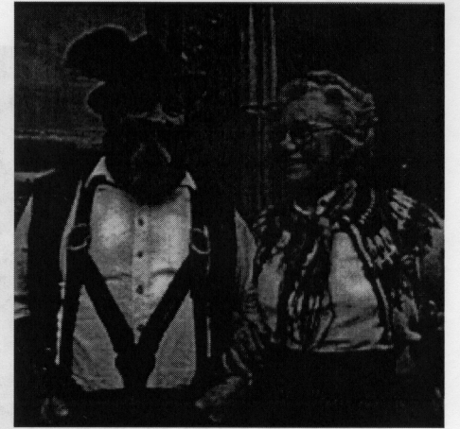
Transform Domain Watermarking(6)
Print, xerox, and scan
  detector response : 7.0

Slide 34
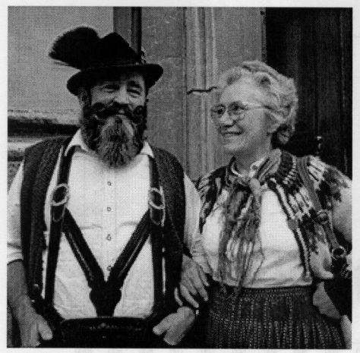
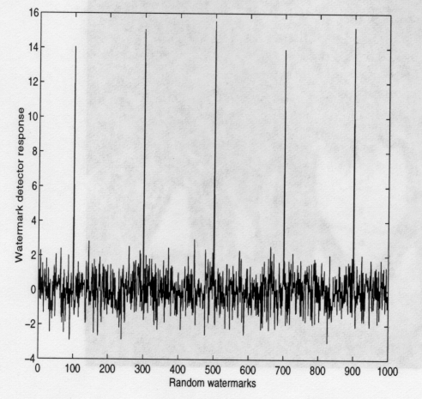
Transform Domain Watermarking(7)
Attack by collusion

Slide 35
Summary
Open problems
  Is digital watermarking the solution for copyright protection?
  ➔Since no watermarking algorithm resists all the attacks
  Is there a better way to solve the problem of intellectual property protection of digital contents?
  ➔Nothing
➔But many research areas related to watermarking must be studied

