Slide 1

Your Presentation Content
Your Expert Connect designer is ready to get started.

Slide 2
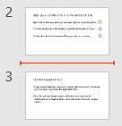
Add your content to this document
Right-click in between slides in left column to see Paste Options for adding slides.
Choose Keep Source Formatting if you like the format you have.
Otherwise choose Destination Theme to add your content. Your designer will use your style choices to guide the design.

Slide 3
Include Comments
If you have details about specific content, feel free to add comments and questions directly to the slides.
Your PowerPoint design expert will include any requests for clarification on individual slides when the deck is returned for your review.

Slide 4
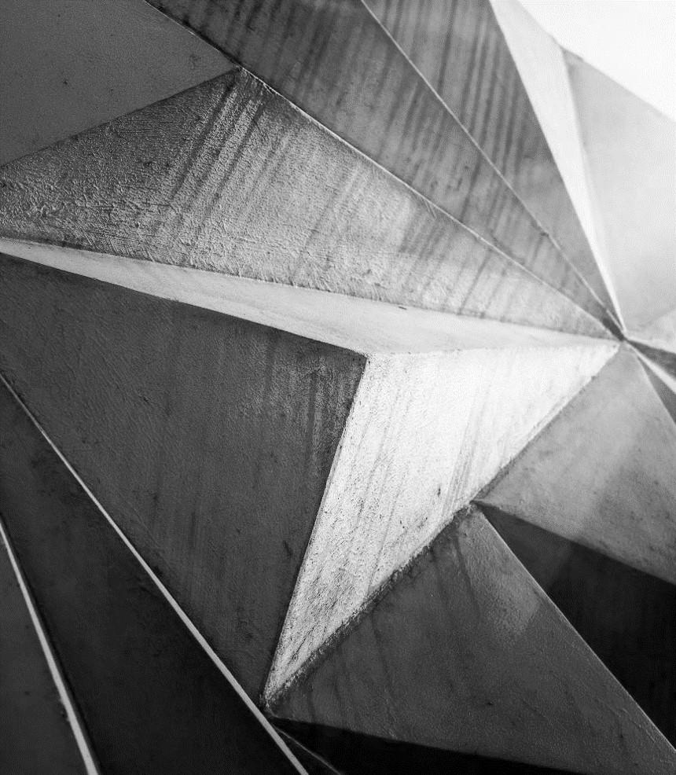
Got graphic assets?
Paste any photos, logos, or other graphic assets you want to include to on the applicable slides.
The designer will also source existing graphics from within PowerPoint or from Creative Commons sources.
Designers will not create original illustrations or artwork as part of this service.

Slide 5

Stay Tuned
You will hear back from your designer shortly with any questions and see an updated version of your content soon for review.

