Slide 1
Tree(Chapter 1)

Slide 2
Tree as data structure:
A tree is also one of the data structures that represent hierarchical data.
Suppose we want to show the employees and their positions in the hierarchical form.

Slide 3
Key Points of Tree data structure
A tree data structure is defined as a collection of objects or entities known as nodes that are linked together to represent or simulate hierarchy.
A tree data structure is a non-linear data structure because it does not store in a sequential manner. It is a hierarchical structure as elements in a Tree are arranged in multiple levels.

Slide 4
In the Tree data structure, the topmost node is known as a root node. Each node contains some data, and data can be of any type.
Each node contains some data and the link or reference of other nodes that can be called children.

Slide 5
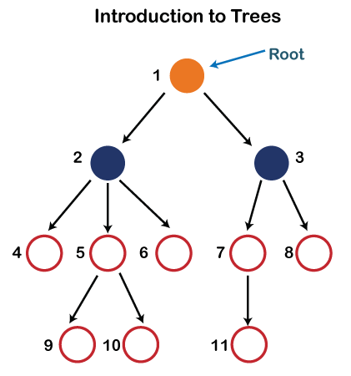

Slide 6
Root: The root node is the topmost node in the tree hierarchy. In other words, the root node is the one that doesn't have any parent. In the above structure, node numbered 1 is the root node of the tree. If a node is directly linked to some other node, it would be called a parent-child relationship.
Child node: If the node is a descendant of any node, then the node is known as a child node.
Parent: If the node contains any sub-node, then that node is said to be the parent of that sub-node.

Slide 7
Sibling: The nodes that have the same parent are known as siblings.
Leaf Node:- The node of the tree, which doesn't have any child node, is called a leaf node. A leaf node is the bottom-most node of the tree. There can be any number of leaf nodes present in a general tree. Leaf nodes can also be called external nodes.
Internal nodes: A node has atleast one child node known as an internal

Slide 8
Ancestor node:- An ancestor of a node is any predecessor node on a path from the root to that node. The root node doesn't have any ancestors. In the tree shown in the above image, nodes 1, 2, and 5 are the ancestors of node 10.
Descendant: The immediate successor of the given node is known as a descendant of a node. In the above figure, 10 is the descendant of node 5.

Slide 9
Properties of Tree data structure
Recursive data structure: The tree is also known as a recursive data structure.
A tree can be defined as recursively because the distinguished node in a tree data structure is known as a root node.
The root node of the tree contains a link to all the roots of its subtrees. The left subtree is shown in the yellow color in the below figure, and the right subtree is shown in the red color.

Slide 10
The left subtree can be further split into subtrees shown in three different colors.
Recursion means reducing something in a self-similar manner. So, this recursive property of the tree data structure is implemented in various applications.

Slide 11
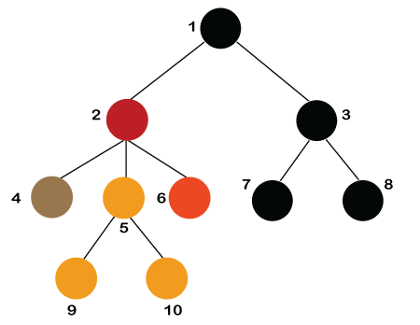

Slide 12
Number of edges: If there are n nodes, then there would n-1 edges. Each arrow in the structure represents the link or path.
Each node, except the root node, will have atleast one incoming link known as an edge. There would be one link for the parent-child relationship.

Slide 13
Height
In a tree data structure, the number of edges from the leaf node to the particular node in the longest path is known as the height of that node.
In the tree, the height of the root node is called "Height of Tree".
The tree height of all leaf nodes is 0.
Height of node x: The height of node x can be defined as the longest path from the node x to the leaf node.

Slide 14
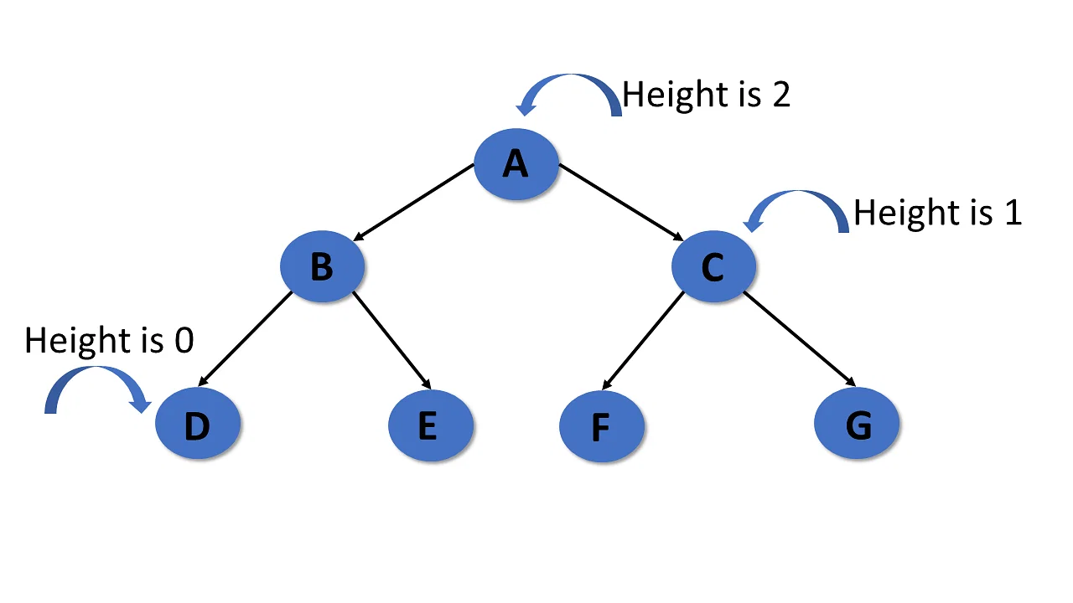

Slide 15
One edge contributes one-unit length in the path.
So, the depth of node x can also be defined as the number of edges between the root node and the node x. The root node has 0 depth.
In a tree, many edges from the root node to the particular node are called the depth of the tree.
In the tree, the total number of edges from the root node to the leaf node in the longest path is known as "Depth of Tree".
In the tree data structures, the depth of the root node is 0.

Slide 16
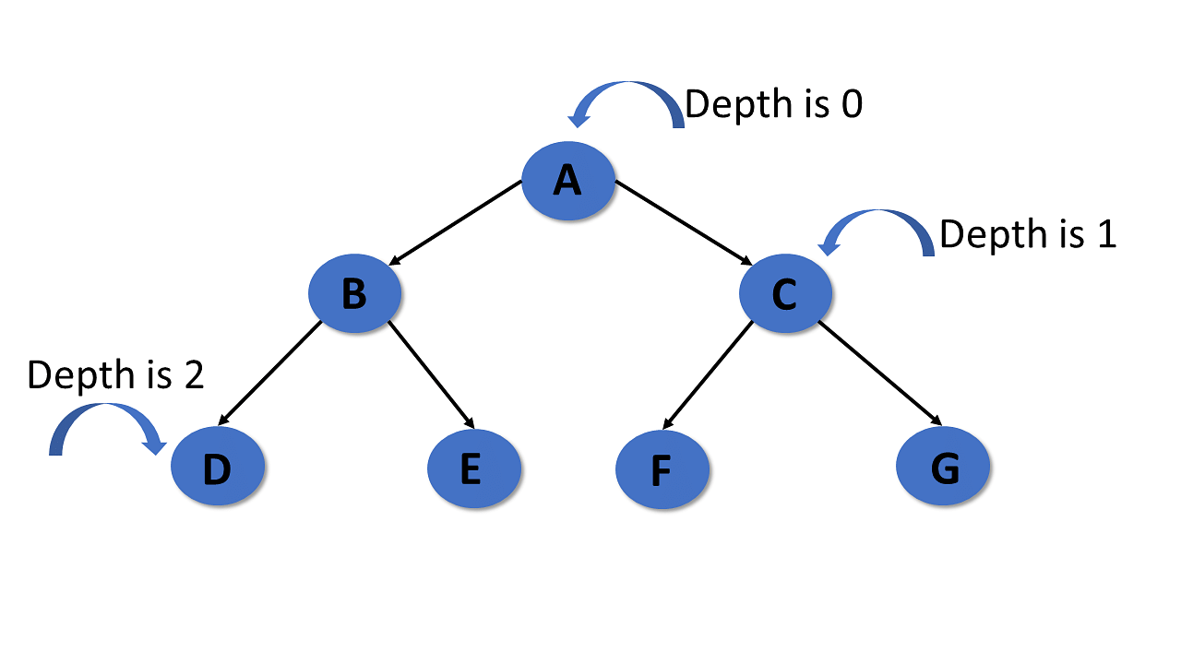

Slide 17
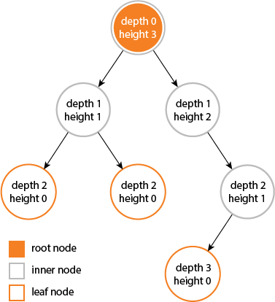

Slide 18
Implementation of Tree
The tree data structure can be created by creating the nodes dynamically with the help of the pointers. The tree in the memory can be represented as shown below:

Slide 19
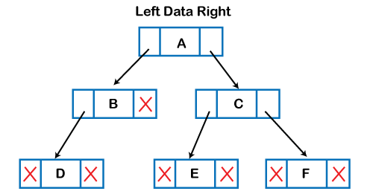

Slide 20
The above figure shows the representation of the tree data structure in the memory. In the above structure, the node contains three fields. The second field stores the data; the first field stores the address of the left child, and the third field stores the address of the right child.

Slide 21
Types of Tree data structure
General tree: The general tree is one of the types of tree data structure. In the general tree, a node can have either 0 or maximum n number of nodes.
There is no restriction imposed on the degree of the node (the number of nodes that a node can contain).
The topmost node in a general tree is known as a root node. The children of the parent node are known as subtrees.

Slide 22
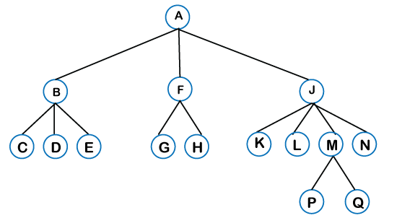

Slide 23
There can be n number of subtrees in a general tree.
In the general tree, the subtrees are unordered as the nodes in the subtree cannot be ordered. Every non-empty tree has a downward edge, and these edges are connected to the nodes known as child nodes.
The root node is labeled with level 0. The nodes that have the same parent are known as siblings.

Slide 24
Binary Tree
The Binary tree means that the node can have maximum two children. Here, binary name itself suggests that 'two'; therefore, each node can have either 0, 1 or 2 children.
The Binary tree means that the node can have maximum two children.
Here, binary name itself suggests that 'two'; therefore, each node can have either 0, 1 or 2 children.

Slide 25
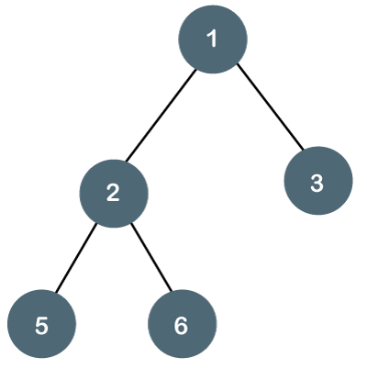

Slide 26
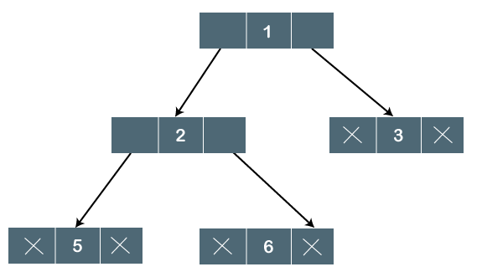

Slide 27
Properties of Binary Tree
At each level of i, the maximum number of nodes is 2^{i}.
The height of the tree is defined as the longest path from the root node to the leaf node.
The tree which is shown above has a height equal to 3. Therefore, the maximum number of nodes at height 3 is equal to (1+2+4+8) = 15. In general, the maximum number of nodes possible at height h is (2⁰ + 2¹ + 2²+….2^{h}) = 2^{h+1} -1.

Slide 28
The minimum number of nodes possible at height h is equal to h+1.
If the number of nodes is minimum, then the height of the tree would be maximum. Conversely, if the number of nodes is maximum, then the height of the tree would be minimum.

Slide 29
Depth and Height
The depth of a node M in the tree is the length of the path from the root to the node M.
The height of the tree is one more than the depth of the deepest node in the tree.

Slide 30
Types of Binary Tree
Types of Binary Tree based on the number of children:
Following are the types of Binary Tree based on the number of children:
Full Binary Tree
Degenerate Binary Tree
Skewed Binary Trees

Slide 31
1. Full Binary Tree
A Binary Tree is a full binary tree if every node has 0 or 2 children. The following are examples of a full binary tree. We can also say a full binary tree is a binary tree in which all nodes except leaf nodes have two children.
A full Binary tree is a special type of binary tree in which every parent node/internal node has either two or no children. It is also known as a proper binary tree.

Slide 32
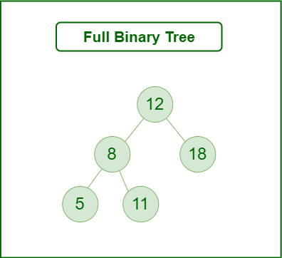

Slide 33
Degenerate (or pathological) tree
A Tree where every internal node has one child. Such trees are performance-wise same as linked list. A degenerate or pathological tree is a tree having a single child either left or right.

Slide 34
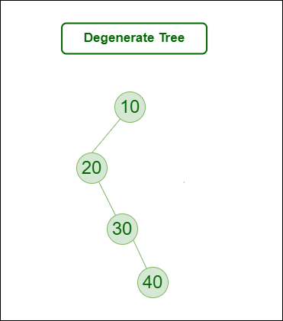

Slide 35
3. Skewed Binary Tree
A skewed binary tree is a pathological/degenerate tree in which the tree is either dominated by the left nodes or the right nodes.
Thus, there are two types of skewed binary tree: left-skewed binary tree and right-skewed binary tree.

Slide 36
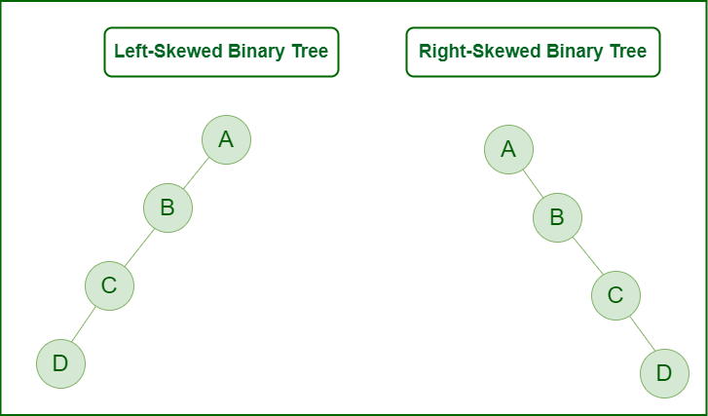

Slide 37
Types of Binary Tree On the basis of the completion of levels:
Complete Binary Tree
Perfect Binary Tree
Balanced Binary Tree

Slide 38
1. Complete Binary Tree
A binary tree is said to be a complete binary tree when all the levels are completely filled except the last level, which is filled from the left..
The complete binary tree is similar to the full binary tree except for the two differences which are given below:
The filling of the leaf node must start from the leftmost side.
It is not mandatory that the last leaf node must have the right sibling.

Slide 39
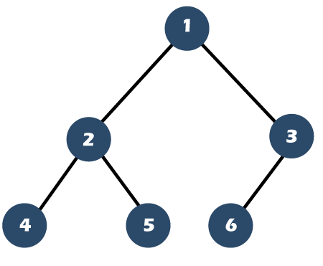

Slide 40
2. Perfect Binary Tree
A Binary tree is a Perfect Binary Tree in which all the internal nodes have two children and all leaf nodes are at the same level.
The following are examples of Perfect Binary Trees.
A perfect binary tree is a type of binary tree in which every internal node has exactly two child nodes and all the leaf nodes are at the same level.

Slide 41
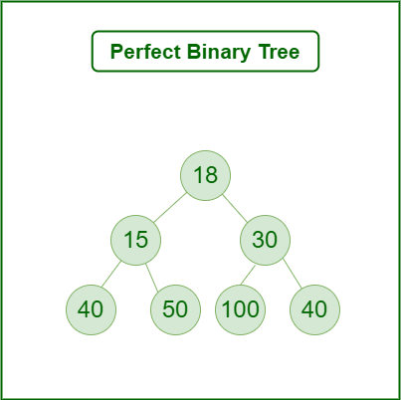

Slide 42
Balanced Binary Tree
A binary tree is balanced if the height of the tree is O(Log n) where n is the number of nodes.
For Example, the AVL tree maintains O(Log n) height by making sure that the difference between the heights of the left and right subtrees is at most 1.

Slide 43
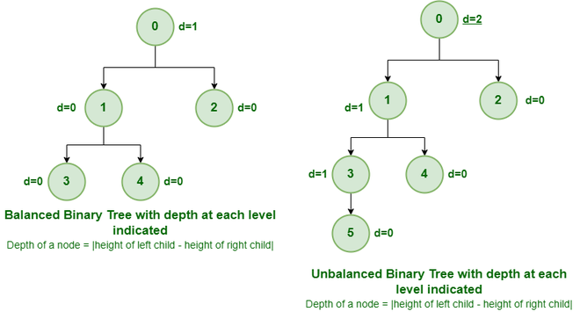

Slide 44
Binary tree:
A binary tree is a tree data structure composed of nodes, each of which has at most, two children, referred to as left and right nodes and the tree begins from root node.

Slide 45
Representation of Binary Tree:
Each node in the tree contains the following:
Data
Pointer to the left child
Pointer to the right child

Slide 46
Basic Operations On Binary Tree:
Inserting an element.
Removing an element.
Searching for an element.
Deletion for an element.
Traversing an element. There are four (mainly three) types of traversals in a binary tree which will be discussed ahead.

Slide 47
Binary Tree Traversals:
Tree Traversal algorithms can be classified broadly into two categories:
Depth-First Search (DFS) Algorithms
Breadth-First Search (BFS) Algorithms

Slide 48
Tree Traversal using Depth-First Search (DFS) algorithm can be further classified into three categories:
Preorder Traversal (current-left-right: Visit the current node before visiting any nodes inside the left or right subtrees. Here, the traversal is root – left child – right child. It means that the root node is traversed first then its left child and finally the right child.
Inorder Traversal (left-current-right): Visit the current node after visiting all nodes inside the left subtree but before visiting any node within the right subtree. Here, the traversal is left child – root – right child. It means that the left child is traversed first then its root node and finally the right child.

Slide 49
Postorder Traversal (left-right-current): Visit the current node after visiting all the nodes of the left and right subtrees. Here, the traversal is left child – right child – root. It means that the left child has traversed first then the right child and finally its root node.

Slide 50
Tree Traversal using Breadth-First Search (BFS) algorithm can be further classified into one category:
Level Order Traversal: Visit nodes level-by-level and left-to-right fashion at the same level. Here, the traversal is level-wise. It means that the most left child has traversed first and then the other children of the same level from left to right have traversed.

Slide 51
What is a Binary Search tree?
A binary search tree follows some order to arrange the elements. In a Binary search tree, the value of left node must be smaller than the parent node, and the value of right node must be greater than the parent node.
This rule is applied recursively to the left and right subtrees of the root.

Slide 52
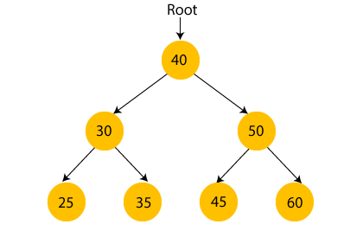

Slide 53
Example of creating a binary search tree
Suppose the data elements are - 45, 15, 79, 90, 10, 55, 12, 20, 50
First, we have to insert 45 into the tree as the root of the tree.
Then, read the next element; if it is smaller than the root node, insert it as the root of the left subtree, and move to the next element.
Otherwise, if the element is larger than the root node, then insert it as the root of the right subtree.

Slide 54

Step 1 - Insert 45. 50

Slide 55
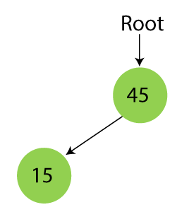
Step 2 - Insert 15. As 15 is smaller than 45, so insert it as the root node of the left subtree.

Slide 56
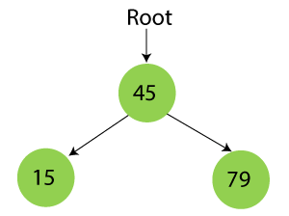
Step 3 - Insert 79. As 79 is greater than 45, so insert it as the root node of the right subtree.

Slide 57
Searching in Binary search tree
Searching means to find or locate a specific element or node in a data structure.
In Binary search tree, searching a node is easy because elements in BST are stored in a specific order.
The steps of searching a node in Binary Search tree are listed as follows -

Slide 58
First, compare the element to be searched with the root element of the tree.
If root is matched with the target element, then return the node's location.
If it is not matched, then check whether the item is less than the root element, if it is smaller than the root element, then move to the left subtree.
If it is larger than the root element, then move to the right subtree.
Repeat the above procedure recursively until the match is found.
If the element is not found or not present in the tree, then return NULL.

Slide 59
insert (element, root)
Node x = root
Node y = NULL
while x:
y = x
if x.value < element.value
x = x.right
else
x = x.left
if y.value < element
y.right = element
else
y.left = element

Slide 60
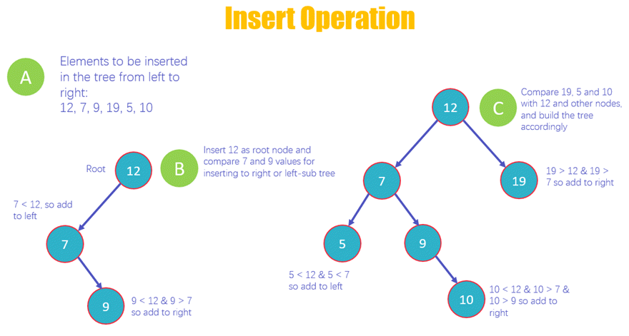

Slide 61
Delete Operations
For deleting a node from a BST, there are some cases, i.e. deleting a root or deleting a leaf node. Also, after deleting a root, we need to think about the root node.
Say we want to delete a leaf node, we can just delete it, but if we want to delete a root, we need to replace the root’s value with another node. Let’s take the following example:

Slide 62
Case 1- Node with zero children: this is the easiest situation, you just need to delete the node which has no further children on the right or left.

Slide 63
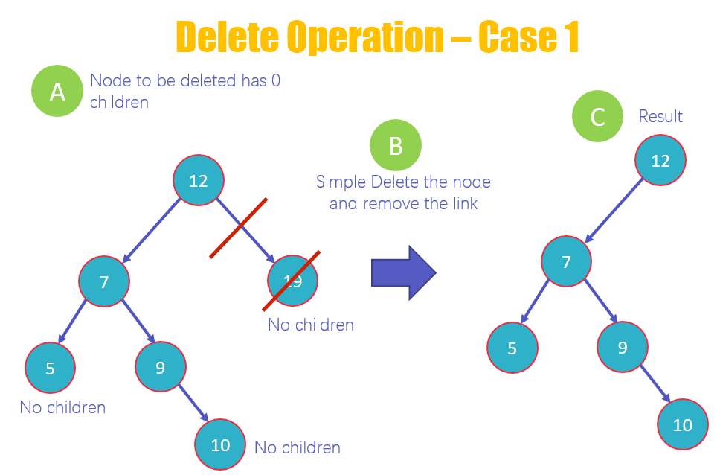

Slide 64
This is the first case of deletion in which you delete a node that has no children. As you can see in the diagram that 19, 10 and 5 have no children. But we will delete 19.
Delete the value 19 and remove the link from the node.
View the new structure of the BST without 19

Slide 65
Case 2
Case 2 – Node with one child: once you delete the node, simply connect its child node with the parent node of the deleted value.

Slide 66


Slide 67
This is the second case of deletion in which you delete a node that has 1 child, as you can see in the diagram that 9 has one child.
Delete the node 9 and replace it with its child 10 and add a link from 7 to 10
View the new structure of the BST without 9

Slide 68
Case 3 Node with two children: this is the most difficult situation, and it works on the following two rules
3a – In Order Predecessor: you need to delete the node with two children and replace it with the largest value on the left-subtree of the deleted node
3b – In Order Successor: you need to delete the node with two children and replace it with the largest value on the right-subtree of the deleted node

Slide 69
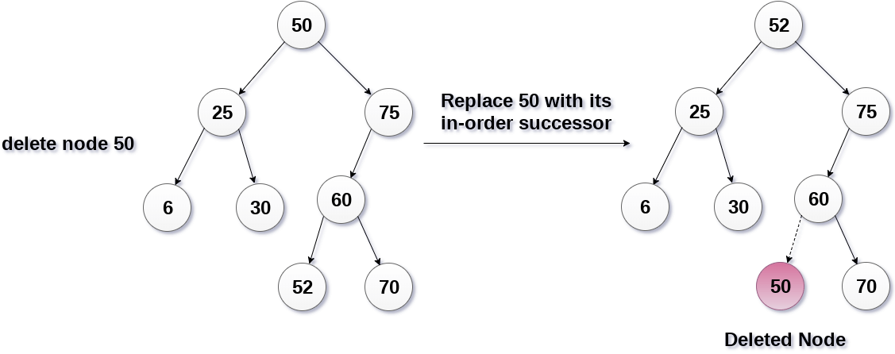

Slide 70
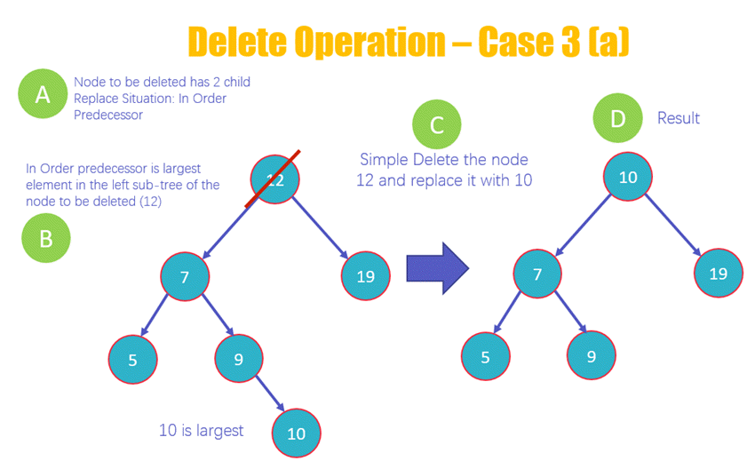

Slide 71
Here you will be deleting the node 12 that has two children
The deletion of the node will occur based upon the in order predecessor rule, which means that the largest element on the left subtree of 12 will replace it.
Delete the node 12 and replace it with 10 as it is the largest value on the left subtree
View the new structure of the BST after deleting 12

Slide 72
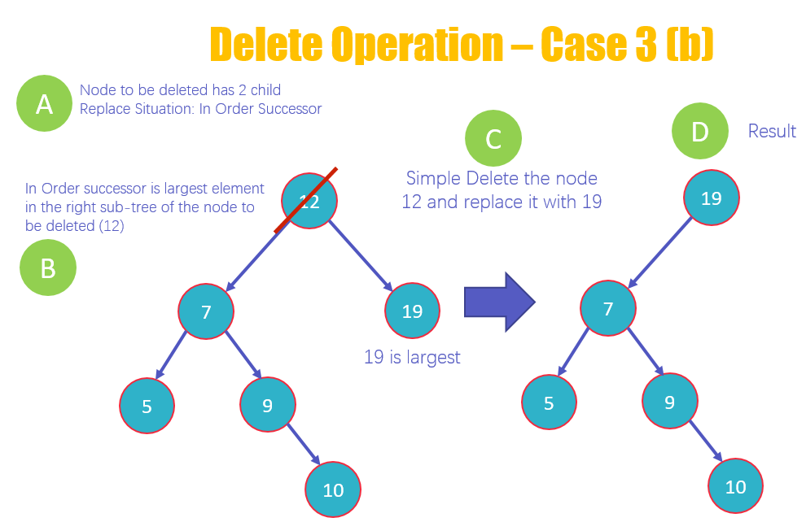

Slide 73
1 Delete a node 12 that has two children
2 The deletion of the node will occur based upon the In Order Successor rule, which means that the largest element on the right subtree of 12 will replace it
3 Delete the node 12 and replace it with 19 as it is the largest value on the right subtree
4 View the new structure of the BST after deleting 12

Slide 74
Search Operation
Always initiate analyzing tree at the root node and then move further to either the right or left subtree of the root node depending upon the element to be located is either less or greater than the root.

Slide 75
Algorithm to search an element in Binary search tree
Search (root, item)
Step 1 - if (item = root → data) or (root = NULL)
return root
else if (item < root → data)
return Search(root → left, item)
else
return Search(root → right, item)
END if
Step 2 - END

Slide 76
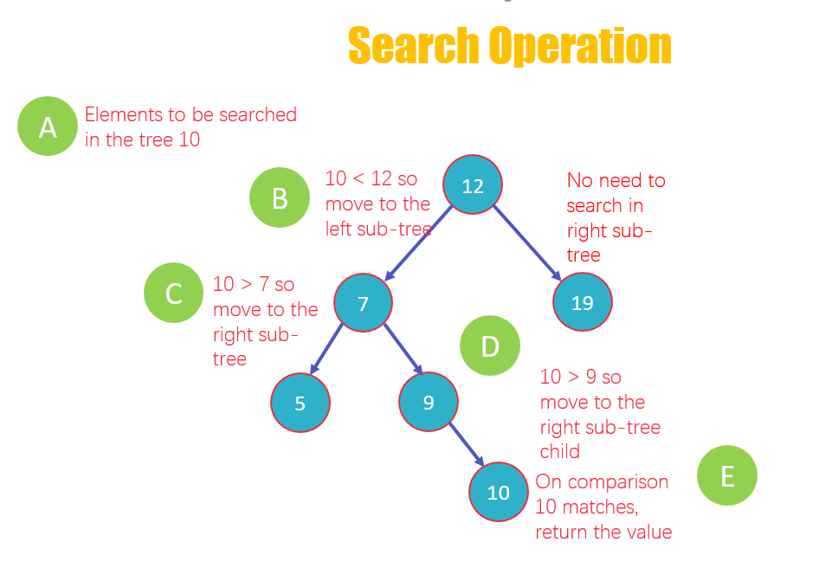

Slide 77
The element to be searched is 10
Compare the element with the root node 12, 10 < 12, hence you move to the left subtree. No need to analyze the right-subtree
Now compare 10 with node 7, 10 > 7, so move to the right-subtree
Then compare 10 with the next node, which is 9, 10 > 9, look in the right subtree child
10 matches with the value in the node, 10 = 10, return the value to the user.

Slide 78
search(element, root)
if !root
return -1
if root.value == element
return 1
if root.value < element
search(element, root.right)
else
search(element, root.left)

Slide 79
AVL Tree:
AVL tree is a self-balancing Binary Search Tree (BST) where the difference between heights of left and right subtrees cannot be more than one for all nodes.
AVL trees are binary search trees in which the difference between the height of the left and right subtree is either -1, 0, or +1.
AVL trees are also called a self-balancing binary search tree. These trees help to maintain the logarithmic search time. It is named after its inventors (AVL) Adelson, Velsky, and Landis.

Slide 80
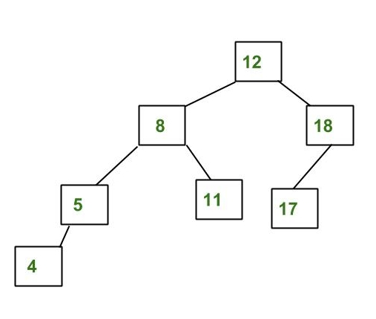

Slide 81
The above tree is AVL because the differences between the heights of left and right subtrees for every node are less than or equal to 1.

Slide 82
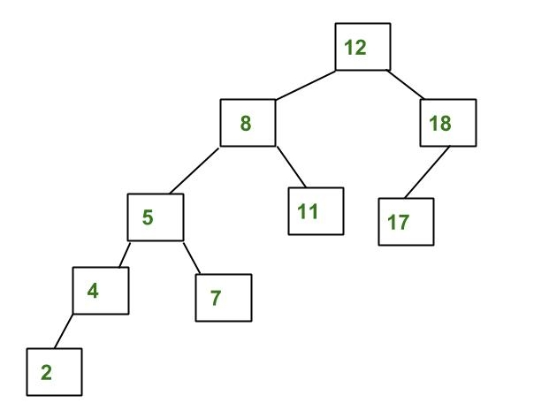

Slide 83
Balance Factor:
Balance factor =height of left sub-tree - height of right subtree
Balance factor=-1,0,1

Slide 84
Insertion
Insertion in AVL tree is performed in the same way as it is performed in a binary search tree.
The new node is added into AVL tree as the leaf node.
However, it may lead to violation in the AVL tree property and therefore the tree may need balancing.
The tree can be balanced by applying rotations.
Rotation is required only if, the balance factor of any node is disturbed upon inserting the new node, otherwise the rotation is not required.

Slide 85
SN | Rotation | Description
1 | LL Rotation | The new node is inserted to the left sub-tree of left sub-tree of critical node.
2 | RR Rotation | The new node is inserted to the right sub-tree of the right sub-tree of the critical node.
3 | LR Rotation | The new node is inserted to the right sub-tree of the left sub-tree of the critical node.
4 | RL Rotation | The new node is inserted to the left sub-tree of the right sub-tree of the critical node.

Slide 86
Why AVL Tree?
AVL tree controls the height of the binary search tree by not letting it to be skewed.
The time taken for all operations in a binary search tree of height h is O(h).
However, it can be extended to O(n) if the BST becomes skewed (i.e. worst case). By limiting this height to log n, AVL tree imposes an upper bound on each operation to be O(log n) where n is the number of nodes.

Slide 87
Algorithm to insert a newNode
A newNode is always inserted as a leaf node with balance factor equal to 0.
Let the initial tree be

Slide 88
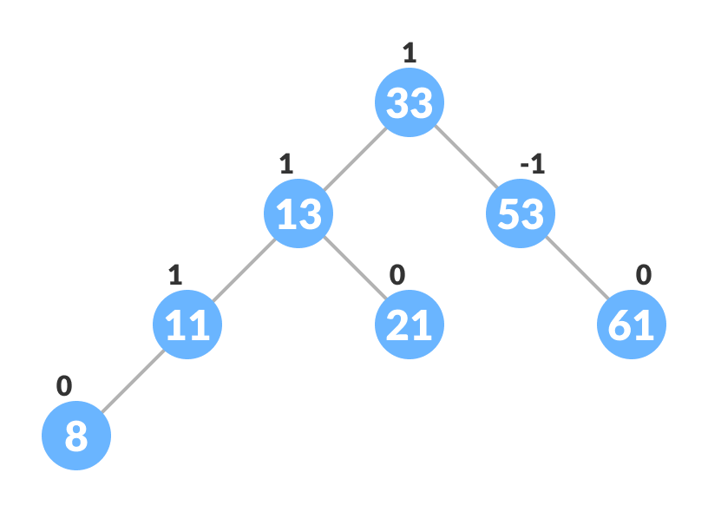

Slide 89
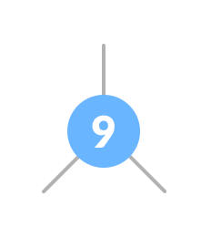
Let the node to be inserted be:

Slide 90
Go to the appropriate leaf node to insert a newNode using the following recursive steps. Compare newKey with rootKey of the current tree.
If newKey < rootKey, call insertion algorithm on the left subtree of the current node until the leaf node is reached.
Else if newKey > rootKey, call insertion algorithm on the right subtree of current node until the leaf node is reached.
Else, return leafNode

Slide 91
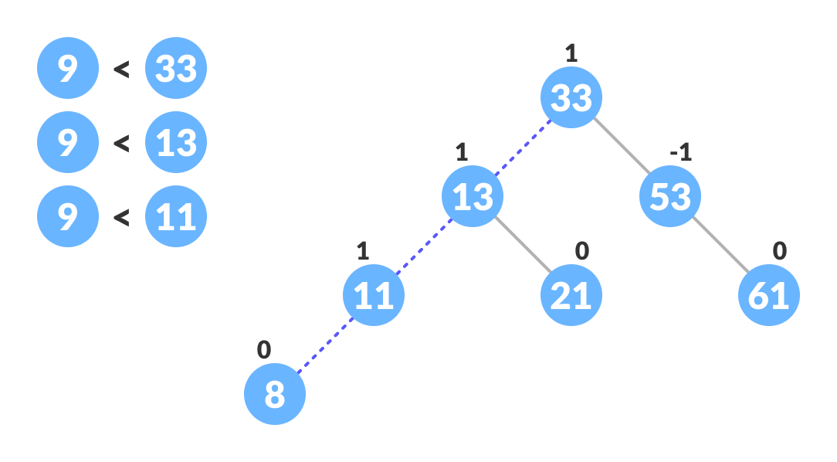

Slide 92
Compare leafKey obtained from the above steps with newKey:
If newKey < leafKey, make newNode as the leftChild of leafNode.
Else, make newNode as rightChild of leafNode.

Slide 93
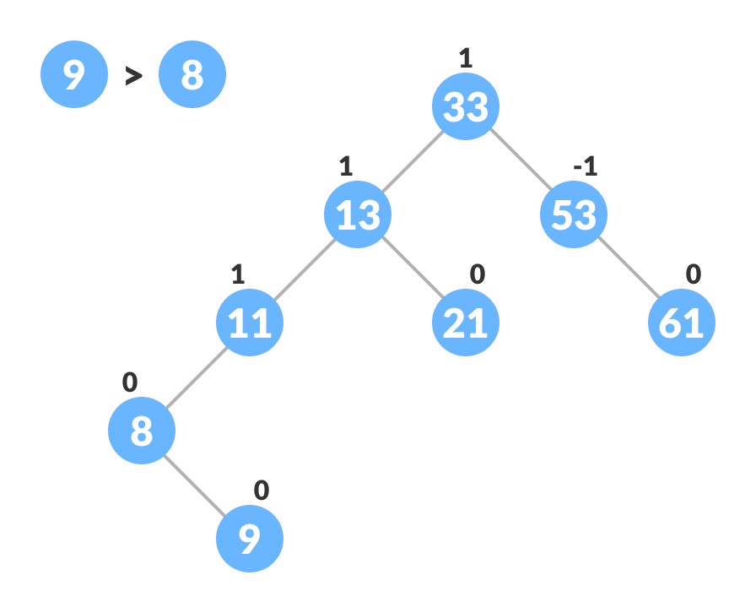

Slide 94
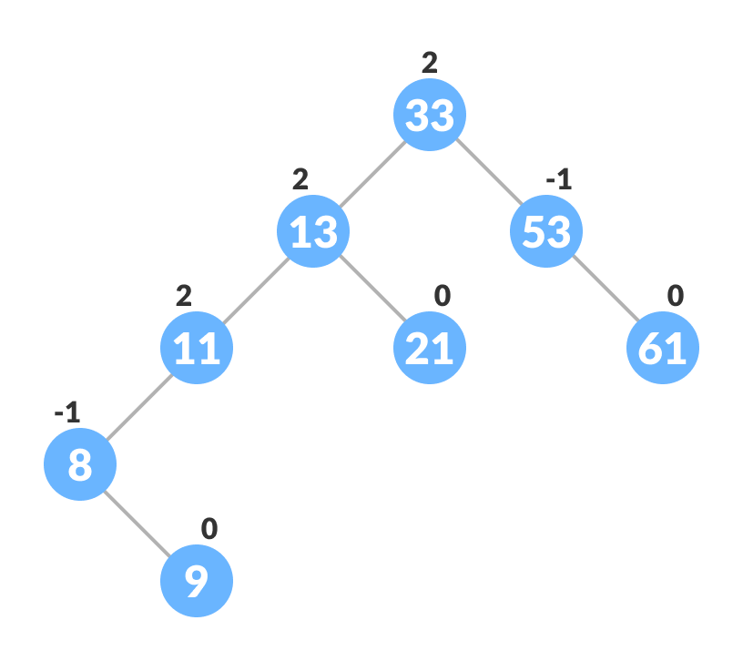
Update balanceFactor of the nodes

Slide 95
If the nodes are unbalanced, then rebalance the node.If balanceFactor > 1, it means the height of the left subtree is greater than that of the right subtree. So, do a right rotation or left-right rotation
If newNodeKey < leftChildKey do right rotation.
Else, do left-right rotation.

Slide 96
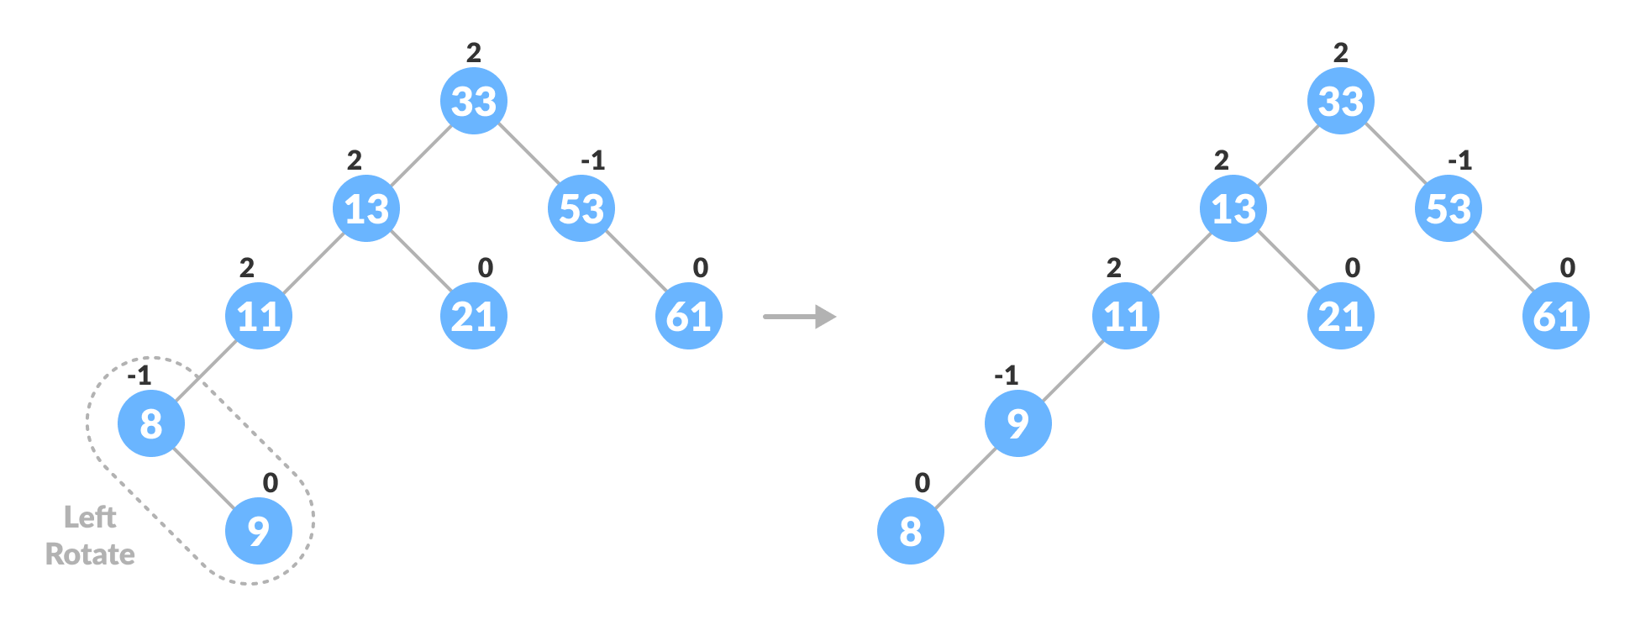

Slide 97
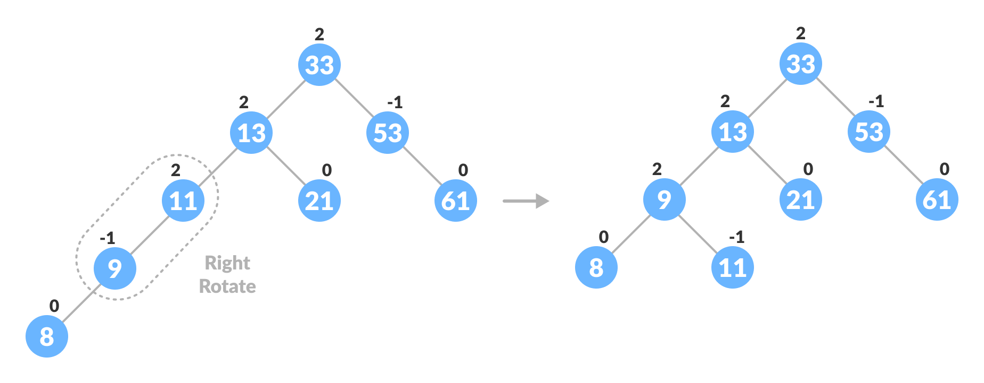

Slide 98
If balanceFactor < -1, it means the height of the right subtree is greater than that of the left subtree. So, do right rotation or right-left rotation
If newNodeKey > rightChildKey do left rotation.
Else, do right-left rotation

Slide 99
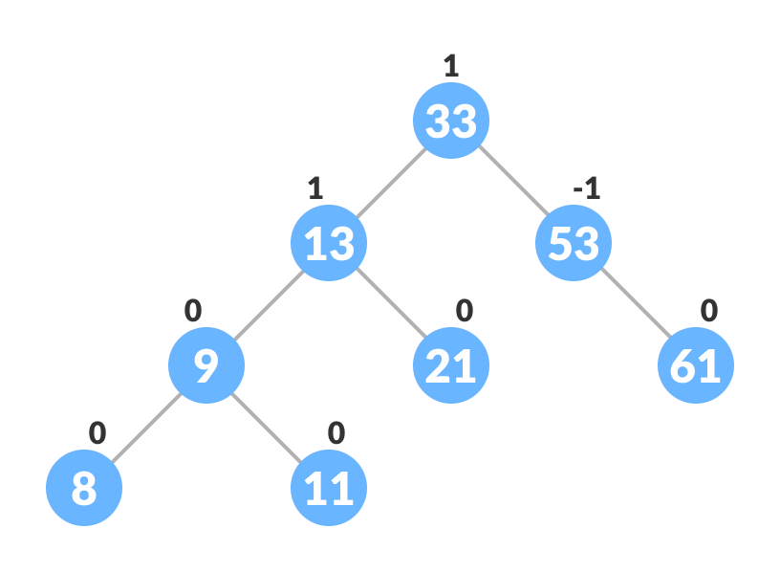

Slide 100
Q. Construct an AVL tree by inserting the following elements in the given order.
63, 9, 19, 27, 18, 108, 99, 81

Slide 101
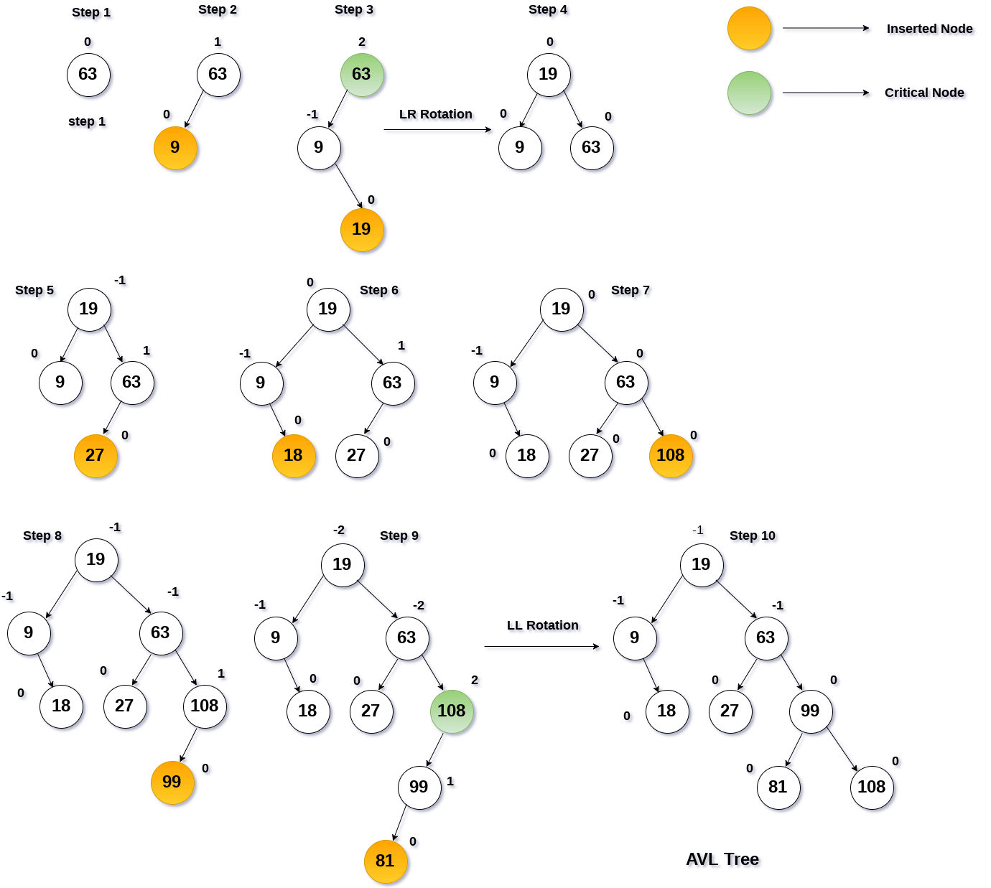

Slide 102
Deletion in AVL Trees
Deletion is also very straight forward. We delete using the same logic as in simple binary search trees.
After deletion, we restructure the tree, if needed, to maintain its balanced height.

Slide 103
Step 1: Find the element in the tree.
Step 2: Delete the node, as per the BST Deletion.
Step 3: Two cases are possible:-

Slide 104
Case 1: Deleting from the right subtree.
1A. If BF(node) = +2 and BF(node -> left-child) = +1, perform LL rotation.
1B. If BF(node) = +2 and BF(node -> left-child) = -1, perform LR rotation.
1C. If BF(node) = +2 and BF(node -> left-child) = 0, perform LL rotation.

Slide 105
Case 2: Deleting from left subtree.
2A. If BF(node) = -2 and BF(node -> right-child) = -1, perform RR rotation.
2B. If BF(node) = -2 and BF(node -> right-child) = +1, perform RL rotation.
2C. If BF(node) = -2 and BF(node -> right-child) = 0, perform RR rotation.

Slide 106
Red and Black Tree
A red-black tree is a kind of self-balancing binary search tree where each node has an extra bit, and that bit is often interpreted as the color (red or black).
These colors are used to ensure that the tree remains balanced during insertions and deletions.
Although the balance of the tree is not perfect, it is good enough to reduce the searching time and maintain it around O(log n) time, where n is the total number of elements in the tree.
This tree was invented in 1972 by Rudolf Bayer.

Slide 107
It must be noted that as each node requires only 1 bit of space to store the color information, these types of trees show identical memory footprints to the classic (uncolored) binary search tree.

Slide 108
Understanding BST problem
In a binary search tree, the searching, insertion and deletion take O(log2n) time in the average case, O(1) in the best case and O(n) in the worst case.

Slide 109
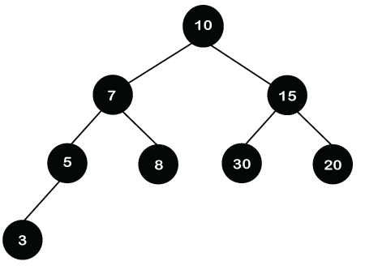

Slide 110
In the above tree, if we want to search the 80. We will first compare 80 with the root node.
80 is greater than the root node, i.e., 10, so searching will be performed on the right subtree.
Again, 80 is compared with 15; 80 is greater than 15, so we move to the right of the 15, i.e., 20.
Now, we reach the leaf node 20, and 20 is not equal to 80. Therefore, it will show that the element is not found in the tree.
After each operation, the search is divided into half. The above BST will take O(logn) time to search the element.

Slide 111
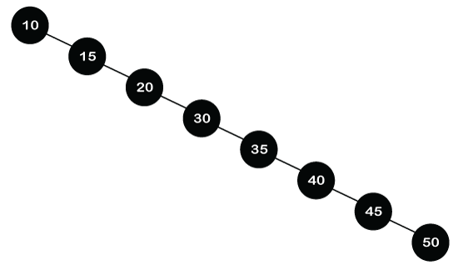

Slide 112
The above tree shows the right-skewed BST. If we want to search the 80 in the tree, we will compare 80 with all the nodes until we find the element or reach the leaf node.
So, the above right-skewed BST will take O(N) time to search the element.
In the above BST, the first one is the balanced BST, whereas the second one is the unbalanced BST.
We conclude from the above two binary search trees that a balanced tree takes less time than an unbalanced tree for performing any operation on the tree.

Slide 113
Therefore, we need a balanced tree, and the Red-Black tree is a self-balanced binary search tree. Now, the question arises that why do we require a Red-Black tree if AVL is also a height-balanced tree.
The Red-Black tree is used because the AVL tree requires many rotations when the tree is large, whereas the Red-Black tree requires a maximum of two rotations to balance the tree.
The main difference between the AVL tree and the Red-Black tree is that the AVL tree is strictly balanced, while the Red-Black tree is not completely height-balanced.
So, the AVL tree is more balanced than the Red-Black tree, but the Red-Black tree guarantees O(log2n) time for all operations like insertion, deletion, and searching.

Slide 114
Insertion is easier in the AVL tree as the AVL tree is strictly balanced, whereas deletion and searching are easier in the Red-Black tree as the Red-Black tree requires fewer rotations.
As the name suggests that the node is either colored in Red or Black color. Sometimes no rotation is required, and only recoloring is needed to balance the tree.
0

Slide 115
Rules That Every Red-Black Tree Follows:
Every node has a color either red or black.
The root of the tree is always black.
There are no two adjacent red nodes (A red node cannot have a red parent or red child).
Every path from a node (including root) to any of its descendants (immediate successor of a node)NULL nodes has the same number of black nodes.
All leaf nodes are black nodes.

Slide 116
Why Red-Black Trees?
Most of the BST operations (e.g., search, max, min, insert, delete.. etc) take O(h) time where h is the height of the BST.
The cost of these operations may become O(n) for a skewed Binary tree.
If we make sure that the height of the tree remains O(log n) after every insertion and deletion, then we can guarantee an upper bound of O(log n) for all these operations.
The height of a Red-Black tree is always O(log n) where n is the number of nodes in the tree.

Slide 117
Segment Tree
A segment tree is a data structure used to store information about array segments and answer segment queries efficiently. There are two main operations performed on a segment tree:
range(i, j): gives the sum of the array elements starting at index i and ending at index j.
update(i, val): updates the value at index i to the val in the original array and updates the segment tree accordingly.

Slide 118
Representation of Segment trees
Leaf Nodes are the elements of the input array.
Each internal node represents some merging of the leaf nodes. The merging may be different for different problems. For this problem, merging is sum of leaf nodes under a node.
An array representation of tree is used to represent Segment Trees. For each node at index i, the left child is at index (2*i+1), right child at (2*i+2) and the parent is at 0 to n.

Slide 119
