Slide 1
Chapter2:Stack and Queue

Slide 2
What is stack
A stack is a list of elements that are accessible only from one end of the list, which is called the top.
One common, real-world example of a stack is the stack of trays at a cafeteria.
Trays are always removed from the top, and when trays are put back on the stack after being washed, they are placed on the top of the stack.
The stack is known as a last-in, first-out (LIFO) data structure.

Slide 3
Because of the last-in, first-out nature of the stack, any element that is not currently at the top of the stack cannot be accessed.
To get to an element at the bottom of the stack, you have to dispose of all the elements above it first.

Slide 4
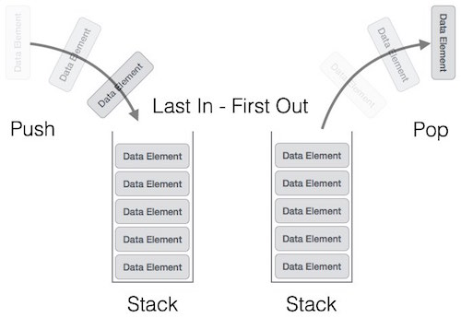

Slide 5
A stack can be implemented by means of Array, Structure, Pointer, and Linked List.
Stack can either be a fixed size one or it may have a sense of dynamic resizing.

Slide 6
Basic Operations
Stack operations may involve initializing the stack, using it and then de-initializing it. Apart from these basic stuffs, a stack is used for the following two primary operations −
push() − Pushing (storing) an element on the stack.
pop() − Removing (accessing) an element from the stack.

Slide 7
To use a stack efficiently, we need to check the status of stack as well. For the same purpose, the following functionality is added to stacks −
peek() − get the top data element of the stack, without removing it.
isFull() − check if stack is full.
isEmpty() − check if stack is empty.

Slide 8
Push Operation
Step 1 − Checks if the stack is full.
Step 2 − If the stack is full, produces an error and exit.
Step 3 − If the stack is not full, increments top to point next empty space.
Step 4 − Adds data element to the stack location, where top is pointing.
Step 5 − Returns success.

Slide 9
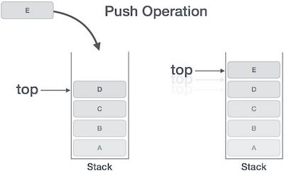

Slide 10
Implementation of stack
Initialise a node
Update the value of that node by data i.e. node->data = data
Now link this node to the top of the linked list
And update top pointer to the current node

Slide 11
Step 1: Initialise a node
// A linked list node
class Node
{
constructor()
{
this.data=0;
this.next=null;
}
}

Slide 12
Step two create a link list
// Create Stack Using Linked list
class StackUsingLinkedlist
{
constructor()
{
this.top=null;
}

Slide 13
push(value) {
const newNode = new Node(value);
if (!this.length) {
this.top = newNode;
} else {
newNode.next = this.top;
this.top = newNode;
}
this.length++;
return this;
}

Slide 14
Pop Operation
Accessing the content while removing it from the stack, is known as a Pop Operation.
In an array implementation of pop() operation, the data element is not actually removed, instead top is decremented to a lower position in the stack to point to the next value.
But in linked-list implementation, pop() actually removes data element and deallocates memory space.

Slide 15
A Pop operation may involve the following steps −
Step 1 − Checks if the stack is empty.
Step 2 − If the stack is empty, produces an error and exit.
Step 3 − If the stack is not empty, accesses the data element at which top is pointing.
Step 4 − Decreases the value of top by 1.
Step 5 − Returns success.

Slide 16
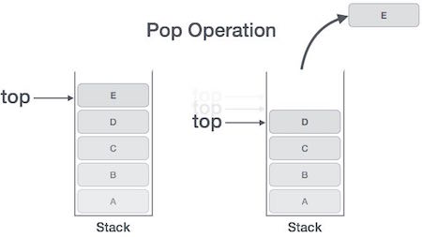

Slide 17
Pop Operation:
First Check whether there is any node present in the linked list or not, if not then return
Otherwise make pointer let say temp to the top node and move forward the top node by 1 step
Now free this temp node

Slide 18
peek()
The peek() is an operation retrieves the topmost element within the stack, without deleting it. This operation is used to check the status of the stack with the help of the top pointer.
Algorithm
1. START
2. return the element at the top of the stack
3. END

Slide 19
isFull()
isFull() operation checks whether the stack is full. This operation is used to check the status of the stack with the help of top pointer.
Algorithm
1. START
2. If the size of the stack is equal to the top position of the stack, the stack is full. Return 1.
3. Otherwise, return 0.
4. END

Slide 20
isEmpty()
The isEmpty() operation verifies whether the stack is empty. This operation is used to check the status of the stack with the help of top pointer.
Algorithm
1. START
2. If the top value is -1, the stack is empty. Return 1.
3. Otherwise, return 0.
4. END

Slide 21
Queue Data structure
Queue is an abstract data structure, somewhat similar to Stacks. Unlike stacks, a queue is open at both its ends.
One end is always used to insert data (enqueue) and the other is used to remove data (dequeue).
Queue follows First-In-First-Out methodology, i.e., the data item stored first will be accessed first.

Slide 22
A real-world example of queue can be a single-lane one-way road, where the vehicle enters first, exits first.
More real-world examples can be seen as queues at the ticket windows and bus-stops.

Slide 23


Slide 24
Queue Representation
As we now understand that in queue, we access both ends for different reasons. The following diagram given below tries to explain queue representation as data structure −

Slide 25
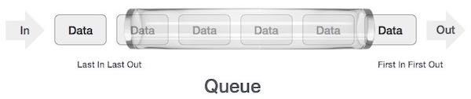

Slide 26
Basic Operations
Queue operations may involve initializing or defining the queue, utilizing it, and then completely erasing it from the memory. Here we shall try to understand the basic operations associated with queues −
enqueue() − add (store) an item to the queue.
dequeue() − remove (access) an item from the queue.

Slide 27
peek() − Gets the element at the front of the queue without removing it.
isfull() − Checks if the queue is full.
isempty() − Checks if the queue is empty.

Slide 28
Enqueue Operation
Queues maintain two data pointers, front and rear. Therefore, its operations are comparatively difficult to implement than that of stacks.
The following steps should be taken to enqueue (insert) data into a queue −
Step 1 − Check if the queue is full.
Step 2 − If the queue is full, produce overflow error and exit.
Step 3 − If the queue is not full, increment rear pointer to point the next empty space.
Step 4 − Add data element to the queue location, where the rear is pointing.
Step 5 − return success.

Slide 29
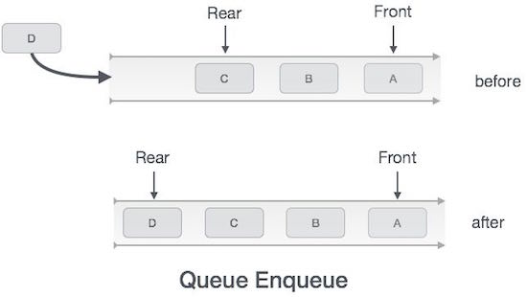

Slide 30
Algorithm for enqueue operation
procedure enqueue(data)
if queue is full
return overflow
endif
rear ← rear + 1
queue[rear] ← data
return true
end procedure

Slide 31
Dequeue Operation
Accessing data from the queue is a process of two tasks − access the data where front is pointing and remove the data after access. The following steps are taken to perform dequeue operation −
Step 1 − Check if the queue is empty.
Step 2 − If the queue is empty, produce underflow error and exit.
Step 3 − If the queue is not empty, access the data where front is pointing.
Step 4 − Increment front pointer to point to the next available data element.
Step 5 − Return success.

Slide 32
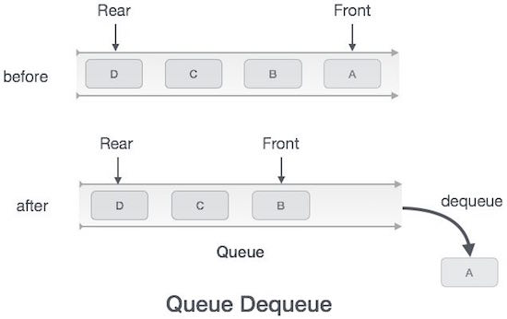

Slide 33
Algorithm for dequeue operation
procedure dequeue
if queue is empty
return underflow
end if
data = queue[front]
front ← front + 1
return true
end procedure

Slide 34
isfull()
As we are using single dimension array to implement queue, we just check for the rear pointer to reach at MAXSIZE to determine that the queue is full.
case we maintain the queue in a circular linked-list, the algorithm will differ.
Algorithm of isfull() function −

Slide 35
Algorithm
begin procedure isfull
if rear equals to MAXSIZE
return true
else
return false
endif
end procedure

Slide 36
isempty()
Algorithm of isempty() function −
Algorithm
begin procedure isempty
if front is less than MIN OR front is greater than rear
return true
else
return false
endif
end procedure

Slide 37
peek()
This function helps to see the data at the front of the queue. The algorithm of peek() function is as follows −
Algorithm
begin procedure peek
return queue[front]
end procedure

Slide 38
Circular Queue
There was one limitation in the array implementation of Queue.
If the rear reaches to the end position of the Queue then there might be possibility that some vacant spaces are left in the beginning which cannot be utilized.
So, to overcome such limitations, the concept of the circular queue was introduced.

Slide 39
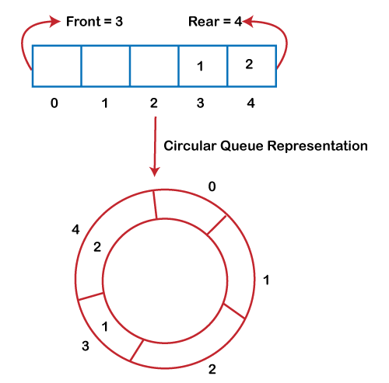

Slide 40
As we can see in the above image, the rear is at the last position of the Queue and front is pointing somewhere rather than the 0th position.
In the above array, there are only two elements and other three positions are empty.
The rear is at the last position of the Queue; if we try to insert the element then it will show that there are no empty spaces in the Queue.
There is one solution to avoid such wastage of memory space by shifting both the elements at the left and adjust the front and rear end accordingly.
It is not a practically good approach because shifting all the elements will consume lots of time.
The efficient approach to avoid the wastage of the memory is to use the circular queue data structure.

Slide 41
Operations on Circular Queue
Front(): It is used to get the front element from the Queue.
Rear(): It is used to get the rear element from the Queue.
enQueue(value): This function is used to insert the new value in the Queue. The new element is always inserted from the rear end.
deQueue(): This function deletes an element from the Queue. The deletion in a Queue always takes place from the front end.

Slide 42
Applications of Circular Queue
The circular Queue can be used in the following scenarios:
Memory management: The circular queue provides memory management. As we have already seen that in linear queue, the memory is not managed very efficiently. But in case of a circular queue, the memory is managed efficiently by placing the elements in a location which is unused.

Slide 43
CPU Scheduling: The operating system also uses the circular queue to insert the processes and then execute them.
Traffic system: In a computer-control traffic system, traffic light is one of the best examples of the circular queue. Each light of traffic light gets ON one by one after every jinterval of time. Like red light gets ON for one minute then yellow light for one minute and then green light. After green light, the red light gets ON.

Slide 44
Enqueue operation
The steps of enqueue operation are given below:
First, we will check whether the Queue is full or not.
Initially the front and rear are set to -1. When we insert the first element in a Queue, front and rear both are set to 0.
When we insert a new element, the rear gets incremented, i.e., rear=rear+1.

Slide 45
Scenarios for inserting an element
There are two scenarios in which queue is not full:
If rear != max - 1, then rear will be incremented to mod(maxsize) and the new value will be inserted at the rear end of the queue.
If front != 0 and rear = max - 1, it means that queue is not full, then set the value of rear to 0 and insert the new element there.
In a circular queue I have set max size=6-1=5
0- 1- 2- 3- 4- 5
G-> B->c->D->E-> F(R)

Slide 46
There are two cases in which the element cannot be inserted:
When front ==0 && rear = max-1, which means that front is at the first position of the Queue and rear is at the last position of the Queue.
front== rear + 1;

Slide 47
Algorithm to insert an element in a circular queue
Step 1: IF (REAR+1)%MAX = FRONT Write " OVERFLOW " Goto step 4 [End OF IF]

Slide 48
Step 2: IF FRONT = -1 and REAR = -1 SET FRONT = REAR = 0 ELSE IF REAR = MAX - 1 and FRONT ! = 0 SET REAR = 0 ELSE SET REAR = (REAR + 1) % MAX [END OF IF]

Slide 49
Step 3: SET QUEUE[REAR] = VAL
Step 4: EXIT

Slide 50
Dequeue Operation
The steps of dequeue operation are given below:
First, we check whether the Queue is empty or not. If the queue is empty, we cannot perform the dequeue operation.
When the element is deleted, the value of front gets incremented by 1.
If there is only one element left which is to be deleted, then the front and rear are reset to -1.

Slide 51
Algorithm to delete an element from the circular queue
Step 1: IF FRONT = -1 Write " UNDERFLOW " Goto Step 4 [END of IF]

Slide 52
Step 3: IF FRONT = REAR SET FRONT = REAR = -1 ELSE IF FRONT = MAX -1 SET FRONT = 0 ELSE SET FRONT = FRONT + 1 [END of IF] [END OF IF]
Step 4: EXIT
5

Slide 53
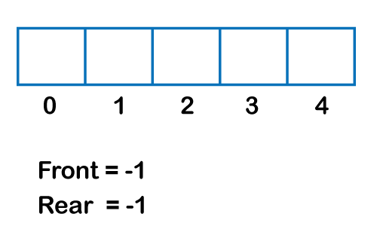
Example

Slide 54
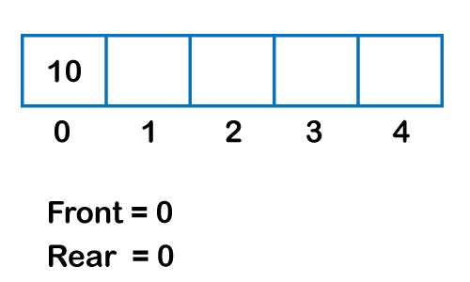

Slide 55
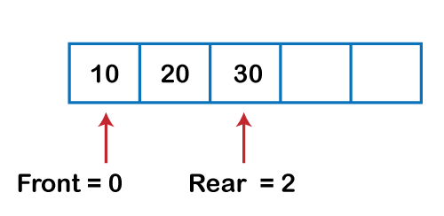

Slide 56
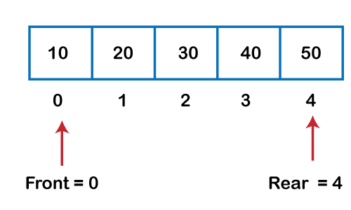

Slide 57
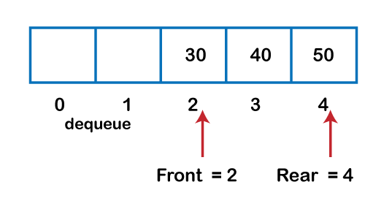

Slide 58
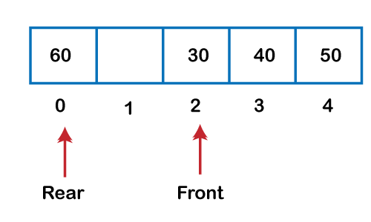

Slide 59
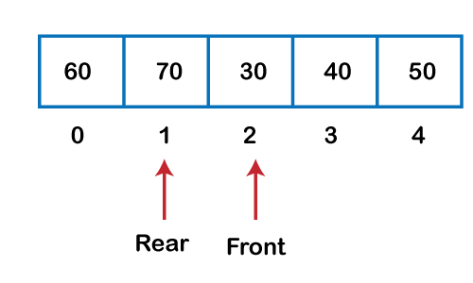

Slide 60
Priority Queue
A priority queue is an abstract data type that behaves similarly to the normal queue except that each element has some priority, i.e.,
the element with the highest priority would come first in a priority queue.
The priority of the elements in a priority queue will determine the order in which elements are removed from the priority queue.

Slide 61
The priority queue supports only comparable elements, which means that the elements are either arranged in an ascending or descending order.
For example, suppose we have some values like 1, 3, 4, 8, 14, 22 inserted in a priority queue with an ordering imposed on the values is from least to the greatest.
Therefore, the 1 number would be having the highest priority while 22 will be having the lowest priority.

Slide 62
Characteristics of a Priority queue
Every element in a priority queue has some priority associated with it.
An element with the higher priority will be deleted before the deletion of the lesser priority.
If two elements in a priority queue have the same priority, they will be arranged using the FIFO principle.

Slide 63
We have a priority queue that contains the following values:
1, 3, 4, 8, 14, 22
All the values are arranged in ascending order. Now, we will observe how the priority queue will look after performing the following operations:
poll(): This function will remove the highest priority element from the priority queue. In the above priority queue, the '1' element has the highest priority, so it will be removed from the priority queue.

Slide 64
add(2): This function will insert '2' element in a priority queue. As 2 is the smallest element among all the numbers so it will obtain the highest priority.
poll(): It will remove '2' element from the priority queue as it has the highest priority queue.
add(5): It will insert 5 element after 4 as 5 is larger than 4 and lesser than 8, so it will obtain the third highest priority in a priority queue.

Slide 65
Types of Priority Queue
Ascending order priority queue: In ascending order priority queue, a lower priority number is given as a higher priority in a priority.
For example, we take the numbers from 1 to 5 arranged in an ascending order like 1,2,3,4,5; therefore, the smallest number, i.e., 1 is given as the highest priority in a priority queue.

Slide 66
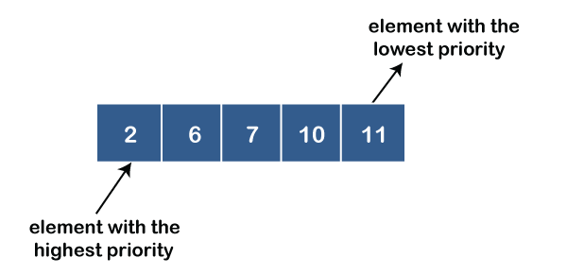

Slide 67
Descending order priority queue: In descending order priority queue, a higher priority number is given as a higher priority in a priority.
For example, we take the numbers from 1 to 5 arranged in descending order like 5, 4, 3, 2, 1; therefore, the largest number, i.e., 5 is given as the highest priority in a priority queue.

Slide 68
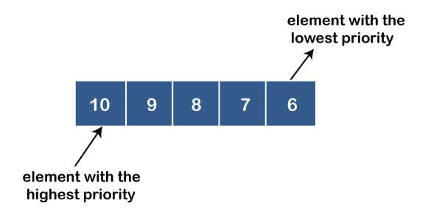

Slide 69
Representation of priority queue
Now, we will see how to represent the priority queue through a one-way list.
We will create the priority queue by using the list given below in which INFO list contains the data elements, PRN list contains the priority numbers of each data element available in the INFO list, and LINK basically contains the address of the next node.

Slide 70
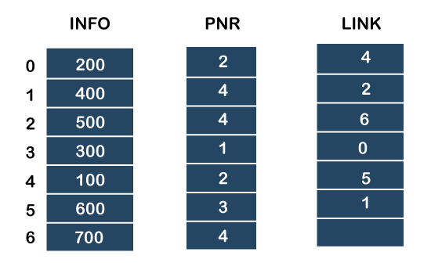

Slide 71
In the case of priority queue, lower priority number is considered the higher priority, i.e., lower priority number = higher priority.

Slide 72
Step 1: In the list, lower priority number is 1, whose data value is 333, so it will be inserted in the list as shown in the below diagram:
Step 2: After inserting 333, priority number 2 is having a higher priority, and data values associated with this priority are 222 and 111. So, this data will be inserted based on the FIFO principle; therefore 222 will be added first and then 111.

Slide 73
Step 3: After inserting the elements of priority 2, the next higher priority number is 4 and data elements associated with 4 priority numbers are 444, 555, 777. In this case, elements would be inserted based on the FIFO principle; therefore, 444 will be added first, then 555, and then 777.
Step 4: After inserting the elements of priority 4, the next higher priority number is 5, and the value associated with priority 5 is 666, so it will be inserted at the end of the queue.

Slide 74
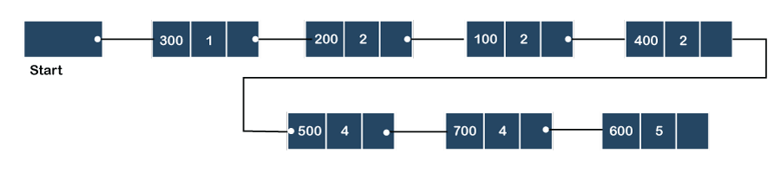

Slide 75
Implementation of Priority Queue
The priority queue can be implemented in four ways that include arrays, linked list, heap data structure and binary search tree.
The heap data structure is the most efficient way of implementing the priority queue, so we will implement the priority queue using a heap data structure in this topic.

Slide 76
Implementation | add | Remove | peek
Linked list | O(1) | O(n) | O(n)
Binary heap | O(logn) | O(logn) | O(1)
Binary search tree | O(logn) | O(logn) | O(1)

Slide 77
PUSH(HEAD, DATA, PRIORITY):
Step 1: Create new node with DATA and PRIORITY
Step 2: Check if HEAD has lower priority. If true follow Steps 3-4 and end. Else goto Step 5.
Step 3: NEW -> NEXT = HEAD
Step 4: HEAD = NEW

Slide 78
Step 5: Set TEMP to head of the list
Step 6: While TEMP -> NEXT != NULL and TEMP -> NEXT -> PRIORITY > PRIORITY
Step 7: TEMP = TEMP -> NEXT [END OF LOOP]

Slide 79
Step 8: NEW -> NEXT = TEMP -> NEXT
Step 9: TEMP -> NEXT = NEW
Step 10: End

Slide 80
POP(HEAD):
Step 1: Set the head of the list to the next node in the list. HEAD = HEAD -> NEXT.
Step 2: Free the node at the head of the list
Step 3: End

Slide 81
PEEK(HEAD):
Step 1: Return HEAD -> DATA
Step 2: End

