Slide 1
Course Code: IT-15 Network Technologies

Slide 2

Course Description
Course Objectives:
1. To understand various computer networks and technologies behind networks
2. To study TCP/IP protocol suite, IP addressing schemes and link layer communication
3. To study routing concept along with Routing protocols
4. To study application layer protocols
5. To understand basics of cryptography and socket programming

Slide 3
Course Outcomes
CO1: Understand the basic concepts of Computer Network, and principle of layering (Understand)
CO2: Apply the error detection and correction techniques used in data transmission (Apply)
CO3: Apply IP addressing schemes and sub netting (Apply)
CO4: Understand the concept of routing protocols, Application layer protocols and Network Security (Understand) CO5: Apply the socket programming basics to create a simple chat application (Apply)

Slide 4
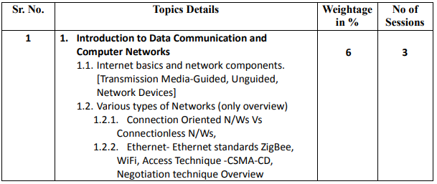

Slide 5
1. Introduction to Data Communication and Computer Networks
1.2 DATA and INFORMATION
Data refers to the raw facts that are collected while information refers to processed data that enables us to take decisions.
The word data refers to any information which is presented in a form that is agreed and accepted upon by is creators and users.

Slide 6
DATA COMMUNICATION
Data Communication is a process of exchanging data or information .
In case of computer networks this exchange is done between two devices over a transmission medium.
This process involves a communication system which is made up of hardware and software.
The hardware part involves the sender and receiver devices and the intermediate devices through which the data passes.
The software part involves certain rules which specify what is to be communicated, how it is to be communicated and when.

Slide 7
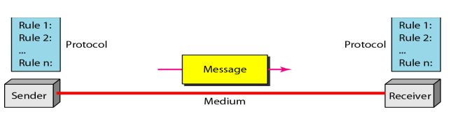
Components

Slide 8
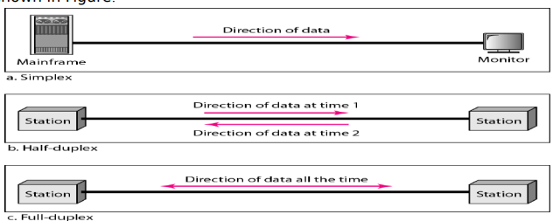
Data Flow

Slide 9
Computer Network and Network Criteria
A group of computers which are connected to each other and follow similar usage protocols for the purpose of sharing information and having communications provided by the networking nodes is called a Computer Network
A network must be able to meet a certain number of criteria
Performance
Reliability
Security

Slide 10

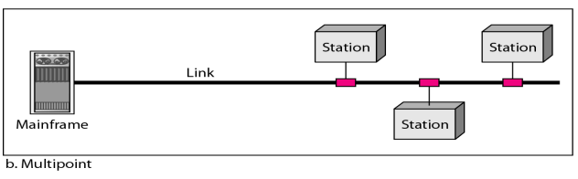
Physical Structures
Type of Connection
Point-to-Point
Multipoint

Slide 11
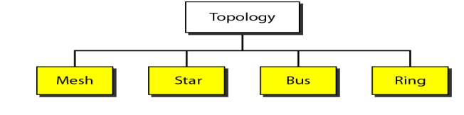
Physical Topology

Slide 12
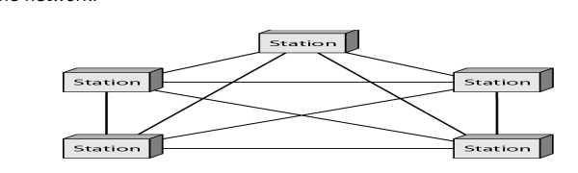
MESH
Advantages of a mesh topology
1.Can handle high amounts of traffic, because multiple devices can transmit data simultaneously.
2.A failure of one device does not cause a break in the network or transmission of data.
3. Adding additional devices does not disrupt data transmission between other devices.

Slide 13
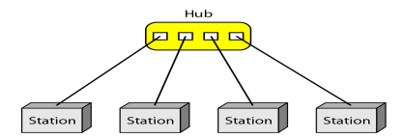
Identifying and describing relations and functions
Advantages of star topology
Centralized management of the network, through the use of the central computer, hub, or switch.
Easy to add another computer to the network.
If one computer on the network fails, the rest of the network
continues to function normally.
The star topology is used in local-area networks (LANs), High-speed LANs often use a star topology with a central hub.

Slide 14
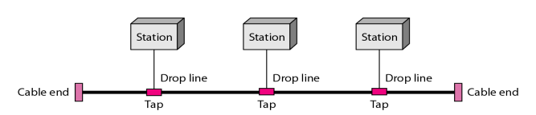
BUS
Advantages of bus topology
1. It works well when you have a small network.
2. It's the easiest network topology for connecting computers or peripherals in a linear fashion.
3.It requires less cable length than a star topology

Slide 15
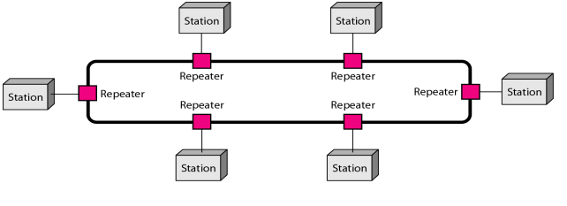
RING:
Advantages of ring topology
All data flows in one direction, reducing the chance of packet collisions.
A network server is not needed to control network connectivity between each workstation.
Data can transfer between workstations at high speeds.
Additional workstations can be added without impacting performance of the network.

Slide 16
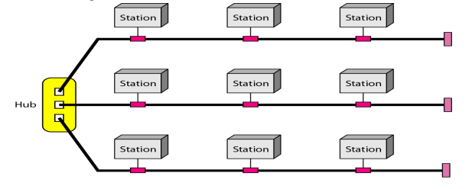
Hybrid Topology

Slide 17
Types of Network based on size
Sr. No. | LAN (Local Area Network) | MAN (Metropolitan Area Network) | WAN (Wide Area Network)
1 | Group of interconnected computers within a small area. | Design to extend over a large area | Are country and worldwide network.
2 | Two or more pc's can from a LAN to share files, folders, printers, applications and other devices. | Connecting number of LAN's to form larger network, so that resources can be shared | Contains multiple LAN's and MAN's.
3 | Due to short distances, errors and noise are minimum. | Networks can be up to 5 to 50 km. | Distinguished in terms of geographical range
4 | Data transfer rate is 10 to 100 mbps. | Data transfer rate is low compare to LAN. | Distinguished in terms of geographical range
5 |  |  | Uses satellites and microwave relays Data transfer rate depends upon the ISP provider and varies over the location

Slide 18
Other types
WLAN (Wireless LAN)
A LAN that uses high frequency radio waves for communication. Provides short range connectivity with high speed data transmission.
PAN (Personal Area Network)
Network organized by the individual user for its personal use.
SAN (Storage Area Network)
Connects servers to data storage devices via fiber-optic cables.

Slide 19
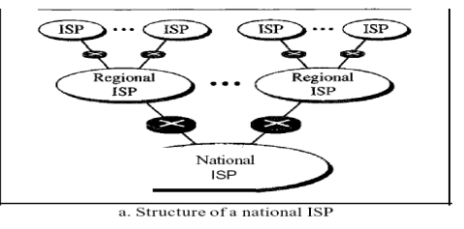
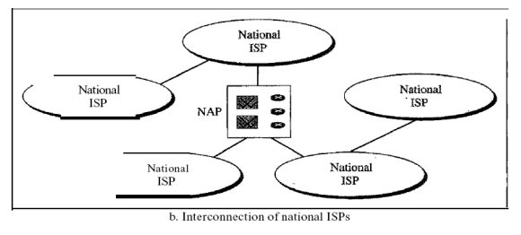
THE INTERNET

Slide 20
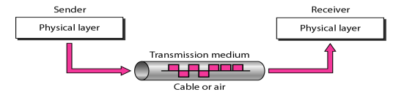
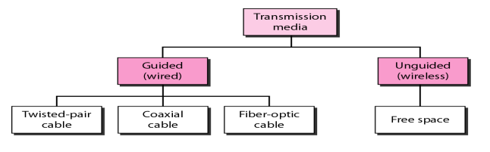
Transmission medium and Classes

Slide 21
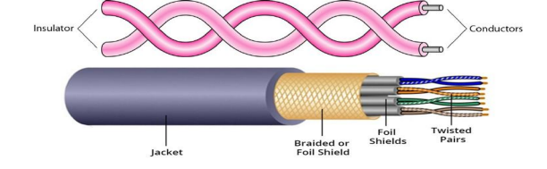
Guided Media: Guided media, which are those that provide a medium from one device to another, include twisted-pair cable, coaxial cable, and fiber-optic cable.
Twisted-Pair Cable

Slide 22

Unshielded Versus Shielded Twisted-Pair Cable
Applications Twisted-pair cables are used in telephone lines to provide voice and data channels. Local-area networks, such as l0Base-T and l00Base-T, also use twisted-pair cables.

Slide 23
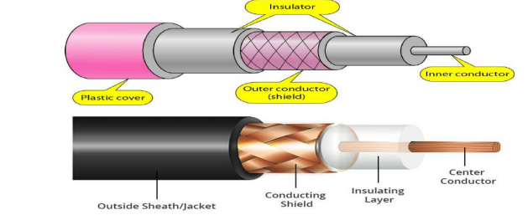
Coaxial Cable
Applications
Coaxial cable was widely used in analog telephone networks, digital telephone networks
Cable TV networks also use coaxial cables. Another common application of coaxial cable is in traditional Ethernet LANs

Slide 24

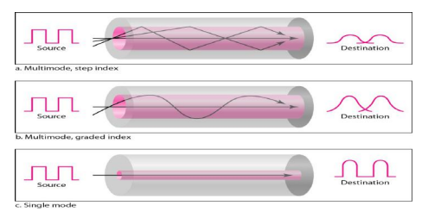
Fiber-Optic Cable

Slide 25
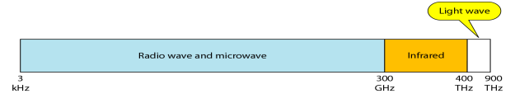
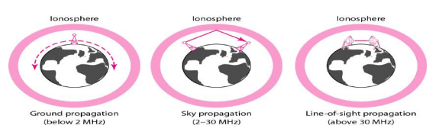
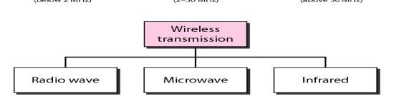
UNGUIDED MEDIA: WIRELESS

Slide 26
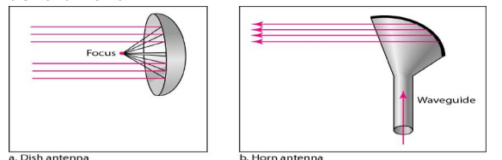
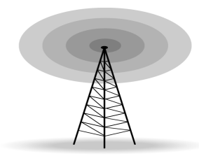
Radio Waves Microwaves Infrared

Slide 27
Network Devices
Network Repeater – Used to generate incoming electrical, wireless or optical signals
Network Hub – It is a small network device. It joins multiple computers together to form a single network segment. On this segment, all computers can interact with each other
Network Switch – It is a small hardware device which joins multiple computers together with a single LAN
Network Router – This device interfaces in multiple networks whose task is to copy packages from one network to another. It provides connectivity inside enterprises, between Enterprises and the Internet and within an ISP
Network Bridge – It reads the outermost section of the data packet to tell where the message is going. It reduces the traffic on other network segments.
Modem – This device converts digital signals into analog signals. It is always placed between a telephone and a computer system

Slide 28
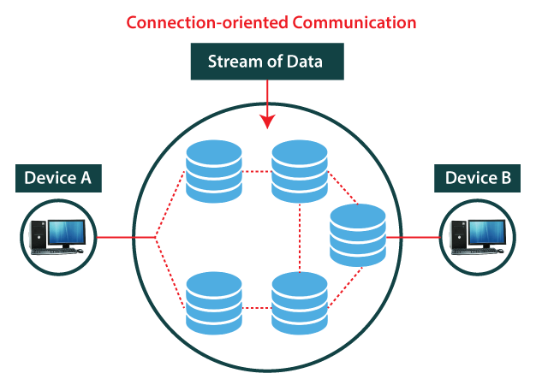
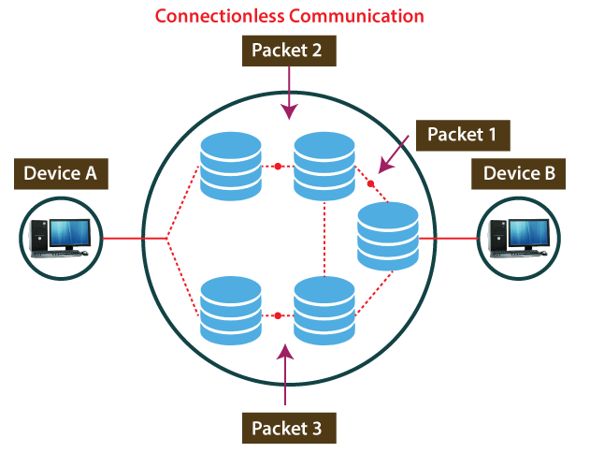
Difference between Connection-Oriented and Connectionless Service

Slide 29
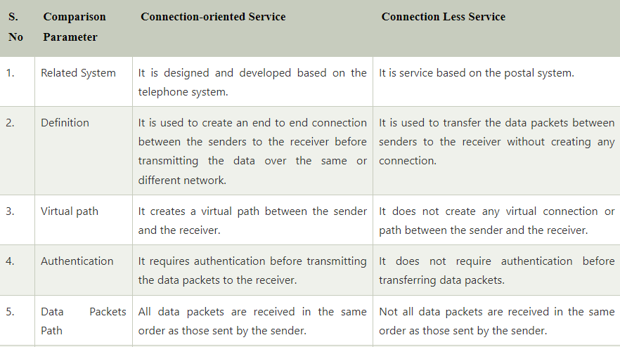

Slide 30
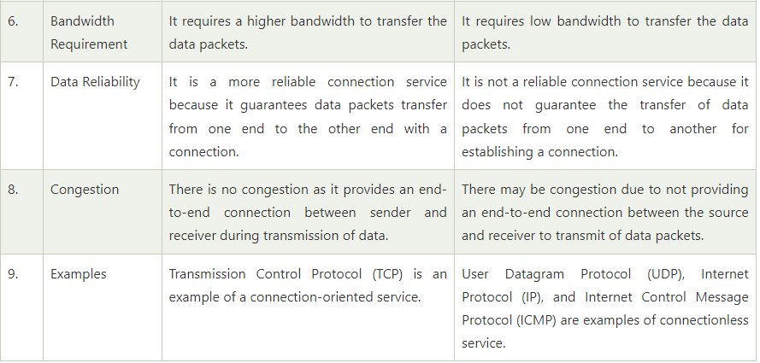

Slide 31
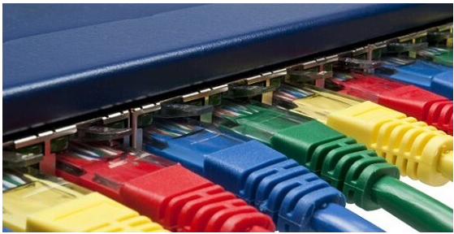
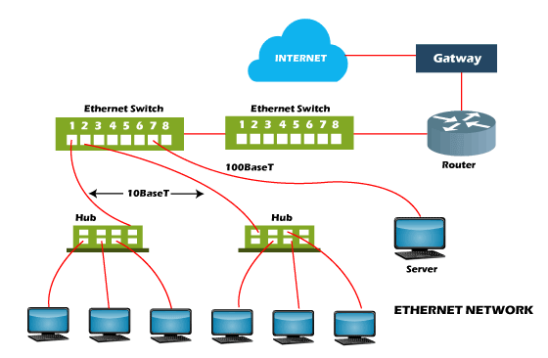

Slide 32
Different Types of Ethernet Networks
Fast Ethernet:
This type of Ethernet is usually supported by a twisted pair or CAT5 cable, which has the potential to transfer or receive data at around100 Mbps.
They function at 100Base and 10/100Base Ethernet on the fiber side of the link if any device such as a camera, laptop, or other is connected to a network.
The fiber optic cable and twisted pair cable are used by fast Ethernet to create communication. The 100BASE-TX, 100BASE-FX, and 100BASE-T4 are the three categories of Fast Ethernet.
Gigabit Ethernet:
This type of Ethernet network is an upgrade from Fast Ethernet, which uses fiber optic cable and twisted pair cable to create communication.
It can transfer data at a rate of 1000 Mbps or 1Gbps. In modern times, gigabit Ethernet is more common.
This network type also uses CAT5e or other advanced cables, which can transfer data at a rate of 10 Gbps.

