Slide 1
Course Code: IT-15 Network Technologies

Slide 2

Course Description
Course Objectives:
1. To understand various computer networks and technologies behind networks
2. To study TCP/IP protocol suite, IP addressing schemes and link layer communication
3. To study routing concept along with Routing protocols
4. To study application layer protocols
5. To understand basics of cryptography and socket programming

Slide 3
Course Outcomes
CO1: Understand the basic concepts of Computer Network, and principle of layering (Understand)
CO2: Apply the error detection and correction techniques used in data transmission (Apply)
CO3: Apply IP addressing schemes and sub netting (Apply)
CO4: Understand the concept of routing protocols, Application layer protocols and Network Security (Understand) CO5: Apply the socket programming basics to create a simple chat application (Apply)

Slide 4
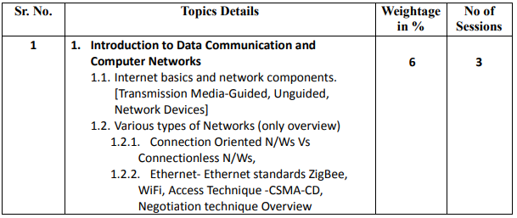

Slide 5
Ethernet Standards ZigBee
ZigBee is a Personal Area Network task group
ZigBee is a technological standard created for controlling and sensing the network.
ZigBee is an open, global, packet-based protocol designed to provide an easy-to-use architecture for secure, reliable, low power wireless networks.
Flow or process control equipment can be place anywhere and still communicate with the rest of the system.
It can also be moved, since the network doesn’t care about the physical location of a sensor, pump or valve.

Slide 6
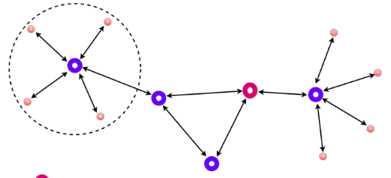
Types of ZigBee Devices:
Zigbee Coordinator Device: It communicates with routers. This device is used for connecting the devices.
Zigbee Router: It is used for passing the data between devices.
Zigbee End Device: It is the device that is going to be controlled.

Slide 7
General Characteristics of Zigbee Standard:
Low Power Consumption
Low Data Rate (20- 250 kbps)
Short-Range (75-100 meters)
Network Join Time (~ 30 msec)
Support Small and Large Networks (up to 65000 devices (Theory); 240 devices (Practically))
Low Cost of Products and Cheap Implementation (Open Source Protocol)
Extremely low-duty cycle.
3 frequency bands with 27 channels.

Slide 8
Wifi
Wifi is also known as Wireless Fidelity.
Wi-Fi is a wireless networking technology that permits to connect wirelessly to a network or to other computer or mobile device.
A circular radio frequency range is used to transmit data in Wi-Fi.
Wifi operates like a local area network without the use of a wire or cables.
WiFi uses the Physical Data Link Layer (PDLL) to operate.
because the Wi-Fi adapter within the device is responsible for receiving the Wi-Fi signal, all modern laptops and mobile devices are competent in using both bandwidths. All devices have a default bandwidth of 2.4 GHz.

Slide 9
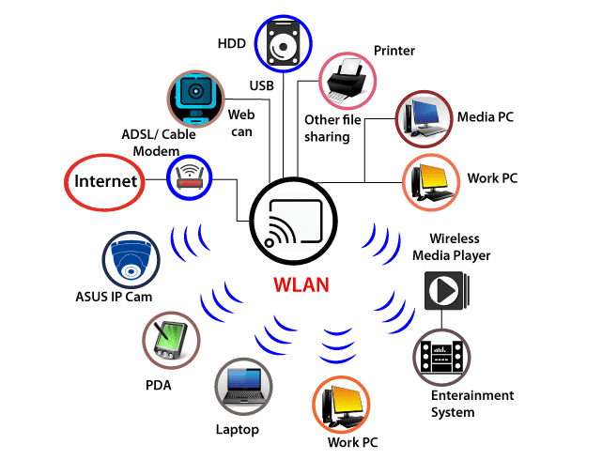
Usage and Application of Wifi

Slide 10
Usage and Application of Wifi
With Wi-Fi, we can connect to the internet from any Wi-Fi-capable device. Wi-Fi allows us to have wireless communication, including streaming or casting audio or video to any device.
Data transfer rates are also very fast when using Wi-Fi to share files, data, etc., among two or more computer or mobile phone.
Another important attribute is the capability to print any document using a Wi-Fi printer.
Wi-Fi can also be used as a HOTSPOT
Also one can create a Point-to-Point network using Wi-Fi or WLAN technology. Two sites that are hard to reach by wire, such as two corporate office buildings, can be connected using this method.
VoWi-Fi is also recognised as voice-over Wi-Fi, which is another useful tool.

Slide 11
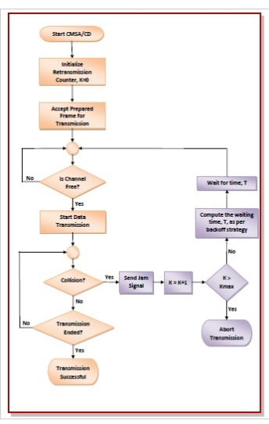
When a frame is ready, the transmitting station checks whether the channel is idle or busy.
If the channel is busy, the station waits until the channel becomes idle.
If the channel is idle, the station starts transmitting and continually monitors the channel to detect collision.
If a collision is detected, the station starts the collision resolution algorithm.
The station resets the retransmission counters and completes frame transmission.

Slide 12
Advantage and Disadvantage of CSMA CD
Disadvantage of CSMA CD
It is not suitable for long-distance networks because as the distance increases, CSMA CD' efficiency decreases.
It can detect collision only up to 2500 meters, and beyond this range, it cannot detect collisions.
When multiple devices are added to a CSMA CD, collision detection performance is reduced.
Advantages of a CSMA CD
It is used for collision detection on a shared channel within a very short time.
CSMA CD is better than CSMA for collision detection.
CSMA CD is used to avoid any form of waste transmission.
When necessary, it is used to use or share the same amount of bandwidth at each station.
It has lower CSMA CD overhead as compared to the CSMA CA.

Slide 13
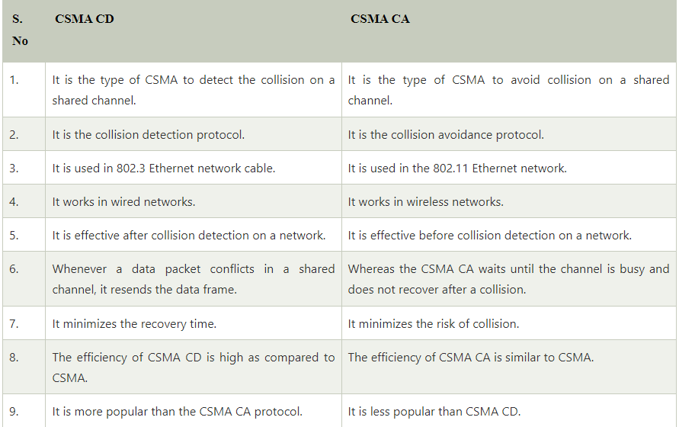

Slide 14
What is VOIP?
Advantages of bus topology
1. It works well when you have a small network.
2 It's the easiest network topology for connecting computers or peripherals in a linear fashion.
3.It requires less cable length than a star topology

Slide 15
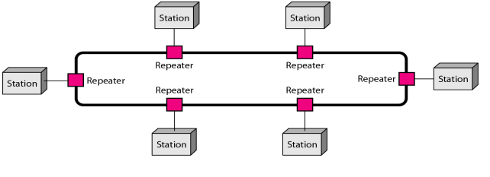
RING:
Advantages of ring topology
All data flows in one direction, reducing the chance of packet collisions.
A network server is not needed to control network connectivity between each workstation.
Data can transfer between workstations at high speeds.
Additional workstations can be added without impacting performance of the network.

Slide 16
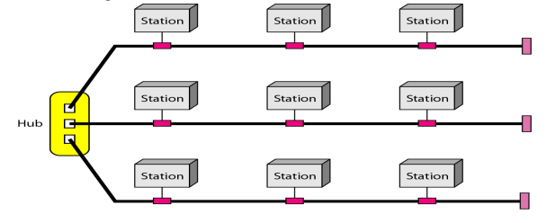
Hybrid Topology

Slide 17
Types of Network based on size
Sr. No. | LAN (Local Area Network) | MAN (Metropolitan Area Network) | WAN (Wide Area Network)
1 | Group of interconnected computers within a small area. | Design to extend over a large area | Are country and worldwide network.
2 | Two or more pc's can from a LAN to share files, folders, printers, applications and other devices. | Connecting number of LAN's to form larger network, so that resources can be shared | Contains multiple LAN's and MAN's.
3 | Due to short distances, errors and noise are minimum. | Networks can be up to 5 to 50 km. | Distinguished in terms of geographical range
4 | Data transfer rate is 10 to 100 mbps. | Data transfer rate is low compare to LAN. | Distinguished in terms of geographical range
5 |  |  | Uses satellites and microwave relays Data transfer rate depends upon the ISP provider and varies over the location

Slide 18
Other types
WLAN (Wireless LAN)
A LAN that uses high frequency radio waves for communication. Provides short range connectivity with high speed data transmission.
PAN (Personal Area Network)
Network organized by the individual user for its personal use.
SAN (Storage Area Network)
Connects servers to data storage devices via fiber-optic cables.

Slide 19
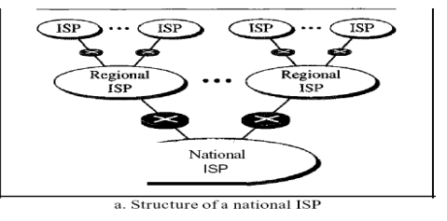
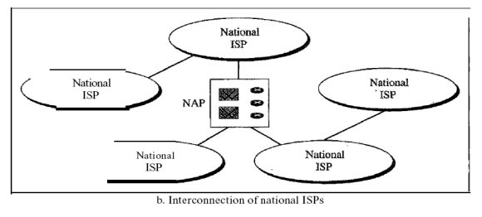
THE INTERNET

Slide 20
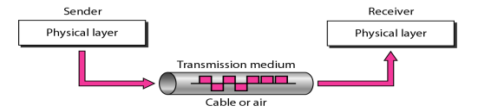
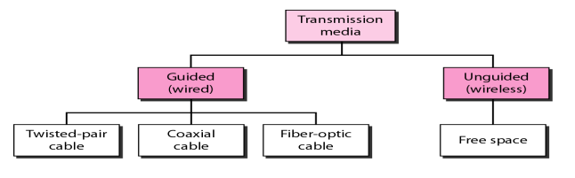
Transmission medium and Classes

Slide 21
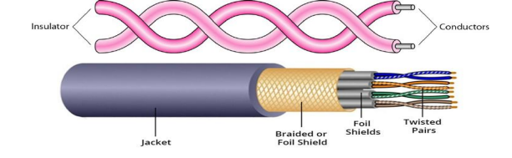
Guided Media: Guided media, which are those that provide a medium from one device to another, include twisted-pair cable, coaxial cable, and fiber-optic cable.
Twisted-Pair Cable

Slide 22

Unshielded Versus Shielded Twisted-Pair Cable
Applications Twisted-pair cables are used in telephone lines to provide voice and data channels. Local-area networks, such as l0Base-T and l00Base-T, also use twisted-pair cables.

Slide 23
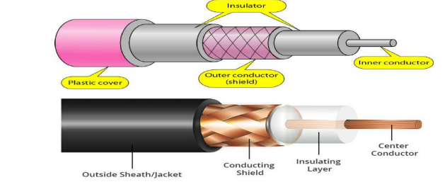
Coaxial Cable
Applications
Coaxial cable was widely used in analog telephone networks, digital telephone networks
Cable TV networks also use coaxial cables. Another common application of coaxial cable is in traditional Ethernet LANs

Slide 24

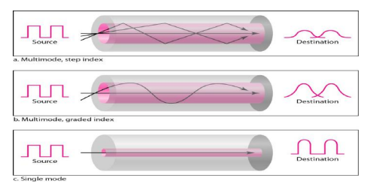
Fiber-Optic Cable

Slide 25
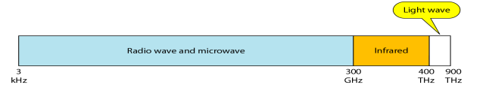
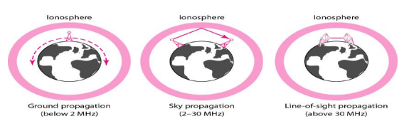
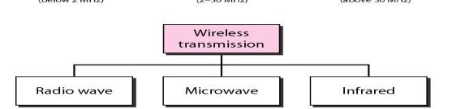
UNGUIDED MEDIA: WIRELESS

Slide 26
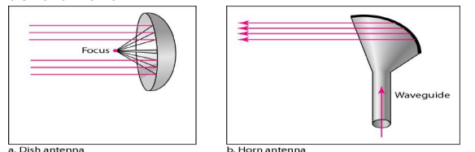
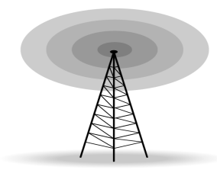
Radio Waves Microwaves Infrared

Slide 27
Network Devices
Network Repeater – Used to generate incoming electrical, wireless or optical signals
Network Hub – It is a small network device. It joins multiple computers together to form a single network segment. On this segment, all computers can interact with each other
Network Switch – It is a small hardware device which joins multiple computers together with a single LAN
Network Router – This device interfaces in multiple networks whose task is to copy packages from one network to another. It provides connectivity inside enterprises, between Enterprises and the Internet and within an ISP
Network Bridge – It reads the outermost section of the data packet to tell where the message is going. It reduces the traffic on other network segments.
Modem – This device converts digital signals into analog signals. It is always placed between a telephone and a computer system

Slide 28
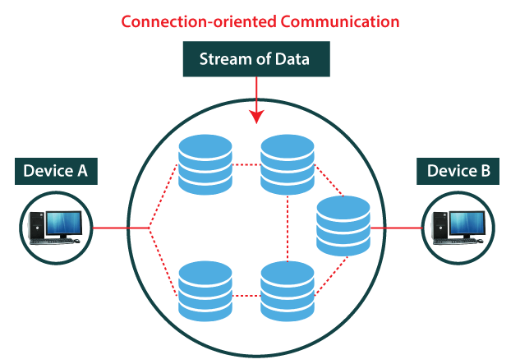
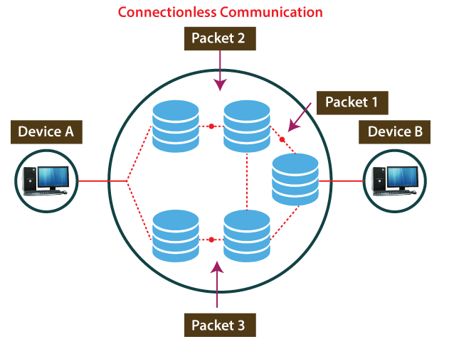
Difference between Connection-Oriented and Connectionless Service

Slide 29
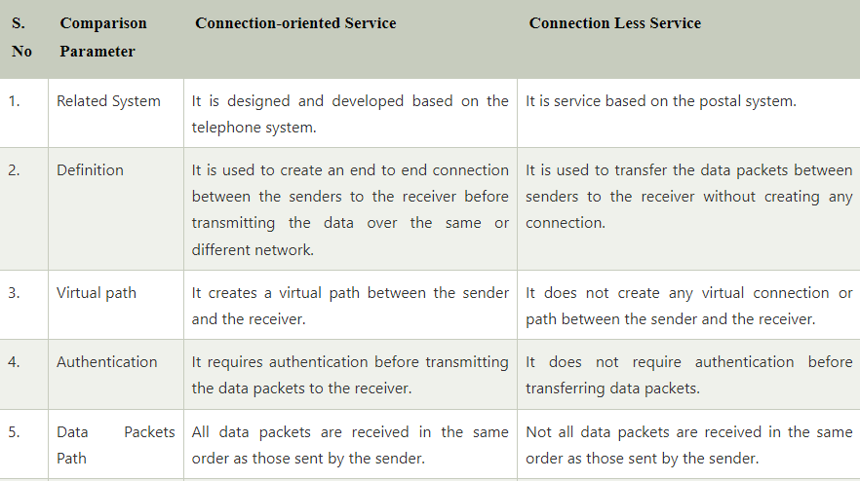

Slide 30
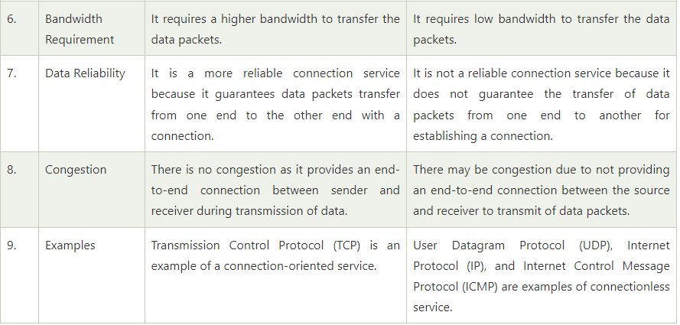

Slide 31
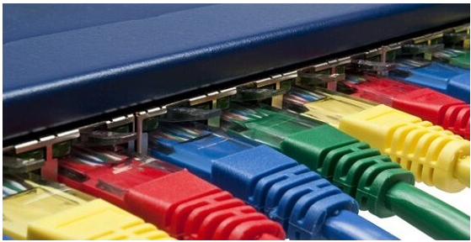
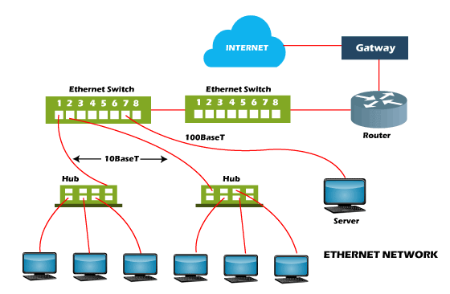

Slide 32
Different Types of Ethernet Networks
Fast Ethernet:
This type of Ethernet is usually supported by a twisted pair or CAT5 cable, which has the potential to transfer or receive data at around100 Mbps.
They function at 100Base and 10/100Base Ethernet on the fiber side of the link if any device such as a camera, laptop, or other is connected to a network.
The fiber optic cable and twisted pair cable are used by fast Ethernet to create communication. The 100BASE-TX, 100BASE-FX, and 100BASE-T4 are the three categories of Fast Ethernet.
Gigabit Ethernet:
This type of Ethernet network is an upgrade from Fast Ethernet, which uses fiber optic cable and twisted pair cable to create communication.
It can transfer data at a rate of 1000 Mbps or 1Gbps. In modern times, gigabit Ethernet is more common.
This network type also uses CAT5e or other advanced cables, which can transfer data at a rate of 10 Gbps.

