Slide 1

Title

Slide 2
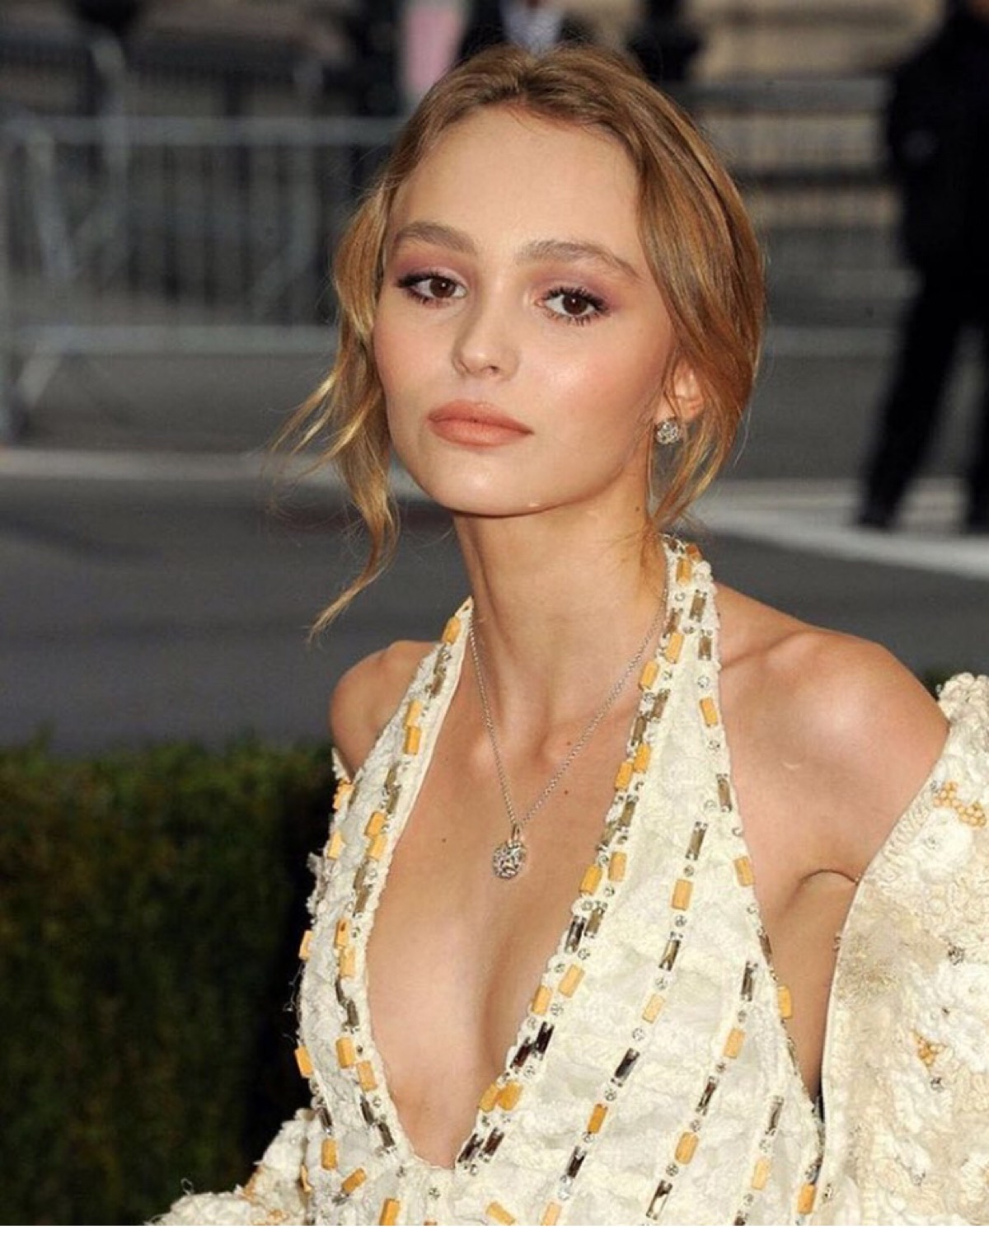
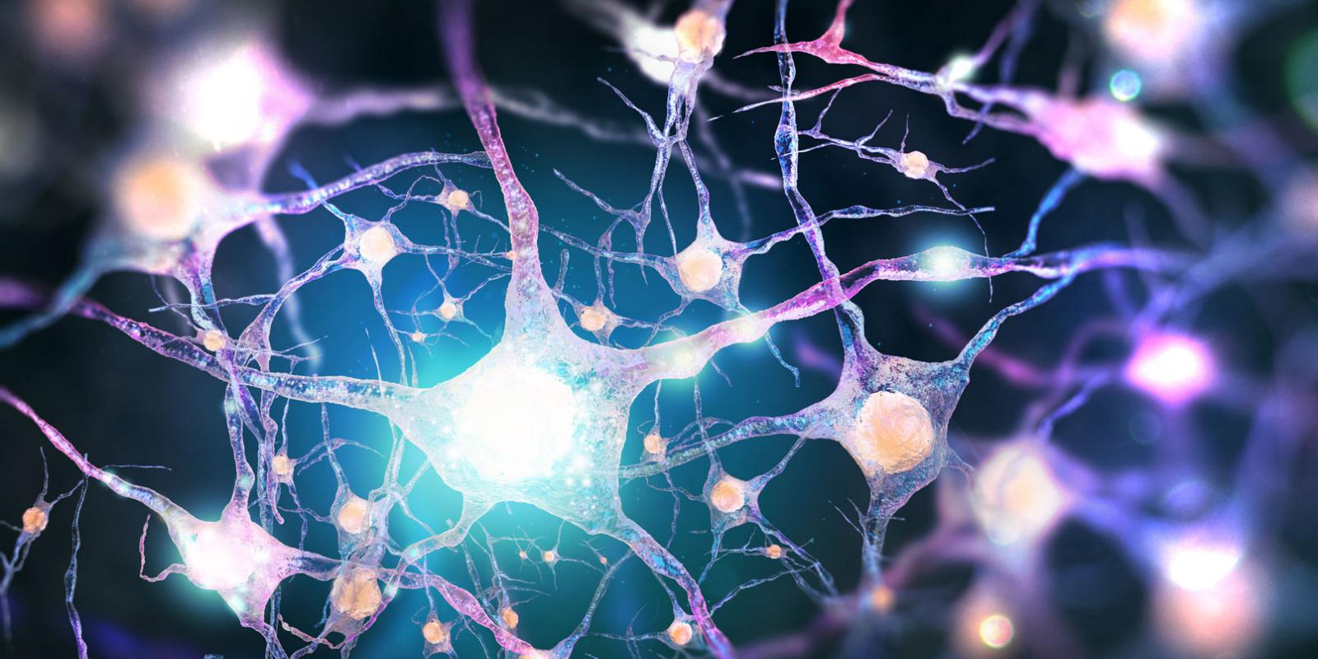

deep
neural
learning

Slide 3

supervised

Slide 4

networks
deep
results
neural

