Slide 1

Google was founded in September 1998 by Larry Page and Sergey Brin while they were Ph.D. students at Stanford University in California.

Slide 2

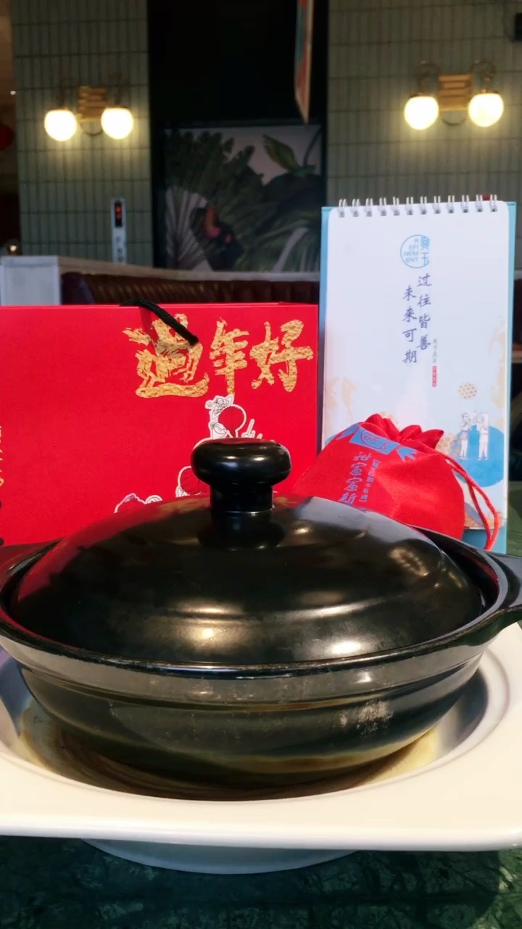
page
control

Slide 3
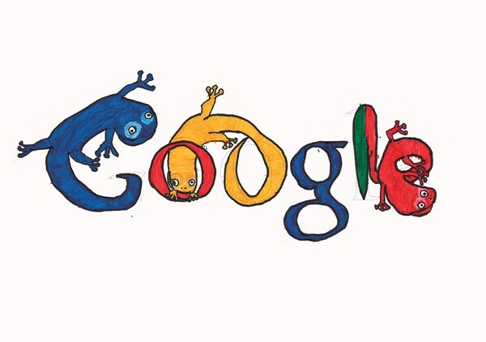
google

Slide 4

public offering
initial

Slide 5

google announced

Slide 6
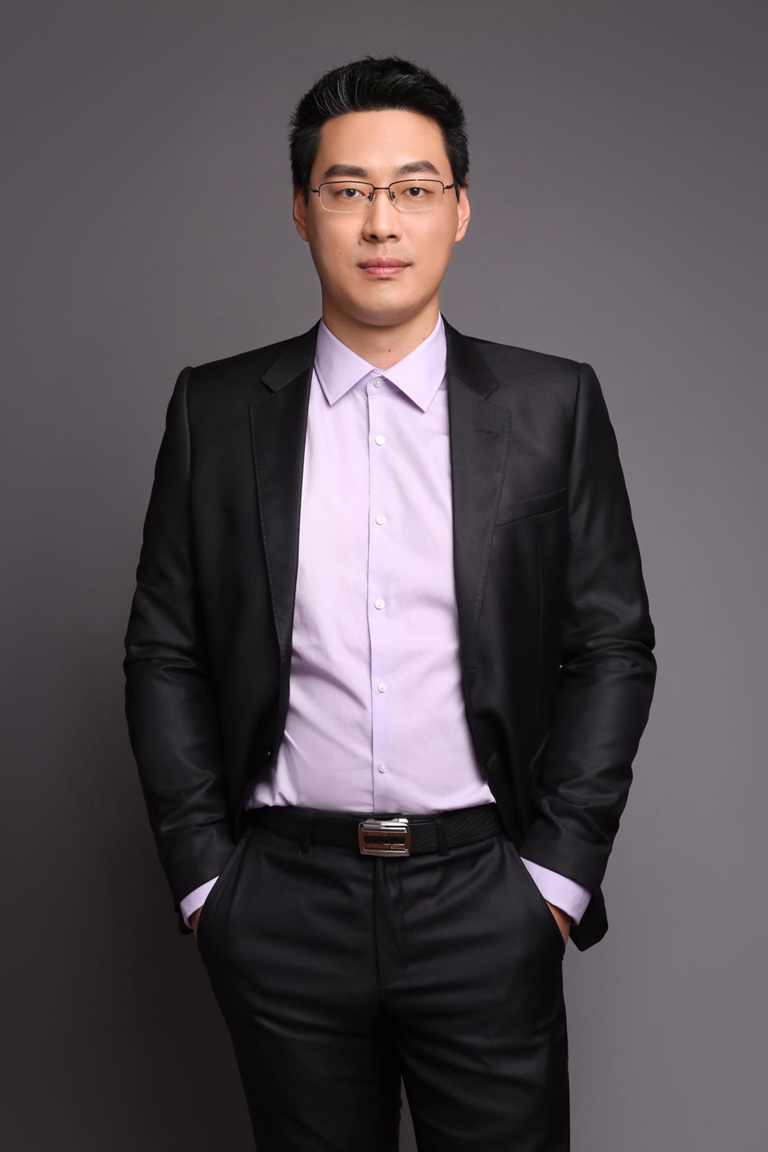
ceo
pichai

