Slide 1

Machine learning (ML) is the scientific study of algorithms and statistical models that computer systems use to perform a specific task without using explicit instructions, relying on patterns and inference instead.

Slide 2


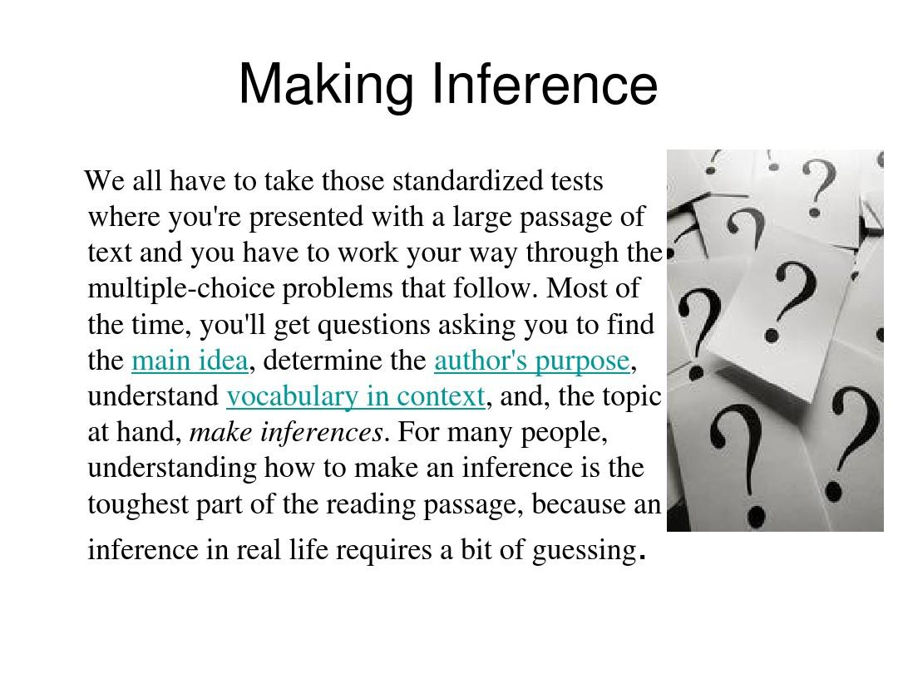
ml
machine learning
inference

Slide 3

artificial

Slide 4
model
learning algorithms build

Slide 5
develop
email
conventional
vision

Slide 6


predictions
learning

Slide 7
optimization
machine
learning
mathematical

Slide 8
data
exploratory
machine
learning

Slide 9
machine
problems
business
learning

Slide 10
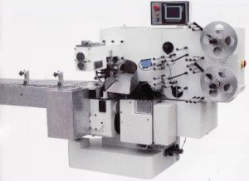
machine
learning

Slide 11
machine
tom
mitchell provided
learning

Slide 12

alan

Slide 13

thinking

