Slide 1

Machine learning algorithms build a mathematical model based on sample data, known as "training data", in order to make predictions or decisions without being explicitly programmed to perform the task.

Slide 2


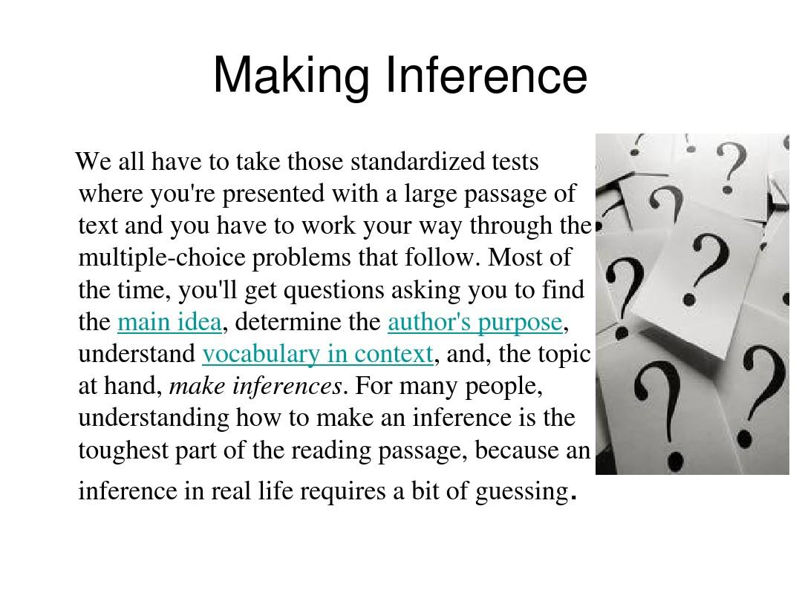
ml
machine learning
inference

Slide 3

artificial

Slide 4
model
learning algorithms build

Slide 5
vision
conventional
computer
develop

Slide 6


learning
predictions

Slide 7
mathematical
machine
learning
optimization

Slide 8
machine
learning
data
exploratory

Slide 9
machine
business
problems
learning

Slide 10
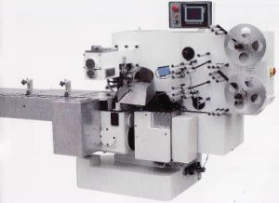
machine
learning

Slide 11
machine
mitchell provided
tom
learning

Slide 12

alan

Slide 13

thinking

Slide 14
unknown
mining
machine
training

Slide 15
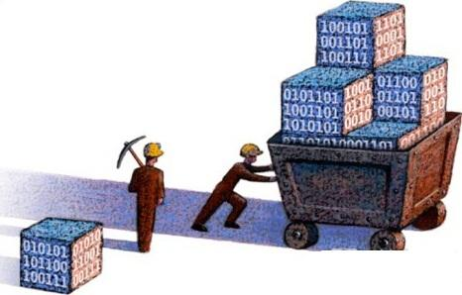
machine
learning
data mining

Slide 16
journals
discovery
research communities
exception

Slide 17


knowledge
known

Slide 18
machine
learning

Slide 19
label
express
classification
loss

Slide 20
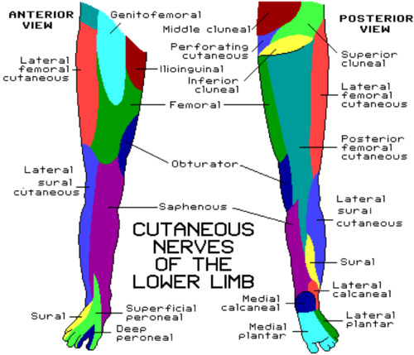

learning
fields arises
set

