Slide 1
Data Visualisation and Storytelling
3.1: Dimensionality Reduction and Principal Component Analysis (PCA)
Jacob Curran-Sebastian

Slide 2
What is dimensionality reduction – and why do we do it?
Data scientists often refer to the ‘Curse of Dimensionality’ – but what does this mean?
We may have a dataset that contains a number of variables, all of which may be correlated with one another to differing degrees.
We might not want to use so many variables – this adds to the complexity of our models and can make it hard to figure out what is actually going on.
We may also be using variables that are totally irrelevant to our outcome of interest.

Slide 3
Dimensionality Reduction
Instead of using all of our variables, which can be hard to visualise, let alone analyse, we may wish to reduce the number of variables,
We could, e.g. combine variables that are highly correlated with one another into a set of new variables that we can plot more easily.
This is the basic idea of clustering and dimensionality reduction.

Slide 4
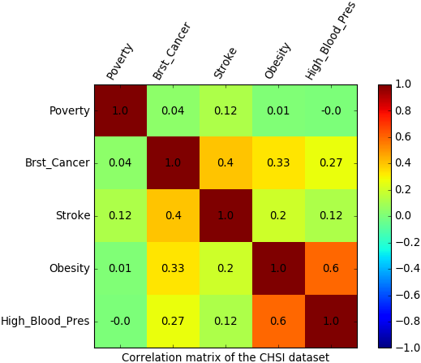
Relationships between variables – Correlation plots
Firstly we want to understand and visualise the relationships between our variables.
The package corrplot, which we will also use for doing the PCA, has some nice ways of plotting this.
This is a table where poistion (i, j) is the correlation coefficient between variable i and variable j.
https://www.vertica.com/blog/in-database-machine-learning-2-calculate-a-correlation-matrix-a-data-exploration-post/

Slide 5
Relationships between variables – Correlation plots
We can see, e.g. a strong correlation between obesity and high blood pressure.
Moderate-to-low positive correlations between breast cancer and other variables (except for poverty).
Little correlation between the other variables.

Slide 6
Principal Component Analysis (PCA)
The *idea* behind PCA is to combine variables that are highly correlated with one another together, by adding scaled versions of these variables together.
These new variables are called the principal components
This allows us to reduce the number of variables by a lot, and ensures that the variables that we have left are not highly correlated.
Crucially, we can plot the relationships between our new variables and also get our old variables back.

Slide 7
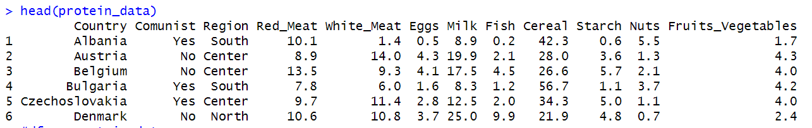
An example:

Slide 8
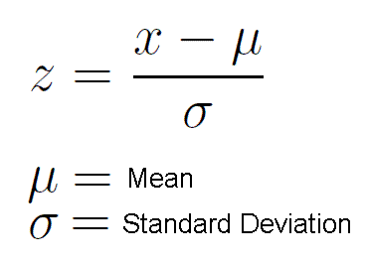
PCA - method
Standardisation:
First, we need to standardise our data, which means calculating z-scores within each variable.
We also remove any NA or missing values in the data (or impute data, if possible).

Slide 9
PCA – method
2. Perform PCA:
Now we obtain the ‘principal compenents’ from the correlation matrix we just calculated by taking a ‘linear combination’ of the variables in our data.
By doing this in a ‘clever’ way (this is called an eigenvalue decomposition), we get an ordered set of new vectors that have decreasing variance.
This new set of vectors give us a kind of alternative to the variables that we had before, only now we don’t have to use as many of them.
Often, the first two or three are taken, depending on how much of the variance in the data is ‘explained’ by these vectors.

Slide 10
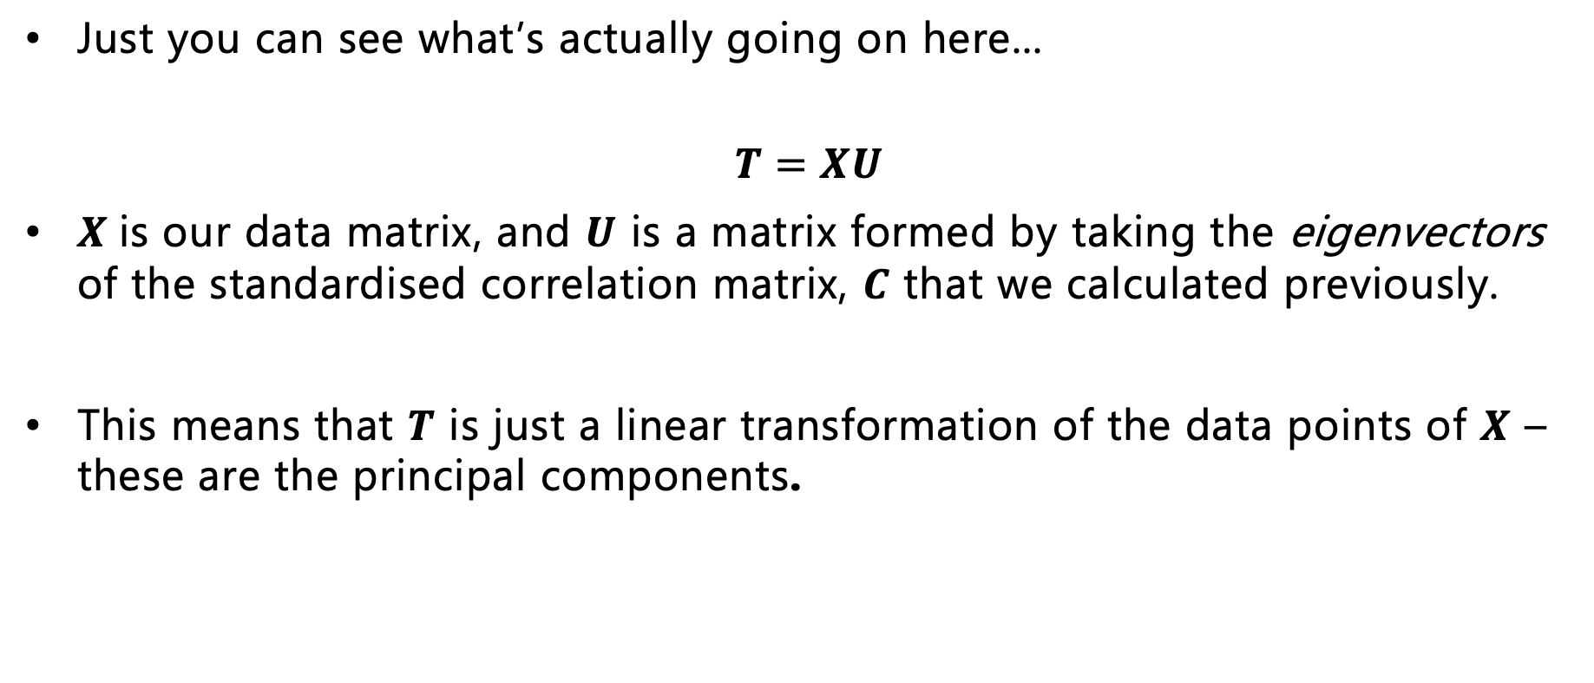
PCA Matrix Equation
Just you can see what’s actually going on here...
$$T=XU$$
$X$is our data matrix, and $U$ is a matrix formed by taking the eigenvectors of the standardised correlation matrix, $C$ that we calculated previously.
This means that $T$ is just a linear transformation of the data points of $X$ – these are the principal components.

Slide 11
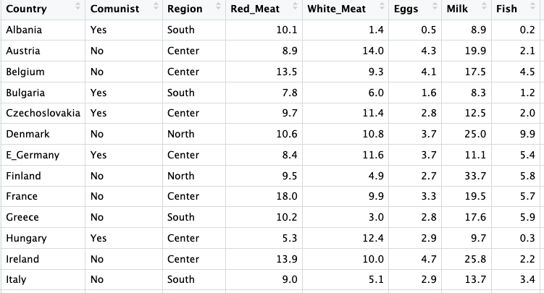
Example – Protein Data
As an example, we’ll take some (pretty old) data about protein consumption in different European countries.
This includes information about average protein consumption (in unspecified units!), and broad geographical information.

Slide 12
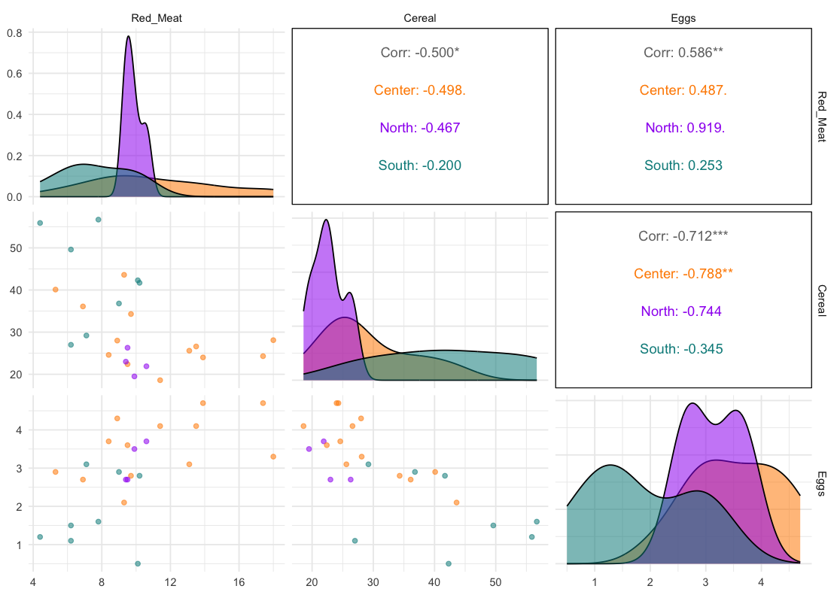
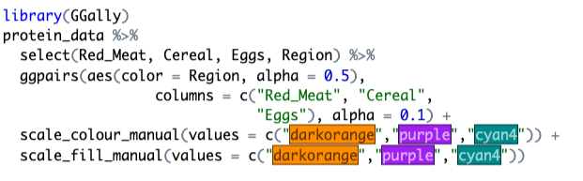
Visualising correlations
We can visualise pairwise correlations in our data using a pair plot

Slide 13
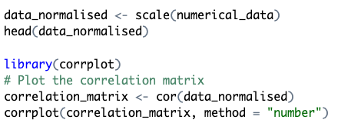
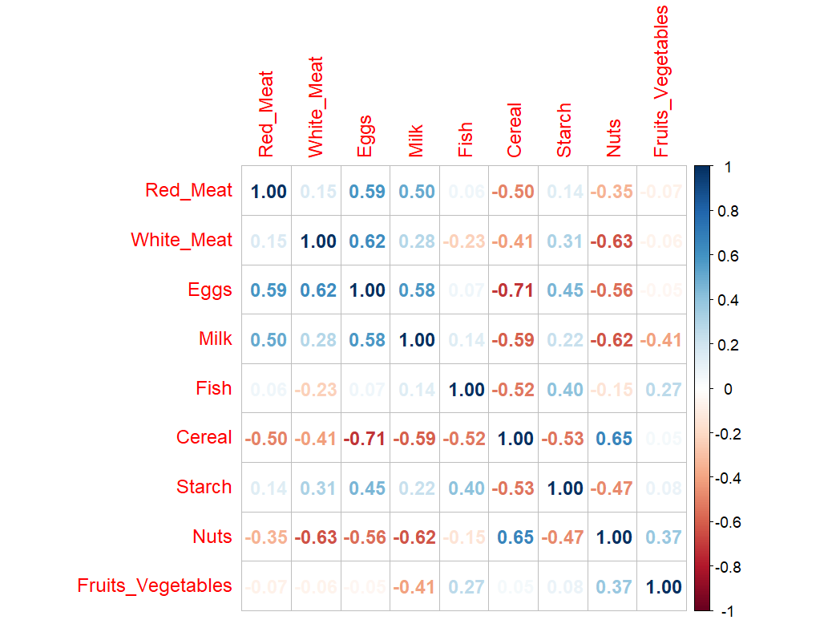
PCA – correlation matrix
Secondly, we calculate the correlation matrix of the data.
We can visualise this matrix as a heatmap, this time using the corrplot package in R.
We can play around with the layout of the correlation plot as well as with different colour gradients.

Slide 14
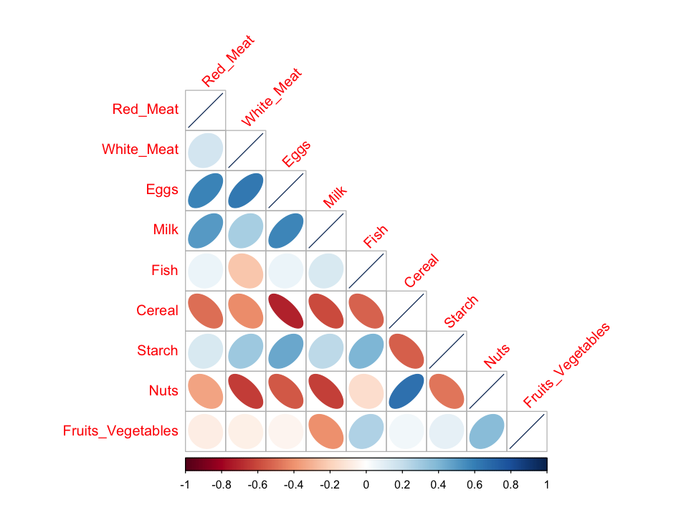
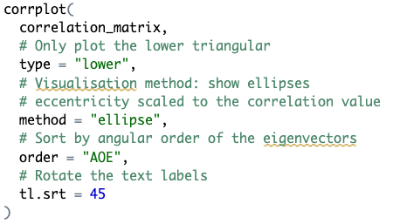
PCA – correlation matrix
Corrplot has lots of customisation options – so have a play around!

Slide 15

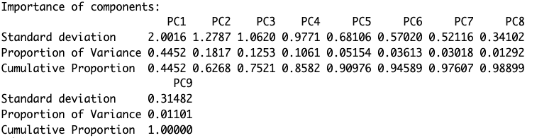
Applying PCA
This is the proportion of the variance in the original data that is contained in each component.
We had 9 variables in our original data, so we have 9 principal components.
However, if we choose only the first 5, we will have columns that contain 90% of the variability in the data.

Slide 16
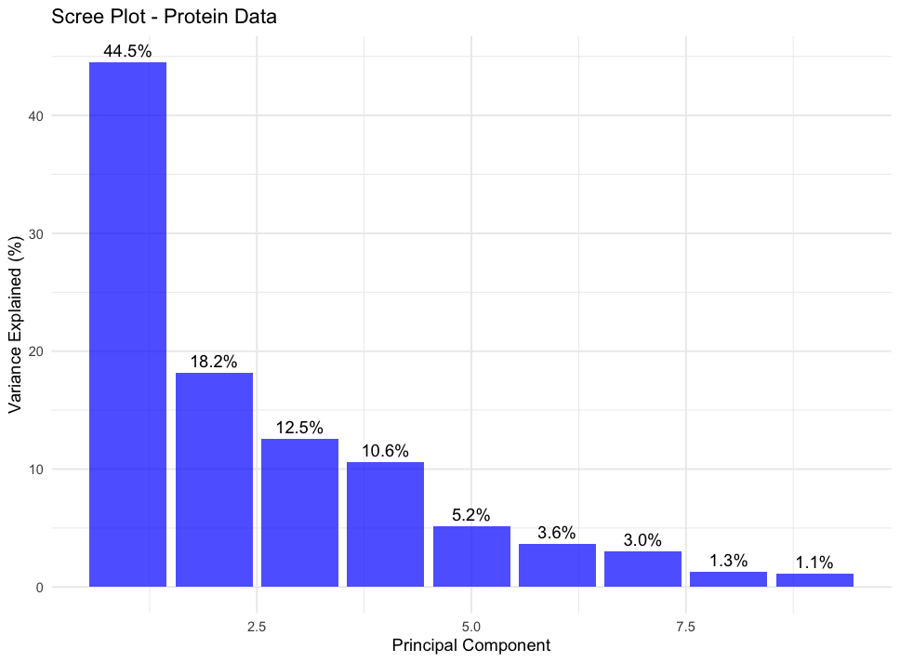
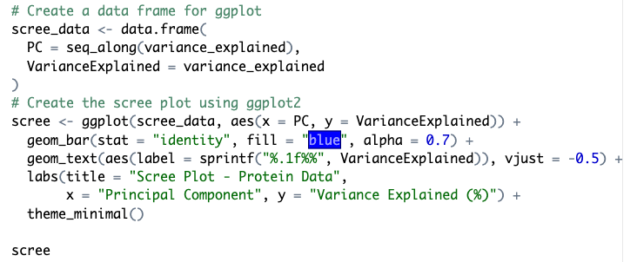
Visualising PCA
We can visualise the variance contained in each principal component using a Scree (or elbow) plot:

Slide 17
Choosing the principal components
Principal components are ordered in decreasing variance – so we need to choose them such that enough of the variance in the data is represented in the components.
Often we hope we can get away with 2 PCs, but sometimes we need more.

Slide 18
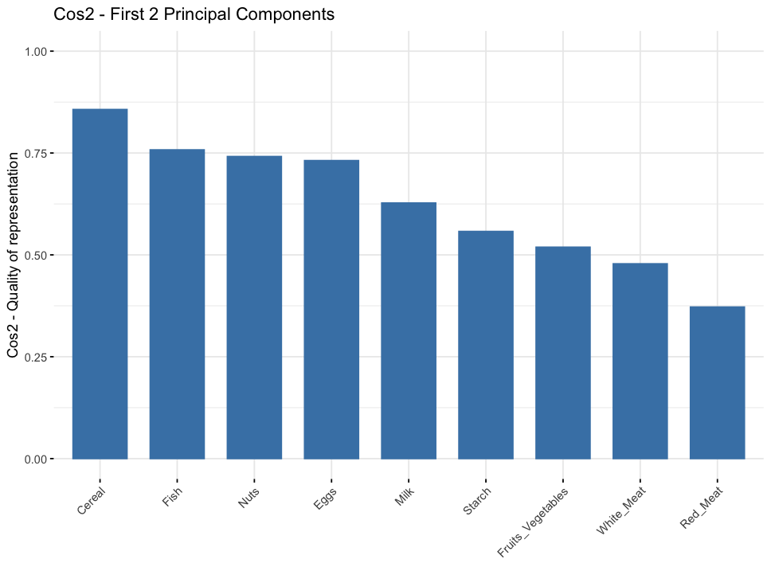
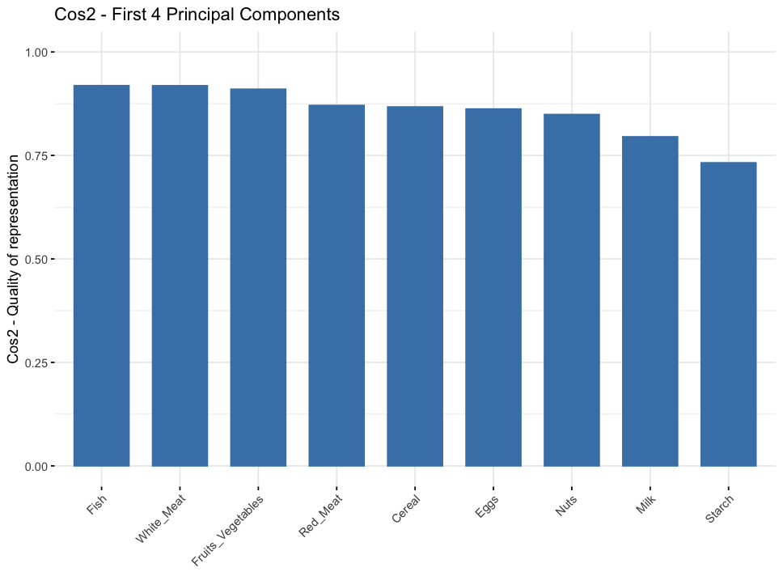

Visualising contribution of each variable to principal components
We can use a $cos^{2}$ transform to get back our original variables from the principal components – this shows how much the variables correspond to each principal component.

Slide 19
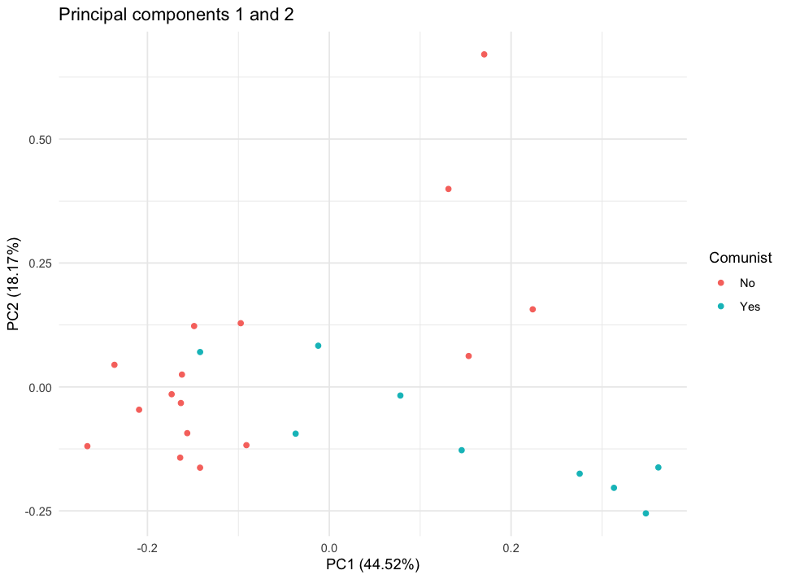
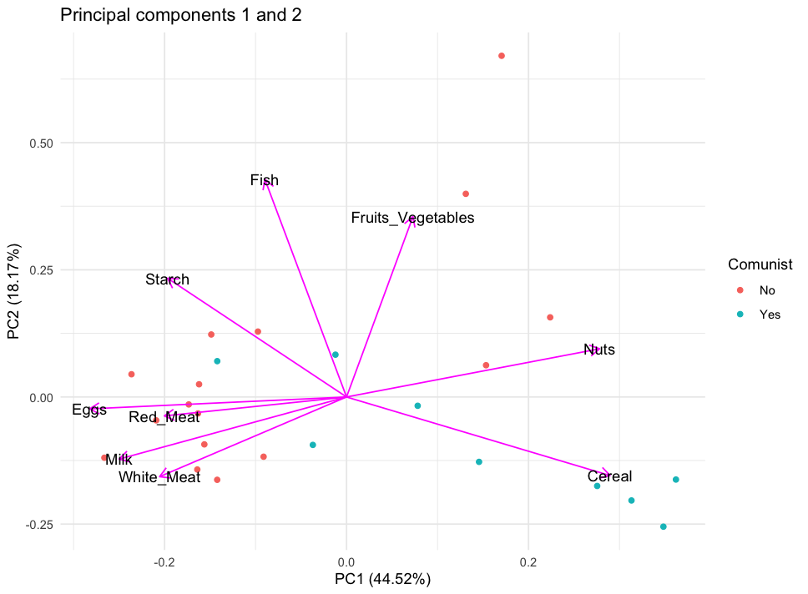
Plotting the principal components

Slide 20
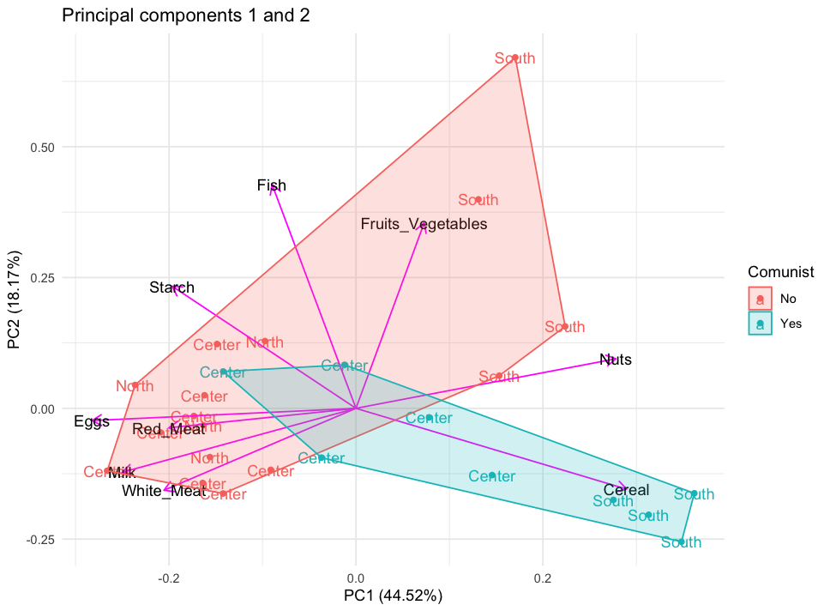
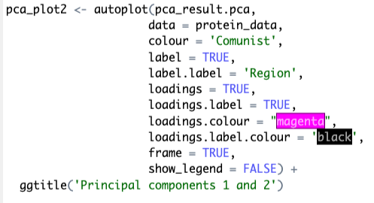
Plotting the principal components

Slide 21
Recap: Why is this useful?
Suppose you have a high number of variables – based on the output of a PCA, you could combine these variables for further downstream analysis.
This is particularly helpful when the amount of data or number of variables is large.
It can also be an exploratory tool to inform downstream analysis – these variables may be grouped together for a reason, and you can use further analyses to try and uncover what this reason is.
With PCA, the clustering is completely interpretable and you can still get your original variables back.

Slide 22
Other methods of dimensionality reduction
There’s a whole field of mathematics and statistics dedicated to dimensionality reduction – it’s a huge topic!
Other popular examples include t-SNE (t-distributed stochastic neighbour embedding) and UMAP (Uniform Manifold Approximation and Projection)
Some of these have been controversial! But as simple visualisation and clustering tools, they can be ok.

Slide 23
UMAP - Uniform Manifold Approximation and Projection
UMAP is based on techniques from ✨ algebraic topology✨
We won’t go into details about how it is calculated, and it’s actually quite convoluted.
However, the implementation is simple, we will use the package uwot in R.

Slide 24
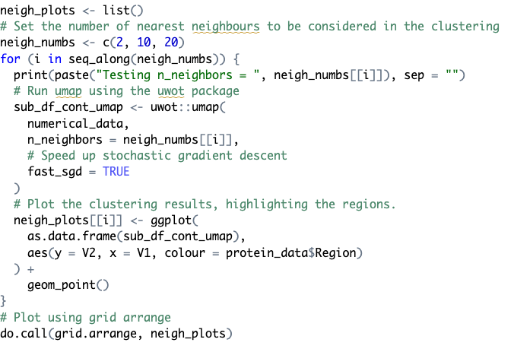
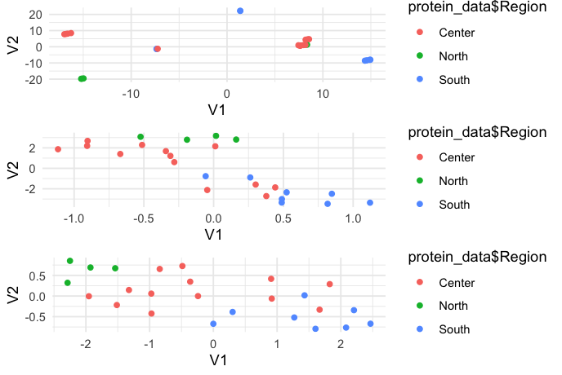
Visualising UMAP clusters

