Slide 2
@GENT
SPITE Hands On
Application Centric Development of a Smart Home Application
24/02/2022

Slide 3
Application Centric Development
DEVICE CENTRIC DESIGN
APPLICATION CENTRIC DESIGN
Device Selection
Device Agnostic
Application Development
VS
Application Development
based on selected devices
Device Selection
Notes:
Most of the IoT applications are developed as follows,
First of all the IoT devices that will be used in the application are selected.
After that, the application is developed, based on these selected devices. Technology specific code (such as code to communicate with the devices, and code to parse the incoming data) is embedded in the application code. It’s time consuming to replace or adapt this code.
Therefore we suggest application centric design. First, the focus is on the design and development of the application, thereafter selection of devices can be done.
This means that the development of the application is completely separated from device technologies and vendors.

Slide 4


Application Centric Development
NEW
DEVICE CENTRIC DESIGN
APPLICATION CENTRIC DESIGN
Device Selection
Device Selection
Device Agnostic
Application Development
VS
Device Selection
Device Selection
Application Development
based on selected devices
Device Selection
Notes:
software survives hardware lifetime
When a new device is introduced in the system there is no need to rewrite the application, only the configurations of the system must be adapted. The develop costs of this is much less then rewriting the application. This also makes the applications much more flexible, as new devices, and device types can be added dynamically.

Slide 5
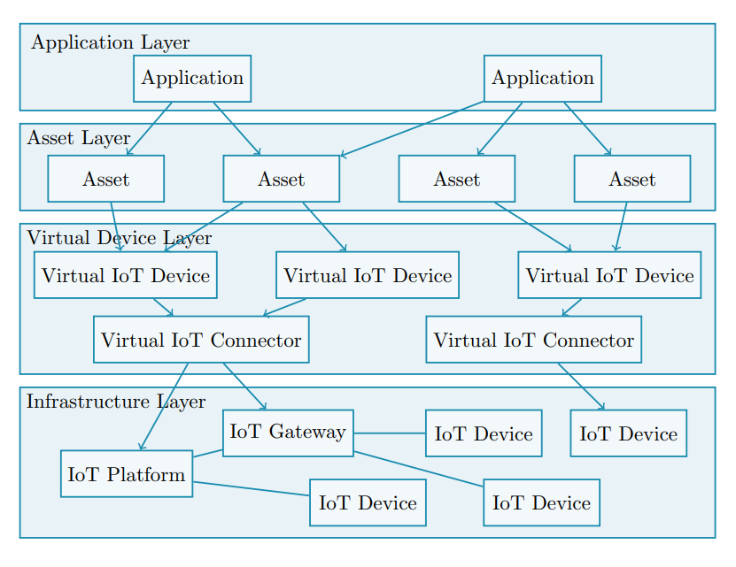
IoT Middleware
MQTT Driver
REST Driver

Slide 6
IoT Middleware
MQTT Driver
REST Driver

Slide 7
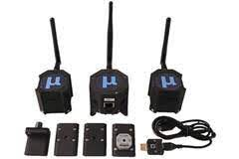
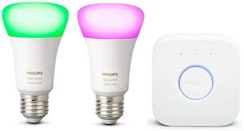
IoT Devices in the Tutorial

Slide 8
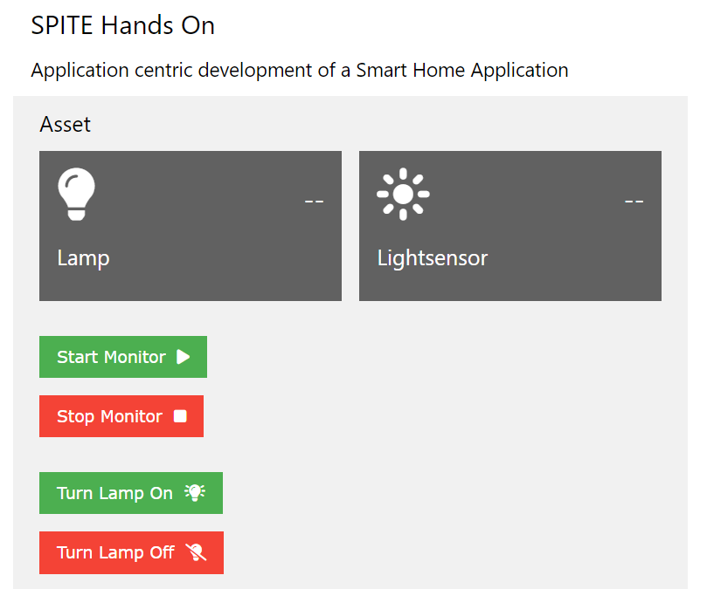

An IoT Web Application

Slide 9
VM NETWORK SETTING: Bridged Adapter
An IoT Web Application
Getting the code
git clone https://github.com/ku-leuven-msec/spite-hands-on.git
subl spite-hands-on
cd spite-hands-on
npm start

Slide 10
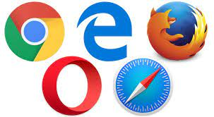
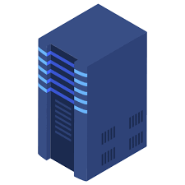
We’ve done this
Sockets
The IoT Middleware takes care of this
REST, MQTT
Your Job:
Correctly configure & address the IoT Middleware

Slide 11
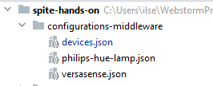
Configure the IoT Middleware
Device configurations – what are the configurations of the physical devices.
Examples: MAC address, ids, …
Device driver configurations – what are accessible device parameters
And how do we address them.

Slide 12
Configure VersaSense
{ "deviceId":"lightsensor_1", "type":"versasense", "settings" : { "mac": "00-17-0D-00-00-30-E9-62", "pid1":"9803", "pid2": "9805" } }

Slide 13
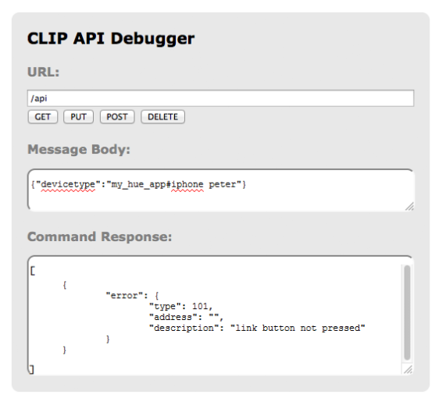
NETWORK: IoT_MSEC2
PWD: IB2games
Configure Philips Hue Devices
{ "deviceId":"lamp_1", "type":"philips-hue-lamp", "settings" : { "ip":“?", "auth-id":“?", "id": “?" } },
{"devicetype":“spite-tutorial#ilse"}
https://discovery.meethue.com
{ip}/debug/clip.html

Slide 14
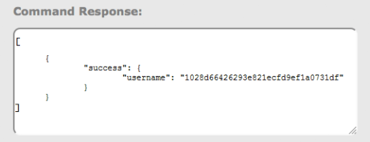
NETWORK: IoT_MSEC2
PWD: IB2games
Configure Philips Hue Devices
{ "deviceId":"lamp_1", "type":"philips-hue-lamp", "settings" : { "ip":“?", "auth-id":“?", "id": “?" } },
{"devicetype":“spite-tutorial#ilse"}
https://discovery.meethue.com
{ip}/debug/clip.html
auth-id

Slide 15
NETWORK: IoT_MSEC2
PWD: IB2games
Configure Philips Hue Devices
{ "deviceId":"lamp_1", "type":"philips-hue-lamp", "settings" : { "ip":“?", "auth-id":“?", "id": “?" } },
/api/{auth-id}/lights
https://discovery.meethue.com
{ip}/debug/clip.html
or
auth-id
See lamp

Slide 16
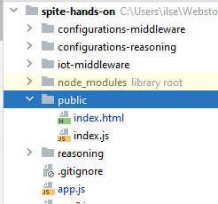
See code

Slide 17
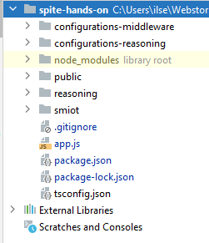
Time to make it work!
const middleware = require('./iot-middleware/control/engine') const engine = new middleware.Engine(); engine.setup('./configurations-middleware/devices.json');
var device = engine.getDevice(<id>);
device.getParameter(<param>);
returns a promise
promise.then(val => <handle value>).catch( err => <handle error>)
device.setParameter(<param>, <value>);
returns a promise
device.monitorParameter(<param>, <callback function>);
device.stopMonitorParameter(<param>);
socket.emit(<event>,<msg>);

Slide 18
io.on('connection', function (socket) { console.log("New socket connected"); socket.on('start-monitor', function (msg){ console.log("TODO write code to monitor devices"); engine.getDevice('lamp_1').monitorParameter("lightstatus", value => { socket.emit('lamp-value', value); }); engine.getDevice('lightsensor_1').monitorParameter("state", value => { socket.emit('lightsensor-value', value); }) }); socket.on('stop-monitor', function (msg){ console.log("TODO write code to stop monitor devices"); engine.getDevice('lamp_1').stopMonitorParameter("lightstatus"); engine.getDevice('lightsensor_1').stopMonitorParameter("state"); }); socket.on('lamp-on', function (msg){ console.log("TODO write code to turn lamp on"); engine.getDevice('lamp_1').setParameter("lightstatus", true).then(console.log("lamp turned on")); }); socket.on('lamp-off', function (msg){ console.log("TODO write code to turn lamp off"); engine.getDevice('lamp_1').setParameter("lightstatus", false).then(console.log("lamp turned off")); }); });

Slide 19
Thank you!
michiel.willocx@kuleuven.be

