Slide 1
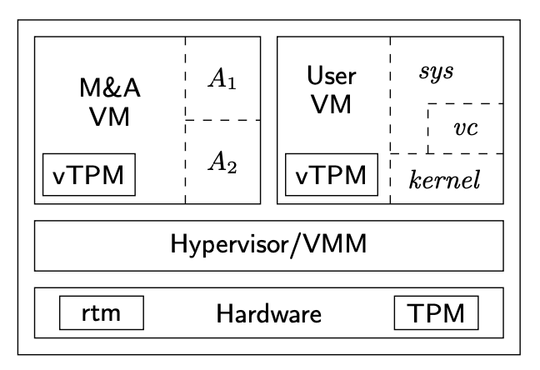
Say we have the architecture from “Confining the Adversary” Paper
3
4
2
1

