Slide 1
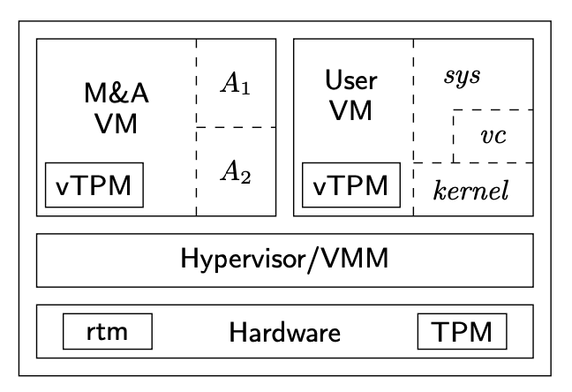
Say we have the architecture from “Confining the Adversary” Paper
3
4
2
1

Slide 2
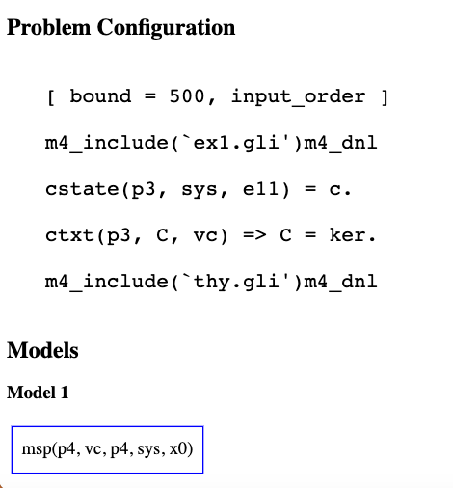
First protocol…. Just measure virus checker
I have no idea what I’m doing with problem configuration
Model doesn’t show anything interesting…

