Slide 1
Goals of cost analysis
Ultimate goal: guide selection of a protocol
How:
systematic variation of assumption
assigning cost to each component that's corrupted
Assign low (or high?) values to difficult actions
Cost may reflect ordering
Realize set of protocols, one with minimum (maximum) cost

Slide 2
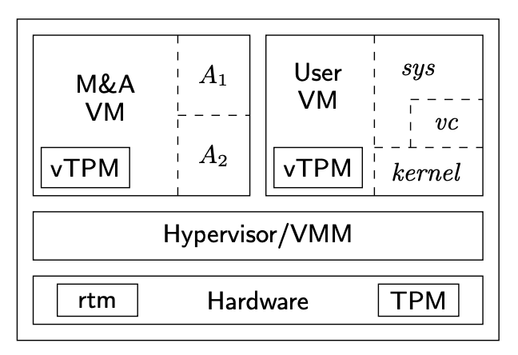
Say we have the architecture from “Confining the Adversary” Paper
ms(rtm, A1)
ms(rtm, A2)
ms(A1, vc)
ms(A2, ker)
msker (vc, sys)
3
4
2
1

Slide 3
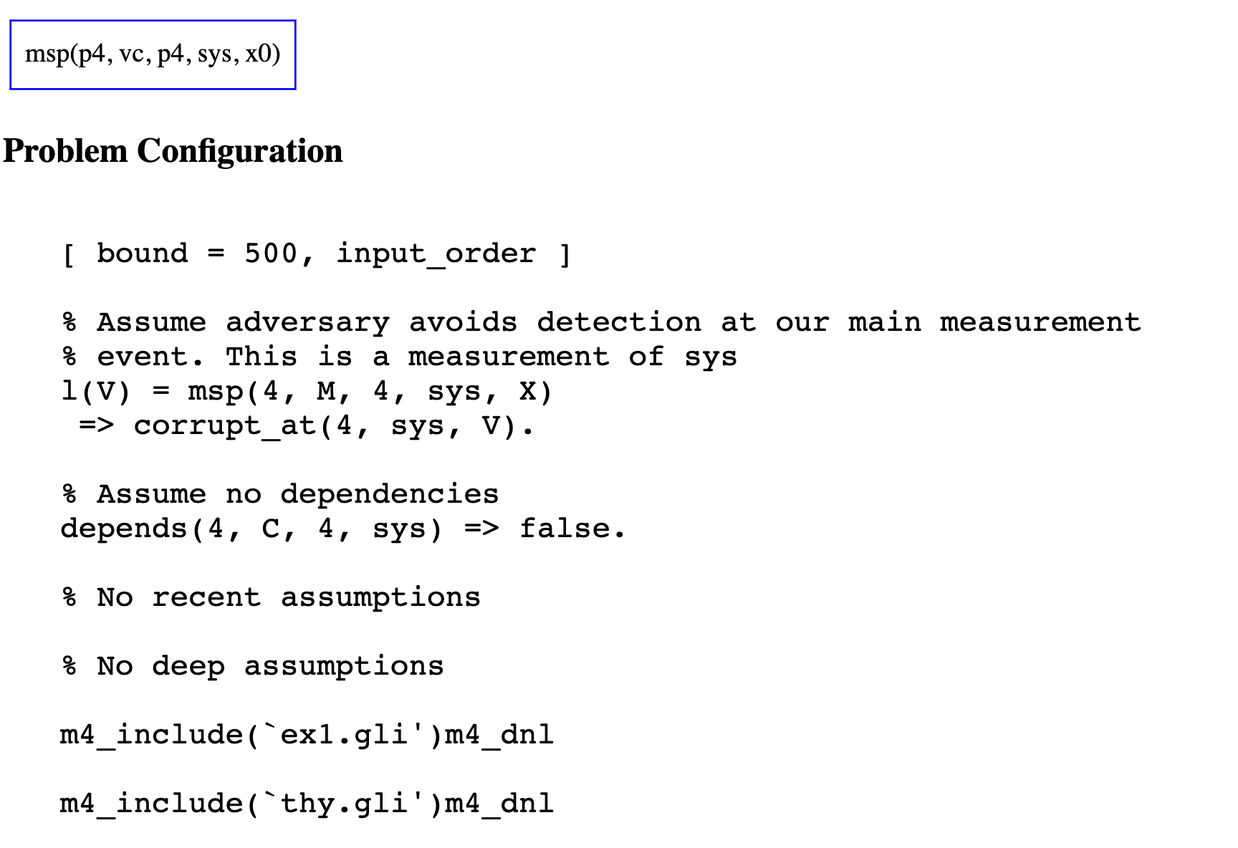
First protocol…. Just measure sys using vc
Protocol:
@4 [vc 4 sys]
Model doesn’t show anything interesting…
No adversary actions

Slide 4
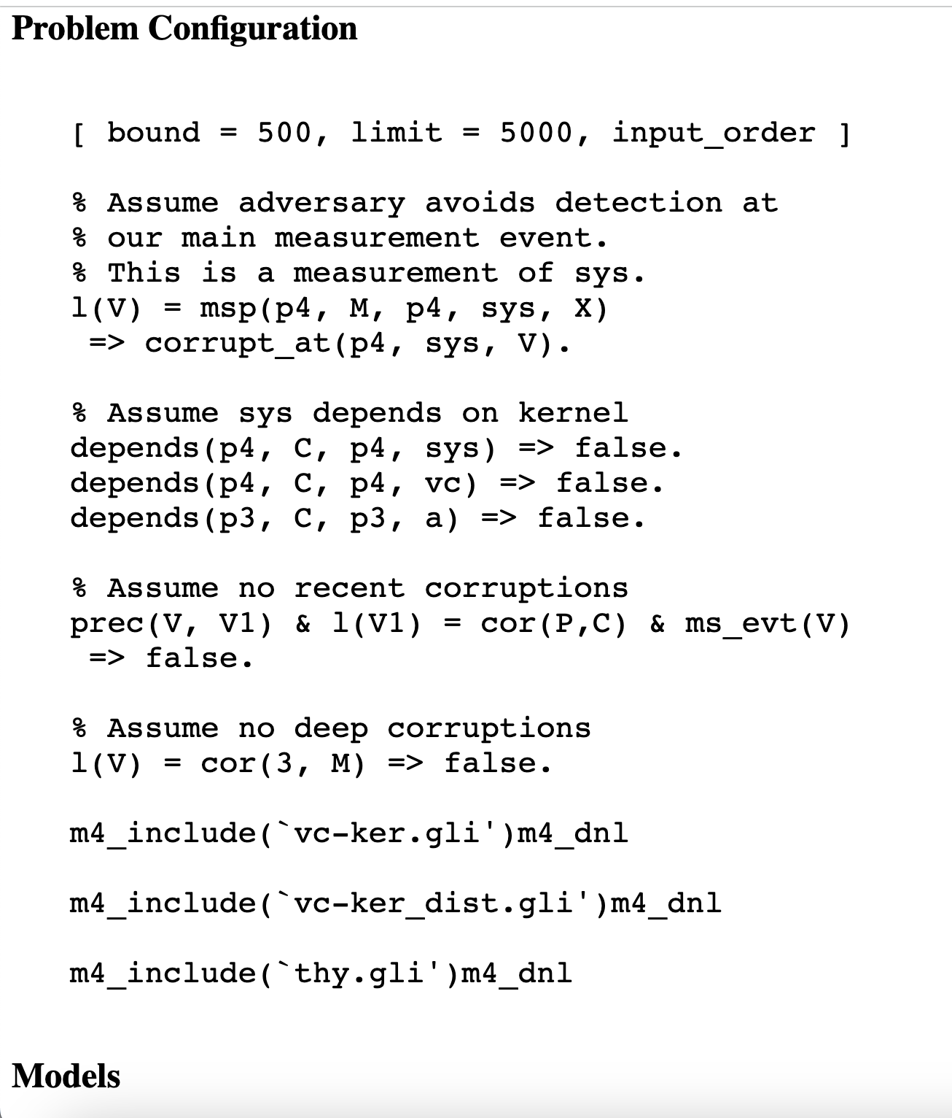
Measure vc and sys in parallel
Protocol
*target: @p3 [a p4 vc] +~+ @p4 [vc p4 sys]
Analysis
No models… this is expected

Slide 5
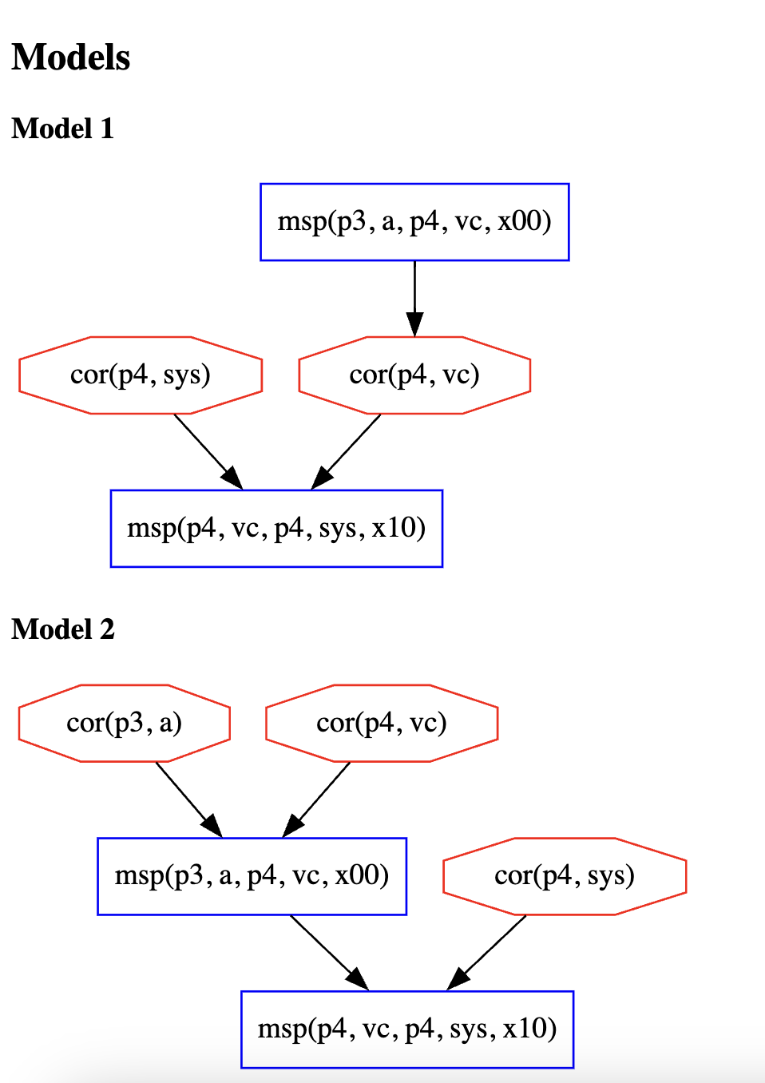
Measure vc and sys in sequence
Protocol
*target: @p3 [a p4 vc]
+<+ @p4 [vc p4 sys]
Analysis
No models if recent or deep assumption… this is expected
Interesting model if no recent + deep assumptions

Slide 6
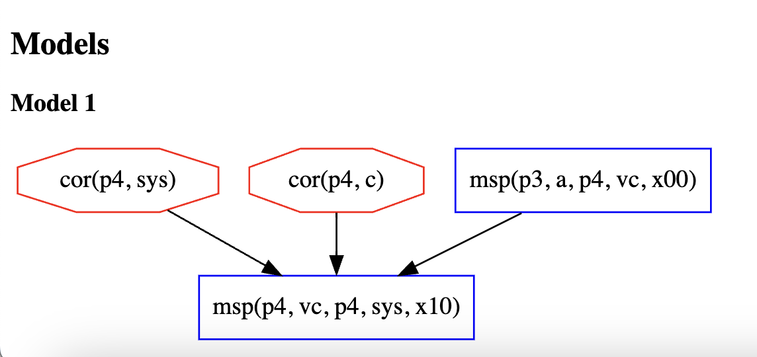
Assume recent + deep but include dependencies
Protocol
*target: @p3 [a p4 vc]
+<+ @p4 [vc p4 sys]
Dependency
depends(p3, C, p3, a) => C = p2.
Analysis
Adversary can corrupt sys or c before an attestation
Maybe because this directly impacts the final measurement… it should have a higher cost?

Slide 7
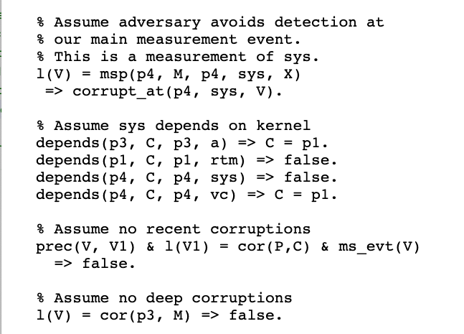
Measure a then vc then sys in parallel
Protocol
*target: @p1 [rtm p3 a
+<+ @p3 [a p4 vc
+<+ @p4 [vc p4 sys]]]]
Analysis
No models with recent + deep theorem, and dependencies

Slide 8
Thoughts/Takeaways
Cost of adding an assumption?
Cost of adding a dependencies?
Cost of applying recent/deep theorem?
Should we consider this a standard assumption?

