Slide 1
Goals of cost analysis
Ultimate goal: guide selection of a protocol
How:
Systematic variation of assumption
Assign abstract cost to each component that's corrupted
Consider:
Cost to adversary
Cost to attester
attester
adversary

Slide 2
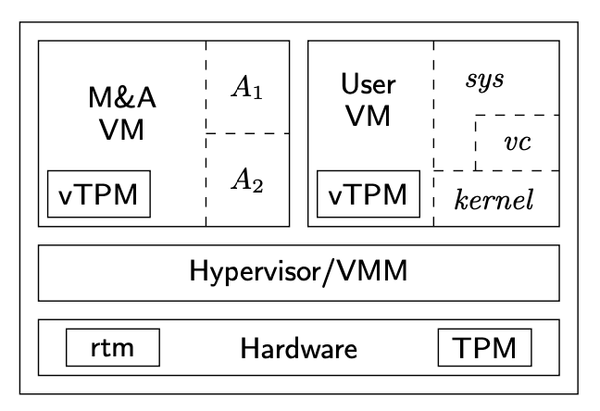
Say we have the architecture from “Confining the Adversary” Paper
ms(rtm, A1)
ms(rtm, A2)
ms(A1, vc)
ms(A2, ker)
msker (vc, sys)
3
4
2
1

Slide 3
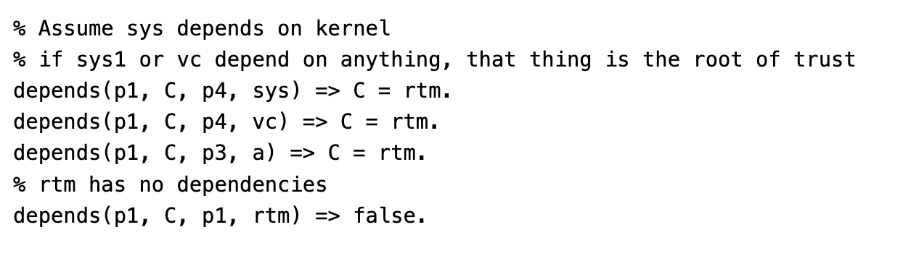
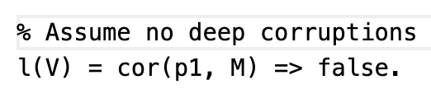
Control Variables
Assumptions
Always assume recent/deep
Make no assumptions about system dependencies except…
TPM is the root of trust… has no dependencies
Virus checker and system depend on the hardware (p1,rtm)
A1 depends on the hardware (p1,rtm)
Side note: I changed all theory files to the original… allows for corruption only at the same place
If I made it allow for corruption at different places… CHASE seemed to introduce corruption events with odd labels

Slide 4
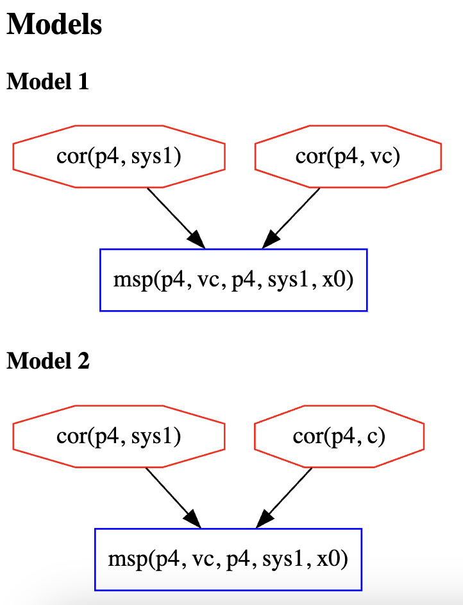
First protocol…. Just measure sys using vc
sys
1
3
1
2
Event | Cost
cor(p4,sys1) | c1
cor(p4,vc) | c3
cor(p4,c) | c2
MODEL 1 COST | c1 + c3
MODEL 2 COST | c1 + c2
If you add in dependencies about a then labels to corruption events change

Slide 5
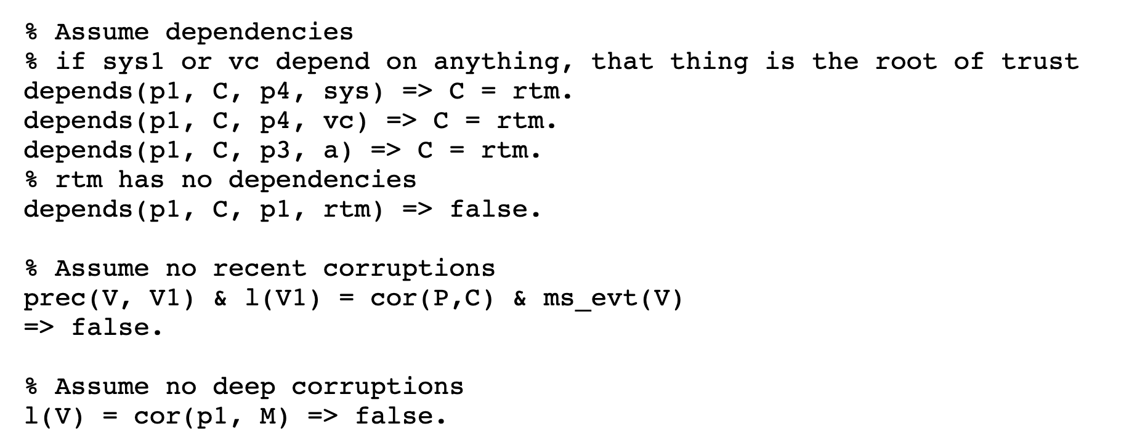
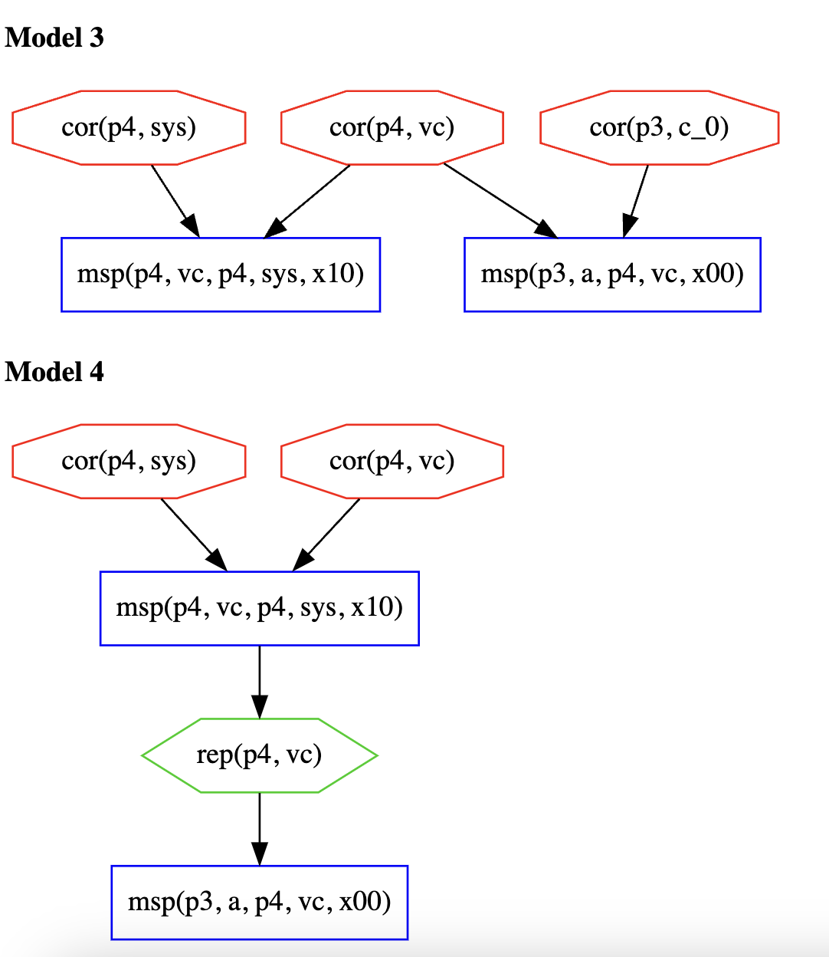
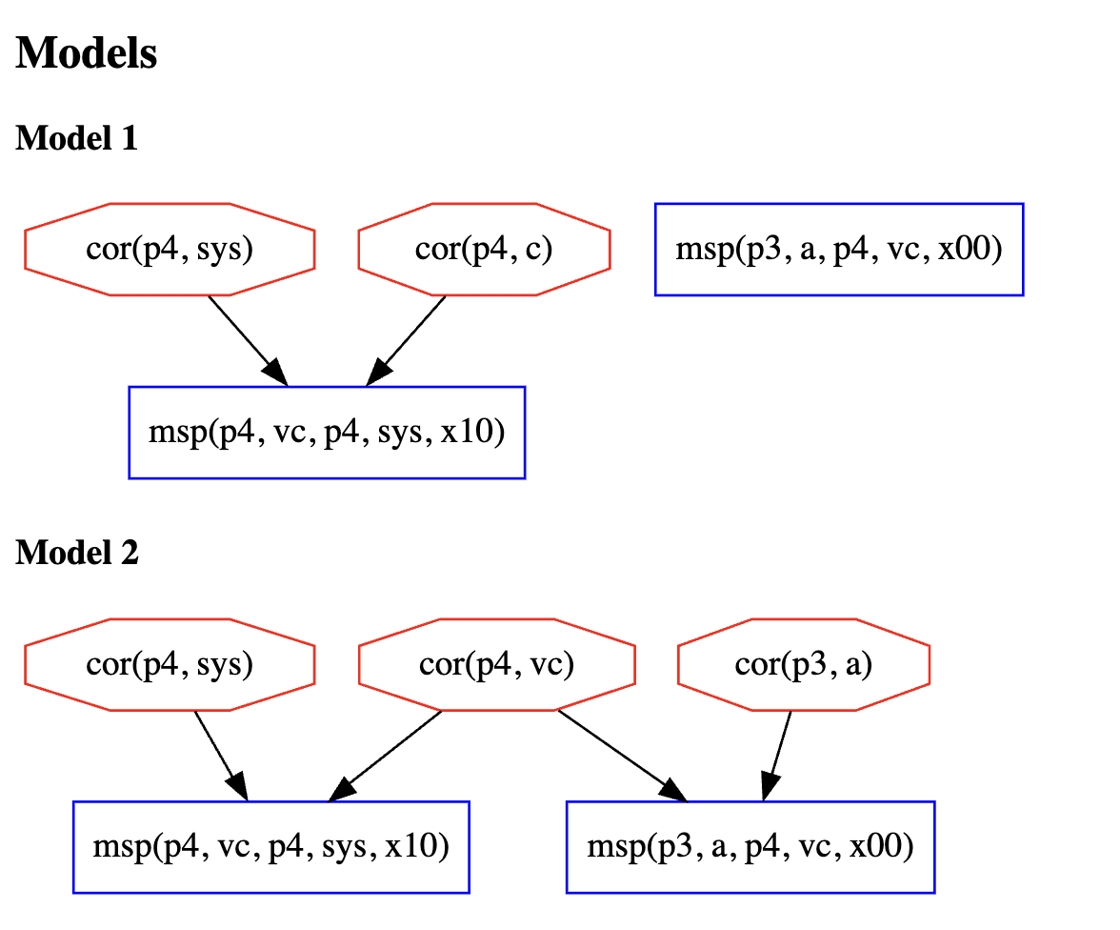
Measure vc and sys in parallel
vc-sys-par
Protocol
*target: @p3 [a p4 vc]
+~+ @p4 [vc p4 sys]
1
3
4
Model | Total cost
1 | c1 + c2
2 | c1 + c3 + c5
3 | c1 + c3 + c4
4 | c1 + c3 + c7
1
2
1
3
1
3
5
7
Notes:
For example, here place names change if you assume things can be corrupt at different places

Slide 6
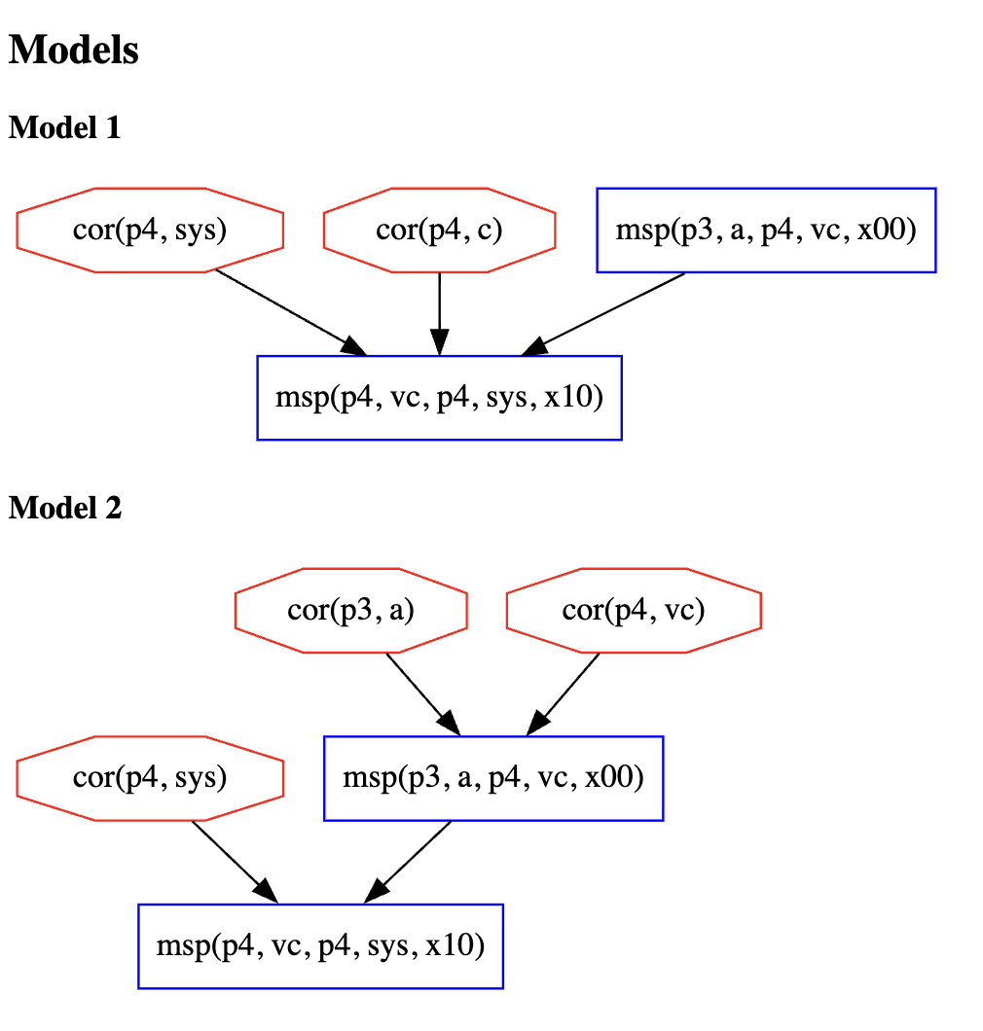
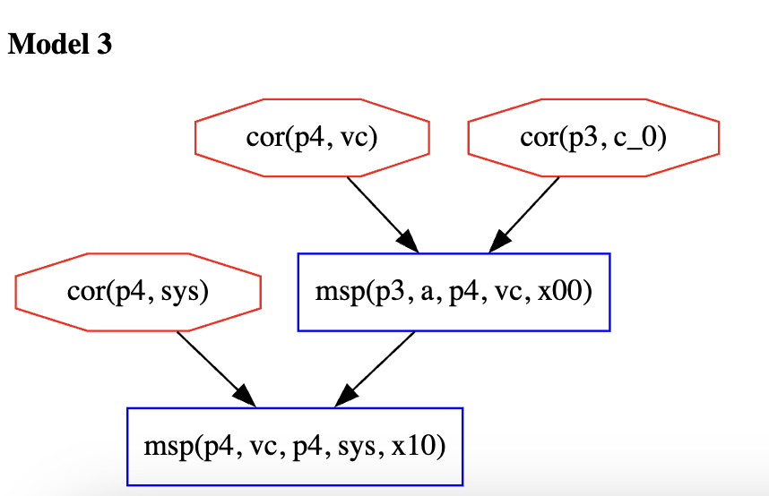
Measure vc and sys in sequence
vc-sys-seq
Protocol
*target: @p3 [a p4 vc]
+<+ @p4 [vc p4 sys]
Model | Total cost
1 | c1 + c2
2 | c1 + c3 + c4
3 | c1 + c5 + c3
1
2
5
3
3
4
1
1
If you add deep thm about p3 model 2 and 3 are removed

Slide 7
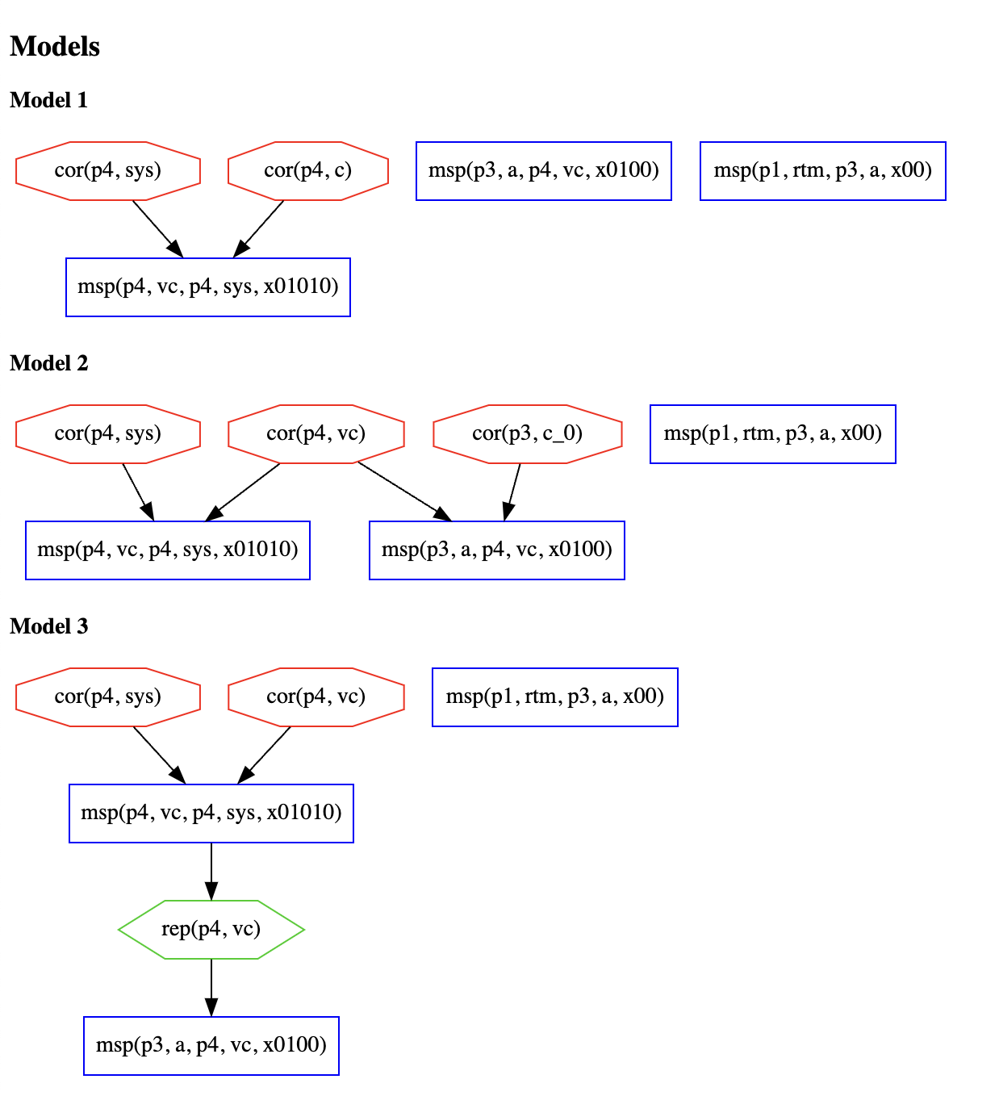
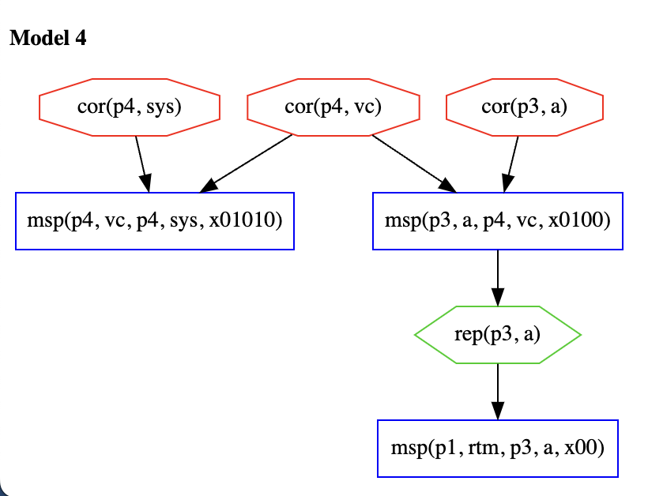
Measure a then vc then sys in parallel
a-vc-sys-par
Protocol
*target: @p1 [rtm p3 a
+~+ @p3 [a p4 vc
+~+ @p4 [vc p4 sys]]]]
1
2
1
3
4
Model | Total cost
1 | c1 + c2
2 | c1 + c2 + c4
3 | c1 + c3 + c7
4 | c1 + c3 + c5 + c6
1
3
1
3
5
7
6
Notes:
I’ve done something wrong here… p1 can’t be corrupted bc it’s the root of trust…

Slide 8
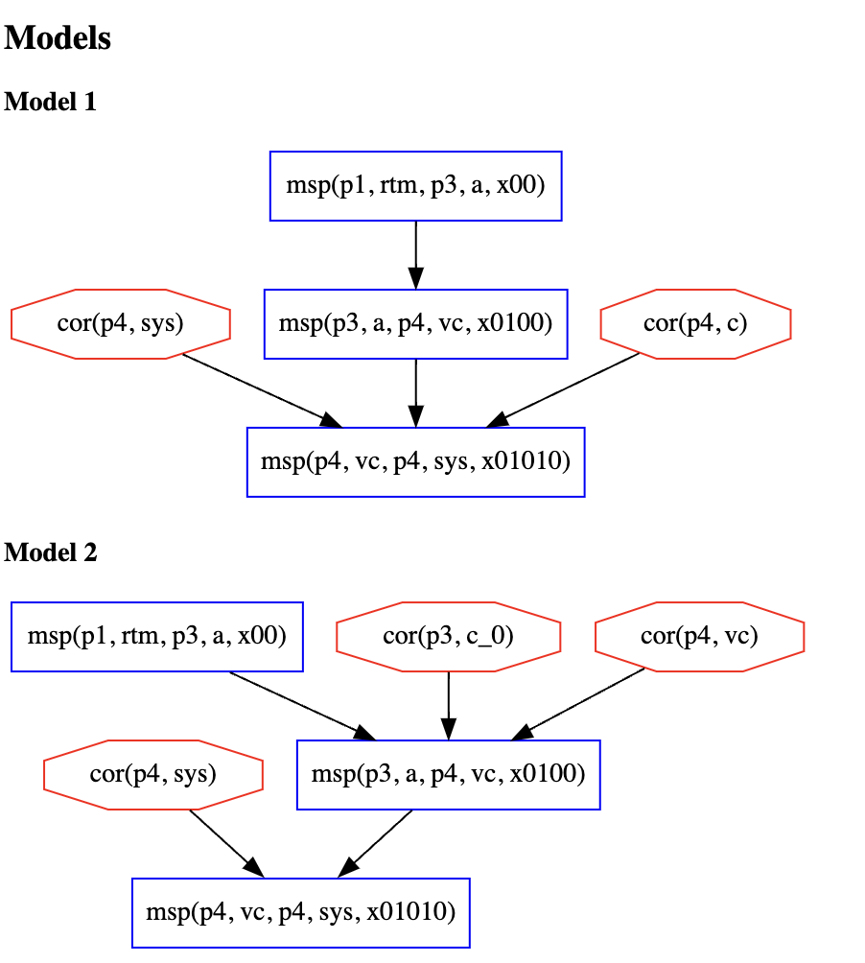
Measure a then vc then sys in sequence
a-vc-sys-seq
Protocol
*target: @p1 [rtm p3 a
+<+ @p3 [a p4 vc
+<+ @p4 [vc p4 sys]]]]
1
2
Model | Total cost
1 | c1 + c2
2 | c1 + c3 + c4
4
3
1

Slide 9
All together
label | protocol | total cost
sys | *target: @p4 [vc p4 sys1] | (c1 + c3) OR (c1 + c2)
vc-sys-par | *target: @p3 [a p4 vc] +~+ @p4 [vc p4 sys] | (c1 + c2) OR (c1 + c3 + c5) OR (c1 + c3 + c4) OR (c1 + c3 + c7)
vc-sys-seq | *target: @p3 [a p4 vc] +<+ @p4 [vc p4 sys] | (c1 + c2) OR (c1 + c3 + c4) OR (c1 + c5 + c3)
a-vc-sys-par | *target: @p1 [rtm p3 a +~+ @p3 [a p4 vc +~+ @p4 [vc p4 sys]]]] | (c1 + c2) OR (c1 + c2 + c4) OR (c1 + c3 + c7) OR (c1 + c3 + c5 + c6)
a-vc-sys-seq | *target: @p1 [rtm p3 a +<+ @p3 [a p4 vc +<+ @p4 [vc p4 sys]]]] | (c1 + c2) OR (c1 + c3 + c4)

Slide 10
Event with label and cost
Event | Label | Cost | Present In
cor(p4,sys) | 1 | c1 | sys(1,2),vc-sys-par(1,2,3,4), vc-sys-seq(1,2,3), a-vc-sys-par(1,2,3,4), a-vc-sys-seq(1,2)
cor(p4,c) | 2 | c2 | sys(2), vc-sys-par(2), vc-sys-seq(1), a-vc-sys-par(1,2), a-vc-sys-seq(1)
cor(p4,vc) | 3 | c3 | sys(1), vc-sys-par(2,3,4), vc-sys-seq(2,3), a-vc-sys-par(3,4), a-vc-sys-seq(2)
cor(p3, c_0) | 4 | c4 | vc-sys-par(3), vc-sys-seq(2), a-vc-sys-par(2), a-vc-sys-seq(2)
cor(p3,a) | 5 | c5 | vc-sys-par(2), vc-sys-seq(3), a-vc-sys-par(4)
rep(p3,a) | 6 | c6 | a-vc-sys-par(4)
rep(p4,vc) | 7 | c7 | vc-sys-par(4), a-vc-sys-par(3)

Slide 11
Thoughts/Takeaways

