Slide 1
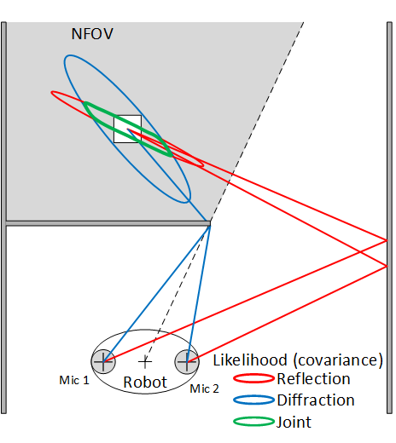
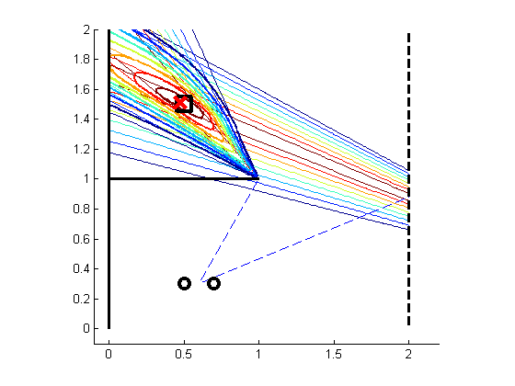
Non-Field-Of-View Indoor Sound Source Localization based on Reflection and Diffraction
Kuya Takami and Tomonari Furukawa
Mechanical Engineering, Virginia Tech, USA
Makoto Kumon
Mechanical System’s Engineering, Kumamoto University, Japan
Lin Chi Mak
AP Photonics Limited, Hong Kong
A new acoustic localization approach for a mobile target outside the field-of-view, or the non-field-of-view of an optical sensor
The approach is based on the reflection and diffraction signals.
A sensor platform determines a reflection time difference of arrival and frequency dependent diffraction to two distinct observation likelihoods from a single target's sound
The fusion of these likelihoods, a joint acoustic observation likelihood, estimate the NFOV target probabilistically within the RBE framework
Joint acoustic observation likelihood

