Slide 1


AI-Based Traffic Monitoring and Anomaly Detection System
Mini Project | Project Phase – 1 | B.Tech Computer Science Engineering
Submitted by
Parth Solanki [202407020494]
Swayam Tanna [202407020495]
Jay Thakkar [202407020496]
Project Mentor: Ms. Pragya Vats
UnitedWorld Institute of Technology, Karnavati University
Notes:
Introduce your team, the topic and your mentor. One line: this project uses AI on camera video to watch traffic and flag unusual events automatically.

Slide 2
Presentation Outline
1
2
3
Abstract
Introduction
Requirements & Design
Summary of the project
Problem · Objectives · Scope
Hardware · Software · Architecture · Diagrams
4
5
6
Implementation
Conclusion
Future Scope
Technologies · Outputs
What this phase achieved
Where the project can grow
Notes:
Quickly walk through the six parts of the report.

Slide 3



Abstract
The problem
Watching many CCTV feeds by hand is tiring and slow, so accidents, breakdowns and wrong-way driving are noticed late.
The approach
YOLO vehicle detection, multi-object tracking and a hybrid anomaly detector that mixes rule-based checks with machine learning.
The outcome
A live dashboard with vehicle counts, traffic density and alerts, plus event logs saved with snapshots and timestamps.
Traffic Monitoring
Anomaly Detection
Computer Vision
Deep Learning
YOLO
Object Tracking
Notes:
Problem, approach, outcome. Mention that this is Phase 1: design and plan; implementation and testing follow in Phase 2.

Slide 4





Why manual traffic monitoring falls short
Manual monitoring
Fixed-time signals
Costly counting
One operator cannot watch dozens of feeds, so incidents are missed.
Pre-set cycles ignore real queue length and density.
Loops and manual surveys are expensive and give limited data.
The need
An automated, camera-based system that monitors traffic continuously and flags abnormal events in real time.
Delayed response
Unused footage
Accidents are reported by the public, not detected automatically.
Recordings are watched only after an incident happens.
Notes:
Indian roads are dense and mixed: cars, bikes, autos, buses, trucks and pedestrians together. Manual methods cannot keep up.

Slide 5
Aim and Objectives
Aim: Design and develop an AI-based system that monitors road traffic from video and automatically detects anomalous events in real time.
1
Study existing traffic monitoring and anomaly detection techniques
5
Detect stopped, wrong-way, over-speeding and sudden-congestion events
2
Detect and classify vehicles with a deep-learning detector
6
Raise real-time alerts; store event logs with snapshots
3
Track vehicles and estimate speed and direction
7
Show everything on an easy operator dashboard
4
Count vehicles; estimate density and congestion
Notes:
Read the aim, then go through the objectives quickly. They map to the modules shown later.

Slide 6


Scope of the Project
In scope
Out of scope
Live camera streams (RTSP / webcam) and recorded video
Detection, classification, tracking and counting of vehicles
Rule-based and ML-based anomaly detection
Dashboard with live view, statistics, alerts and history
Evaluation on public datasets and local road videos
Automatic number-plate recognition and e-challan
Direct control of traffic signals or control-room hardware
Large-scale multi-city deployment and edge optimisation
Limitations: accuracy depends on camera angle, lighting, weather and occlusion; speed estimation needs a fixed, calibrated camera.
Notes:
Be clear about what is in scope for this phase and what is deliberately left out.

Slide 7
System Requirements
Hardware
Software
Component | Minimum | Recommended
Processor | Core i5 (8th Gen) / Ryzen 5 | Core i7 / Ryzen 7 or higher
RAM | 8 GB | 16 GB or more
GPU | Optional (slow on CPU) | NVIDIA, 4 GB+ VRAM (CUDA)
Storage | 256 GB SSD | 512 GB SSD
Camera | 720p webcam / IP camera | 1080p IP camera, RTSP
Network | Broadband | Wired LAN for IP cameras
Language: Python 3.10+
Deep learning: PyTorch + Ultralytics YOLO
Vision: OpenCV
ML / data: NumPy, Pandas, Scikit-learn
Tracking: ByteTrack / DeepSORT
Dashboard: Streamlit or Flask
Database: SQLite
OS: Windows 10/11 or Ubuntu 22.04
Notes:
A normal GPU-enabled laptop or desktop is enough. Everything in the software stack is free and open source.

Slide 8
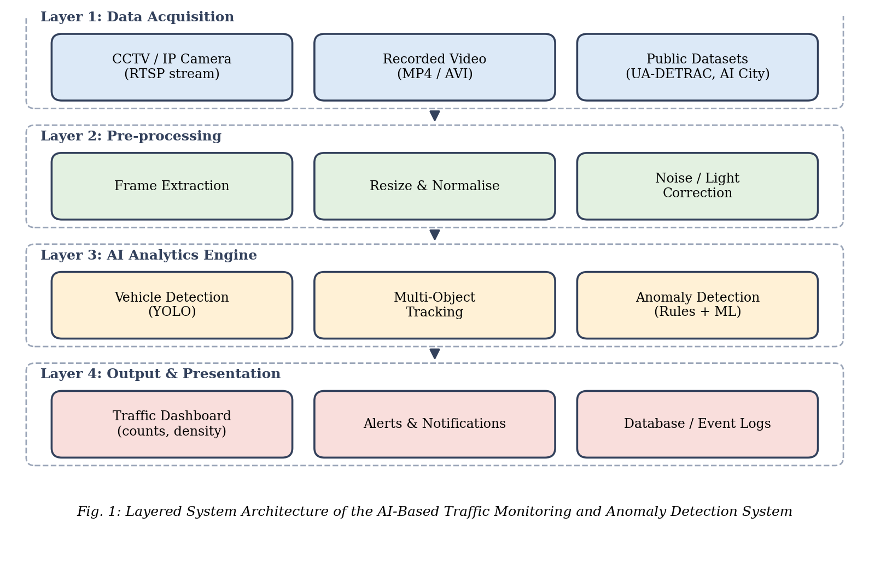
System Architecture: four layers
1
Data Acquisition
CCTV / IP cameras, video files and public datasets
2
Pre-processing
Frame extraction, resize, normalise, light correction
3
AI Analytics Engine
YOLO detection, tracking and anomaly detection
4
Output & Presentation
Dashboard, alerts and event database
Notes:
Each layer does one job and hands its output to the next, which keeps the design modular and easy to test.

Slide 9
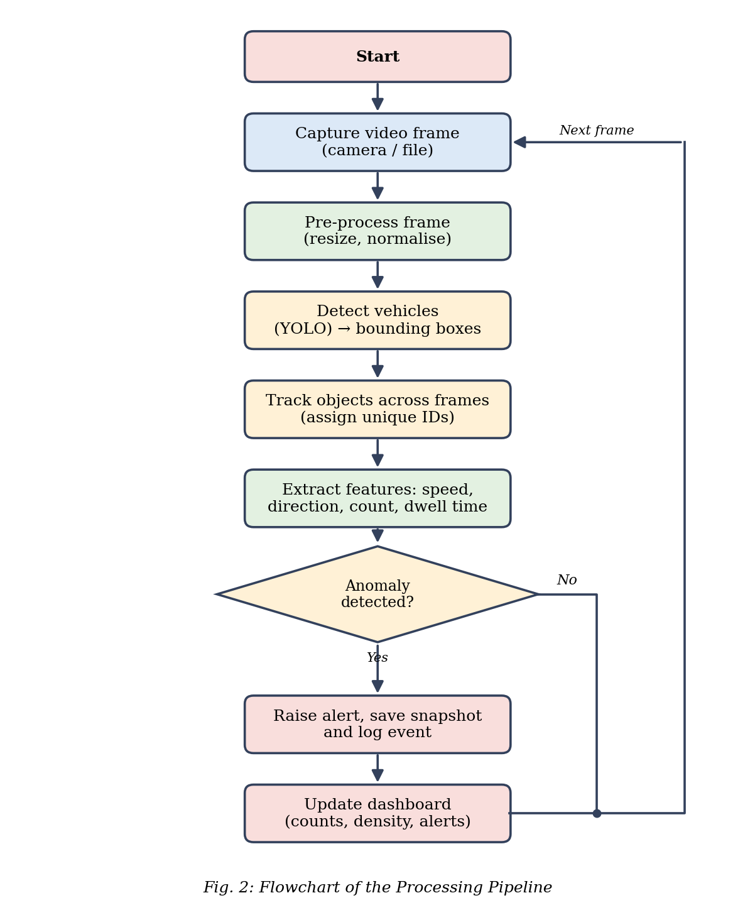
How each video frame is processed
1
Capture & pre-process
Frames from camera or file, resized and normalised
2
Detect
YOLO gives boxes, vehicle classes and confidence scores
3
Track
ByteTrack / DeepSORT keep one unique ID per vehicle
4
Analyse
Speed, direction, dwell time and lane density
5
Alert
Anomaly found: snapshot, log entry, dashboard update
Real-world speed comes from a perspective (homography) calibration.
Notes:
Walk through the five steps along the flowchart on the right. Speed is estimated using a perspective calibration of the road plane.

Slide 10
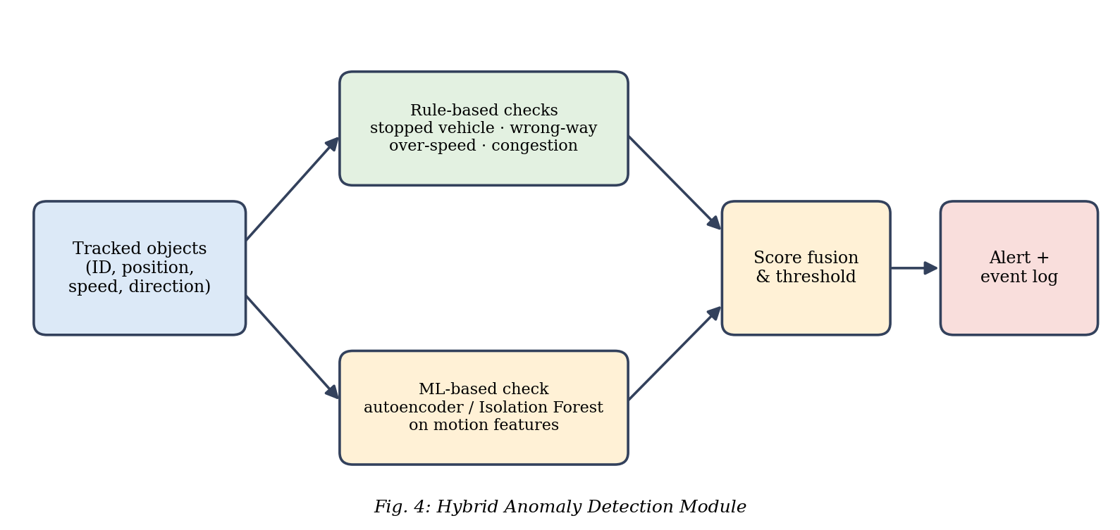





Hybrid anomaly detection
Rules
Explainable, no training data needed
Machine learning
Autoencoder / Isolation Forest finds unseen behaviour
Score fusion
Combining both reduces false alarms
Anomalies covered
Stopped vehicle
Wrong-way driving
Over-speeding
Sudden congestion
Pedestrian on road
Notes:
Rules are simple and explainable but only catch known events. ML can catch unusual behaviour that was not programmed. Combining both gives a more robust system.

Slide 11
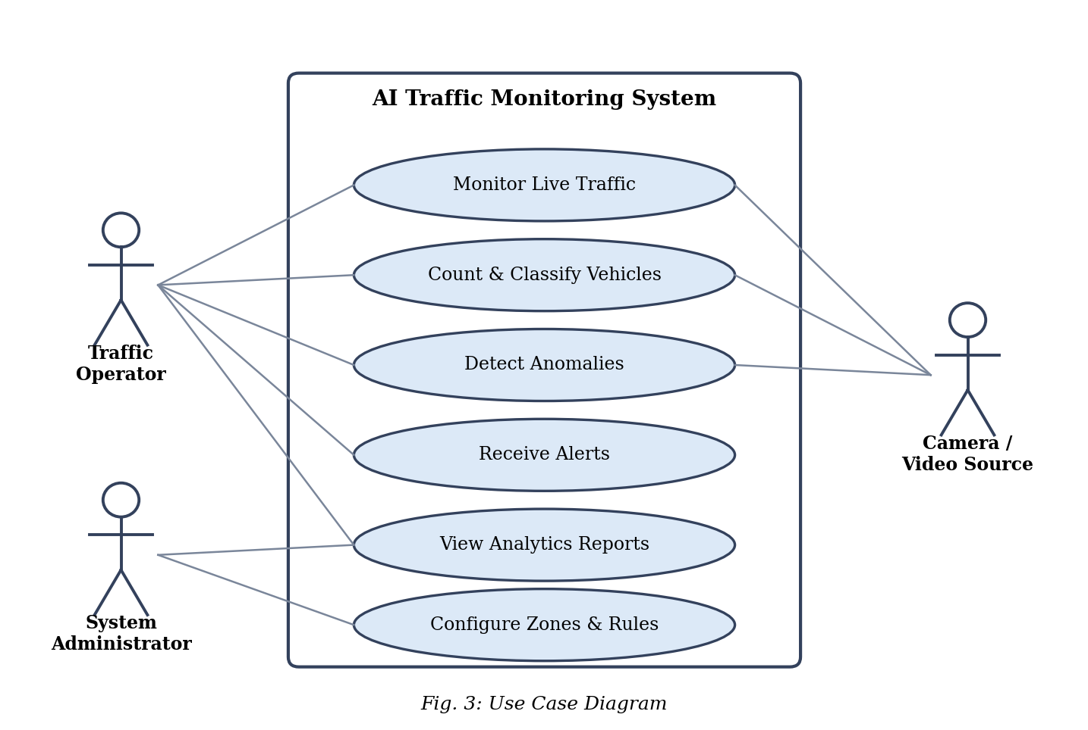



Use case diagram: who uses the system
Traffic operator
Monitors live traffic, views analytics and receives alerts
System administrator
Configures zones, lanes, thresholds and rules
Camera / video source
Supplies live streams or recorded video to the system
Notes:
Operators watch and receive alerts, administrators configure zones and rules, and the camera or video source feeds the system.

Slide 12





Technologies Used
Python
OpenCV
PyTorch + YOLO
ByteTrack / DeepSORT
Main language for the full pipeline
Video capture, zones and overlays
Vehicle detection and classification
Multi-object tracking with IDs
Scikit-learn
Streamlit / Flask
SQLite
Colab + GitHub
Isolation Forest for ML anomaly scores
Dashboard for live view and alerts
Event logs, counts, alert history
GPU training and version control
Datasets: UA-DETRAC (detection and tracking) · COCO (pre-trained weights) · AI City Challenge (anomaly videos) · local road videos
Notes:
All tools are open source. YOLO is pre-trained on COCO and fine-tuned on traffic data.

Slide 13
Implementation plan
1
2
3
4
Collect & prepare data
Fine-tune YOLO
Integrate tracker
Define zones & lanes
Convert labels to YOLO format
Train on the required vehicle classes
Check IDs stay stable under occlusion
Counting lines and lane directions in config
5
6
7
Phase 2
Full implementation, training and testing on real traffic videos
Build anomaly checks
Build dashboard & DB
Test and tune
Rule-based checks plus ML model
Connect alerts and event storage
Different light, angles and density
Notes:
Steps 1 to 7 are the build plan. Phase 2 will carry out the full implementation, training and testing.

Slide 14
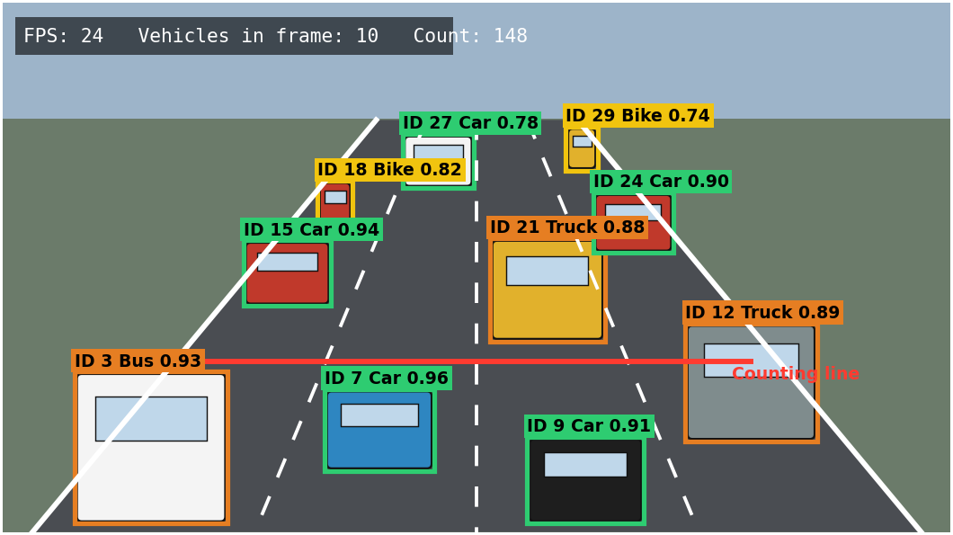
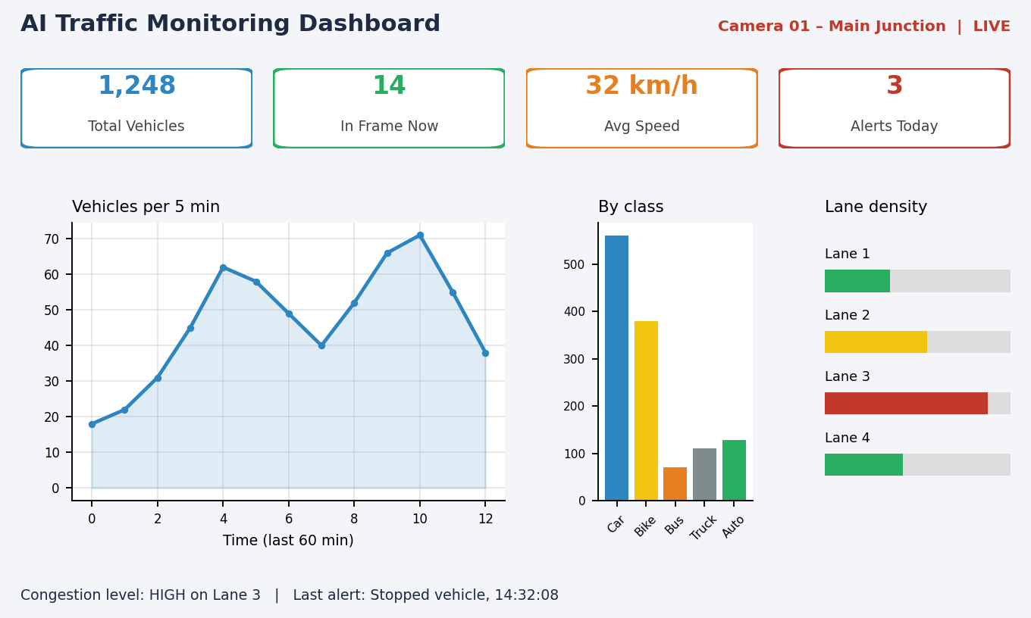
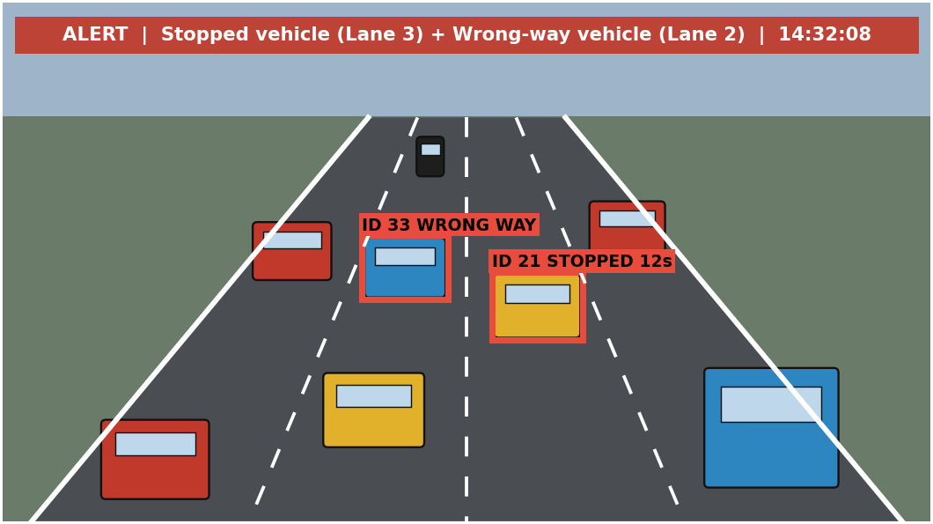
Expected outputs
Detection with boxes, classes and tracking IDs
Dashboard: counts, speed, class-wise count, lane density
Alert: stopped vehicle and wrong-way vehicle
Illustrative output screens of the proposed system.
How it will be evaluated
mAP
MOTA / IDF1
Precision · Recall · F1
False-alarm rate
FPS
Notes:
These are simulated illustrations of the intended output screens, prepared in the design phase. Real screenshots will come from the working prototype.

Slide 15



Conclusion
Phase 1 delivered a complete design for an AI-based traffic monitoring and anomaly detection system: YOLO detection, multi-object tracking and hybrid anomaly detection, supported by a dashboard and an event database.
Modular design
Affordable
Faster response
Four clear layers that are easy to build, test and extend.
Open-source tools on a normal GPU-enabled computer.
Less dependence on operators and earlier incident detection.
Next: full implementation, training, testing and tuning on real traffic videos.
Notes:
Summarise: problem studied, design completed, next phase is building and testing.

Slide 16







Future Scope
Number-plate recognition
Violation detection
Accident detection
Identify vehicles involved in violations
Helmet, seat-belt, red-light for e-challan
Severity estimation with video transformers
Adaptive signals
Edge deployment
Multi-camera tracking
Reinforcement learning from live density
Jetson / Raspberry Pi with TensorRT
Follow vehicles across junctions
Traffic prediction
Mobile app and cloud
Robustness
LSTM / graph networks forecast congestion
Alerts to police, ambulance and public
Night, fog, rain and heavy occlusion
Notes:
Pick two or three to speak about: ANPR, adaptive signals and edge deployment are the most practical next steps.

Slide 17
Thank You
Questions?
Parth Solanki · Swayam Tanna · Jay Thakkar | Mentor: Ms. Pragya Vats
Notes:
Invite questions.

