Slide 1
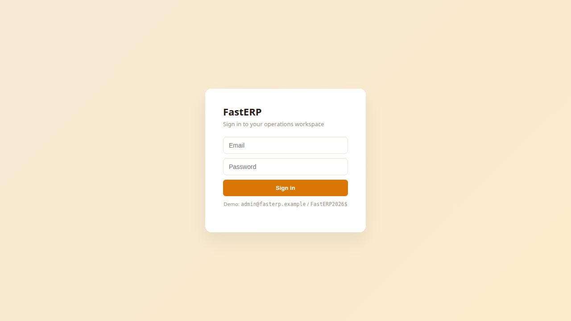
FastERP User Guide
Accounting Workspace User Guide
Self-contained synthetic demonstration

Slide 2
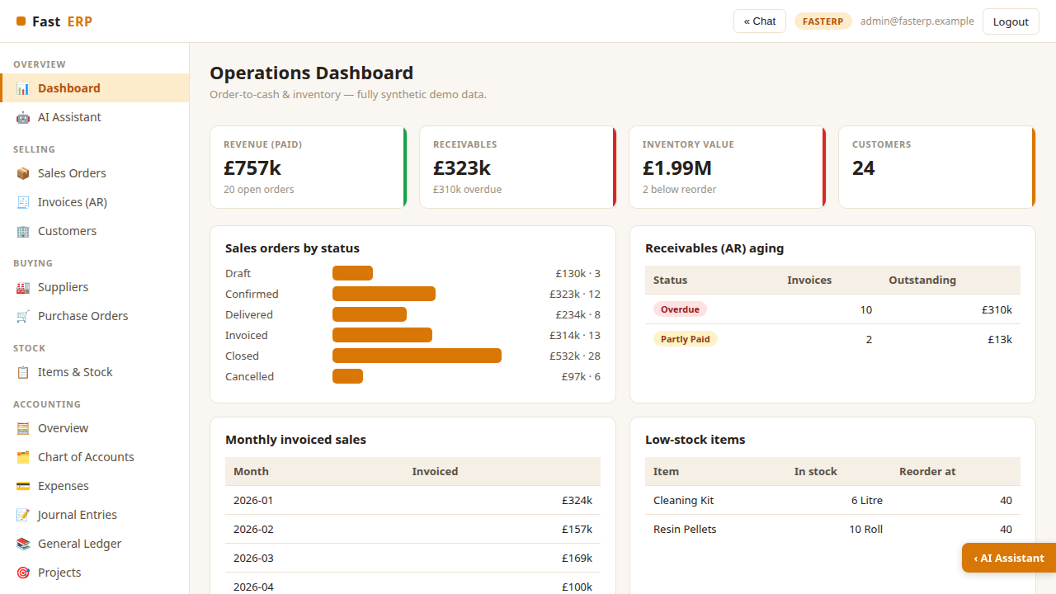
Operations dashboard
Start at the daily cockpit for paid revenue, receivables, inventory value and
open orders. The charts highlight order status, aging debt and low-stock items.
Collapse the AI rail whenever you need a wider working area.
FastERP · Synthetic accounting workspace · 2026-07-28

Slide 3
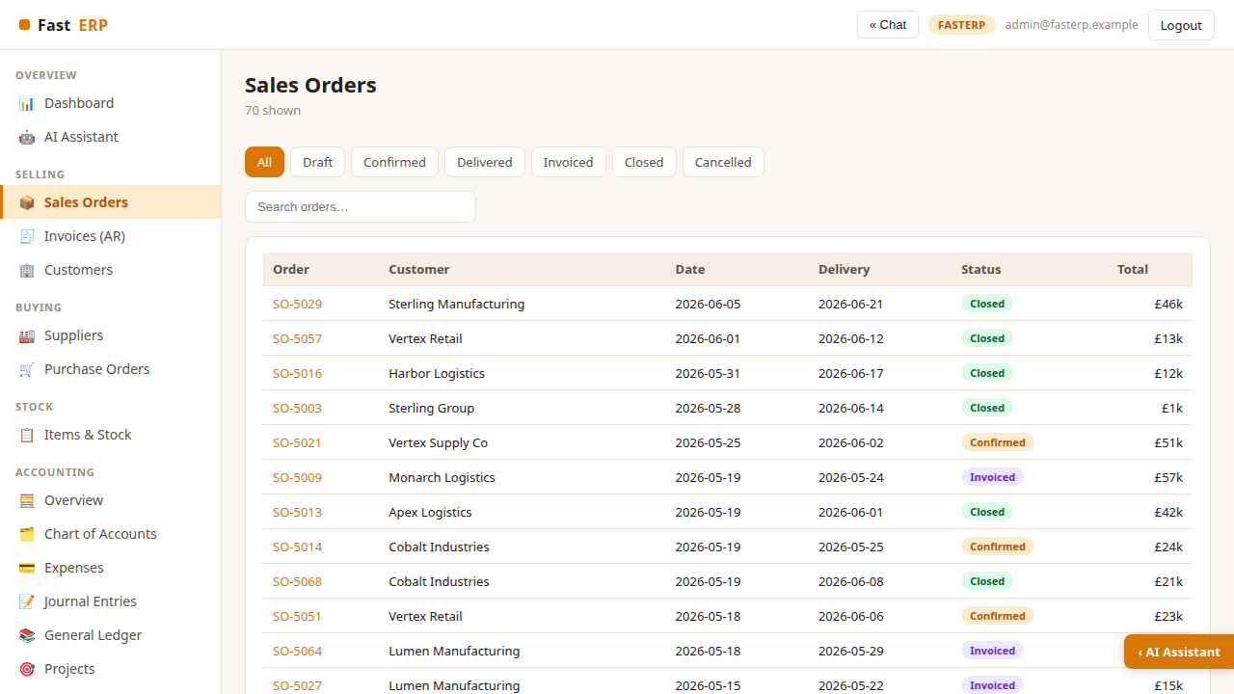
Sales orders
Open Selling → Sales Orders to filter the order book by status or search for
a customer or reference. Each row exposes delivery timing, workflow state and
total value.
FastERP · Synthetic accounting workspace · 2026-07-28

Slide 4
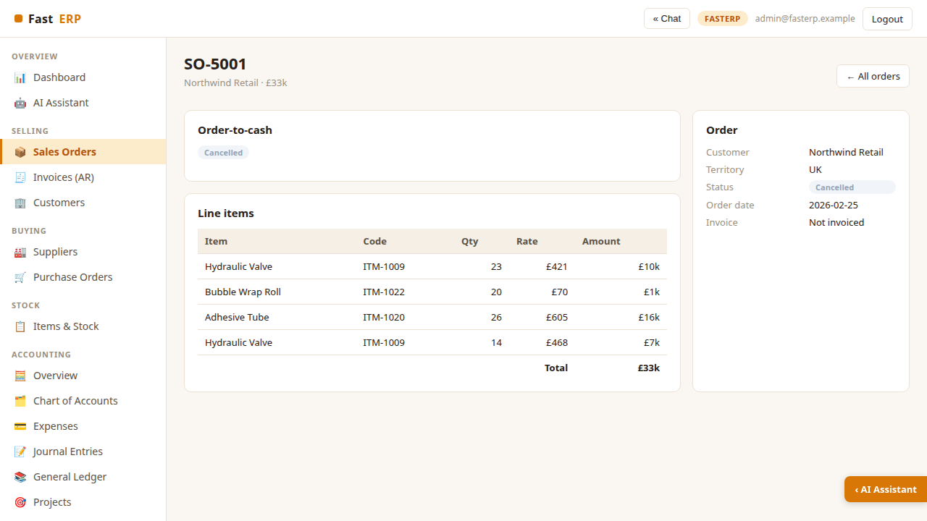
Order-to-cash workflow
An order detail page combines customer data, line items, totals and the next
transactional action. Move eligible orders through Confirm, Deliver and Invoice;
delivery adjusts stock and invoicing creates balanced accounting entries.
FastERP · Synthetic accounting workspace · 2026-07-28

Slide 5
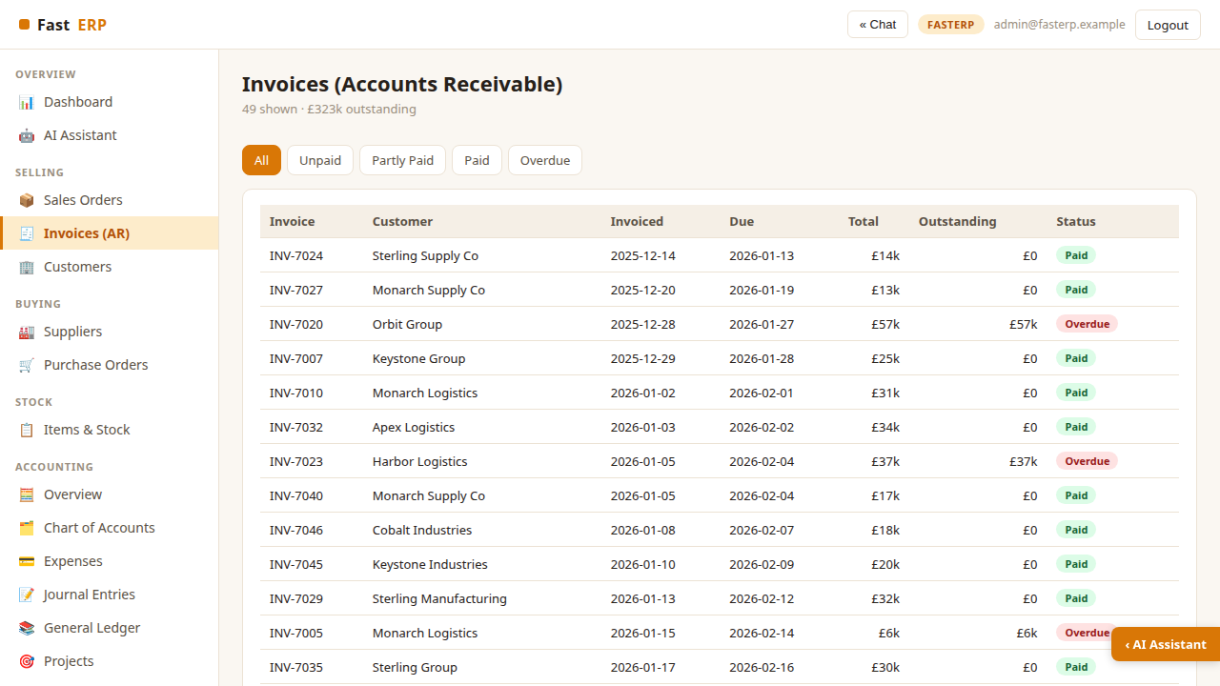
Invoices and receivables
Use Invoices (AR) to review outstanding, partly paid, paid and overdue
invoices. Record a payment from an order or invoice workflow to clear Accounts
Receivable and increase Cash.
FastERP · Synthetic accounting workspace · 2026-07-28

Slide 6
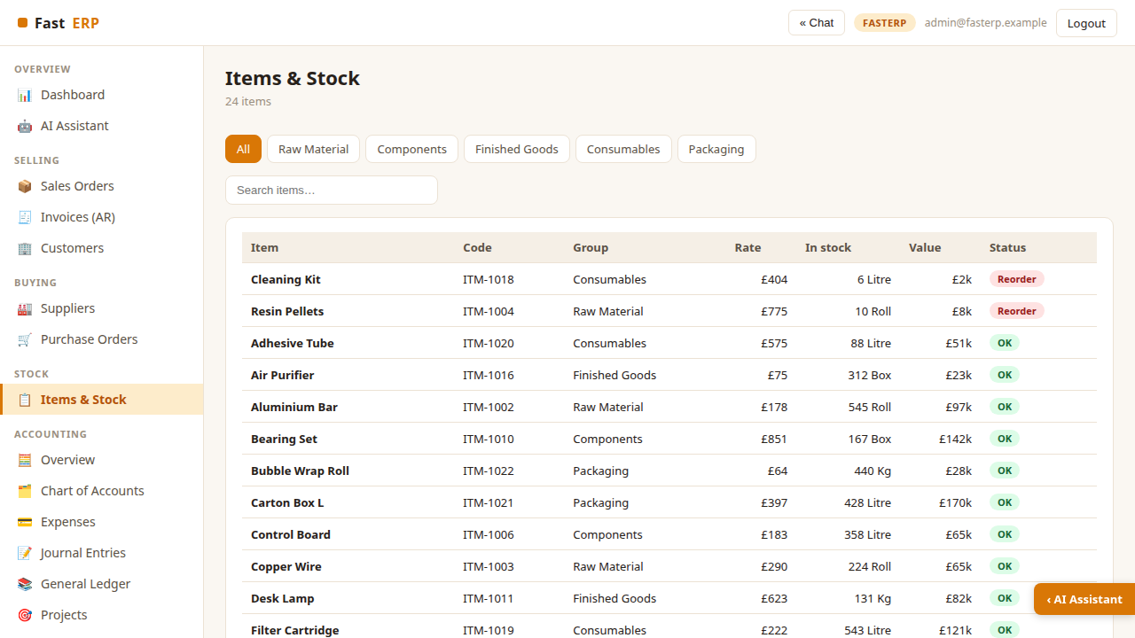
Items and stock
The stock register shows item codes, groups, selling rates, quantities, values
and reorder status. Filter by item group or search the catalog to investigate
availability before confirming demand.
FastERP · Synthetic accounting workspace · 2026-07-28

Slide 7
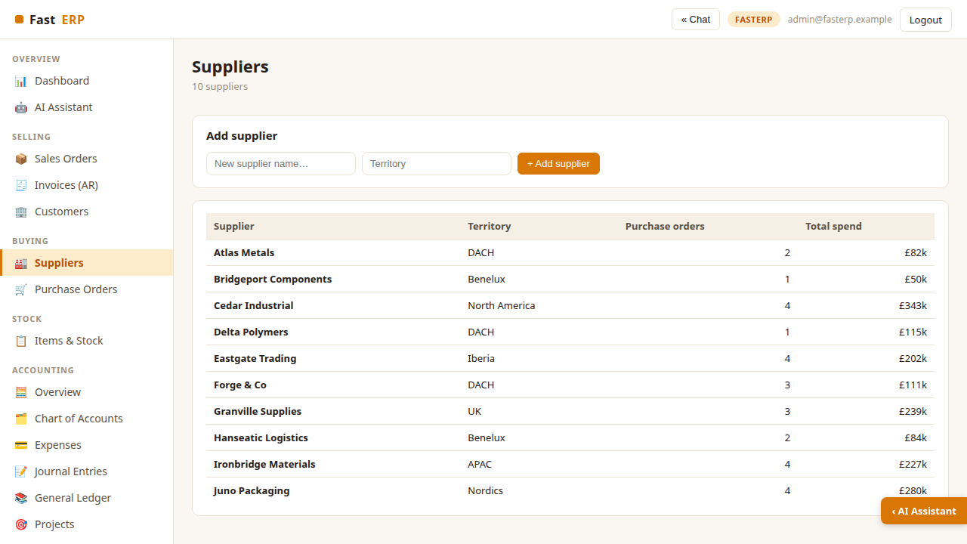
Suppliers
The supplier register summarizes territory, purchase-order count and total
spend. Add synthetic suppliers here before creating a purchasing transaction.
FastERP · Synthetic accounting workspace · 2026-07-28

Slide 8
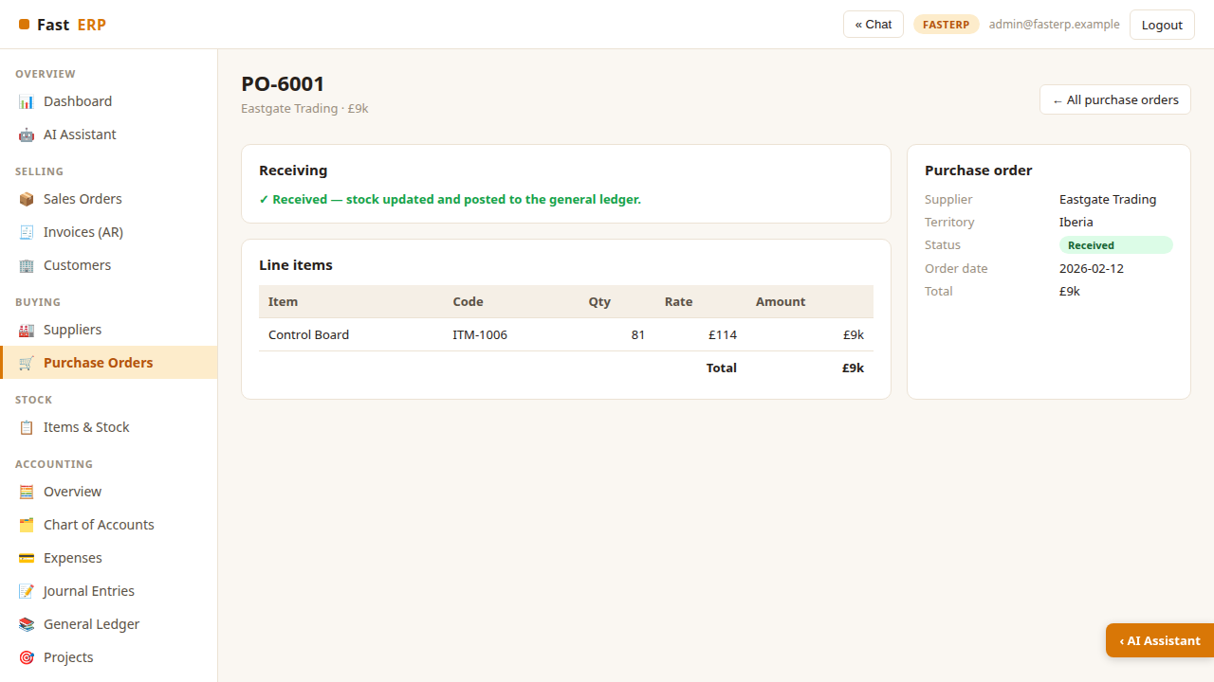
Purchase order and goods receipt
A purchase order records supplier, line items and workflow status. Receiving an
ordered PO increases stock and posts Inventory against Accounts Payable, linking
procurement to the general ledger.
FastERP · Synthetic accounting workspace · 2026-07-28

Slide 9
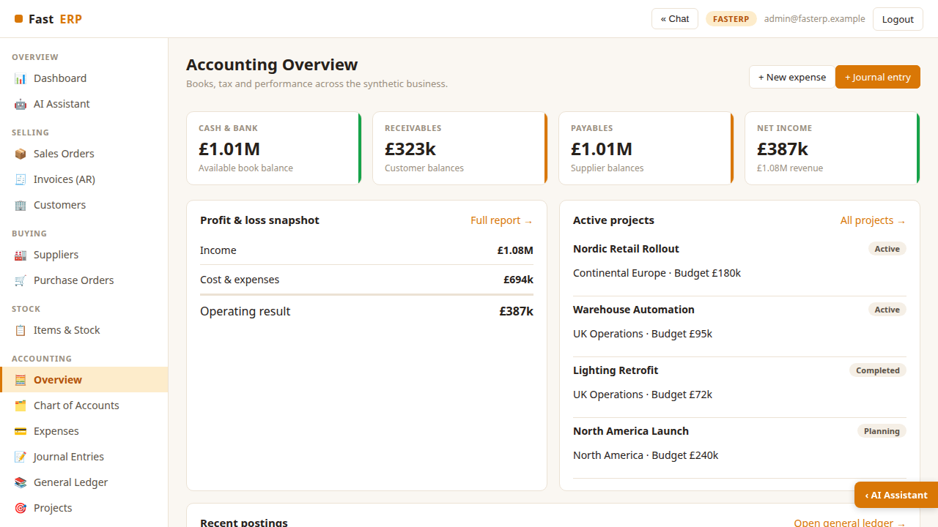
Accounting overview
Open Accounting → Overview for cash, receivables, payables and net income.
Review the Profit & Loss snapshot, active projects and latest postings, or start
a new expense or manual journal.
FastERP · Synthetic accounting workspace · 2026-07-28

Slide 10
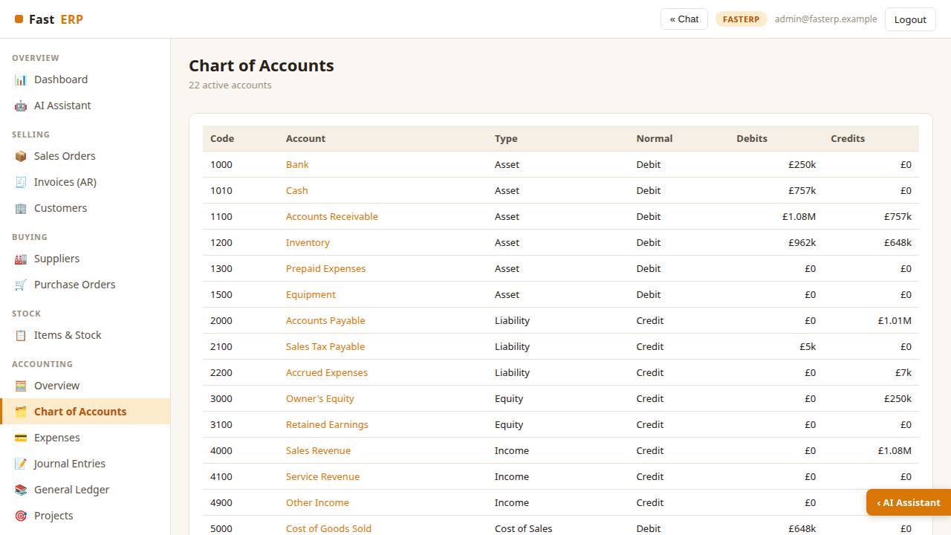
Chart of accounts
The 22-account chart groups assets, liabilities, equity, income, cost of sales
and operating expenses. Select an account to trace its postings in the General
Ledger.
FastERP · Synthetic accounting workspace · 2026-07-28

Slide 11
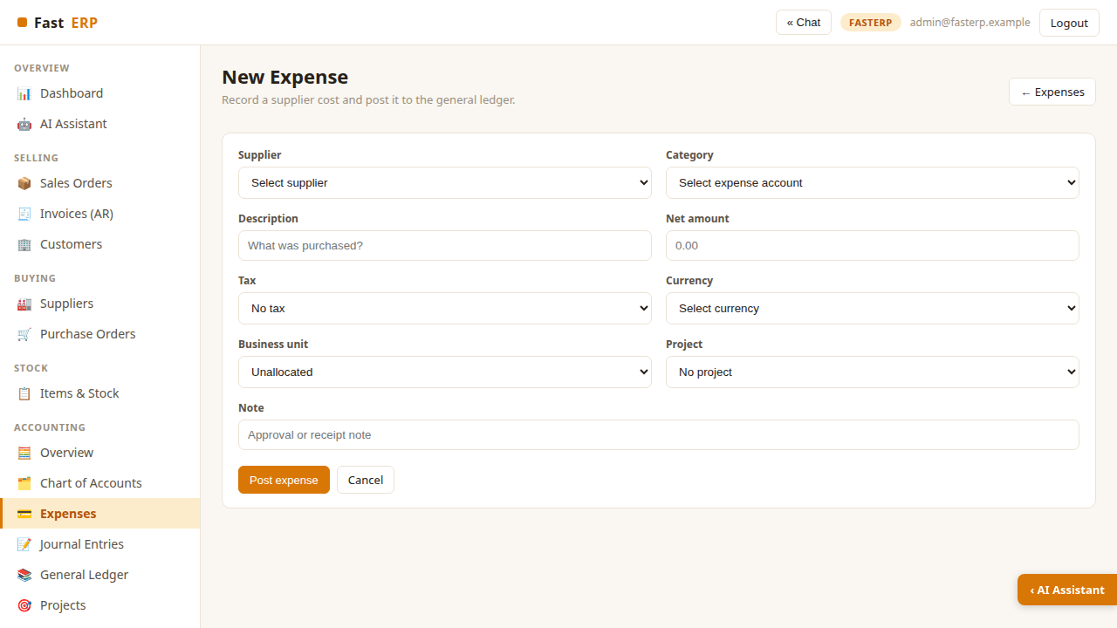
Record an expense
Choose a supplier and expense category, then enter the net amount, tax code and
currency. Optional business-unit and project dimensions flow to ledger lines and
profitability reporting. A note can retain approval or receipt context.
FastERP · Synthetic accounting workspace · 2026-07-28

Slide 12
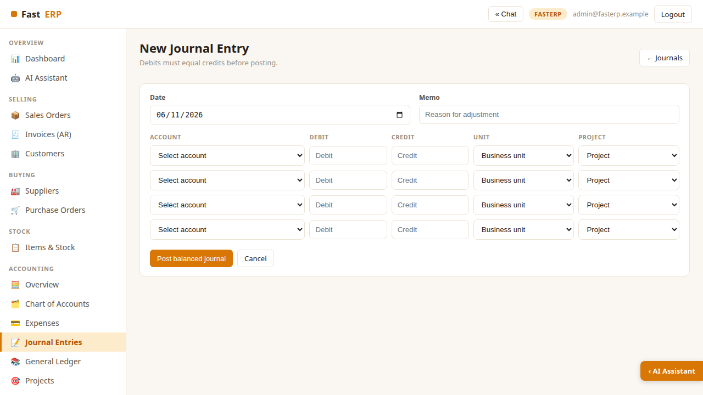
Post a journal entry
Enter a date and memo, then add at least two account lines. Each line may carry a
business unit and project. FastERP rejects the journal unless total debits equal
total credits.
FastERP · Synthetic accounting workspace · 2026-07-28

Slide 13
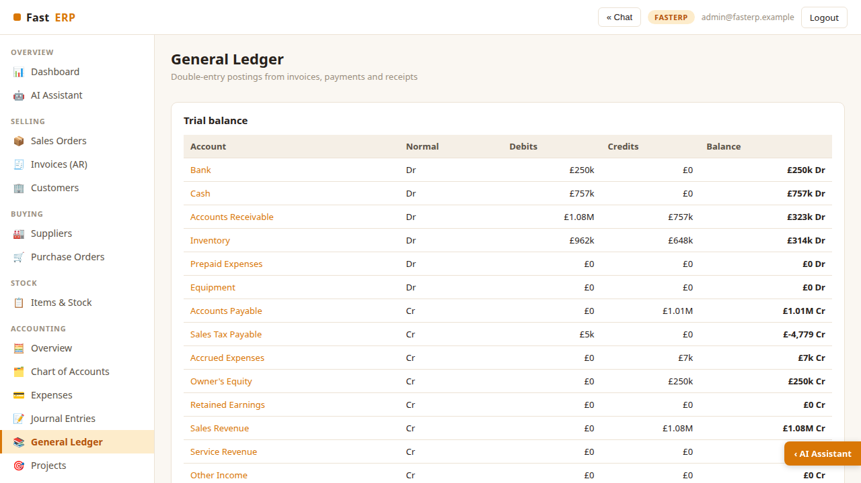
General ledger
The Trial Balance summarizes debits, credits and normal-side balances. Filter
ledger entries by account and use shared references such as INV-7042,
EXP-8001 and JE-9001 to follow linked transactions.
FastERP · Synthetic accounting workspace · 2026-07-28

Slide 14
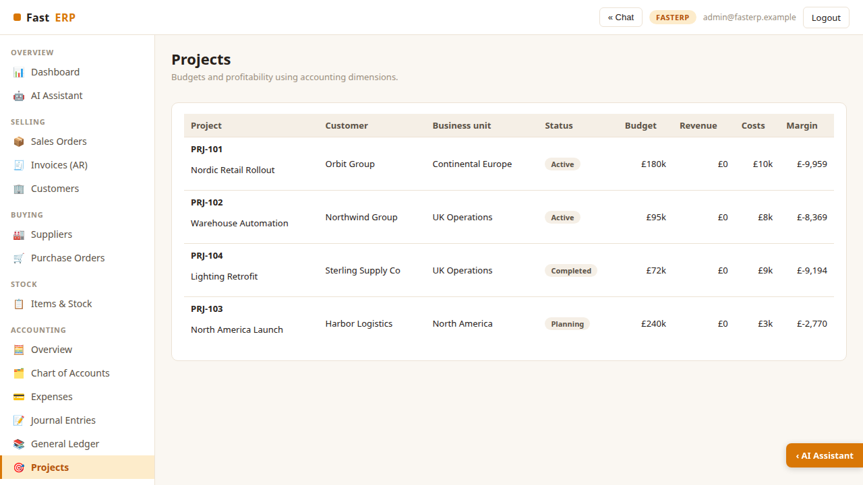
Projects and business units
Projects combine customer, owning business unit, status, budget, revenue, costs
and margin. Dimensioned expenses and journals update project costs immediately
without requiring separate ledgers.
FastERP · Synthetic accounting workspace · 2026-07-28

Slide 15
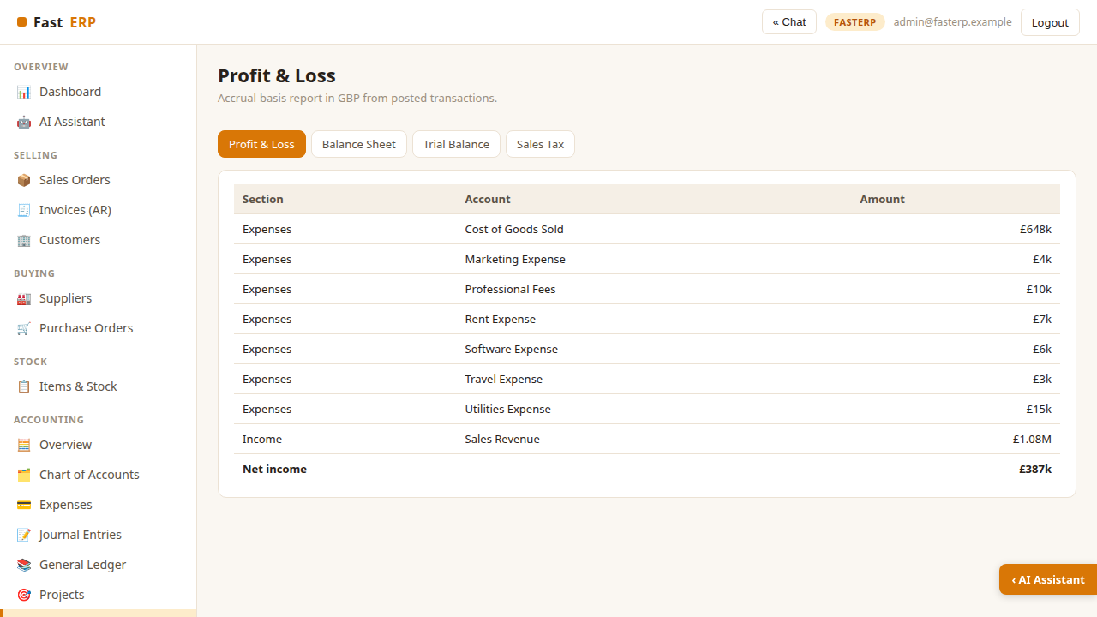
Financial reports
Switch between Profit & Loss, Balance Sheet, Trial Balance and Sales Tax. Reports
are accrual-basis, presented in GBP and derived solely from posted double-entry
transactions.
FastERP · Synthetic accounting workspace · 2026-07-28

Slide 16
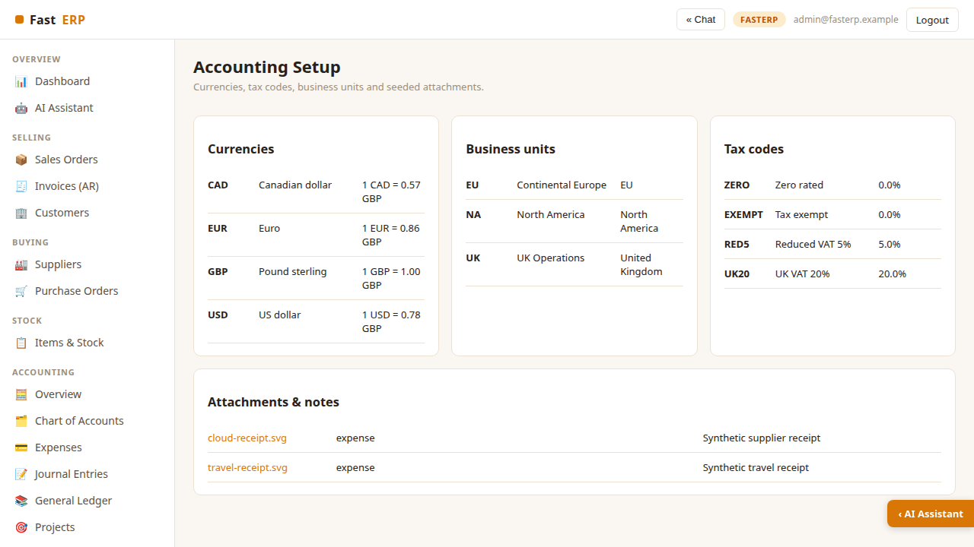
Accounting setup and attachments
Setup lists GBP, EUR, USD and CAD rates, tax codes, business units and synthetic
receipt attachments. The rates and tax treatment are illustrative; the receipt
images contain no real supplier or payment information.
FastERP · Synthetic accounting workspace · 2026-07-28

Slide 17
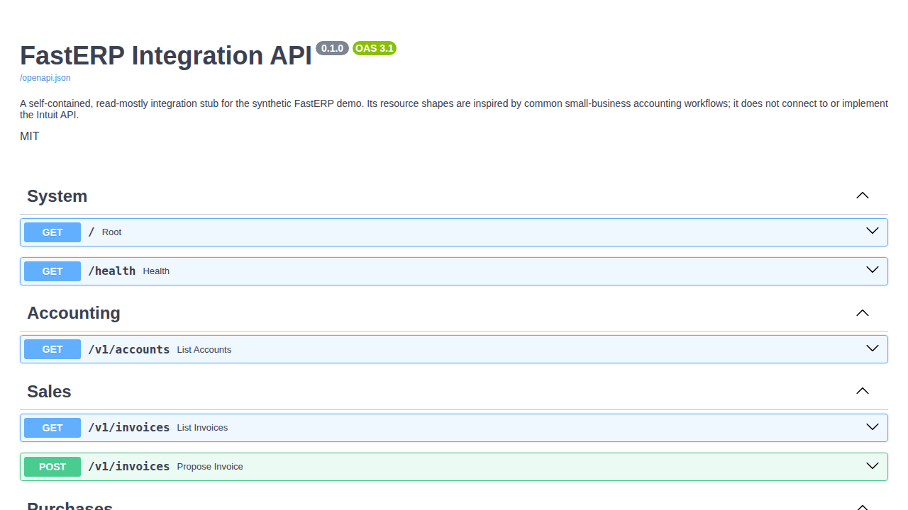
Integration API and Swagger
Run .venv/bin/uvicorn api_app:app --port 5012 and open
http://localhost:5012/docs. The read-mostly FastAPI stub documents accounts,
invoices, expenses, projects, reports and webhook examples. Invoice POSTs
validate previews without posting to the books.
FastERP · Synthetic accounting workspace · 2026-07-28

