Slide 1
CBRE CRM: Architecture Choices
OSS core + semantic layer + knowledge graph: an AI-ready target architecture.
Author: Michael Palys | 2026-04-24

Slide 2
Where CBRE is today
The as-is: read-only analytics sitting on top of an opaque system of record.
Tableau front-ends layered on SharePoint -- good to see, bad to act.
Proprietary CRM / project tool underneath -- old, isolated, a single point of risk.
Tableau and the proprietary CRM do not talk to each other.
Salesforce gravity is real in the estate -- sales and finance trust it.
Design ambition: React-Native + Material UI based on the new CBRE design system.

Slide 3
The three functional needs
All three asks are real -- they are not the same product.
Executive dashboards that let leaders see the business AND kick off workflows -- a "system of action".
Account maintenance -- creation, setup, ownership, lifecycle.
CRM / project management -- pipelines, deals, work packages, timelines.

Slide 4
Two failure modes on the table
Fail mode A: Let Salesforce rebuild everything
Fail mode B: Full custom composable platform
Multi-quarter delivery before basics are live.
License + SI + customisation -- seven-figure run rate.
Hard to unwind later. Lock-in tightens while AI rearranges vendor economics.
Data egress, AI SKUs, storage limits -- not your knobs.
Fine for pipeline. Wrong for the whole estate.
You rebuild accounts, permissions, workflow, reports from zero.
Classic multi-year enterprise programme that never finishes.
80% of what you build is undifferentiated.
Great engineering team evaporates maintaining glue.
Avoid by standing on an OSS substrate (Frappe CRM) -- learn domain features from specialist CRE SaaS like Enaia.

Slide 5
Why open-source beats a Salesforce-led rebuild
Not free in year one. Dramatically cheaper across years two to five.
Atlassian lesson: an "extensible platform" you don't own can pivot (Server to Cloud) and invalidate years of customisation overnight.
With OSS you own the schema, the upgrade cadence, and the exit cost.
AI value is moving to whoever has the data. Keep the data on your side of the line.
Extensions are code you wrote, not apps you rent -- no marketplace-churn tax.
Exit cost becomes the cost of moving a Postgres database, not a re-platform.

Slide 6
OSS reference stacks -- honest comparison
Dimension | Frappe CRM (Py / Vue) | Plane (TS) | OpenProject (Rails)
Domain fit | Sales CRM (leads, deals, calls, SLAs) | Project / issue tracking | Project / portfolio / Gantt
Language / stack | Python + Vue 3 + MariaDB / PG | Next.js + Django + PG | Rails + Angular + PG
Licence | AGPL-3 | AGPL-3 (+ Enterprise tier) | GPL-3 (+ Enterprise add-ons)
Extensibility | Metadata-driven DocTypes -- no fork | Code forks; plugin API young | Ruby plugins; Rails skills scarce
Multi-tenant | Sites-per-tenant, each own DB | Workspaces inside one DB | Typically single-tenant
Integrations | Twilio, WhatsApp, ERPNext, IMAP/SMTP, webhooks, RPC | REST + webhooks | REST + webhooks; SAML/LDAP
CBRE fit | Closest infra match -- CRM + extensible | No -- not a CRM | Good for projects, heavy to extend

Slide 7
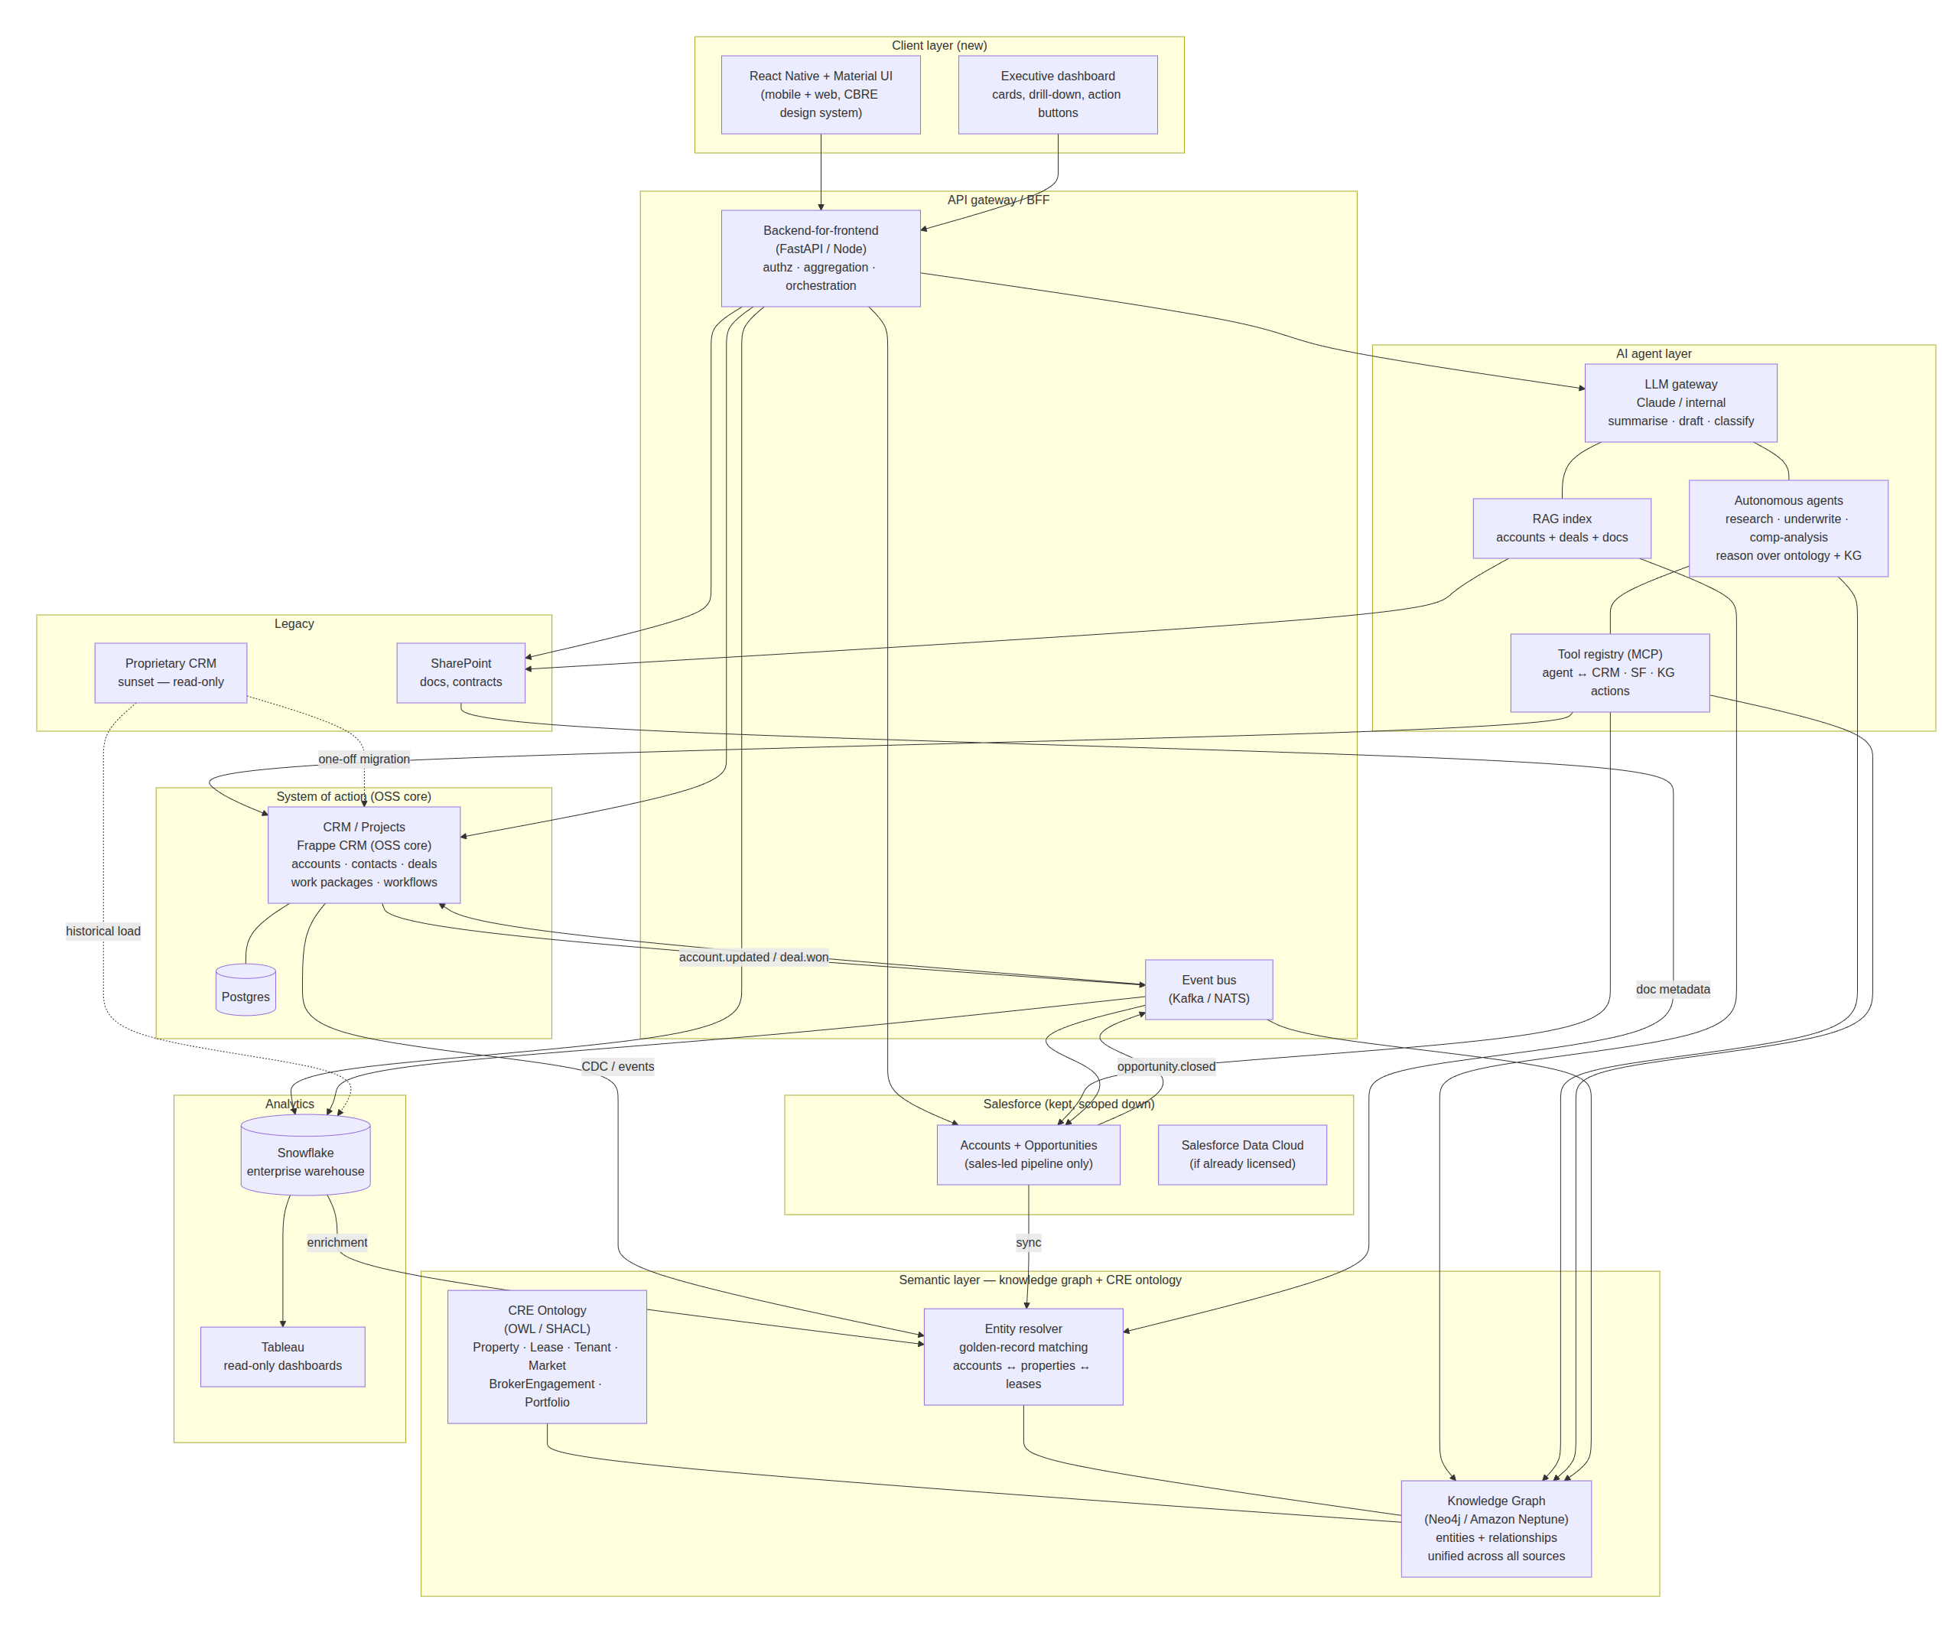
Target architecture: OSS core + semantic layer + AI agents
BFF + event bus + semantic layer (knowledge graph + CRE ontology). OSS core is the durable asset. AI agents reason over the ontology.

Slide 8
Why this shape specifically
OSS core (Frappe CRM) is the system of record for accounts, projects, workflows -- a Postgres schema you own.
Salesforce stays, but only for sales pipeline. SF becomes a consumer of accounts, not the master.
A thin BFF + event bus is the integration surface. Swap or upgrade the OSS core later without touching clients.
Tableau becomes read-only, fed from the event bus / warehouse. It stops being the front door.
Learn from best-in-class CRE SaaS (e.g. Enaia) for domain UX, workflows, data models -- build those features on the OSS core you control.

Slide 9
Semantic Layer
Knowledge graph + CRE ontology: the AI-readiness layer

Slide 10
Why a semantic layer, not just a warehouse
The single most important structural decision for AI readiness.
Snowflake stores facts as rows. A knowledge graph stores facts AND their relationships.
"Account A holds Lease B on Property C in Market D managed by Broker E" -- that is a graph, not a table.
AI agents traverse context in a graph; they issue sequential SQL queries against a warehouse. Graph wins for reasoning.
For a commercial real-estate business, the entity graph IS the business.
The semantic layer sits between operational systems (CRM, SF, SharePoint) and AI -- single source of connected truth.

Slide 11
CRE Ontology (OWL / SHACL): the domain vocabulary
Ontology class | What it represents | Key relationships
cre:Property | Physical asset -- building, floor, unit | hasLease, inMarket, managedBy
cre:Lease | Contractual tenancy | hasTenant, onProperty, hasTerm
cre:Tenant | Occupier entity | holdsLease, linkedAccount
cre:Market | Geographic / sector market | containsProperty, hasComps
cre:BrokerEngagement | Advisory mandate | forAccount, onProperty, assignedBroker
cre:Portfolio | Grouped set of properties | containsProperty, ownedBy
cre:Comp | Comparable transaction | inMarket, forPropertyType, atPrice

Slide 12
Entity resolver: golden-record matching
Accounts live in CRM, Salesforce, SharePoint, and Snowflake -- often under different names.
"CBRE Global Investors", "CBRE GI", and Salesforce Account #00341 resolve to one node in the graph.
Fuzzy matching + deterministic rules (tax ID, DUNS, domain) across all sources.
CDC events from CRM and SF feed the resolver continuously -- the graph stays current without batch ETL.
This is the prerequisite for any AI agent that needs to answer questions spanning multiple systems.

Slide 13
AI Agents
Autonomous reasoning over the knowledge graph

Slide 14
AI agents: what the ontology enables
The ontology is the stable contract between your data and whatever AI runs on top of it.
Research: "Pull all lease expirations in the next 18 months for Portfolio X, find comps, draft a renewal strategy." Graph traversal, not API calls.
Underwriting: "Given this property and market comps, score the deal." Agent reads the ontology to know what a comp is.
Comp analysis: find the five most relevant comparables for a lease. Traverses cre:Comp -> cre:Market -> cre:PropertyType.
Tool registry (MCP) gives agents structured write-back into CRM, SF, and the KG -- ontology-typed actions, not raw SQL.
When new AI capabilities arrive (planning, multi-step reasoning), the ontology is already there. Upgrade models, not data structures.

Slide 15
Sequencing: 12 months, semantic layer + AI agents
Phase 0
Wk 0-4
Foundations: BFF, event bus, SSO, design system
Phase 1
Wk 4-10
Executive dashboard on React Native -- reads SF + legacy
Phase 2
Wk 8-16
Frappe CRM pilot -- benchmark against specialist CRE SaaS (e.g. Enaia)
Phase 3
Wk 16-20
CRE DocTypes (Property, Lease, BrokerEngagement) on Frappe
Phase 4
Wk 18-30
Accounts mastered + CRE ontology v1 + knowledge graph seeded
Phase 5
Wk 30-42
AI agents + KG traversal: comp analysis, lease alerts, research
Phase 6
Wk 42-52
Full workflow move; ontology extended; multi-agent orchestration

Slide 16
What NOT to do
Do not let Salesforce lead a greenfield rebuild of account + project management.
Do not pick 'fully custom composable platform' on day one -- use Frappe CRM for the 80%, learn CRE domain features from specialist SaaS like Enaia for the 20%.
Do not treat Tableau as the action layer. Tableau is a read model.
Do not skip the knowledge graph -- without the ontology, you get summarisation, not reasoning.
Do not skip the event bus -- it is the piece that makes every later swap cheap.

Slide 17
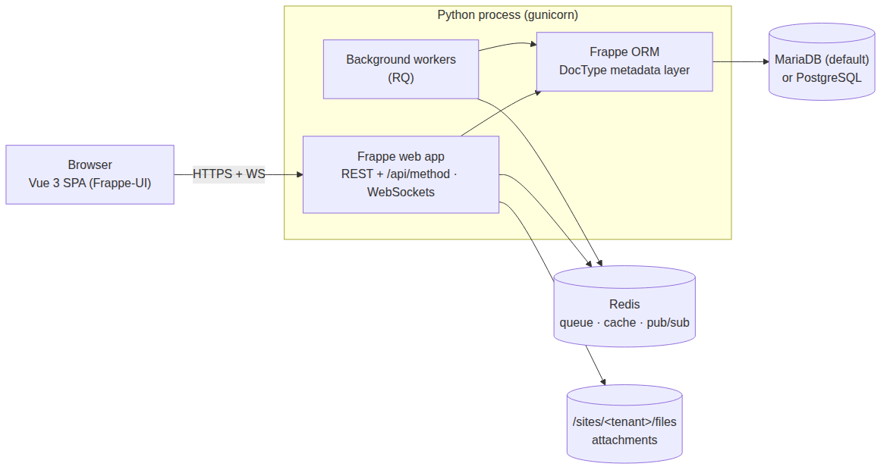
Reference runtime shape: Python back-end, Vue front-end
Frappe-shaped: Vue 3 SPA + Python web workers + RQ queue + Redis + MariaDB/Postgres + per-site file store.

Slide 18
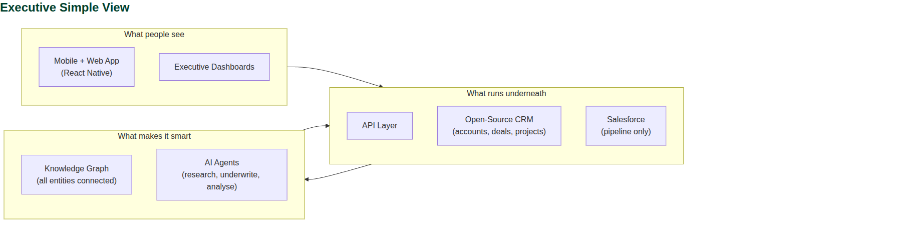
Architecture option: Exec Simple
Executive view: three layers, one sentence each. For senior stakeholders who need the shape, not the detail.

Slide 19
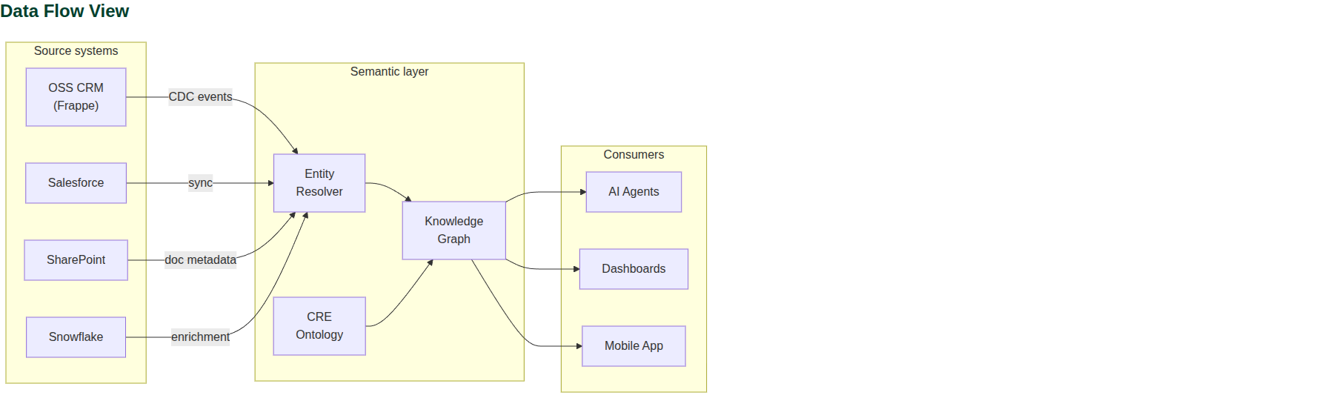
Architecture option: Data Flow
Data flow view: how information moves from source systems through the semantic layer to AI agents and dashboards.

Slide 20
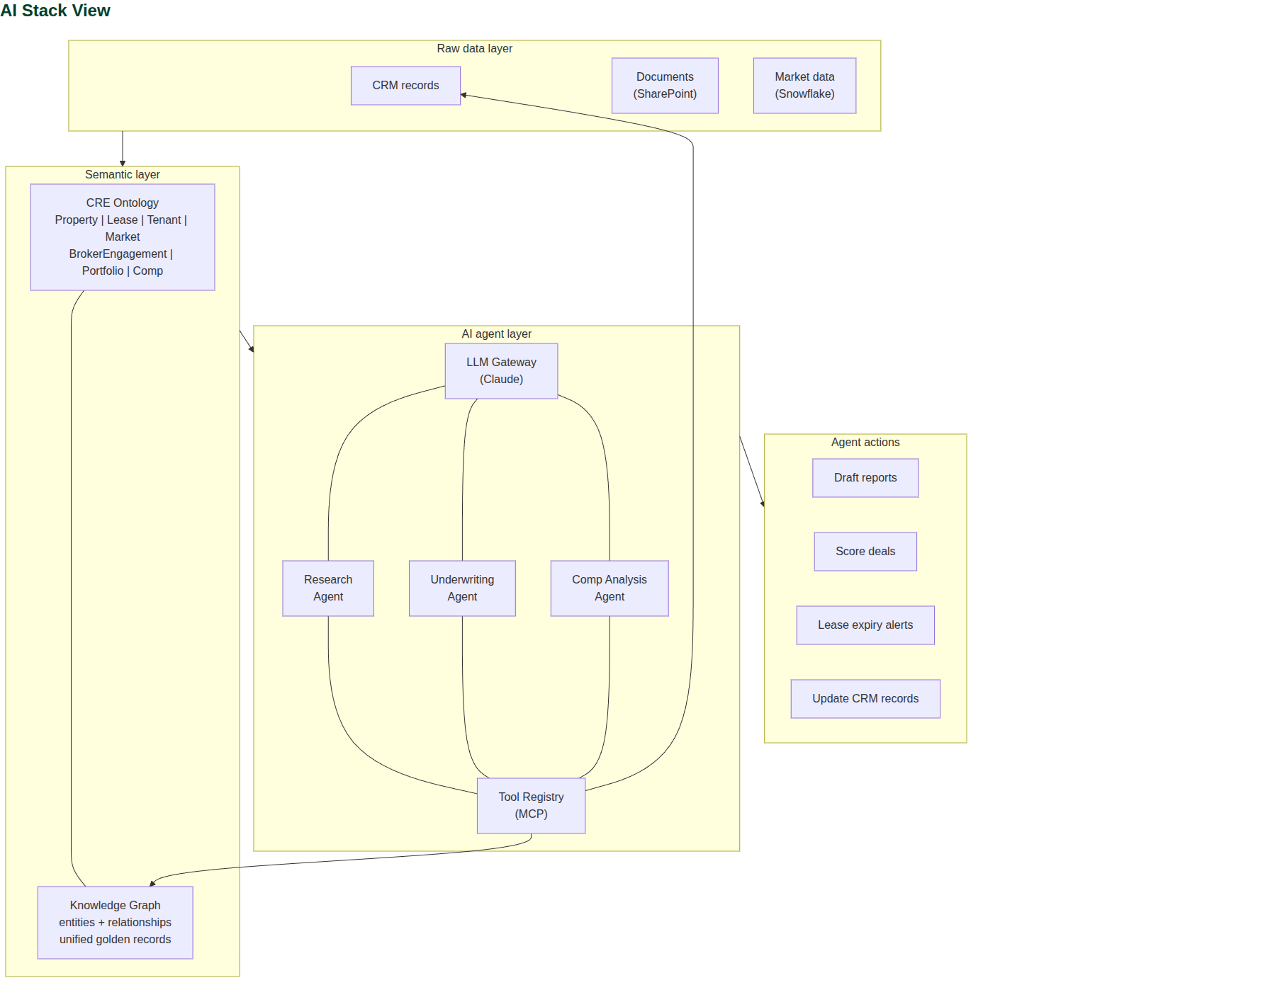
Architecture option: Ai Stack
AI stack view: from raw data through ontology and knowledge graph to autonomous agent actions.

Slide 21
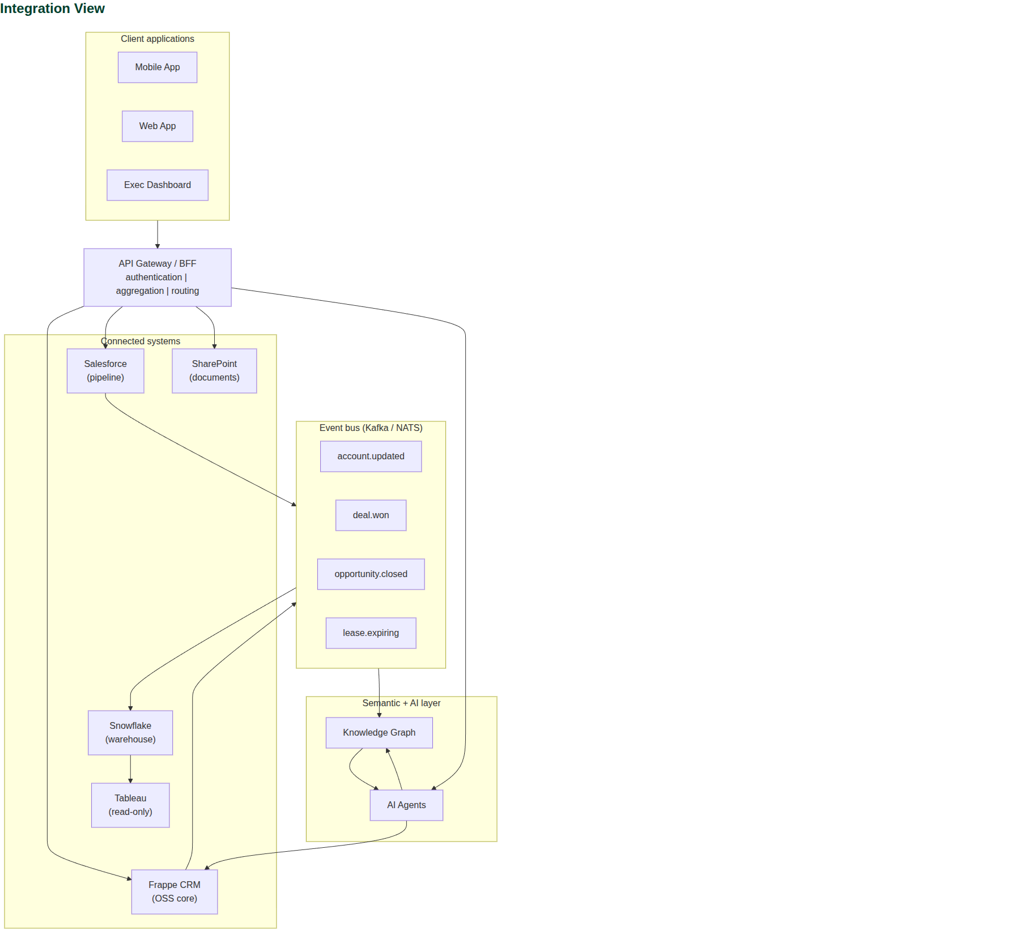
Architecture option: Integration
Integration view: what connects to what, with the event bus and BFF as the two seams.

Slide 22
The decision in one paragraph
Keep Salesforce for pipeline.
Move accounts and projects onto a Frappe CRM open-source core -- learning domain features from best-in-class CRE SaaS like Enaia.
Put a BFF, event bus, and knowledge graph between systems. Layer a CRE ontology (OWL/SHACL) so AI agents reason over the full entity graph.
React-Native Material UI on top. Tableau goes read-only. Proprietary CRM is sunset over 12 months.
Exit cost at any future point is a Postgres export + a portable ontology -- not a re-platform.

