Slide 1

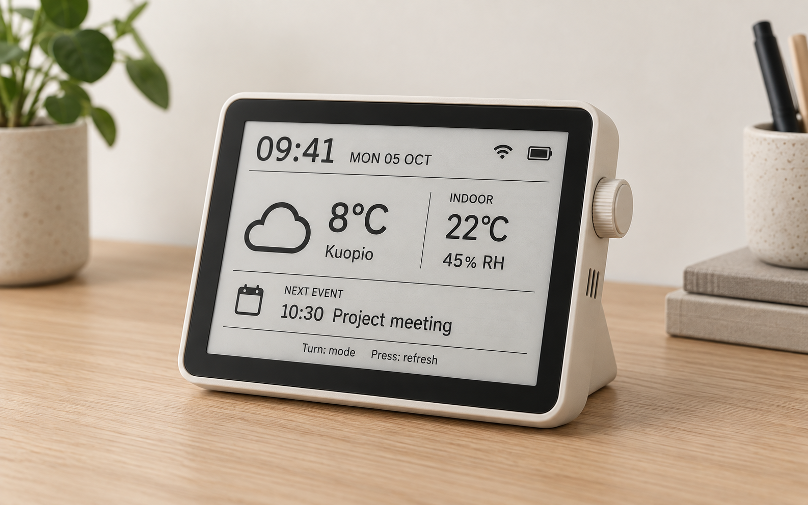
TEAM 2 / IOT PROJECT
Ambient E-Ink
Desk Companion
Essential information
at a glance
Concept visualization
Ding Han (Project Manager), Dong Nguyen, Yiming Chen,
Hossam Ragab, Kyrylo Luhinin
01
Notes:
Introduce the team and our proposed desktop device. It combines essential daily information with an E-Ink display. The image is an imagined design, not a photograph of an existing prototype. Team members: Ding Han, project manager, Dong Nguyen, Yiming Chen, Hossam Ragab and Kyrylo Luhinin.
Source: supplied design-report.md and group manager’s five-section structure. Product image and paper background are AI-generated concept illustrations. Features describe a proposal, not verified prototype performance.

Slide 2
1 / CONCEPT & DESIGN GOALS
A quiet source of daily information
A quick phone check can become a distraction.
Our desk device keeps essentials visible in one place.
At a glance
Weather, indoor conditions, calendar and tasks
Low power
E-Ink retains the image while the controller sleeps
Ambient
Calm updates without sounds or blinking notifications
02
Notes:
Checking weather or a task on a phone can lead to scrolling. Information is also spread across apps. This project explores a quiet desktop alternative. At a glance means seeing information without opening another device. Low power means the screen retains the image between updates while the controller sleeps. Ambient means the device stays useful without demanding attention. Reducing screen use is a goal, not a measured result.
Source: supplied design-report.md and group manager’s five-section structure. Product image and paper background are AI-generated concept illustrations. Features describe a proposal, not verified prototype performance.

Slide 3
2 / REQUIREMENTS 3 / SYSTEM DESIGN
Requirements & system design
Core requirements
System operation
Time, weather and indoor conditions
Calendar, tasks and habit reminders
Wi-Fi and web configuration
OTA updates and battery status
01 Wake and read sensors
02 Fetch data over HTTPS / JSON
03 Refresh the E-Ink display
04 Turn off Wi-Fi and sleep
Optional: air quality and Spotify, with a backend for OAuth / artwork
03
Notes:
Core functions show time and date, weather, indoor temperature and humidity, calendar events, tasks and habit reminders. Wi-Fi enables HTTPS and JSON API requests. Web setup supports configuration, OTA supports firmware updates and battery status stays visible. ESP32 is the working controller assumption. It wakes, reads sensors and APIs, renders a 1-bit frame, updates E-Ink and returns to sleep. The screen shows snapshots between updates. The report also lists Raspberry Pi hardware, so controller and driver selection remain open. A backend may handle OAuth and artwork conversion. Air quality and Spotify are optional. Privacy, cost, reliability and readability are requirements.
Source: supplied design-report.md and group manager’s five-section structure. Product image and paper background are AI-generated concept illustrations. Features describe a proposal, not verified prototype performance.

Slide 4
4 / HARDWARE & SOFTWARE 5 / UI / INTERACTION
Hardware & user interaction
Proposed build
Simple interaction
ESP32 and monochrome E-Ink
Temperature / humidity sensor
Li-Po battery and printed enclosure
Arduino or ESP-IDF firmware
GxEPD2 and Adafruit GFX
Header: time, date and status
Main area: selected mode
Footer: next event or hint
Rotate: mode Press: refresh
Long press: configuration
To confirm: controller, display size and compatible display driver
04
Notes:
Proposed hardware includes an ESP32, a monochrome E-Ink display, a temperature and humidity sensor, a rotary encoder and a Li-Po power system inside a 3D-printed enclosure. The report offers ESP32-S3 or C6 and 5.83-inch or 7.5-inch displays. Software uses Arduino or ESP-IDF, GxEPD2, Adafruit GFX and JSON parsing. The screen has a status header, content area and footer for the next event or hint. Dashboard, Calendar and Environment are main modes. Spotify is optional. Rotate switches modes, press refreshes data and long press starts configuration. The web portal manages location, API settings, refresh interval and preferences. Confirm controller, display size and compatible driver. The Pi Bonnet is a Pi-specific alternative.
Source: supplied design-report.md and group manager’s five-section structure. Product image and paper background are AI-generated concept illustrations. Features describe a proposal, not verified prototype performance.

Slide 5
THANK YOU
Questions?
05
Notes:
Close with the central product goal: useful daily information on a quiet, always-visible desk device. The next proposed steps are to confirm the hardware, integrate the core dashboard and test refresh behavior and power consumption. The report has no measured battery-life or performance figures. Invite questions.
Source: supplied design-report.md and group manager’s five-section structure. Product image and paper background are AI-generated concept illustrations. Features describe a proposal, not verified prototype performance.

