Slide 1

CNN based Object Detection
Reporter: WENHAO HE
Date: May 9th 2016

Slide 2
Outline
Review of my previous reports
Y(ou)O(nly)L(ook)O(nce)

Slide 3
Sliding Window Model
Review of my previous reports
Y(ou)O(nly)L(ook)O(nce)

Slide 4
YOLO
You Only Look Once: Unified, Real-Time Object Detection
Authors: Joseph Redmon, Santosh Divvala, Ross Girshick, Ali Farhadi
Ross Girshick: Facebook AI Research, rbg@fb.com
(Fast, Faster) RCNN

Slide 5
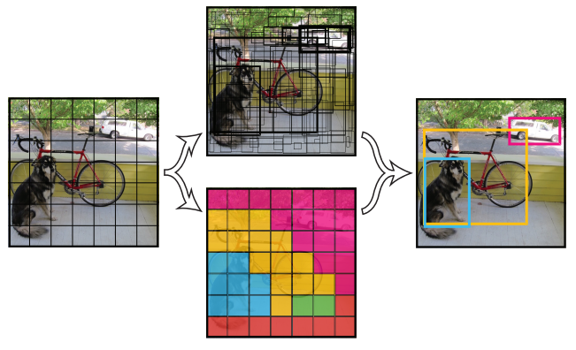
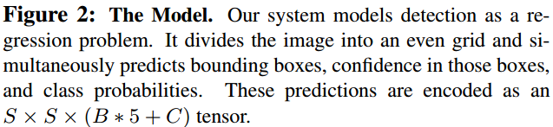
YOLO
5-dim vector =>
(conf, x1, y1, x2, y2)
C-dim vector =>
Probability distribution

Slide 6
YOLO

Slide 7
THANKS!
Any questions?

