Slide 1
開發report系統
20231024

Slide 2
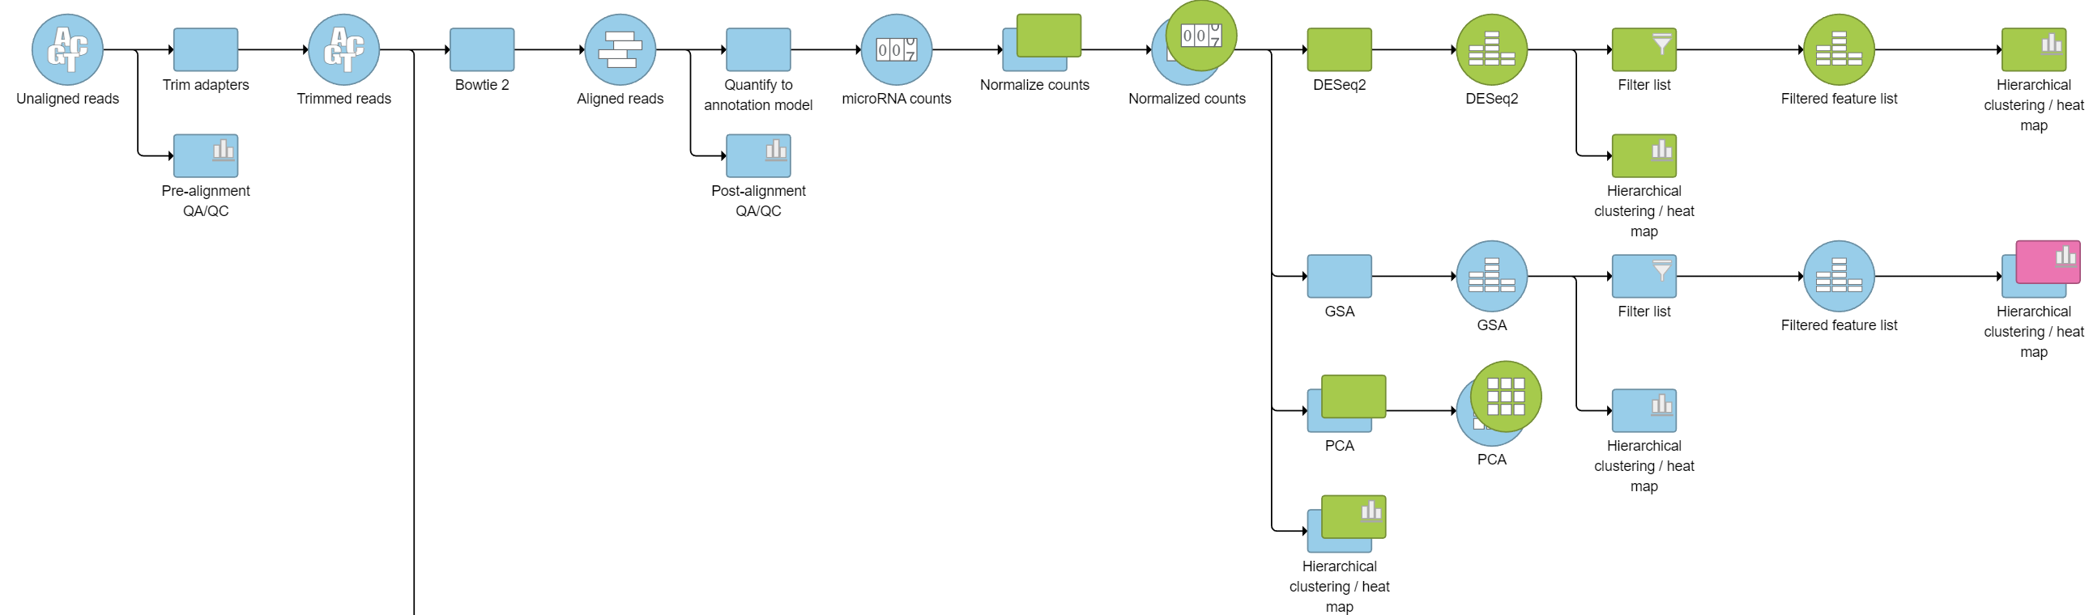

Slide 3
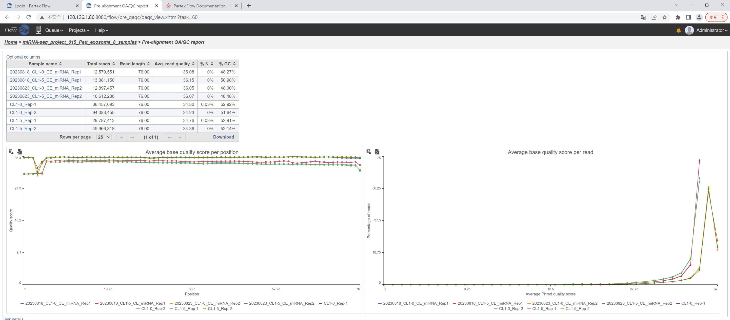
00. QC_01. Raw reads

Slide 4
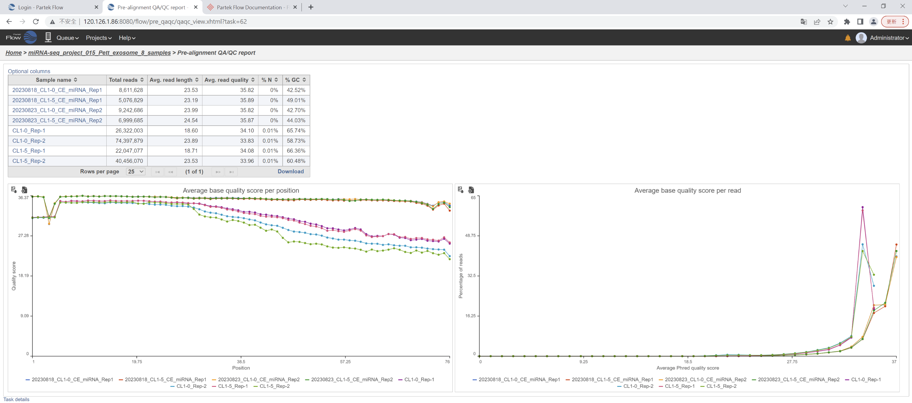
00. QC_02. Adaptor Trimming

Slide 5

00. QC_03. Base Trimming

Slide 6
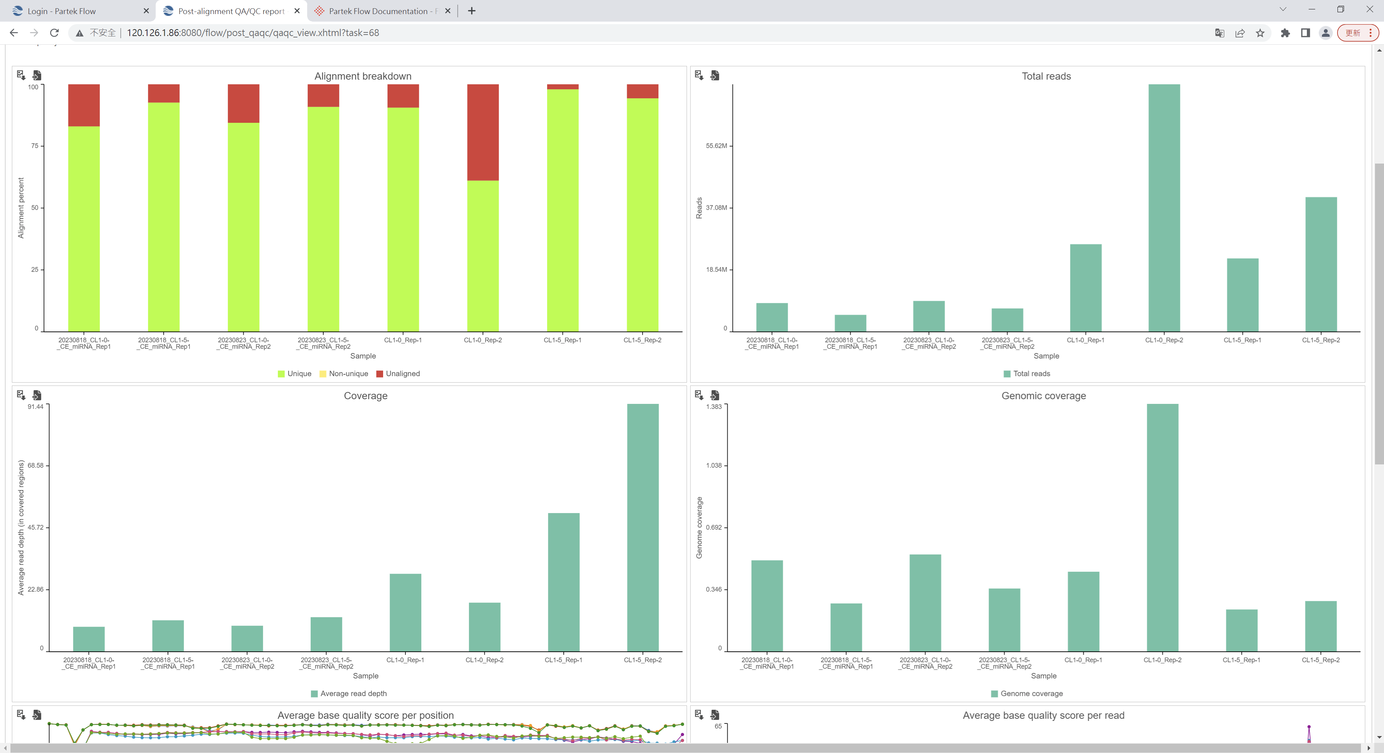
00. QC_04. post alignment (1/2)

Slide 7
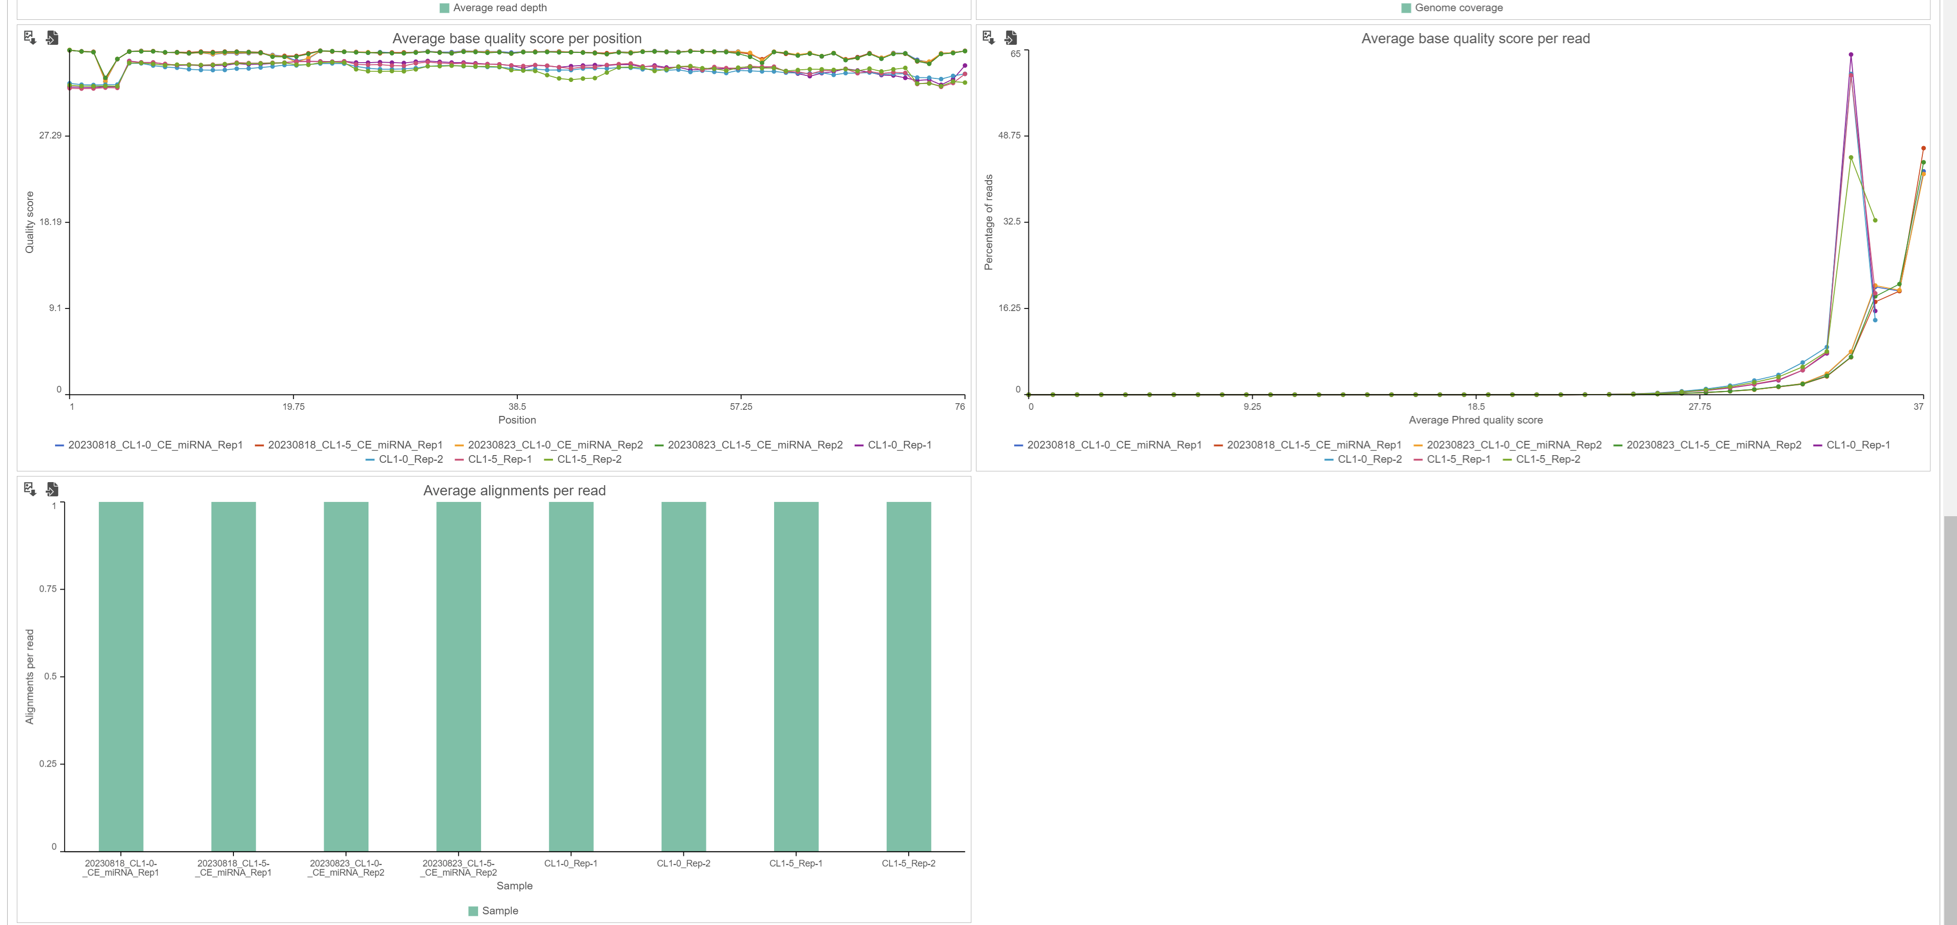
00. QC_04. post alignment (2/2)

Slide 8
00. QC_01. Raw reads

