Slide 1
Consistency Testing for a Distributed System
v2 2018-04
黄小满
Notes:
Testing linearizable distributed systems using fault injection along with linearizability checking is an effective approach.

Slide 2
Consistency
Consistency in database systems refers to the requirement that any given database transaction must change affected data only in allowed ways.

Slide 3
Consistency Model
Strict consistency
is the strongest consistency model. It requires that if a process reads any memory location, the value returned by the read operation is the value written by the most recent write operation to that location.
Linearizability
sequential consistency model as defined by Lamport(1979) is a weaker memory model than strict consistency.
can be defined as sequential consistency with the real-time constraint.
Causal consistency
can be considered a weakening model of sequential consistency by categorizing events into those causally related and those that are not.

Slide 4
Linearizability
is a guarantee about single operations on single objects
It provides a real-time guarantee on the behavior of a set of single operations (often reads and writes) on a single object (e.g., distributed register or data item).
Linearizability for read and write operations is synonymous with the term “atomic consistency” and is the “C,” or “consistency,” in Gilbert and Lynch’s proof of the CAP Theorem.

Slide 5
Linearizability
is a strong consistency model, relatively easy to build other systems on top of linearizable systems.
并发正确性的证明
https://cs.brown.edu/~mph/HerlihyW90/p463-herlihy.pdf
every operation appears to execute atomically and instantaneously at some point between the invocation and response.
if operations on each object in a system are linearizable, then all operations in the system are linearizable.

Slide 6
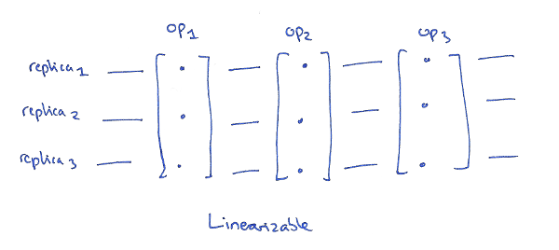
Linearizability
In a distributed context, we may have multiple replicas of an object’s state,
and in a linearizable schedule it is
as if they were all updated at once at a single point in time.

Slide 7
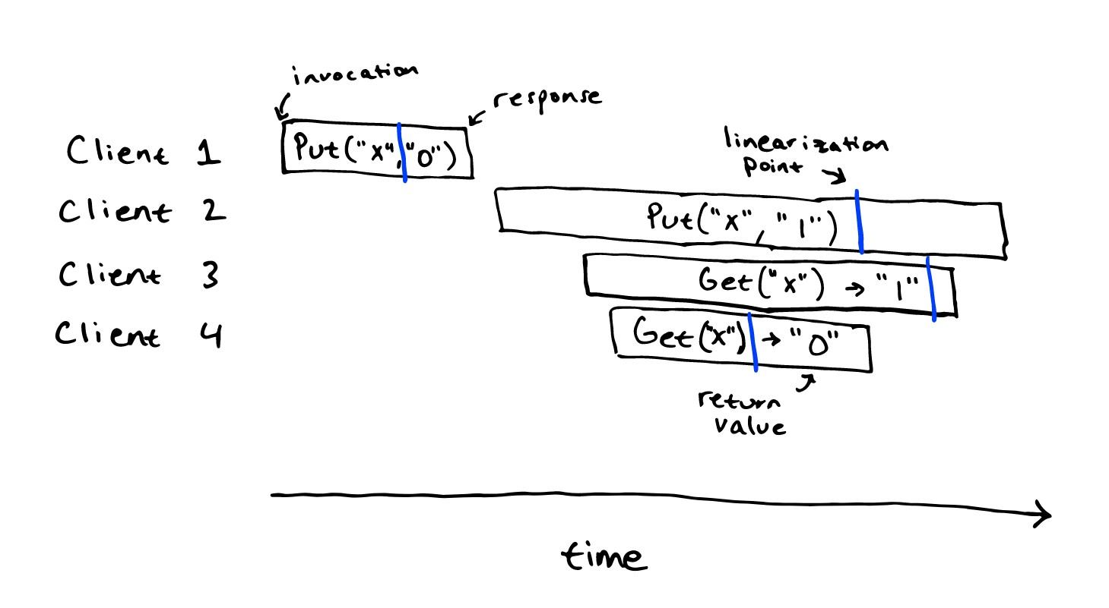
Linearizability
Notes:
We can show this by explicitly finding linearization points for all operations (drawn in blue below). The induced sequential history, Put("x", "0"), Get("x") -> "0", Put("x", "1"), Get("x") -> "1", is a correct history with respect to the sequential specification.

Slide 8
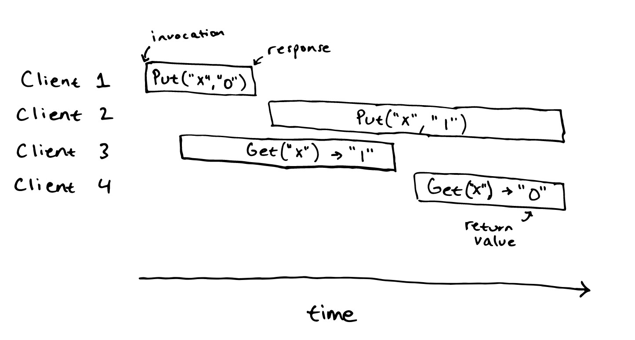
Not linearizability
There is no linearization of this history with respect to the sequential specification: there is no way to assign linearization points to operations in this history.
Notes:
We could start assigning linearization points to the operations from clients 1, 2, and 3, but then there would be no way to assign a linearization point for client 4: it would be observing a stale value. Similarly, we could start assigning linearization points to the operations from clients 1, 2, and 4, but then the linearization point of client 2’s operation would be after the start of client 4’s operation, and then we wouldn’t be able to assign a linearization point for client 3: it could legally only read a value of "" or "0".

Slide 9
Ad-hoc Testing
for client_id = 0..10 {
spawn thread {
for i = 0..1000 {
value = rand()
kvstore.put(client_id, value)
assert(kvstore.get(client_id) == value)
}
}
}
wait for threads
It is certainly the case that if the above test fails, then the key-value store is not linearizable. However, there are non-linearizable key-value stores that would always pass this test.

Slide 10
Complete random testing
but what is correct?
NP-Completeness
for client_id = 0..10 {
spawn thread {
for i = 0..1000 {
value = kvstore.get(rand())
or
kvstore.put(rand(), rand())
}
}
}
wait for threads

Slide 11
Porcupine
kvstore.put(rand(), rand());
kvstore.get(rand());
A linearizability checker takes as input a sequential specification and a concurrent history, and it runs a decision procedure to check whether the history is linearizable with respect to the spec.
算法实现
https://arxiv.org/pdf/1504.00204.pdf
Notes:
we can test for correctness by recording an entire history of operations on the system and then checking if the history is linearizable with respect to the sequential specification.
Implementations of linearizability checkers take an executable specification along with a history, and they run a search procedure to try to construct a linearization, using tricks to constrain the size of the search space.

Slide 12
Porcupine
supports specifying history in two ways, either as a list of operations with given call and return times, or as a list of call/return events in time order.

Slide 13
Apusic Chaos架构
pd
n1
n2
n3
n4
n5
service
service
service
service
service
service
Agent
Agent
Agent
Agent
Agent
Agent
Controller

Slide 14
Bank Case
Its model is a restricted, unrealistic [2] “bank” that maintains accounts on different rows of a table with a “balance” column.
Each transaction contains two SELECTs and two UPDATEs behind a condition.
the event generator issues randomly distributed read and transfer events.

Slide 15
Serializability
is a guarantee about transactions, or groups of one or more operations over one or more objects.
It guarantees that the execution of a set of transactions (usually containing read and write operations) over multiple items is equivalent to some serial execution (total ordering) of the transactions.
Serializability is the traditional “I,” or isolation, in ACID.
serializability does not—by itself—impose any real-time constraints on the ordering of transactions. Serializability is also not composable. Serializability does not imply any kind of deterministic order

Slide 16
Why we have both
linearizability can be viewed as a special case of strict serializability where transactions are restricted to consist of a single operation applied to a single object.
In practice, your database is unlikely to provide serializability, and your multi-core processor is unlikely to provide linearizability—at least by default. As the above theory hints, achieving these properties requires a lot of expensive coordination.

