Slide 1

A Heterogeneous Graph-Attention MAPPO Algorithm
for Cooperative Multi-UAV Search under
Intermittent Communication Constraints
Presenter : Yinying Kuang
Huazhong University of Science and Technology, HUST
CAC 2026
Notes:
各位老师、同学早上好。我是华中科技大学的匡银莹。今天很荣幸向大家汇报我们关于间歇通信约束下多无人机协同搜索的工作。本文提出了 IC-HGAT-MAPPO 算法，把间歇通信建模为信息约束，并结合重访感知信念维护与异构图注意力策略，实现去中心化协同搜索。

Slide 2
01
Background and Motivation
CONTENTS
02
IC-HGAT-MAPPO Framework
03
Experiments and Prospect
2
Notes:
汇报分为三部分：一是研究背景与动机；二是提出的 IC-HGAT-MAPPO 方法框架；三是实验结果与展望。

Slide 3
1. Background
1.1 Cooperative multi-UAV search
Earthquake Response
Wildfire Monitoring
Maritime Rescue
Border Patrol
Rapid coverage of damaged areas with limited infrastructure
Parallel sensing under smoke and interference
Wide-area search with unreliable long-range links
Persistent surveillance with intermittent peer contact
Multi-UAV teams improve search efficiency via parallel deployment,
but disaster/interference-prone areas cause incomplete local beliefs and intermittent peer information.
3
Notes:
地震救援、森林火灾监测、海上搜救和边境巡逻等任务都需要在动态环境中高效搜索。多无人机可通过并行部署提升效率，但在灾区或强干扰区域，通信受距离与中断影响，机队只能依赖不完整的局部信念与间歇同伴信息来协同。

Slide 4
1. Background
1.2 Challenges under intermittent communication
01 Incomplete Exchange
Hard to keep consistent environmental beliefs and coordinated exploration when links drop.
02 Heterogeneous Relations
UAV–UAV, UAV–target/frontier, and UAV–obstacle interactions are poorly captured by homogeneous graphs.
03 Stale Peer Messages
After link recovery, received beliefs may be outdated; relevance must be ranked by communication history.
4
Notes:
现有工作仍面临三大挑战：第一，信息不完整导致环境信念难以一致、探索难以协同；第二，无人机、搜索实体与障碍之间的异构交互难以用同构图刻画；第三，通信恢复后收到的信息可能过时，需要按通信历史评估相关性。因此，我们把间歇通信建模为信息约束，而非单独优化通信本身。

Slide 5
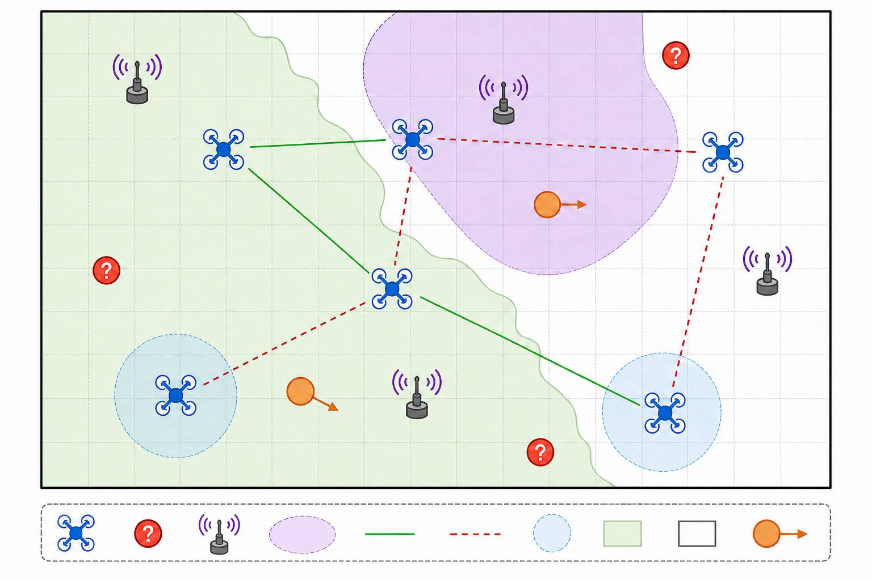
1. Background
1.3 Problem formulation (Dec-POMDP)
System model
• N UAVs, M moving targets, K obstacles
• Discrete 9-action motion (8 dirs + hover)
• Sensing Rs; communication Rc with outage
• Local P / E / R belief maps per UAV
• Link mask: only reachable peer messages
• Shared policy, decentralized execution
• Metrics: decisiveness, discovery, T80
Fig. 1 UAV-swarm search with intermittent links
5
Notes:
问题建模为 Dec-POMDP。固定高度机群在二维有界区域搜索，含移动目标、动态障碍与干扰源。每架无人机维护概率、不确定性和重访陈旧度三类局部地图；通信可用性由瞬时对称邻接矩阵决定。策略参数共享，但执行时仅使用机载观测与可达同伴信息。评价指标包括信念决断度、目标发现率以及达到80%发现的时间T80。

Slide 6
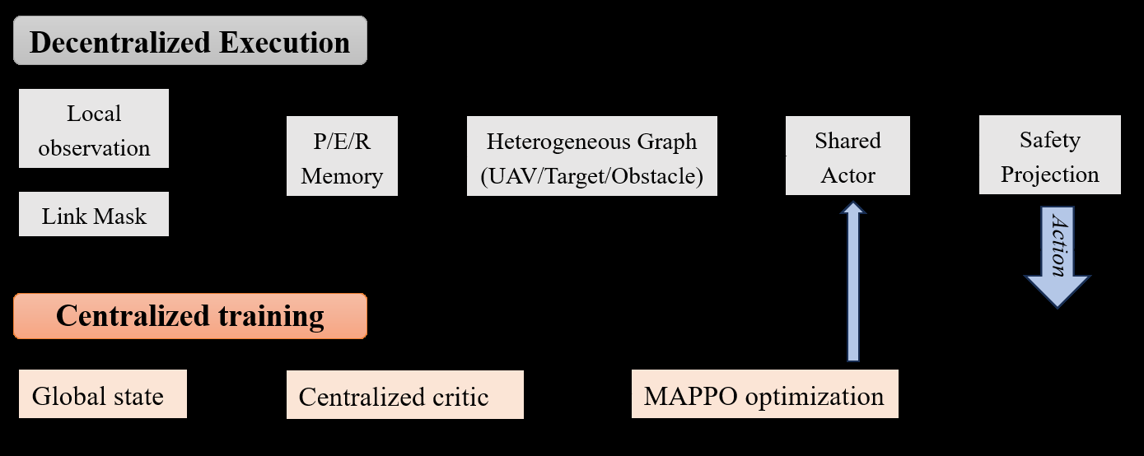
2. IC-HGAT-MAPPO Framework
2.1 Overview
Fig. 2 Decentralized execution with link-masked HGAT actor + centralized MAPPO critic
6
Notes:
这是方法总览。执行阶段：局部观测经链路掩码进入 P/E/R 记忆，构建异构图后由共享 Actor 输出动作，再经安全投影。训练阶段：用全局状态与中心化 Critic，通过 MAPPO 优化共享策略。通信只限制可用信息，不作为单独优化目标。

Slide 7
2. IC-HGAT-MAPPO Framework
2.2 Belief maintenance & history-aware selection
P / E / R Memory
Source Selection
Design Goal
• Probability map P: target occupancy belief
• Uncertainty map E: exploration priority
• Revisit-staleness map R: aging of visited cells
• No global map sharing required
• Instantaneous link mask restricts peers
• Node-level communication-history indicator
• Prefer informative & fresh peer beliefs
• Down-weight stale recovered messages
• Decide with onboard observations only
• Use reachable messages when available
• Keep team search coordinated under outage
• Treat communication as information constraint
7
Notes:
每个无人机维护三类局部地图：概率图、不确定性图和重访陈旧度图，无需全局地图共享。瞬时链路掩码限制可接收同伴；再通过节点级通信历史指标，挑选信息量大且相对新鲜的同伴信念，降低过时消息干扰。

Slide 8
2. IC-HGAT-MAPPO Framework
2.3 Heterogeneous graph-attention policy
UAV nodes
Target / Frontier
Obstacle nodes
Reachable teammates under current link mask
Search entities guiding informative moves
Visible dynamic obstacles for safe planning
Policy pipeline
Masked HGAT encoder → Shared actor → 9 discrete actions → Safety projection
HGAT: 2 layers, 4 heads, hidden width 128. Typed relations help interpret search cues and obstacle risks
under incomplete observations. Only one centralized critic is used during CTDE training.
8
Notes:
异构图编码器同时建模可达无人机、目标/前沿实体与可见障碍。经链路掩码的图注意力编码后，共享 Actor 输出九维离散动作，再经安全投影。训练采用 CTDE：执行去中心化，仅用一个中心化 Critic 做 MAPPO 更新。

Slide 9
2. IC-HGAT-MAPPO Framework
2.4 Training & decentralized execution
Algorithm 1 IC-HGAT-MAPPO
Contributions
for each episode:
for each timestep t:
for each active UAV i:
Sense; update P/E/R; select sources
Build masked graph; sample action
Apply safety projection
Store samples; receive team reward r_t
Estimate GAE; update critic V_φ & clipped MAPPO
1. Intermittent-communication-aware cooperative search
2. Revisit-aware belief + history-aware source selection
3. Heterogeneous graph-attention policy under incomplete observations
9
Notes:
训练与执行流程如 Algorithm 1。每步先更新局部信念并选择通信源，再构图采样动作并做安全投影；回合结束后用 GAE 与裁剪 MAPPO 更新。三大贡献对应：间歇通信感知协同搜索、重访与历史感知信念选择、异构图注意力策略。

Slide 10
3. Experiments
3.1 Setup and baselines
Map / Horizon
30×30 cells, T=200
Fleet
6 UAVs, 15 targets, 10 obstacles
Radii
Rs=2 cells, Rc=10 cells
Outage
base 0.02; pjam=prec=0.45
Training
2,000 episodes; 5 seeds
Eval
30 held-out scenarios
Baselines & ablations
Heuristic search | QMIX | MAPPO (local encoder) | Homogeneous Graph MAPPO
Ablations: w/o revisit memory · w/o communication-history weighting
10
Notes:
实验在统一动作空间、环境分布、奖励与训练预算下进行。地图30×30，6机15目标10障碍，评估30个留出场景、五个独立训练策略。对比启发式、QMIX、局部观测MAPPO、同构图MAPPO，以及去掉重访记忆或通信历史加权的消融。

Slide 11
3. Experiments
3.2 Main results (Table I)
62.15%
86.78%
82.0%
88.63
Belief Decisiveness
Target Discovery
T80 Success Rate
T80 Mean Steps
Highest among all methods
+9.00 vs heuristic
vs 60.0% homo-graph
Fast among successful runs
Key takeaways
• Heterogeneous relations vs homogeneous graph: +15.10 decisiveness points
• Removing revisit memory: −16.33 decisiveness, −13.67 discovery
• Safety projection changes only 0.17% of nominal actions (collision ≈ heuristic)
11
Notes:
IC-HGAT-MAPPO 在信念决断度与发现率上均为最高，分别为62.15%与86.78%。达到80%发现阈值的成功率为82.0%，显著高于同构图的60.0%；条件平均步数88.63。消融显示异构关系编码与重访记忆贡献最稳定；安全投影仅改动0.17%名义动作。

Slide 12
3. Experiments
3.2b Comparative evaluation (five-seed, 30 scenarios)
Method
Decisiveness
Discovery
T80 Succ.
T80 Mean
Heuristic search
44.99%
77.78%
63.3%
96.21
QMIX
30.00%
72.11%
38.7%
127.57
MAPPO (local)
41.91%
76.22%
53.3%
122.00
Homo. Graph MAPPO
47.05%
79.78%
60.0%
88.61
w/o revisit memory
45.82%
73.11%
53.3%
141.06
w/o hist. weighting
53.99%
85.33%
86.7%
98.19
IC-HGAT-MAPPO
62.15%
86.78%
82.0%
88.63
12
Notes:
这是五策略、三十个留出场景的对比结果。IC-HGAT-MAPPO在决断度与发现率上均为最优；T80成功率82.0%，高于同构图的60.0%。去掉重访记忆后性能明显下降，说明重访层很关键；去掉历史加权后决断度下降、条件T80变慢，说明历史项主要提升信念质量与成功回合效率。

Slide 13
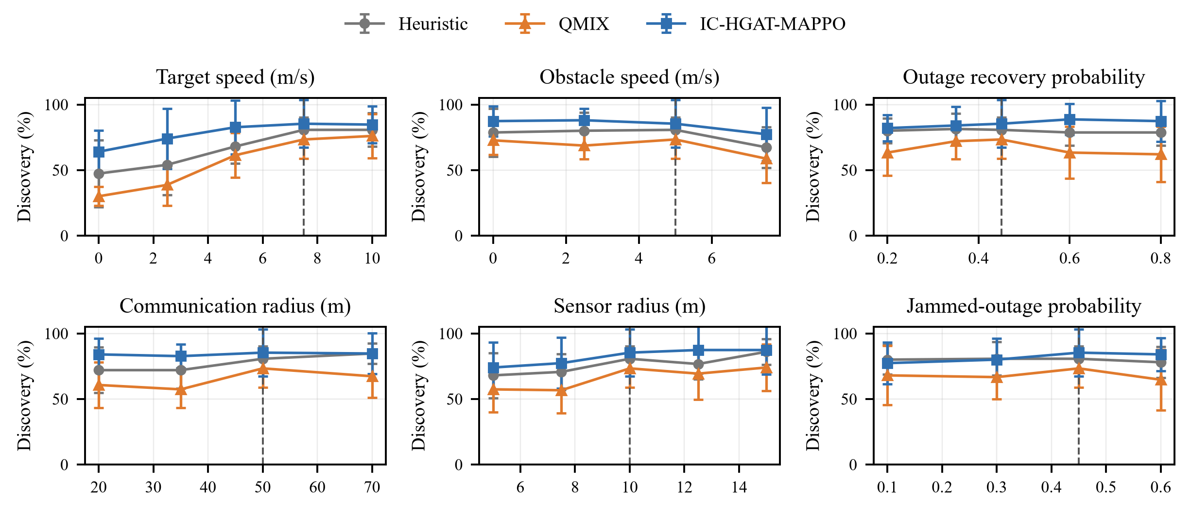
3. Experiments
3.3 Ablation & sensitivity
Robustness
Higher discovery than heuristic & QMIX across sweeps
• Target/obstacle speed
• Sensing & communication radii
• Outage recovery & jam probability
Link-aware constraint + local memory avoid reliance on fixed link patterns
Fig. 4 Discovery under motion & communication perturbations
13
Notes:
敏感性分析在配对场景下逐一改变目标/障碍速度、感知与通信半径、中断恢复与干扰概率。相较启发式与QMIX，IC-HGAT-MAPPO在各扰动下保持更高发现率，体现链路感知信息约束与局部信念记忆的鲁棒性。

Slide 14
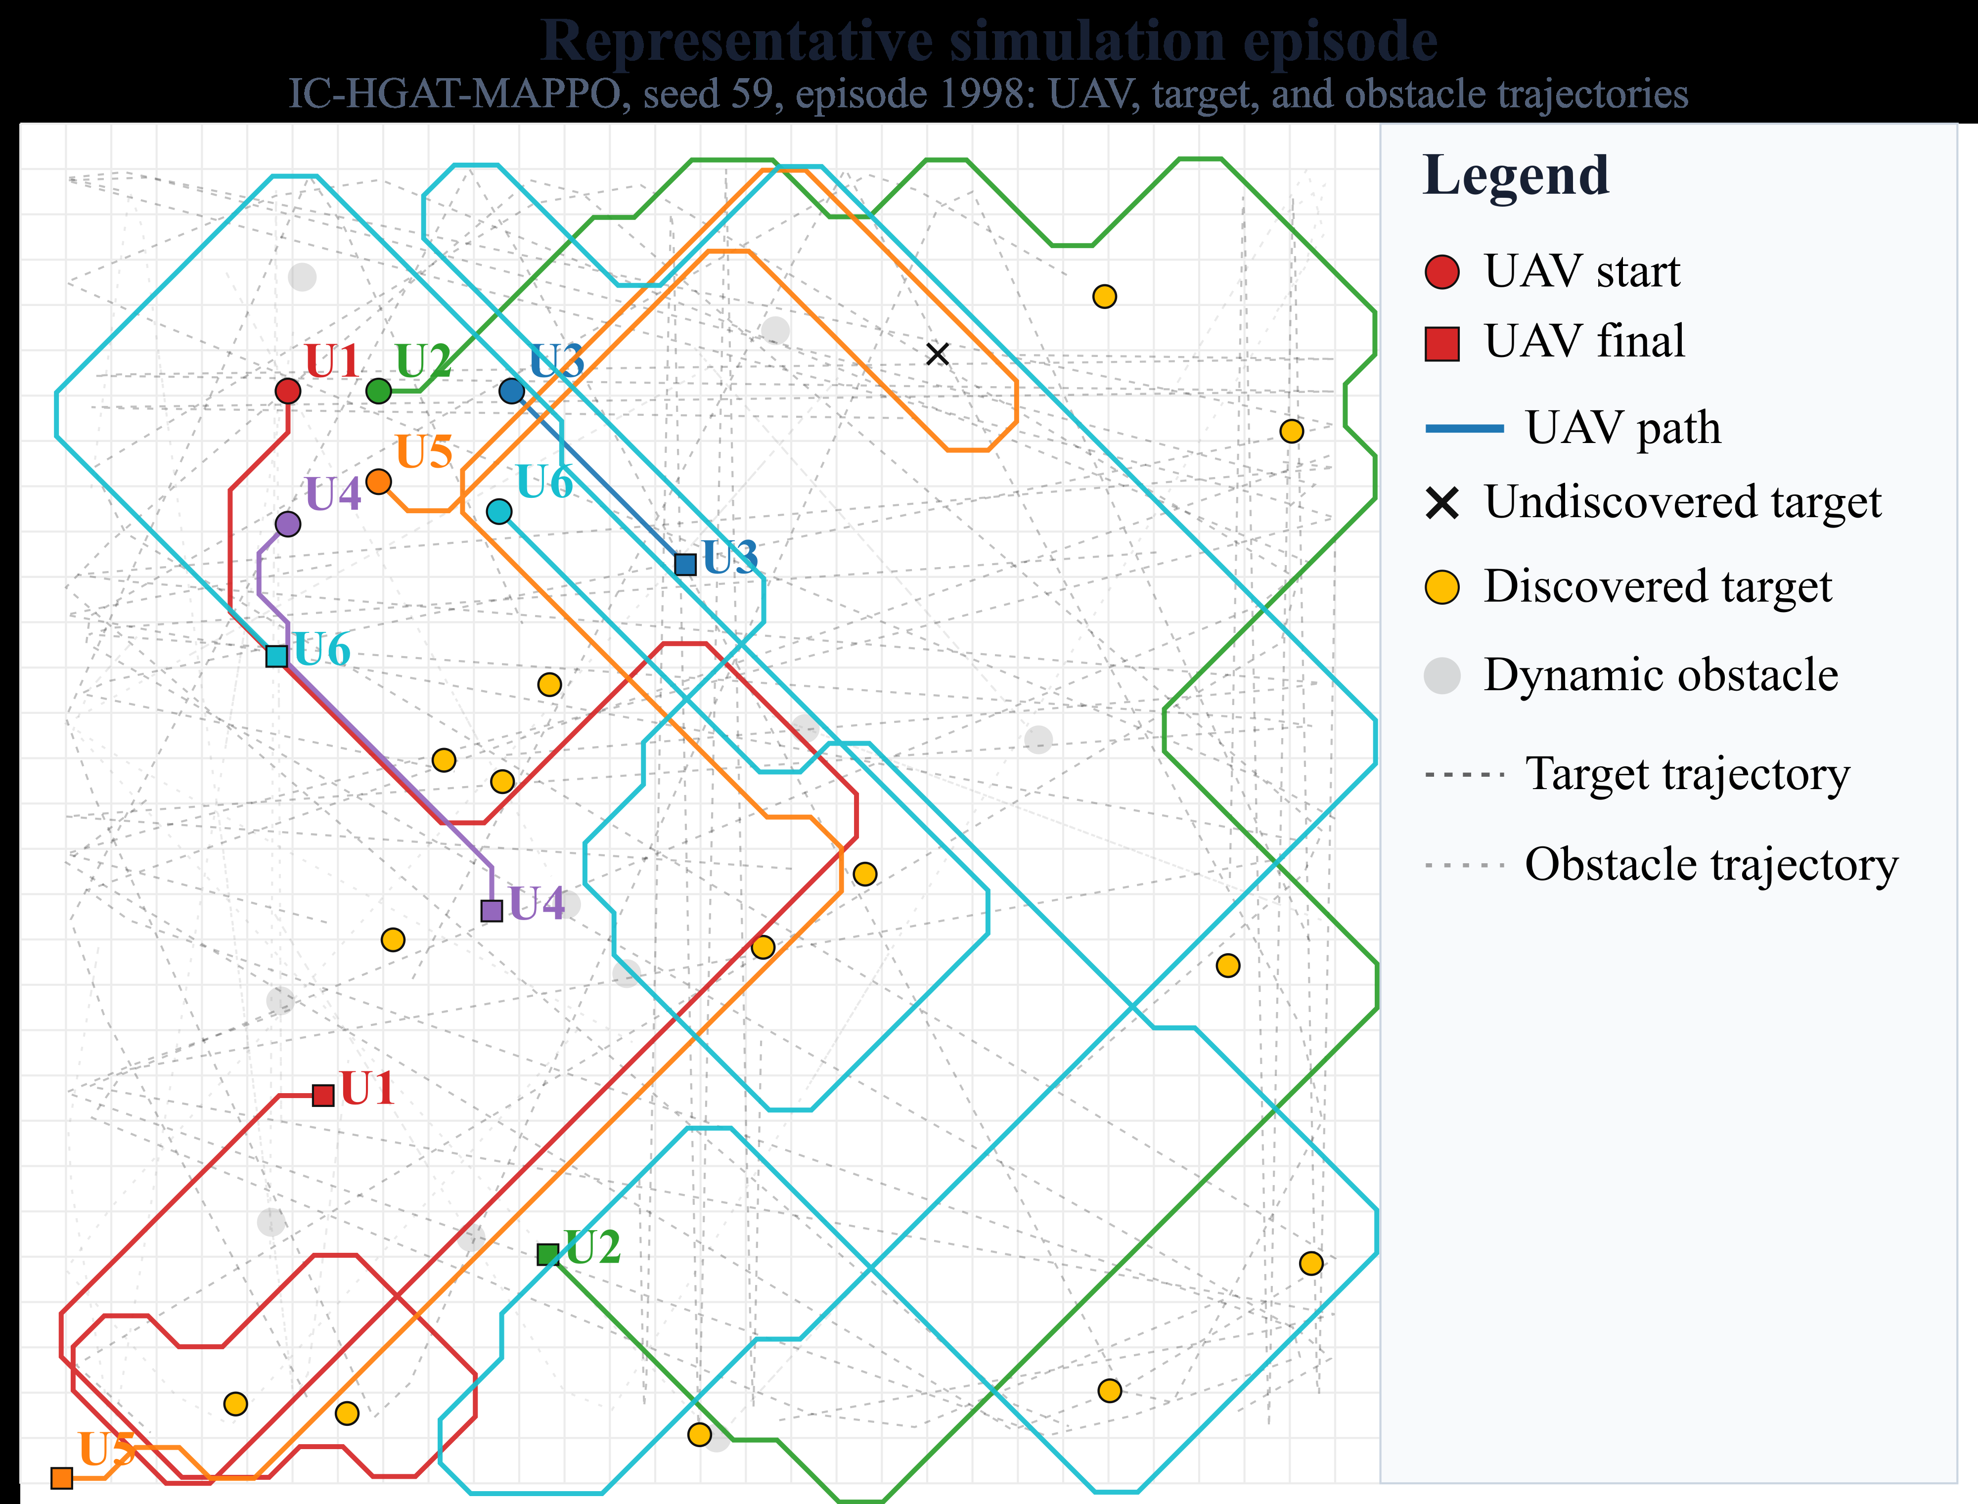
3. Experiments
3.4 Representative episode near convergence
Fig. 3 Trajectories, endpoints, discoveries, and dynamic obstacles (qualitative)
14
Notes:
图3给出接近收敛时的代表训练回合可视化，用于定性展示轨迹、发现结果与动态障碍运动，不作定量对比。

Slide 15
4. Summary and Prospect
Summary
Prospect
• IC-HGAT-MAPPO for cooperative multi-UAV search under intermittent links
• Revisit-aware beliefs + communication-history-aware source selection
• Heterogeneous graph-attention encoding of UAV / target / obstacle relations
• Best mean decisiveness (62.15%) and discovery (86.78%) on 30 scenarios × 5 seeds
• Extend to three-dimensional environments
• Fully decentralized safety mechanisms
• Hardware-in-the-loop validation with practical radios
15
Notes:
总结：我们提出面向间歇通信的IC-HGAT-MAPPO，融合重访感知信念、通信历史源选择与异构关系编码，在30个留出场景上取得最高决断度与发现率。未来将拓展到三维、更去中心化的安全机制，以及硬件在环与真实通信系统验证。

Slide 16
Thank you for your listening！
Yinying Kuang, HUST
Email: kuangyinying039@163.com
CAC 2026
Notes:
汇报到此结束，感谢各位老师和同学的聆听，欢迎批评指正。

