Slide 1


Chinese Automation Congress · CAC 2026
A Heterogeneous Graph-Attention MAPPO Algorithm
for Cooperative Multi-UAV Search
under Intermittent Communication Constraints
Yinying Kuang, Zhaowei Liang, Yongran Zhi, Huijin Fan*, Lei Liu*, Bo Wang*
Huazhong University of Science and Technology
Wuhan Second Ship Design and Research Institute
CAC 2026 · Beijing · October 2026
Notes:
【中文】
各位老师、同学，大家好。今天汇报的工作是间歇通信约束下的多无人机协同搜索。请先记住问题本身：不是默认全局信息可共享，而是每架无人机只能使用机载观测，以及当前物理上可达的邻居信息。算法名称 IC-HGAT-MAPPO 后面再给出。
【English】
Good morning. This talk studies cooperative multi-UAV search under intermittent communication. Please keep the problem first: we do not assume a shared global map. Each UAV may use only onboard observations and currently reachable peer messages. The name IC-HGAT-MAPPO comes after the problem is clear.

Slide 2
01
Background and Problem Formulation
CONTENTS
02
Proposed IC-HGAT-MAPPO
03
Experimental Results and Conclusions
2
Notes:
【中文】
报告分三部分，大约十几秒带过即可。第一部分讲背景与问题；第二部分讲提出的 IC-HGAT-MAPPO；第三部分给出实验与结论。
【English】
The talk has three parts. I will introduce the problem and motivation, then the proposed IC-HGAT-MAPPO framework, and finally the experimental results. This slide takes about ten to fifteen seconds.

Slide 3
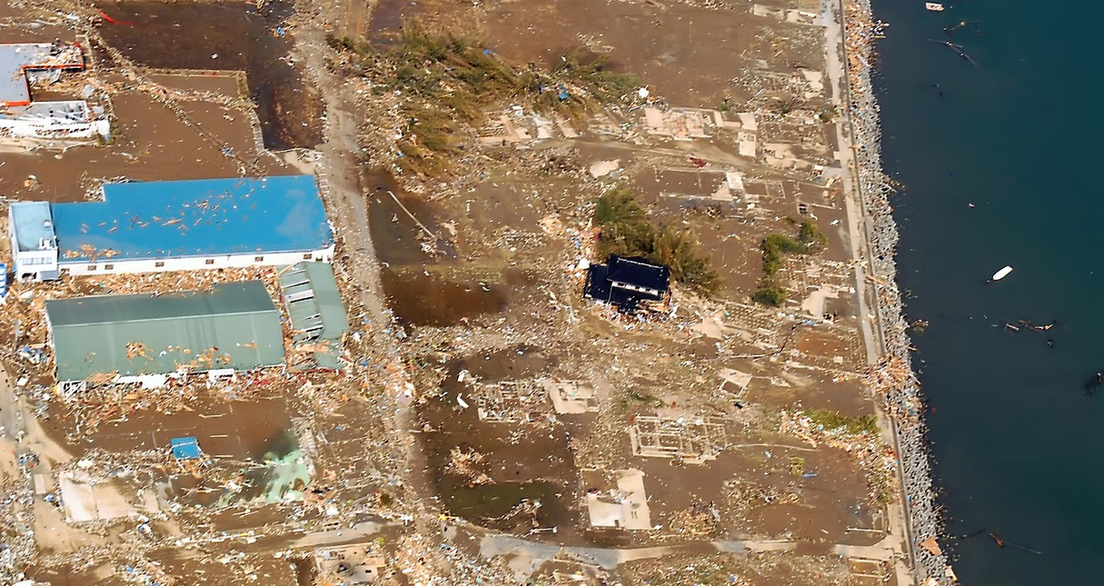
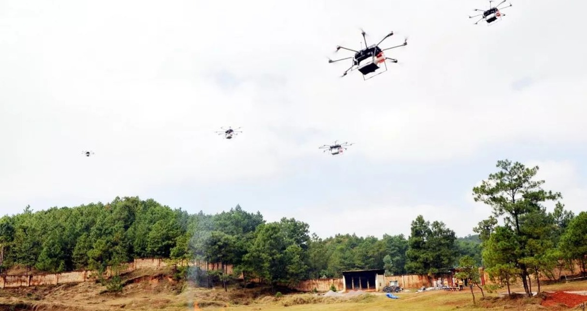
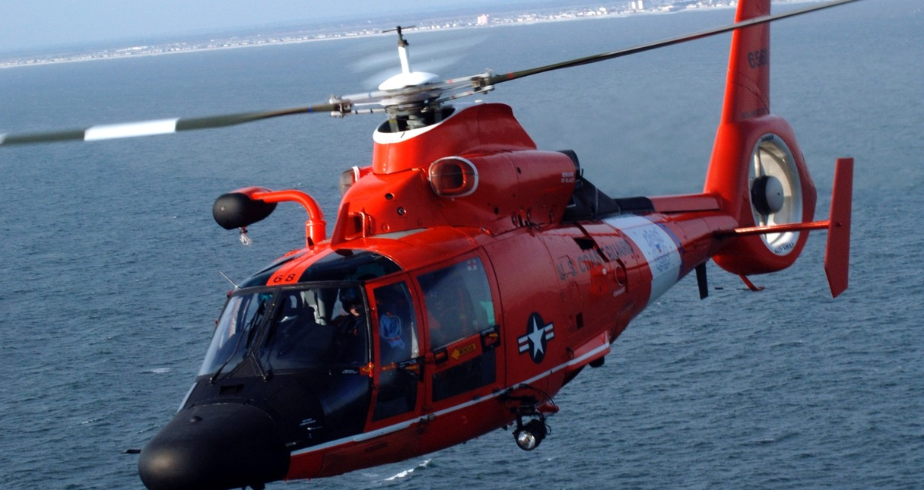
1. Background
1.1 Cooperative Multi-UAV Search
Earthquake Response
Wildfire Monitoring
Maritime Rescue
Global / Reliable Information
→ Local Observation + Intermittent Communication
More realistic but more challenging
Conventional Setting
Practical Setting
Research Needs
Stable communication
Synchronized / global information
Homogeneous interaction modeling
Intermittent links
Local and incomplete beliefs
UAV / target / obstacle interactions
1. Maintain useful local beliefs
2. Exploit reachable peer information
3. Model heterogeneous relations
3
Notes:
【中文】
多无人机可以并行覆盖震后搜救、林火监测和海上救援等场景。很多 MARL 方法默认通信充分、信息接近全局。但在干扰环境下链路会间歇中断，无人机实际上只能依赖局部观测和当前仍连通的邻居。因此问题不只是“怎么搜索”，而是“信息不完整时如何协同搜索”。左侧是常规设定，中间是更现实的设定，右侧三条研究需求对应后文三个模块。
【English】
Multi-UAV teams can search in earthquake response, wildfire monitoring, and maritime rescue. Many MARL methods assume stable communication and nearly global information. Under interference, links drop, so each UAV has only local observations and currently reachable neighbors. The question is not only how to search, but how to coordinate under incomplete information. The three research needs on the right map to the three designs that follow.

Slide 4
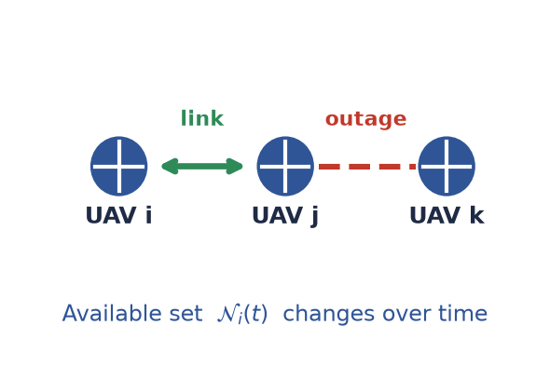
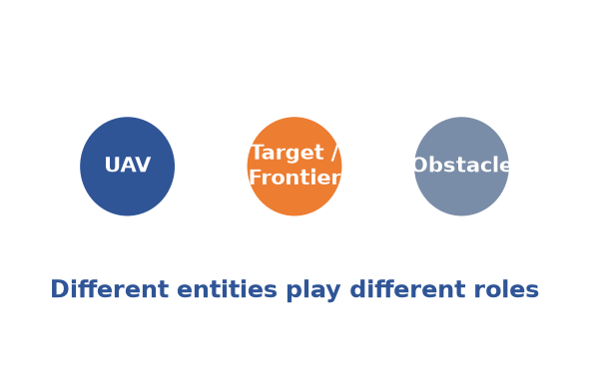
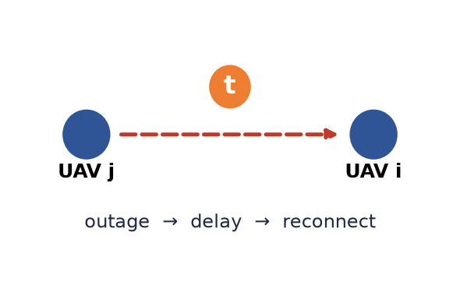
1. Background
1.2 Key Challenges under Intermittent Communication
1 Incomplete Information Exchange
2 Heterogeneous Interactions
3 Information Staleness
No shared global map
Only reachable peer messages
Decentralized decisions
Peer cooperation
Search utility
Collision risk
Recovered information may be outdated
Not all reachable beliefs are equally useful
Which source should be trusted?
Our focus: cooperative decision-making under communication constraints,
rather than communication-protocol optimization.
4
Notes:
【中文】
间歇通信带来三个核心挑战。第一，没有共享全局地图，可用邻居集合随时间变化，决策必须去中心化。第二，无人机、目标或前沿、障碍物角色不同，不能只用同构 UAV 图。第三，通信恢复后拿到的信念可能过时，不能默认“能连上就可信”。请注意：我们优化的是通信约束下的决策，而不是通信协议本身。
【English】
Three challenges follow. First, there is no shared global map, and the reachable set changes over time, so decisions are decentralized. Second, UAVs, targets or frontiers, and obstacles play different roles, so a homogeneous UAV graph is not enough. Third, beliefs recovered after an outage may be stale, so reachability is not the same as usefulness. Our focus is decision-making under communication constraints, not protocol optimization.

Slide 5
1. Background
1.3 Proposed Solution
Challenge 1
Challenge 2
Challenge 3
Learning Framework
Incomplete beliefs
Stale peer information
Heterogeneous entities
Shared Actor
Centralized Critic
MAPPO / CTDE
Common Safety Projection
Solution
Solution
Solution
Revisit-aware
P/E/R Memory
Communication-History-
Aware Source Selection
Heterogeneous
Graph Attention
Our problem: Cooperative Multi-UAV Search under Intermittent Communication Constraints
Q1. How to maintain useful beliefs without global map sharing?
Q2. How to select useful information after communication recovery?
IC-HGAT-
MAPPO
Q3. How to model UAV, task, and obstacle interactions jointly?
5
Notes:
【中文】
这一页完成转折：三个挑战分别由三个机制回答。不完整信念用 revisit-aware P/E/R 记忆；过时邻居信息用通信历史感知的源选择；异构实体用异构图注意力。学习框架是共享 Actor、训练期集中 Critic、MAPPO/CTDE；底部的安全投影是所有方法共用的，不是本文贡献。三个问题汇到 IC-HGAT-MAPPO。
【English】
This slide is the turning point. Incomplete beliefs are handled by revisit-aware P/E/R memory; stale peer information by communication-history-aware source selection; heterogeneous entities by heterogeneous graph attention. Training uses a shared actor, a centralized critic, and MAPPO with CTDE. The safety projection is shared by all methods and is not a contribution. These three questions lead to IC-HGAT-MAPPO.

Slide 6
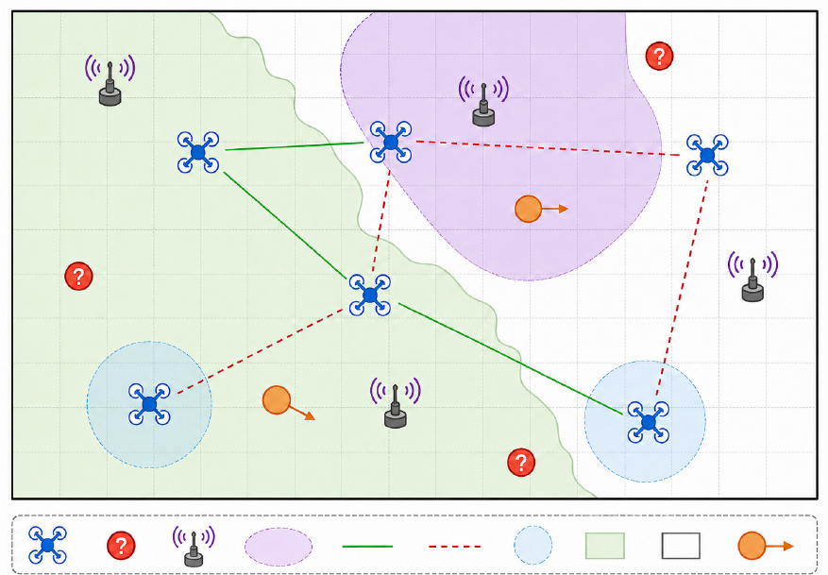
2. Proposed IC-HGAT-MAPPO
2.1 Problem Formulation
Motion model
Discrete motion with adaptive decision interval
Communication constraint
Only instantaneous reachable links are available
Fig. 1 Local sensing, intermittent links, moving targets, dynamic obstacles
Evaluation objectives
Scenario
Target discovery Dt Belief decisiveness Ct Speed T80
6 UAVs · 15 targets · 10 obstacles · 30×30 area
Local sensing + intermittent links
Action: 8 directions + hover
Higher Dt, Ct → better · Lower T80 → faster
6
Notes:
【中文】
问题设定对应论文第二节。左侧是搜索场景：局部感知、实线连通、虚线断链、运动目标和动态障碍。仿真是 6 架无人机、15 个目标、10 个障碍、30×30 区域，动作为八方向加悬停。运动是带可行域投影的离散更新。最关键的一句：策略只能使用瞬时可达链路。评价指标三个：发现率 Dt、信念决断度 Ct、到达 80% 发现的时间 T80。Dt、Ct 越高越好，T80 越低越快。
【English】
This is the problem formulation. The figure shows local sensing, live and broken links, moving targets, and dynamic obstacles. The setting has 6 UAVs, 15 targets, 10 obstacles, and a 30 by 30 map, with eight move directions plus hover. Motion is discrete with a feasible-set projection. The key sentence is that only instantaneous reachable links are available. We report discovery Dt, belief decisiveness Ct, and T80. Higher Dt and Ct are better; lower T80 is faster.

Slide 7
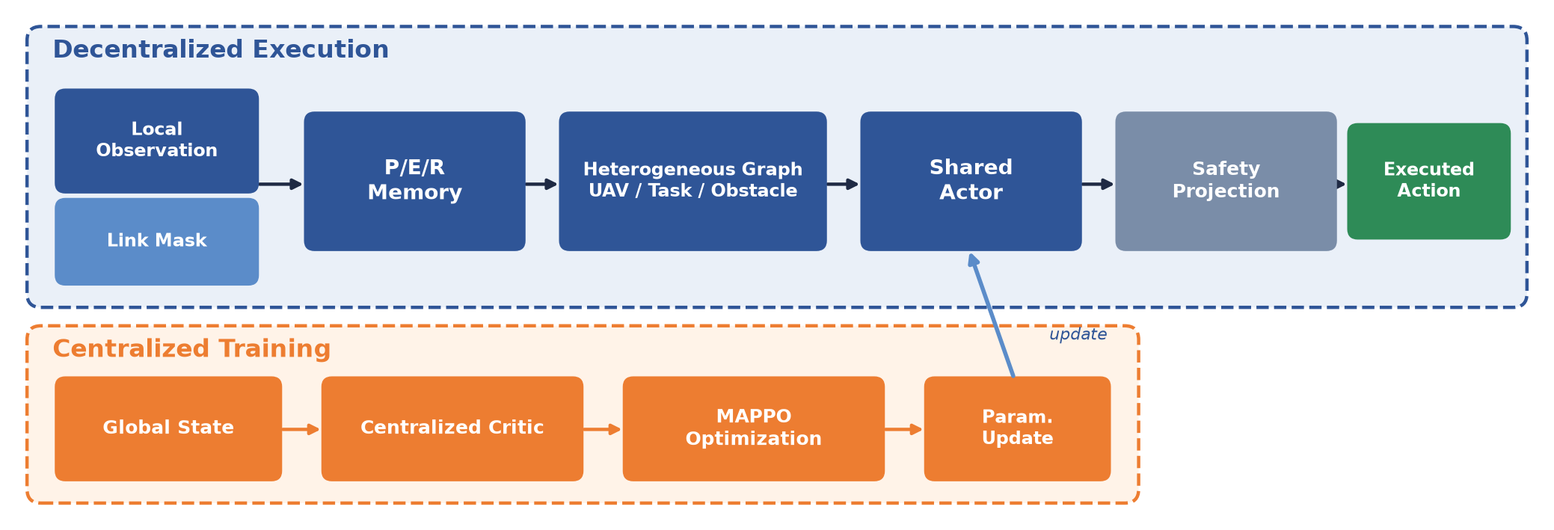
2. Proposed IC-HGAT-MAPPO
2.2 IC-HGAT-MAPPO Framework
Decentralized
Communication-aware
CTDE
local + reachable information only
instantaneous link masking
global state only used during training
Safety projection is shared by all methods and is not a contribution.
7
Notes:
【中文】
请按箭头从左到右讲，不要跳模块。执行时：局部观测与链路掩码进入 P/E/R 记忆，再进入异构图，共享 Actor 给出名义动作，再经安全投影执行。训练时集中 Critic 看到全局状态，MAPPO 更新参数后写回 Actor。执行阶段去掉 Critic。务必说明：安全投影对所有对比方法相同，性能不能记在 safety layer 上。
【English】
Please follow the arrows from left to right. At execution, local observation and the link mask update P/E/R memory, then the heterogeneous graph, then the shared actor, then safety projection. During training, a centralized critic sees global state and MAPPO writes the update back to the actor. The critic is removed at execution. Safety projection is shared by all methods, so it is not the source of the gains.

Slide 8
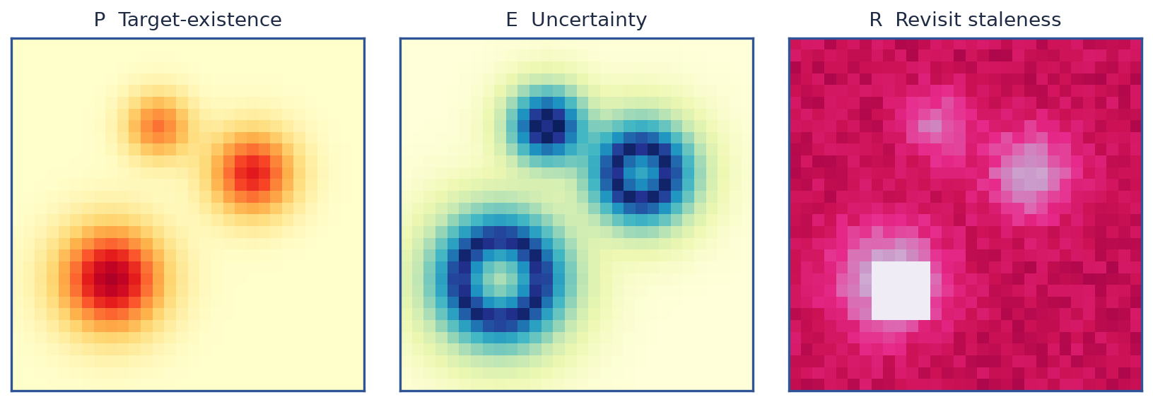
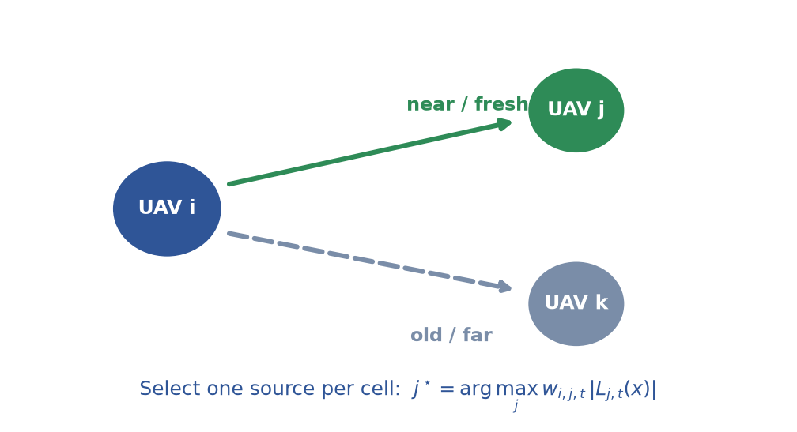
2. Proposed IC-HGAT-MAPPO
2.3 Local Belief Maintenance and Information Selection
Revisit-Aware P/E/R Memory
Communication-History-Aware Source Selection
R ← aging + spatial diffusion
sensed cells → reset to 0
unsensed cells → gradually become stale
One reachable source is selected per cell
Avoid correlated evidence accumulation
8
Notes:
【中文】
左栏回答“记什么”。每架无人机维护目标存在信念 P、不确定性 E 和回访陈旧度 R。被感知格子重置为 0，未感知格子随时间老化并向邻域扩散。右栏回答“信谁”。即使 j 和 k 都能通信，也按距离和通信历史加权，每个格子只选一个源，避免把相关 log-odds 简单相加。
【English】
The left column answers what to remember: target-existence P, uncertainty E, and revisit staleness R. Sensed cells reset to zero; unsensed cells age and diffuse. The right column answers whom to trust. Even if both j and k are reachable, weights use distance and communication history, and one source is chosen per cell. We do not add correlated log-odds.

Slide 9
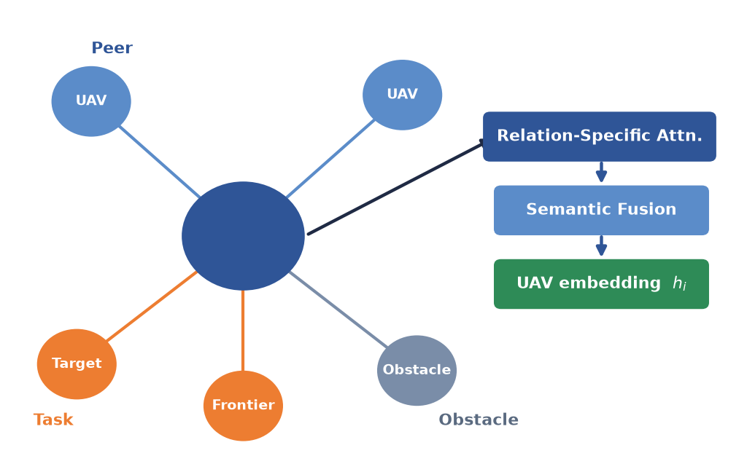
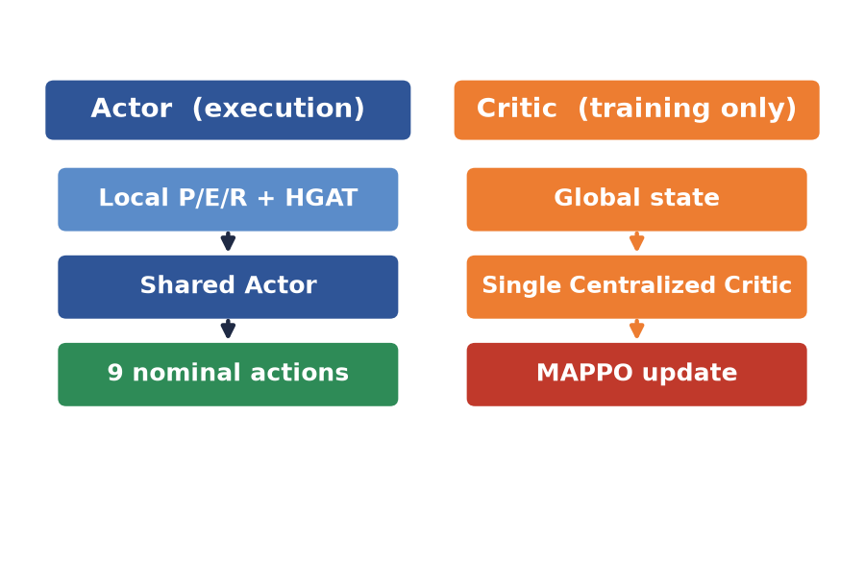
2. Proposed IC-HGAT-MAPPO
2.4 Heterogeneous Graph Policy and MAPPO Optimization
Relation confidence · Distance prior · Link mask
(λD, λC, λsafe) = (1.0, 0.30, 0.10) · MAPPO: PPO clipping + GAE
Heterogeneous Graph Attention
9
Notes:
【中文】
异构图以本机 UAV 为中心，分别连同伴、任务和障碍，再做关系专用注意力与语义融合，得到嵌入。注意力由 QK、关系置信、距离先验和链路掩码共同决定，这是相对普通 GAT 的差别。右侧是共享 Actor 输出 9 个名义动作；单一集中 Critic 只在训练使用。奖励是发现增量加决断度增量，减去安全代价，权重 1.0、0.30、0.10。完整 PPO 公式不必展开。
【English】
The graph is centered on UAV i, with peer, task, and obstacle relations, then relation-specific attention and semantic fusion. Attention uses the QK term, relation confidence, a distance prior, and the link mask. That is the difference from a plain GAT. The shared actor outputs nine nominal actions; one centralized critic is used only in training. The reward is discovery plus decisiveness minus a safety cost, with weights 1.0, 0.30, and 0.10. The full PPO derivation can wait for questions.

Slide 10
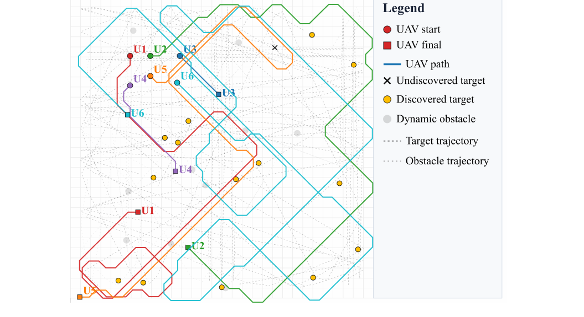
3. Experimental Results
3.1 Experimental Setup and Main Results
Experiment setup
6 UAVs · 15 targets · 10 obstacles · 30×30 grid
Horizon = 200 · 2,000 training episodes
5 independently trained policies
30 held-out scenarios
Common environment, reward, action space and training budget
vs. Heuristic
vs. QMIX
+17.16 pp decisiveness
+9.00 pp discovery
+32.15 pp decisiveness
+14.67 pp discovery
T80 · 82.0% success · 88.63 steps conditional on success
Safety intervention 0.17%; collision rate comparable to the heuristic (not ranked).
UAV trajectories · discovered / undiscovered targets · dynamic obstacles
10
Notes:
【中文】
实验协议公平：同一环境、奖励、动作空间和训练预算；5 个独立策略，30 个保留场景。左下轨迹图只说明系统长什么样，不作为定量证据。主结果请看柱状图而不是表格：决断度 62.15%，发现率 86.78%。相对启发式分别提高 17.16 和 9.00 个百分点，相对 QMIX 提高 32.15 和 14.67 个百分点。T80 成功率为 82.0%，成功条件下 88.63 步。安全干预仅 0.17%，碰撞与启发式相当，不要把安全列说成本文优势。
【English】
The protocol is shared: same environment, reward, action space, and budget; five independently trained policies and thirty held-out scenarios. The trajectory figure shows what a run looks like; it is not the quantitative evidence. Please read the bars, not a table: 62.15 percent decisiveness and 86.78 percent discovery. Versus the heuristic that is plus 17.16 and plus 9.00 points; versus QMIX, plus 32.15 and plus 14.67. T80 succeeds in 82.0 percent of runs at 88.63 steps when successful. Safety intervention is only 0.17 percent, and collision is comparable to the heuristic, so do not rank the method on safety columns.

Slide 11
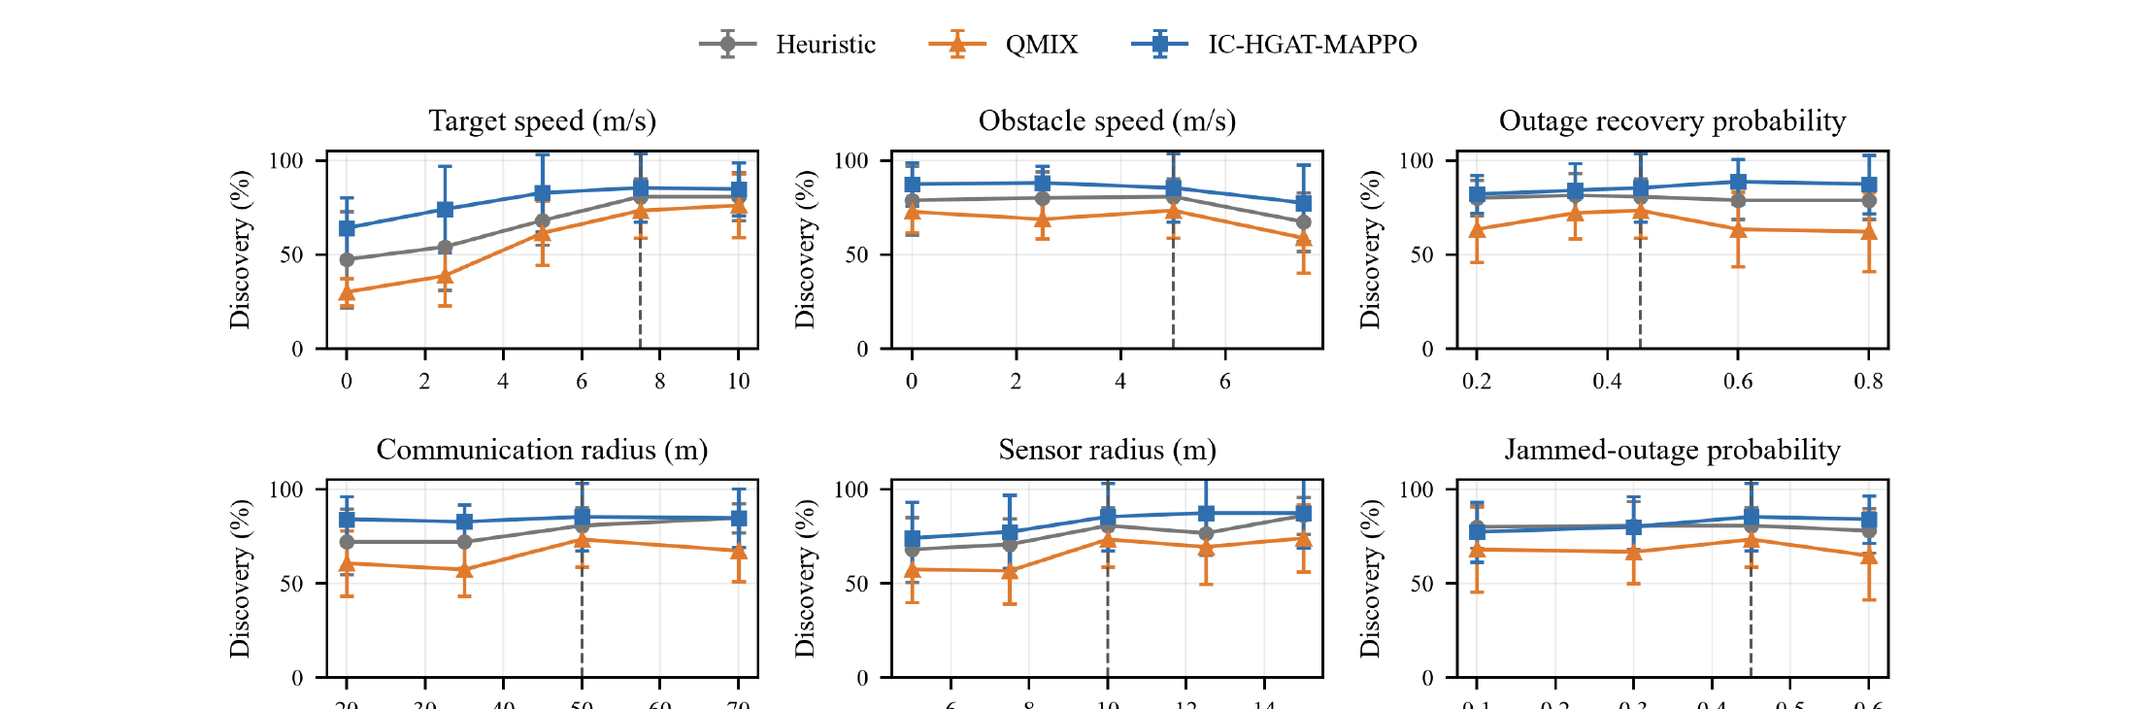
3. Experimental Results
3.2 Ablation and Sensitivity Analysis
Heterogeneous relations
+15.10 pp decisiveness
vs. Homogeneous Graph MAPPO
Revisit memory
−16.33 pp decisiveness
−13.67 pp discovery when removed
History weighting
−8.16 pp decisiveness when removed
T80 88.63→98.19; success 82.0% vs 86.7%
IC-HGAT-MAPPO maintains higher mean discovery across the tested perturbation ranges.
11
Notes:
【中文】
消融说明三个模块都有用。相对同构图，异构关系带来约 15.10 个百分点决断度。去掉 revisit 记忆，决断度和发现率分别下降 16.33 和 13.67 个百分点。去掉历史加权，决断度下降 8.16，条件 T80 从 88.63 变到 98.19，但阈值成功率从 82.0% 升到 86.7%，这是需要主动承认的权衡。下方敏感性不必六张图逐张讲，举目标速度和通信半径或中断概率两例，然后说在测试扰动范围内平均发现率更高。
【English】
Ablations support all three modules. Heterogeneous relations add about 15.10 points of decisiveness over a homogeneous graph. Removing revisit memory drops decisiveness and discovery by 16.33 and 13.67 points. Removing history weighting drops decisiveness by 8.16 points and slows conditional T80 from 88.63 to 98.19, while threshold success rises from 82.0 to 86.7 percent; that trade-off should be stated. Do not walk through all six sensitivity plots. Mention target speed and communication radius or outage, then conclude that mean discovery stays higher over the tested ranges.

Slide 12
4. Summary and Future Plan
Contributions, results, and next steps
1. Communication-Constrained Decision Making
Decentralized policies use only local observations and reachable peer information.
2. Belief Management
Revisit-aware P/E/R memory + communication-history-aware source selection.
3. Heterogeneous Relational Encoding
HGAT explicitly models peer, task and obstacle relations within MAPPO.
62.15% belief decisiveness | 86.78% discovery | 82.0% T80 success
88.63 steps conditional T80
Future Plan
3D environments
Fully decentralized safety
Realistic validation
Extend planar search to three-dimensional UAV scenarios
Remove the simulator-level centralized safety supervisor
Hardware-in-the-loop and real communication systems
12
Notes:
【中文】
总结只留三条：通信约束下的去中心决策、P/E/R 与历史感知选源的信念管理、异构关系编码。请再念一遍核心数字：62.15%、86.78%、82.0%，成功条件下 88.63 步。未来工作按论文来：三维环境、完全去中心安全、以及含真实通信的半实物验证。如果被问到仓库里的围捕代码，只作为口头补充，不要把这篇 search 报告讲成 pursuit。
【English】
Leave three contributions: communication-constrained decentralized decisions; belief management with P/E/R and history-aware selection; and heterogeneous relational encoding. Repeat 62.15 percent, 86.78 percent, 82.0 percent, and 88.63 conditional steps. Future work follows the paper: 3D environments, fully decentralized safety, and hardware-in-the-loop with real communication. If asked about pursuit code in the repo, mention it only as an ongoing extension. Do not turn this search talk into a pursuit talk.

Slide 13
Thank you for your attention!
A Heterogeneous Graph-Attention MAPPO Algorithm for
Cooperative Multi-UAV Search under Intermittent Communication Constraints
Yinying Kuang
Huazhong University of Science and Technology
kuangyinying039@163.com
CAC 2026 · October 2026
Notes:
【中文】
谢谢各位。欢迎就间歇通信下的信念维护、源选择和异构图提问。联系邮箱是 kuangyinying039@163.com。
【English】
Thank you for your attention. I welcome questions on belief maintenance, source selection, and heterogeneous graphs under intermittent communication. My email is kuangyinying039@163.com.

