Slide 1
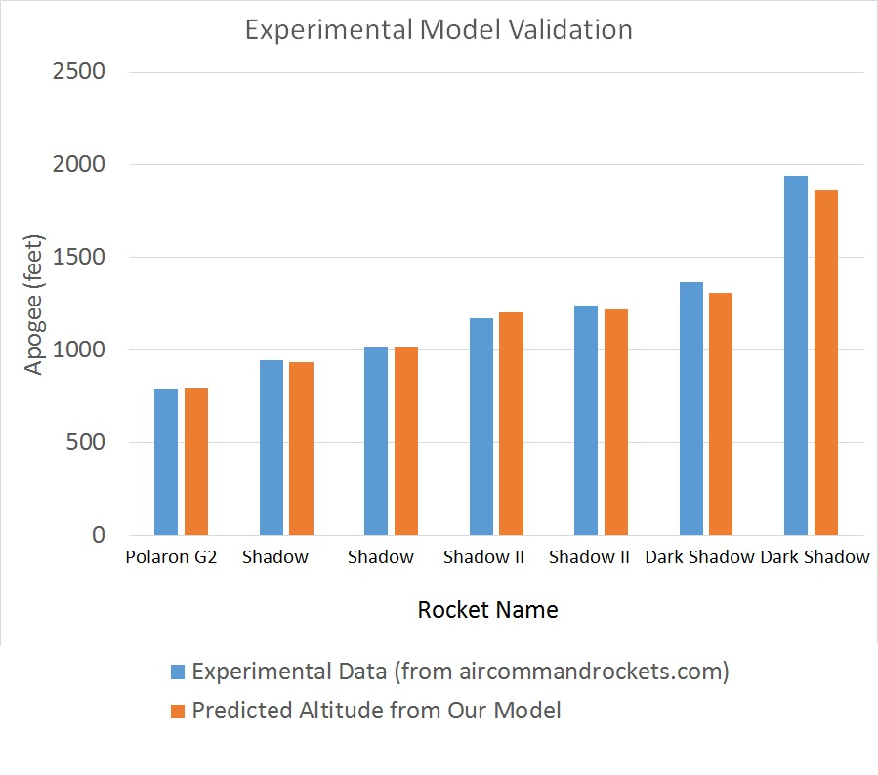
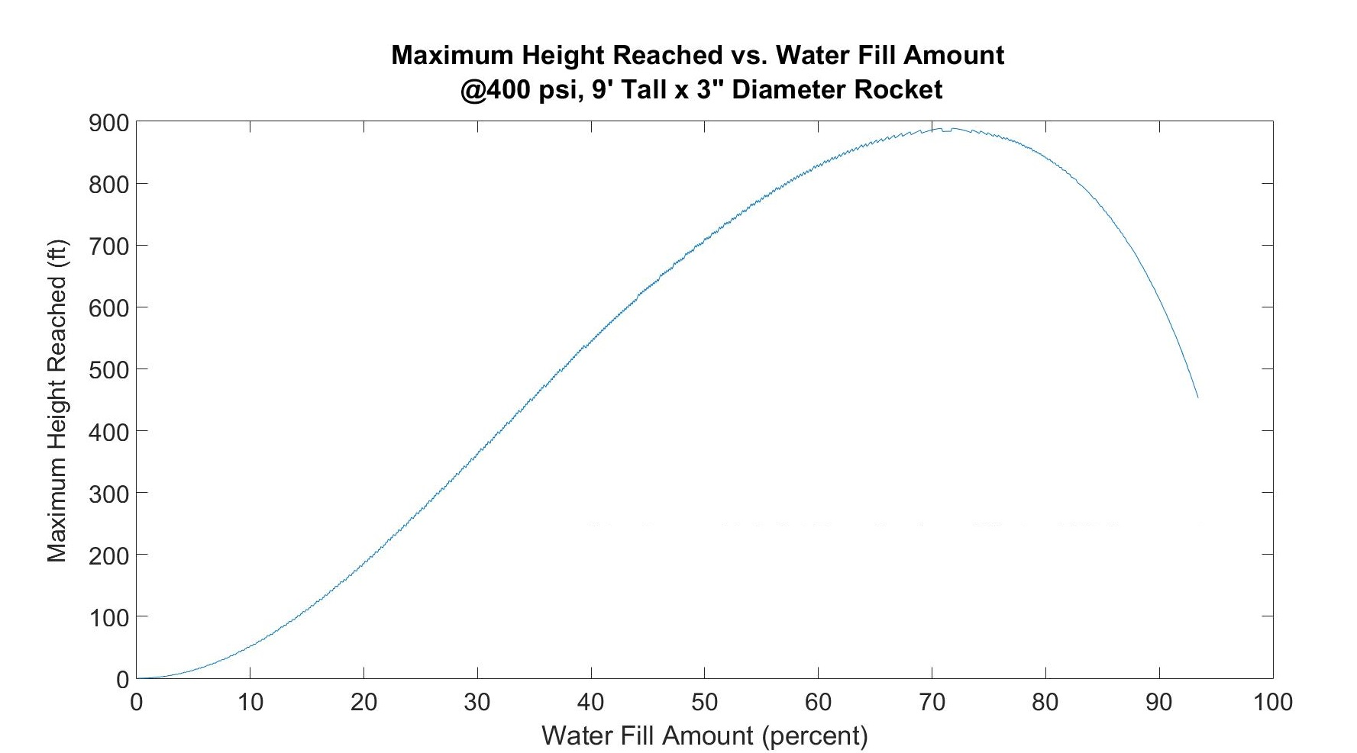
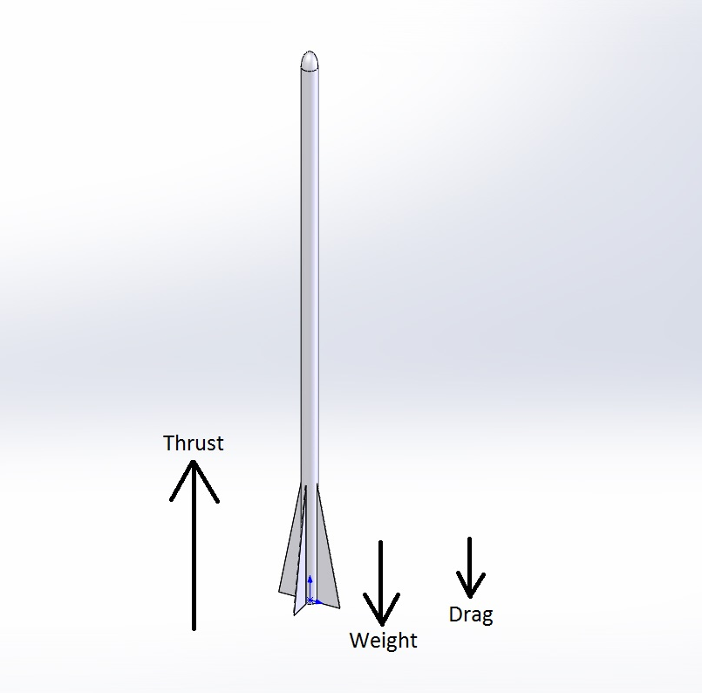
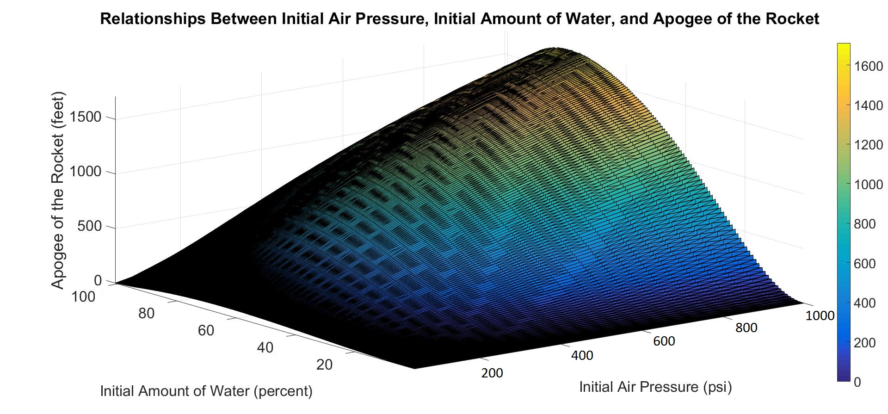
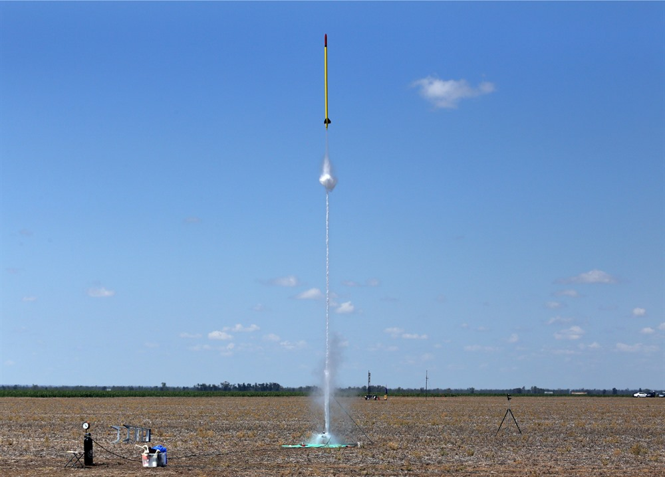
How High Can Water Go?
Joseph Lee & Anne Ku
Water Rockets: Breaking the World Record
Validating the Model: Qualitative and Quantitative Analysis
80% Water Fill is About Right
Rockets powered by nothing but water and compressed air have become increasingly sophisticated as rocket hobbyists have pushed for higher and higher maximum altitudes. These rockets are called water rockets and range in complexity from simple 2 liter soda bottle rockets operating at up to around 100 psi all the way to large rockets operating at several hundred psi made from composites and controlled by flight computers. Inspired by a drive to design a rocket to break the world record altitude for this type of rocket, currently 2723’, we decided to develop a model to calculate the apogee of the rocket for a wide range of operating conditions. This leads to our primary question:
How do initial air pressure and initial amount of water impact the apogee of a water rocket? What is the optimum amount of water to achieve maximum altitude?
To validate our model, we first started by analyzing limiting conditions in pressure and water fill amount. In the case where the pressure was 0 psi, the model behaved as expected – the rocket accelerated downwards (due to gravity). In the case where the rocket is completely filled with water, since water is assumed to be non-compressible, no thrust was produced as there was no stored energy. In the latter case, with the rocket full of air, since our model does not account for the air pulse thrust (thrust due to compressed air being propelled through the nozzle), again no thrust was produced. In all three limiting cases, the model made intuitive sense.
The second step in our model validation was experimental quantitative analysis. We gathered data and dimensions for various water rockets online and input those parameters to our model. Comparing the experimental data for maximum altitude with the predicted altitude from out model reveals that our model is extremely accurate quantitatively as well as qualitatively.
Taking a 2D cross section of the 3D plot shown in the previous section, the optimum water fill amount was determined to be approximately 80%.
How Could We Make the Model Even Better?
The Model: Rocket Motion
Develop a model that could simulate water rockets with foam instead of water (a technique used to prolong thrust duration)
Implement a model that allows us to design multi-stage rockets
Reduce the inaccuracies due to the discretized time step in Euler’s method
For purposes of designing a rocket to break the world record, a model that account for environmental factors such as wind, temperature, etc. would allow more accurate design work.
Develop a model that works in 3D space; a model that accounts for launch angle and weather-cocking
The Effect of Pressure and Water Fill
Back to Beating the World Record
Our current model does provide all the information we need to design a high performance water rocket and could probably even be used to design a rocket to break the world record. We might also find it beneficial to implement some or all of the possible improvements above before designing a rocket to actually break the world record. Another relationship we plan to explore before actually fabricating these water rockets is to find out how the design of the rocket impacts the optimum water fill amount. We know that for our current design, the optimum amount is about 80% and that the maximum height we can achieve at a reasonable pressure (1000 psi) is about 1800’, but we have not verified whether or not this relationship holds for other designs.
The Model: Governing Equations
Q = Nozzle Area*V*K
P₁V₁ = P₂V₂
Drag = .5 * p * v² * C_{D} * A
Thrust = m * V_{exit} + (p_{exit} - p_{initial}) A_{exit}
Where Q is the flowrate in ft^3/sec, V is flow velocity (ft/s), K is a correction factor for the nozzle shape, p is air density, v is rocket velocity, Cd is the coefficient of drag, and A is the reference area. P exit is the exit pressure.
Because water is virtually non-compressible, the exit pressure will equal the initial pressure, thus the second term of the thrust equation drops out.
Rocket Height: 9’
Rocket Diameter: 3”
Dark Shadow II: from www.aircommandrockets.com

