Slide 1
Application Acceleration with High-Level Synthesis LabB
Systolic Array
電機系 110061555 李冠霈

Slide 2
Outline
Introduction
- Systolic array
Code & Pragma
Time & Utilization
- Original
- Unroll and array partition
- Software emulation
- Hardware emulation
- Hardware
Question
Github

Slide 3
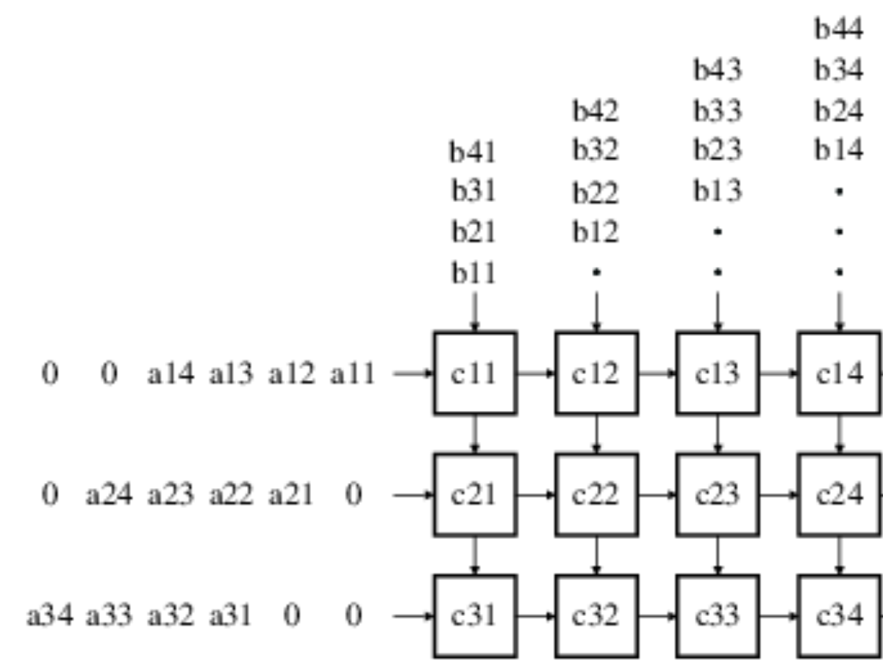
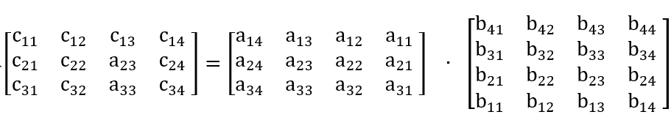
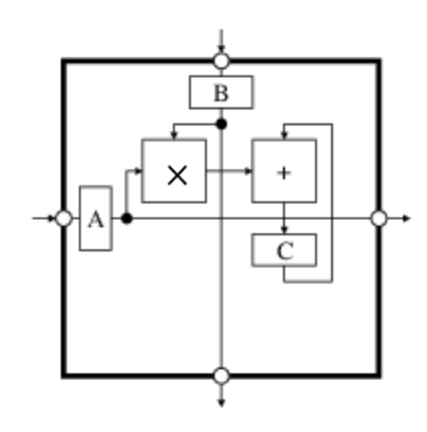
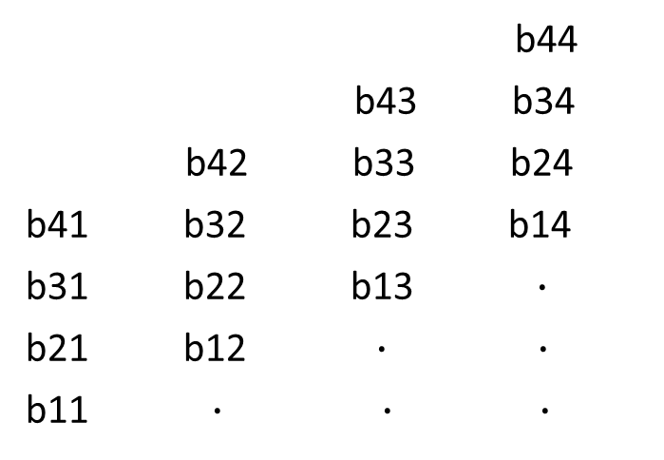
Introduction
Systolic Array
b44
b43 b34
b42 b33 b24
b41 b32 b23 b14
b31 b22 b13 $∙$
b21 b12 $∙$ $∙$
b11 $∙$ $∙ ∙$
0 0 a14 a13 a12 a11
0 a24 a23 a22 a21 0
a34 a33 a32 a31 0 0

Slide 4
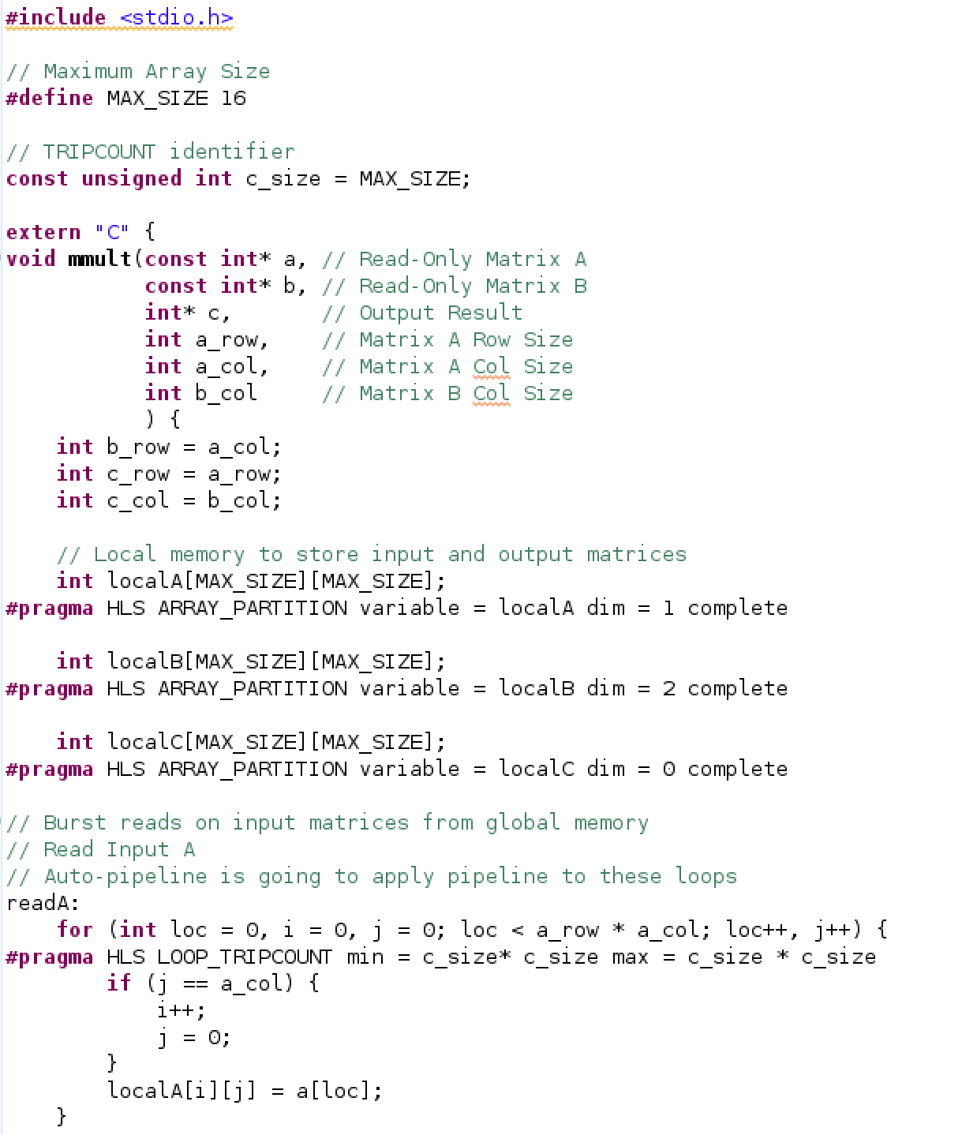
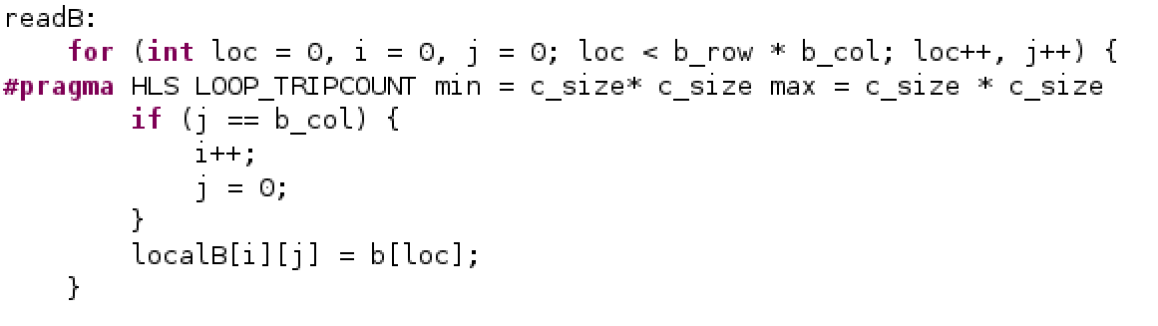
Code & Pragma

Slide 5
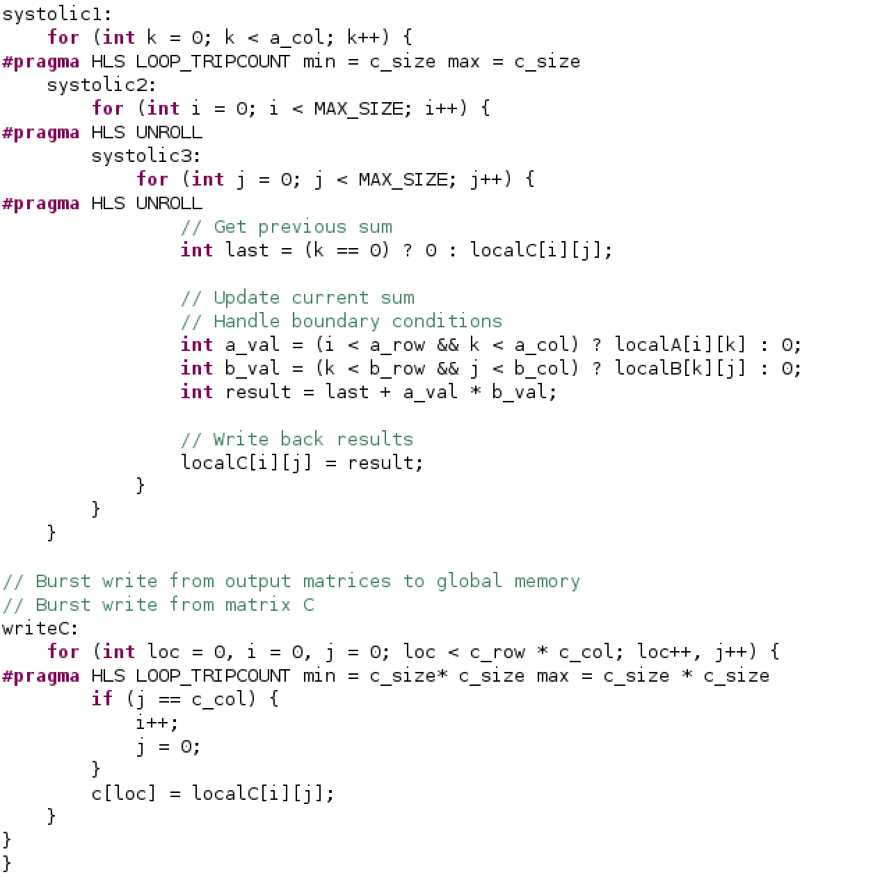
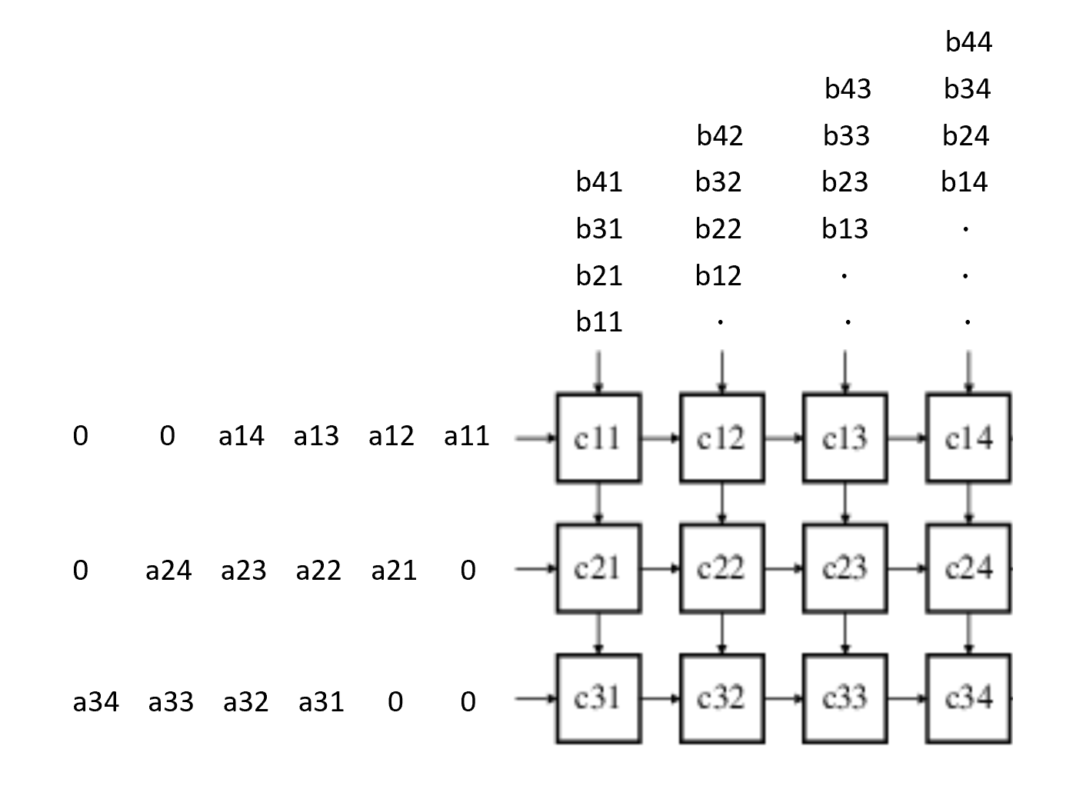
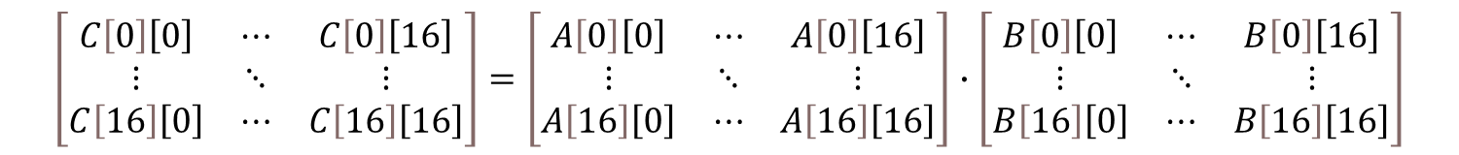
Code & Pragma
$$\left[\begin{matrix}C\left[0\right]\left[0\right] & ⋯ & C\left[0\right]\left[16\right] \\ ⋮ & ⋱ & ⋮ \\ C\left[16\right]\left[0\right] & ⋯ & C\left[16\right]\left[16\right]\end{matrix}\right]=\left[\begin{matrix}A\left[0\right]\left[0\right] & ⋯ & A\left[0\right]\left[16\right] \\ ⋮ & ⋱ & ⋮ \\ A\left[16\right]\left[0\right] & ⋯ & A\left[16\right]\left[16\right]\end{matrix}\right]∙\left[\begin{matrix}B\left[0\right]\left[0\right] & ⋯ & B\left[0\right]\left[16\right] \\ ⋮ & ⋱ & ⋮ \\ B\left[16\right]\left[0\right] & ⋯ & B\left[16\right]\left[16\right]\end{matrix}\right]$$
Partial sum

Slide 6
Code & Pragma

Slide 7
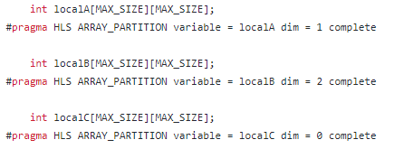
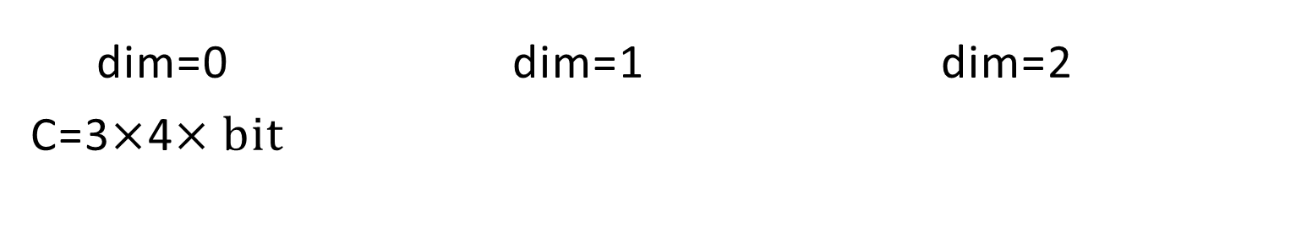
Code & Pragma
dim=0 dim=1 dim=2
C=3$×$4$×bit$

Slide 8
Time & Utilization
mmult |  | Original | Unroll and array partition
Software emulation | Total application run time | 70.6691ms | 65.903ms
 | Device execution time | 0.52ms | 0.48ms
 | CU utilization | 0.469ms (86%) | 0.426ms (87%)
Hardware emulation | Total application run time | 43069ms | 42703.5ms
 | Device execution time | 0.022ms | 0.01ms
 | CU utilization | 0.018ms (84%) | 0.004ms (69%)
Hardware | Total application run time | 5674.54ms | 4926.1201ms
 | Device execution time | 0.35ms | 0.028ms

Slide 9

Question
How many cycles does it take to use a systolic array to complete the A[3][4]$∙B[4][4]$ operation?

Slide 10
Hithub
https://github.com/kuanpei/Lab_B_Systolic_array

Slide 11
Thanks for listening

