Slide 1
DataVis Final Report
Kuan Xing kxing@mtu.edu

Slide 2
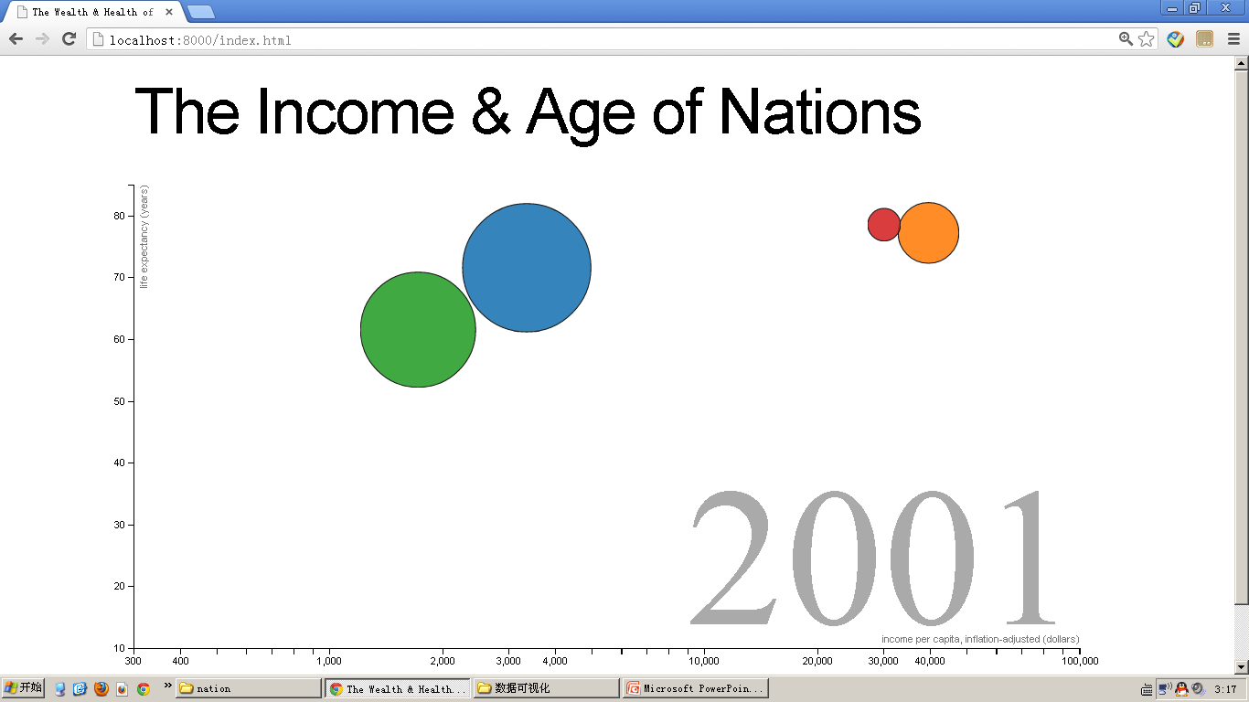
My Project
"The Income and Age of Nations"
Use d3 to built a dynamic motion chart to present the statistic data such as Income level, population ratio, age expectation among nations. Dynamic effect accoding to user interaction with specific DOM elements.

Slide 3
Focus
1)Basic SVG graphic layout and style adjusting
2)External data source importing and binding
3)User Interaction
4)Dynamic data loading and Interpolation

Slide 4
Progress Review
1) SVG Operation
*CSS Attribution and DOM Structure
Layout
Style(size, border, color...)
Elements:<g>,<circle>,<text>
2) External Data
*Data Importing and Parsing
JSON, CSV
*Data Scaling and Binding
d3.scale d3.selection.data

Slide 5
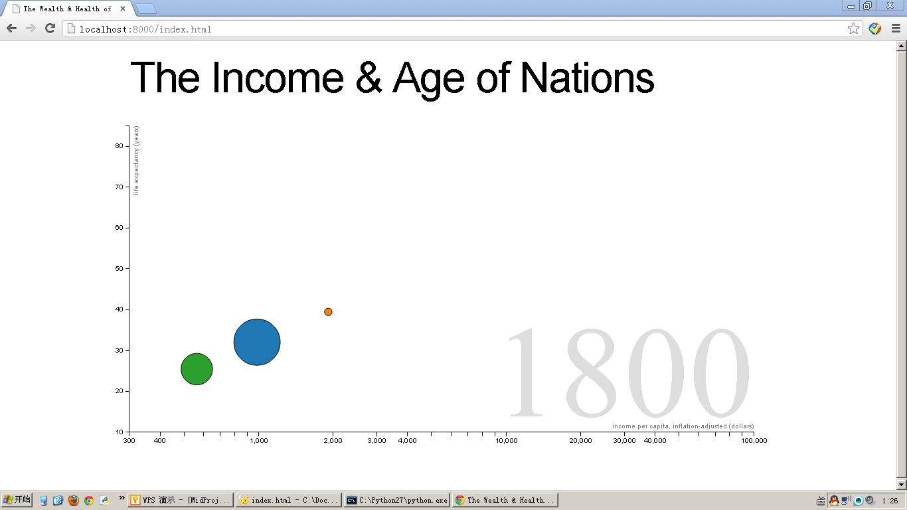
DOM Structure again
Head <h1>
Axis(line+path+text)
Circle
<text>
Axis(line+path+text)
<g>

Slide 6
DOM Structure
BODY
H1 (Header: the title of chart)
P
SVG
G
X Axis
G
Y Axis
TEXT
Axis title
G
CIRCLE: center for income and age, radius for relative population ratio
TEXT
Year
RECT
Overlay: for further interaction

Slide 7
General Procedure
JSON/CSV file
Local variable
Elements selection
Change data value
Data binding to elements
User interaction
Adjust elements’ style and attributions

Slide 8
Data Load and Bind
*d3.json("./data.json",function(d){
//preprocessing the data
Interpolate(d);
//build the container for circle
svg.append("g")
.selectAll(".dot")
//binding data object to element
.data(d)
.enter().append("circle")
//use data object's member attribution
.attr(Attribution,function(d){...});
})

Slide 9
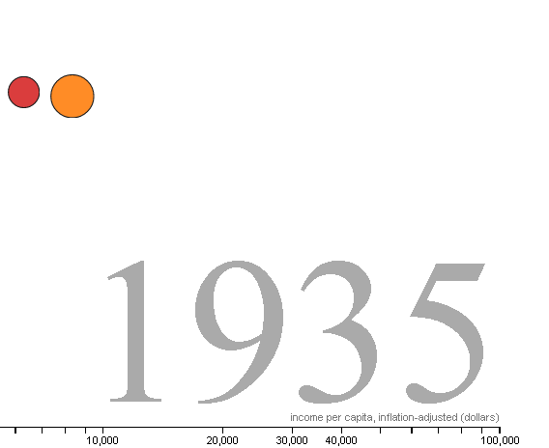
User Interaction
We need to get current position value of mouse cursor and map the position data to Year number.
We need to update the circle’s attribution values, such as radius, position.
Reference to the box area with getBBox()
Set event listener on elements with selection.on(‘mousemove’) or on(‘mouseover’)
Get cursor position with d3.mouse
Map cursor position to Year with scale.invert()
Update the circle attribution with elements.call( update function)

Slide 10
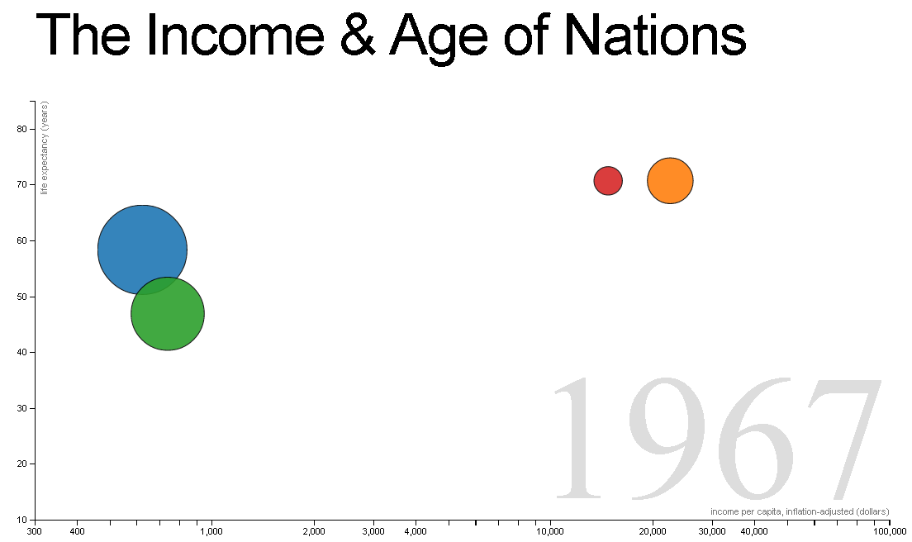
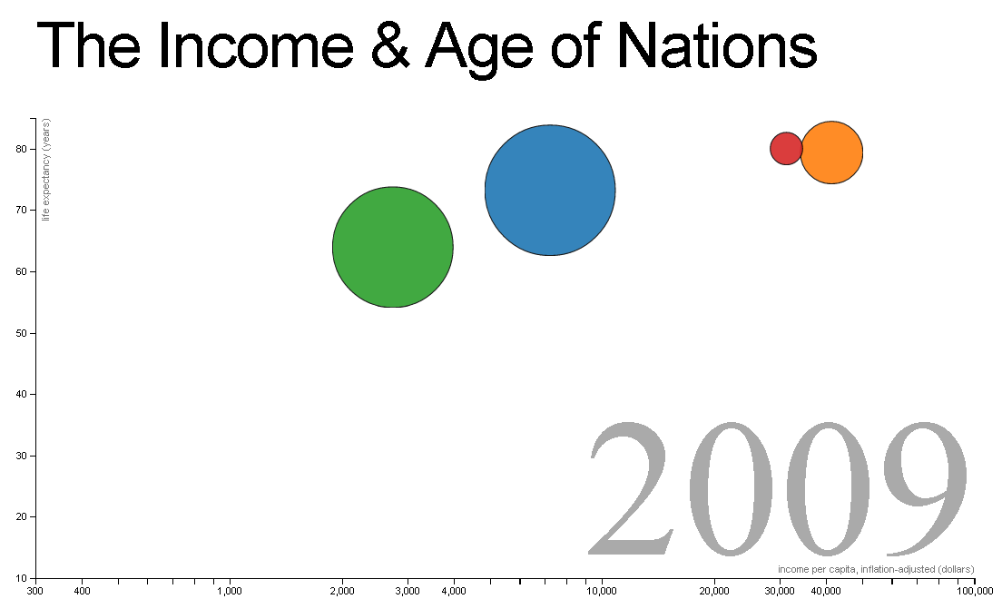
Update the Viz
When user cursor move over the Year area, the event listener will detect the direct element and feed back the position of cursor relative to that element, then the scaler can use this feedback value to inversely mapping year, when year value is ready, we can do data extraction or data interpolation.
yearScale.invert(d3.mouse(this)[0]) to get year
circle.data(interpolateData(year)).call(updataVis_function)

Slide 11
Data Interpolation
JSON/CSV file
Local variable
d3.bisector.left(dataset, dest_data)
It will return a index (i) where the dest_data is if inserted into dataset or the current position if the data is already in dataset.
Data Interpolation method:
a=dataset[i]
b=dataset[i-1]
t = (dest_data – a[0]) / (b[0] – a[0])
return a[1] * (1 - t) + b[1] * t;
InterpolateData:
Extract the data from JSON object according to specific year number
InterpolateValue:
Sub function in InterpolateData,
Search requied data for specific year or generate the data by interpolation.

Slide 12
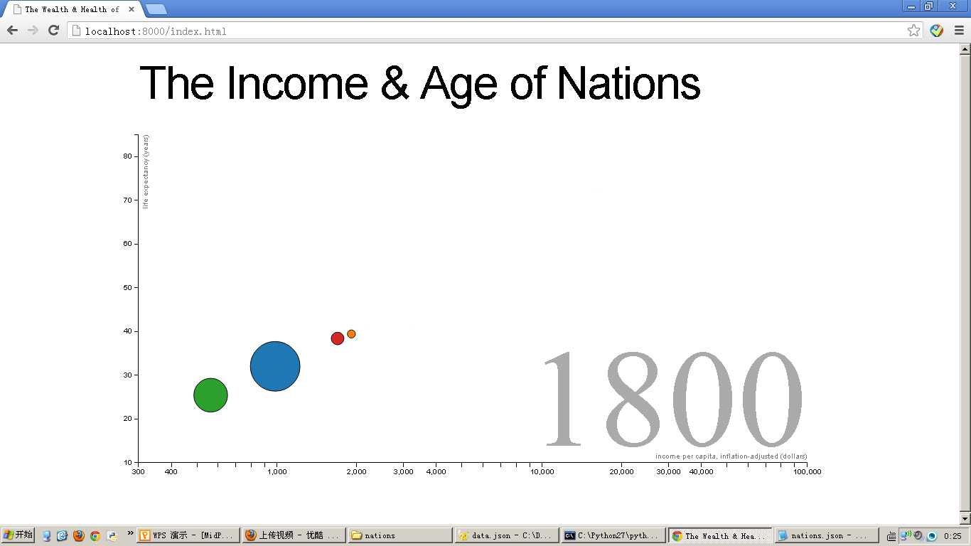
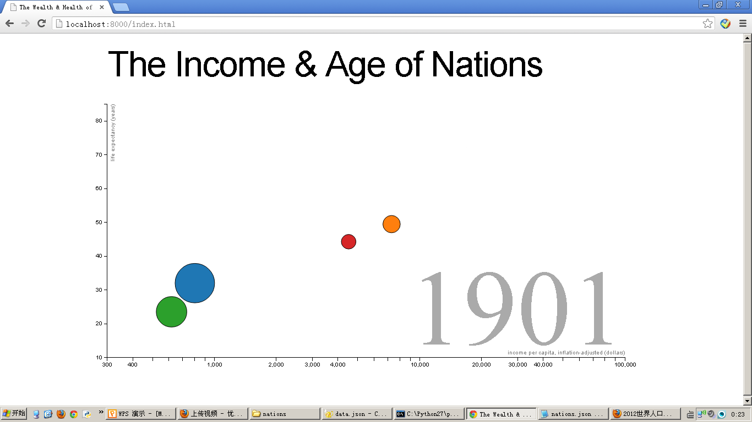
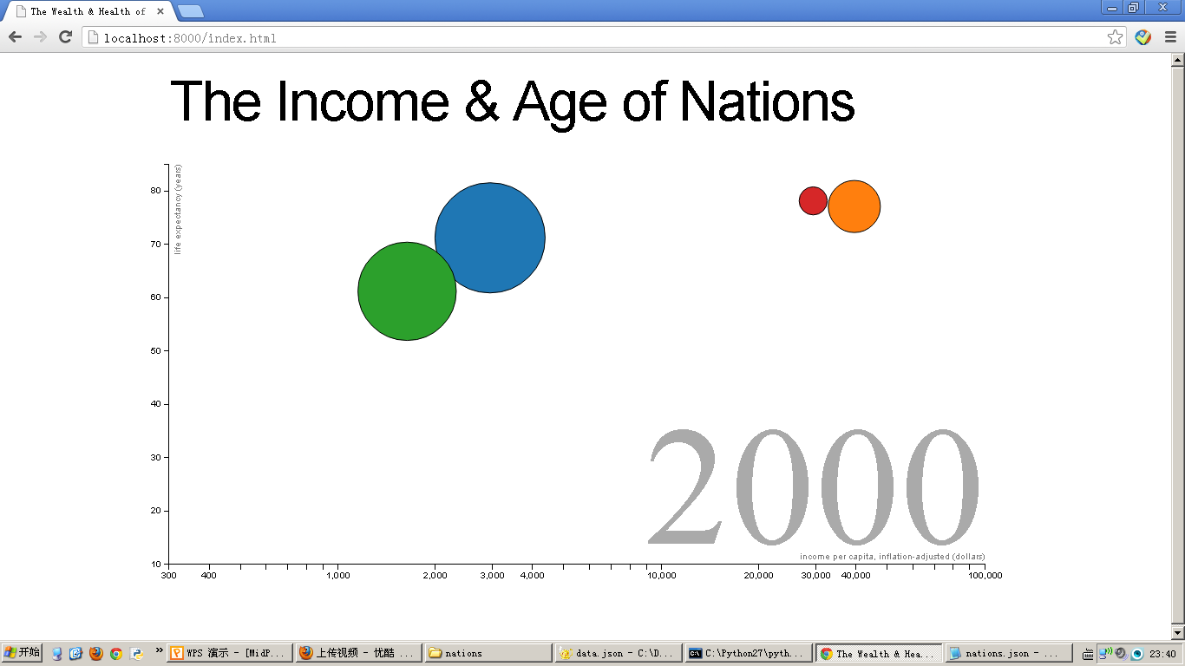
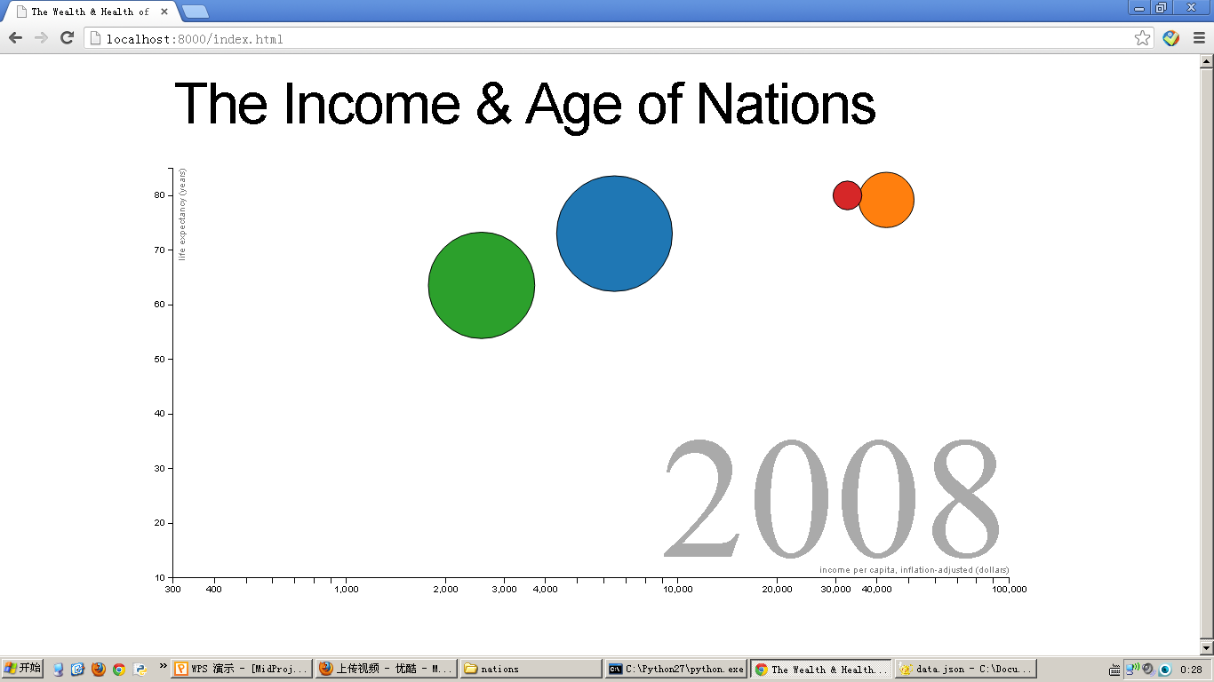
DEMO

Slide 13
Reference
https://github.com/mbostock/d3/wiki/Gallery
http://bost.ocks.org/mike/
http://alignedleft.com/tutorials/d3/
"D3: Data-Driven Documents", http://vis.stanford.edu/papers/d3
http://www.recursion.org/d3-for-mere-mortals/
http://www.w3.org/TR/SVG

