Slide 1
NTUT AIOT LAB · PROGRESS REPORT · JULY 2026
A Fine-Tuned Vision-Language-Action Pilot,
Kept Safe by the Guardrail
From pluggable slot to a trained 7B model flying real urban maps — with every action still validated
Department of International Graduate Program, EECS
Advisor:
Presenter:

Slide 2


ARCHITECTURE
The pipeline today — two new layers since last report
User
Command
Constraint
Compiler
Fine-tuned VLA
(7B, ours)
Depth
Avoidance NEW
Rate
Limiter
Safety
Shield
Sim /
MAVLink
teal = guardrail-side (deterministic, auditable) · tinted = swappable learned model · Shield remains the FINAL authority on every action
Layer 1 (new): the pilot is now OURS
Layer 2 (new): perception safety
AerialVLA fine-tuned with QLoRA on 5,500+ self-collected flight samples — sees front + down cameras, reads the mission text, emits (forward, down, yaw-rate) at ~0.8 Hz.
A depth-camera avoidance layer brakes, side-steps and climbs around buildings BEFORE the Shield — cutting how often hard rules must fire.
02

Slide 3




SUMMARY
Four upgrades since the last report
Real 7B VLA in the slot
Fine-tuning campaign (3 runs)
OpenVLA-7B (base) then AerialVLA (UAV LoRA) integrated: 4-bit NF4, 4.7–5.6 GB VRAM on RTX 4080, inference 0.9–1.3 s/action.
QLoRA on our own expert-flight data. Deployed config: efficiency 0.942 → 0.996, shield workload −60% (108 → 43.6 interventions).
Urban UE5 worlds unlocked
Mission Control GUI + avoidance
Project AirSim rail (5th sim) + PASBlocks maps: JapaneseCity day/night, Airport, Military Airbase. Best flight: 0 interventions, NFZ 0.0 s.
Click waypoints, draw NFZs (become live policy), watch the drone move on the map. Depth layer slaloms building canyons.
03

Slide 4

THE PILOT
Model & inference — the numbers
Property | Value
Base model | openvla-7b (7B params)
UAV adapter | AerialVLA LoRA r=64 + our QLoRA
Quantization | 4-bit NF4 (bitsandbytes)
VRAM in flight | 5.6 GB (of 16 GB, sim shares GPU)
Model load time | 18–25 s (warm disk cache)
Inference latency | 0.9–1.3 s / action
Effective VLA rate | ~0.8 Hz (action held between)
Control loop | 10 Hz, never blocks (worker thread)
Why threading matters
The 7B model cannot run at 10 Hz. Inference lives in a background thread with its own sim connection; the control loop always uses the latest action.
Blocking the loop was the root cause of the freeze-then-jerk flight seen earlier — fixed, and the same design is what a Jetson deployment needs.
04

Slide 5


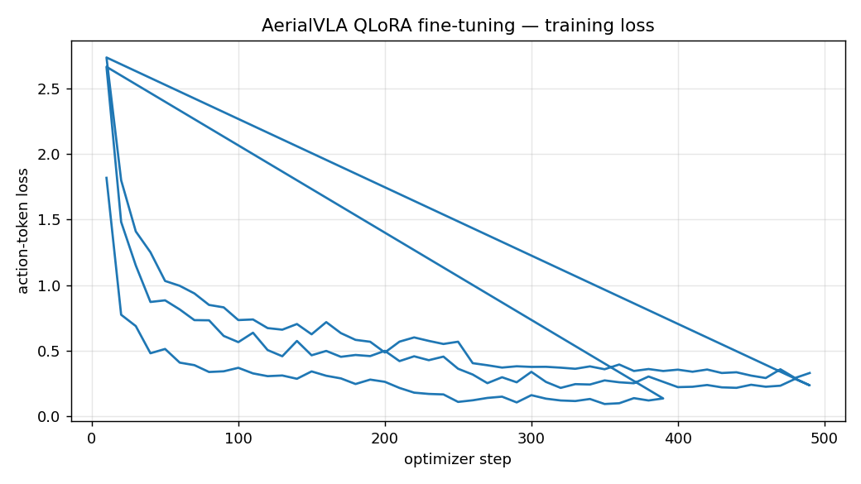
FINE-TUNING
Method: our own data engine + QLoRA
Data engine (self-collected)
Training recipe
Expert planner flies randomized missions in AirSimNH while we record camera mosaics + prompts + quantized action labels.
• 3 datasets, 5,500+ samples total
• v2: mid-episode retargeting → 48% turning samples
• v3: expert re-decides every 12 ticks = matches the VLA's real decision latency
• Labels: 99-bin text tokens (fwd 0–5 m/s, down ±5, yaw ±1.1 rad/s)
QLoRA on RTX 4080 SUPER: LoRA r=64 on LLM projections + full projector, lr 2e-5, 2 epochs ≈ 53 min/run, batch 1 × grad-accum 8, bf16 compute.
05

Slide 6
FINE-TUNING
Three runs, two hard lessons
Run | Data | Closed-loop outcome | Lesson
run1 | 1,567 samples, ~90% fly-straight | REGRESSION — model unlearned turning | label DISTRIBUTION beats loss
run2 | 1,961 samples, 48% turning | deploy: eff 0.996, interv 43.6 — production | balance the behaviors you need
run3 | latency-matched expert (12-tick) | calmer, but did not beat run2 | match train/deploy dynamics
Every run was judged by CLOSED-LOOP flight (5 episodes, random targets, same seeds) — never by training loss alone. Loss fell 1.82 → 0.24 in run1 too, and run1 was our worst model: offline metrics lie, flights don't.
Honest limit: PURE VLA (no mission-direction assist) reaches the target only ~20% of the time — at 0.8 Hz each decision lasts ~63° of heading change. Deployed system uses 55% mission-direction assist (a standard global-planner + local-policy split).
06

Slide 7
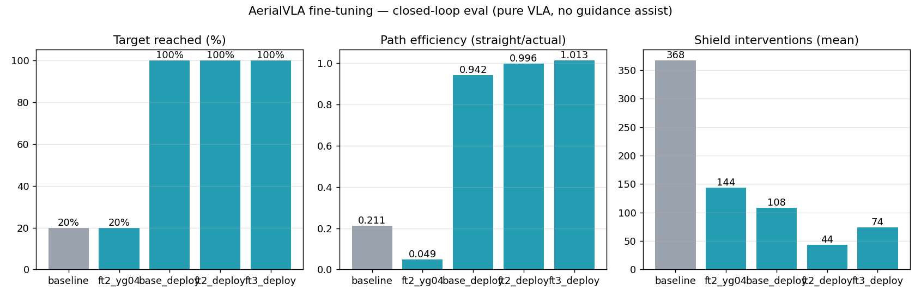
RESULTS
Before vs after fine-tuning (deployed config)
5 episodes, random targets, identical seeds · deployed config = mission assist 0.55 + yaw damp 0.4 · NFZ time 0.0 s in every run
07

Slide 8
KEY STORY
Shield interventions per flight — constraints pushed upstream
368
baseline VLA, pure (no assist, no tuning)
235
hand-written stub pilot + shield (old demo)
108
original AerialVLA, deployed config
43.6
OUR fine-tuned model, deployed config
0
fine-tuned model, JapaneseCity urban flight
Same guardrail every row. The safety layer's WORKLOAD falls as the pilot improves — the KPI (zero NFZ violations) never moves.
08

Slide 9
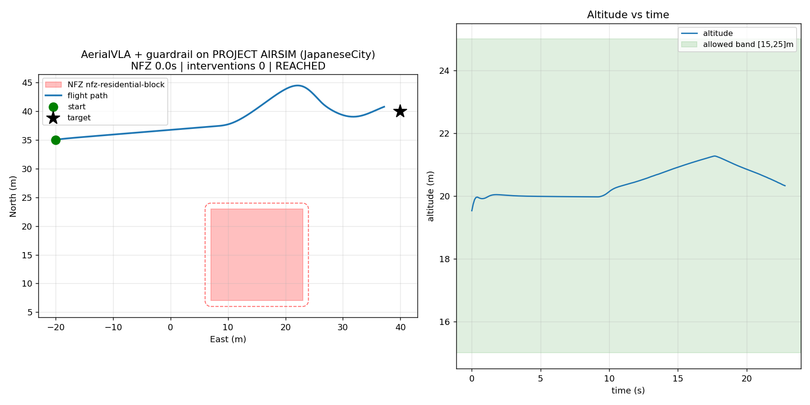
URBAN WORLDS
JapaneseCity (UE5) — best flight of the project
Flight facts
• 229 ticks (~23 s) to target
• 0 shield interventions
• NFZ 0.0 s
• altitude flat at ~20 m
• spawn moved to an open street — (0,0) sits under a roof
Maps available: city day / night, airport, military airbase (from the PASBlocks repo).
09

Slide 10
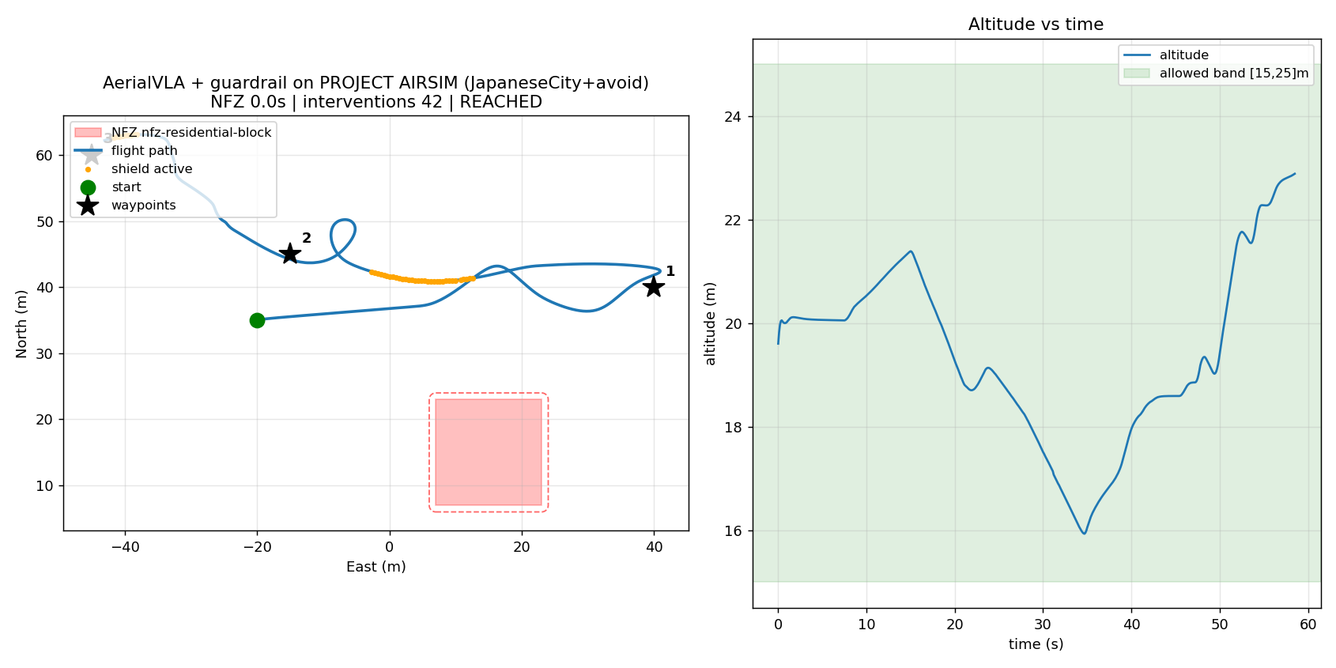
PERCEPTION SAFETY
Depth-camera obstacle avoidance — how it works
Parameter | Value
Sensor | front depth cam 400×225 @ 20 Hz
Wire format | 16UC1 uint16, values in meters
Robustness | 5th-percentile windows, own-props masked (<1.5 m)
Brake threshold | < 15 m → scale speed ∝ distance
Evade threshold | < 8 m → strafe to freer side + climb 1.2 m/s
Goal-pull damping | ×0.25 while avoiding (don't fight the steer)
Stall recovery | 6 s → ESCAPE (reverse+climb 4 s); 14 s → safe skip
Verified in flight
3-leg city route: slow → climb+steer → clear slalom through a building canyon, final waypoint REACHED, NFZ 0.0 s.
10

Slide 11



DEMO TOOLING
Mission Control GUI + one-click runner
Point-and-click missions
Live tracking
Left-click the map = waypoints. Right-drag = draw NFZ rectangles — they compile into REAL guardrail policy (YAML) before takeoff.
Drone position streams onto the map at 5 Hz (atomic live.json); dot turns orange whenever the shield touches an action.
One-click demo
Same safety path
run_japanesecity.bat: kills old sims, boots UE5 city (~2 min), loads the 7B model, flies, pops trajectory.png. Zero typing.
GUI or script, the chain is identical: VLA → avoidance → limiter → Shield. Drawn NFZs are enforced exactly like pre-briefed ones.
11

Slide 12
ENGINEERING
Latency & resource budget (RTX 4080 → Jetson)
Stage | RTX 4080 SUPER (measured) | Jetson Orin 16 GB (projected)
VLA inference / action | 0.9–1.3 s | 2–4 s (TensorRT-LLM: ÷2–3)
Control loop | 10 Hz | 10 Hz (CPU, unchanged)
Shield check / action | < 1 ms | < 1 ms
Depth avoidance | < 5 ms / frame | < 10 ms
Model VRAM (4-bit) | 5.6 GB | fits 16 GB unified
Model load | 18–25 s | ~60 s
Deployment path: merge LoRA → TensorRT-LLM on Jetson → guardrail unchanged (pure CPU). The architecture already tolerates slow inference: action-holding, mission assist and the Shield absorb the latency.
12

Slide 13

STATUS
KPI scoreboard & honest limits
Holding everywhere
Known limits (reported as-is)
• P0 violation escape rate = 0 across 40+ evaluation flights, 5 simulators, every configuration
• 100% target reach, path efficiency 0.996 (deployed config)
• Full route patrol + drawn-NFZ missions verified
• Every flight leaves a hash-stamped audit trail
• Pure-VLA navigation ~20% reach — 0.8 Hz decisions; needs faster inference or waypoint-level action chunking (future work)
• Buildings taller than the 25 m ceiling are unreachable BY DESIGN — the system tries slow/steer/climb/escape, then skips safely
• Jetson numbers are projections; hardware validation pending
13

Slide 14
TAKEAWAY
The pilot got smart.
The rules never moved.
A 7B vision-language pilot we fine-tuned ourselves now flies real urban maps at 0.996 path efficiency — and the guardrail still checks every single action, still writes every audit line, and still reports zero violations.
Thank You

