Slide 1
Discussion 8: Introduction to AWS and Linux Commands
EE599 Deep Learning
Kuan-Wen (James) Huang
Spring 2020
Contributors: Kuan-Wen Huang , Arindam Jati

Slide 2
AWS
Register an account https://aws.amazon.com/console/
Request for EC2 P instances limit increase http://aws.amazon.com/contact-us/ec2-request

Slide 3
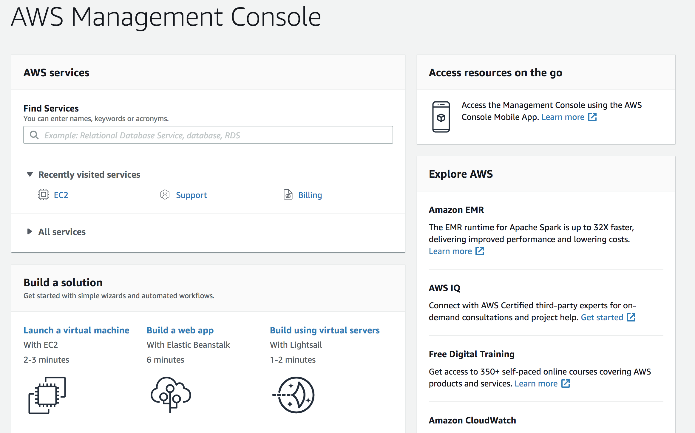
AWS

Slide 4
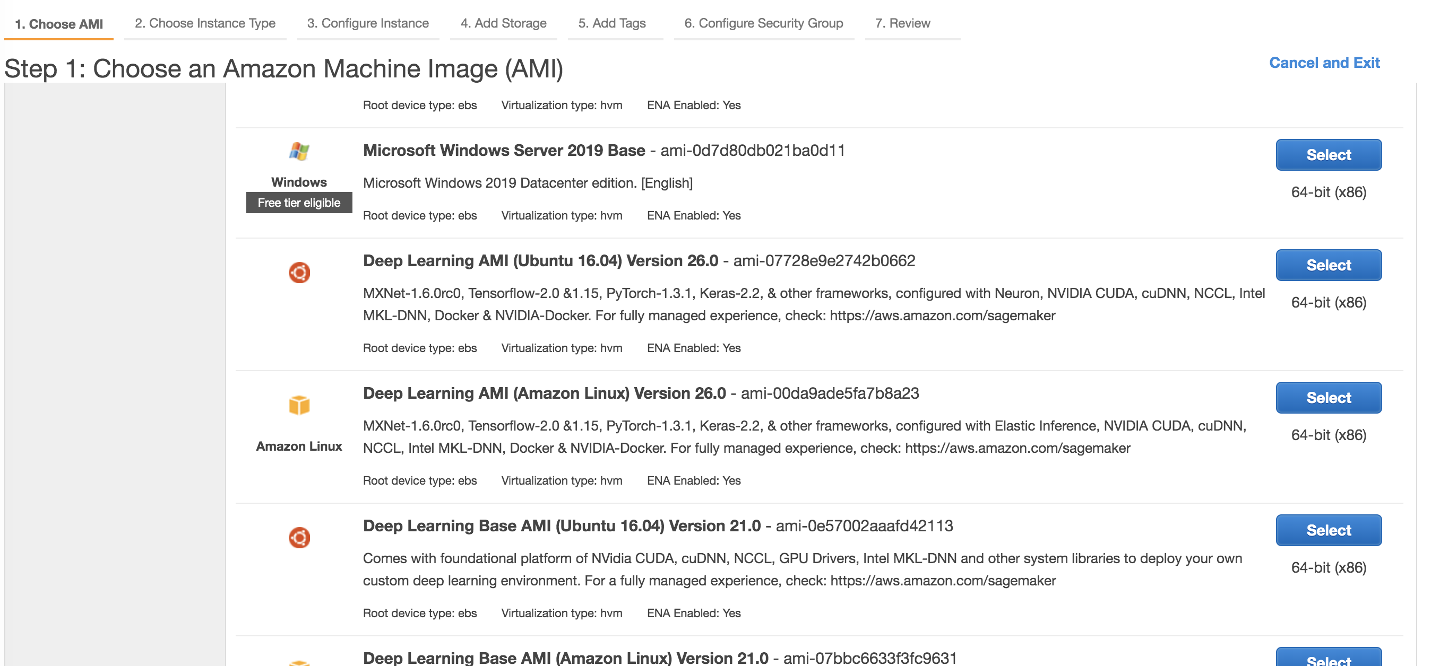
AWS
a

Slide 5
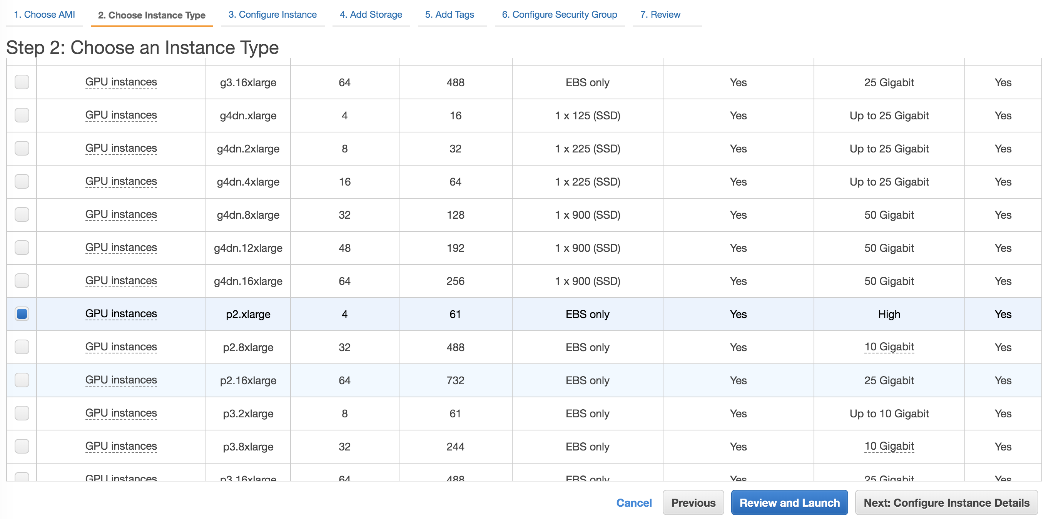
AWS

Slide 6
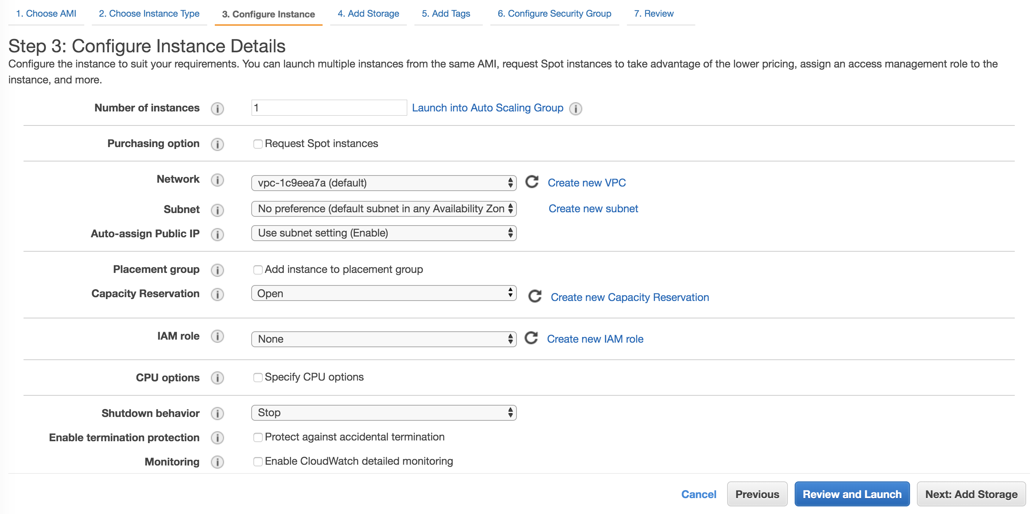
AWS

Slide 7
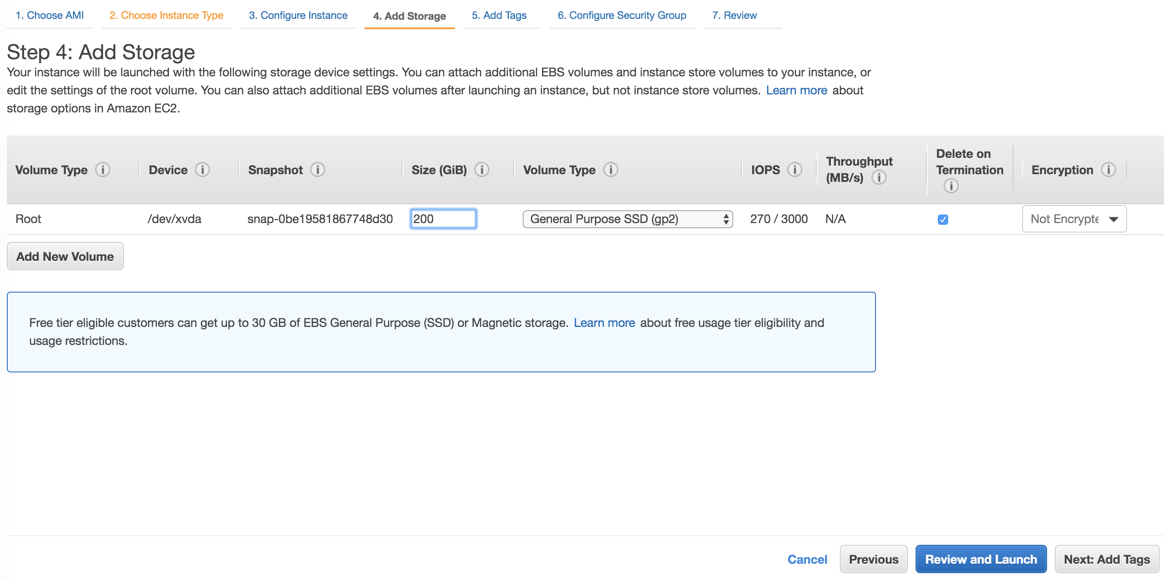
AWS

Slide 8
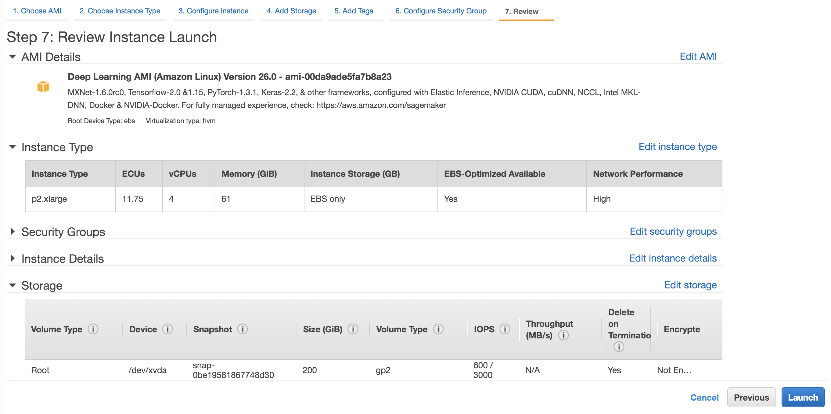
AWS

Slide 9
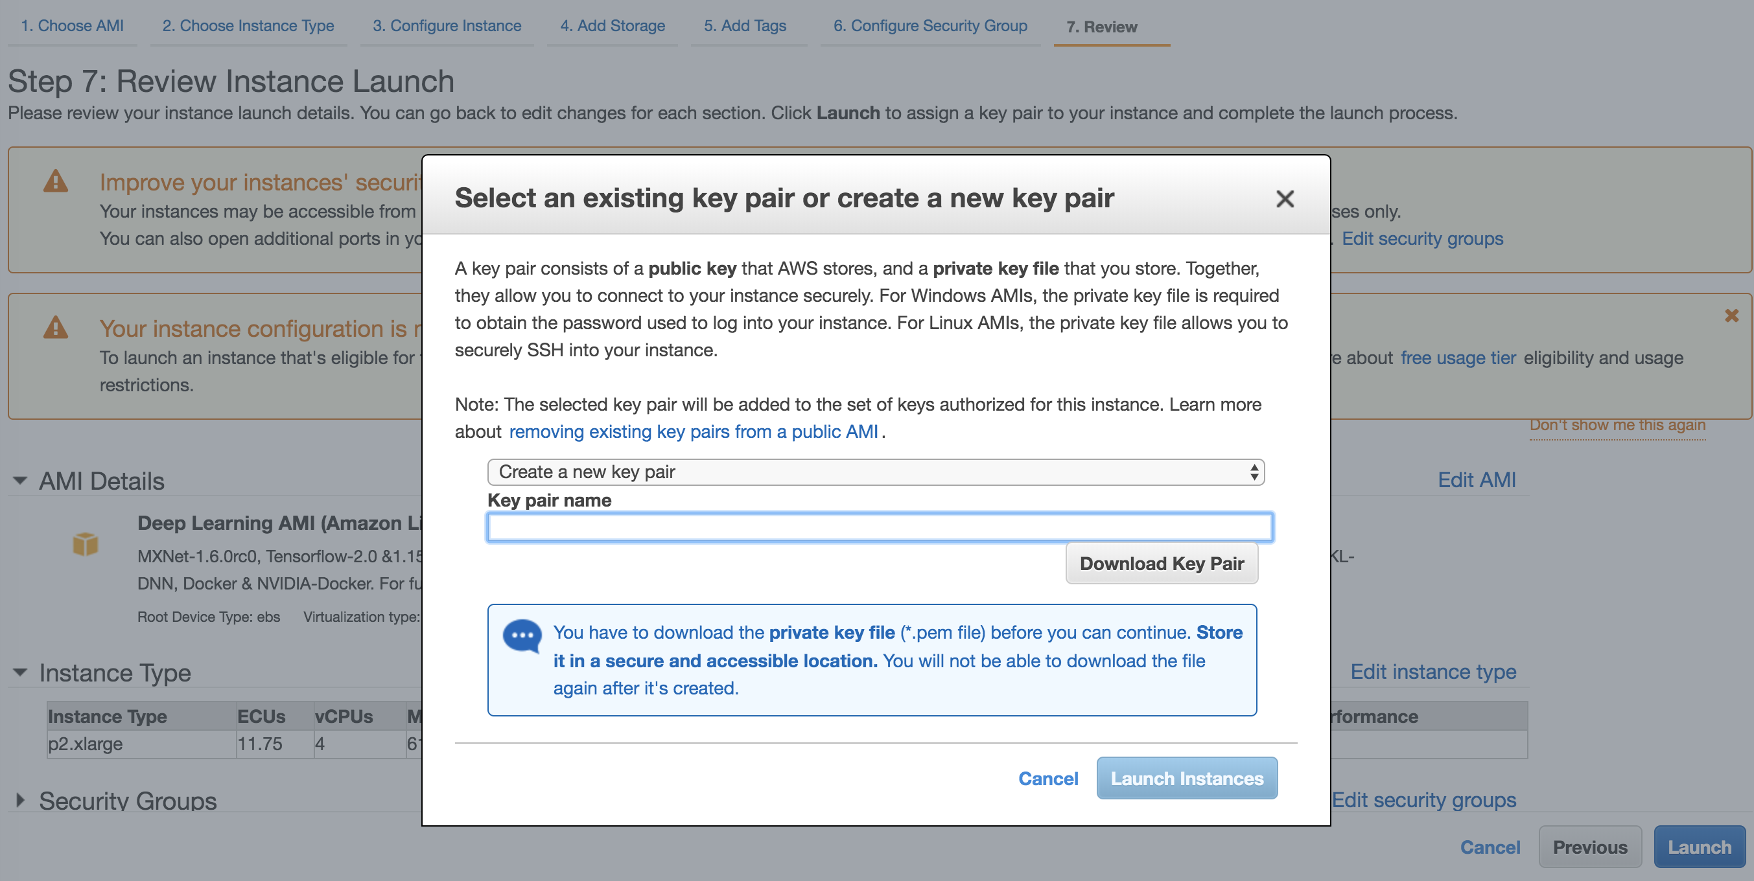
AWS

Slide 10
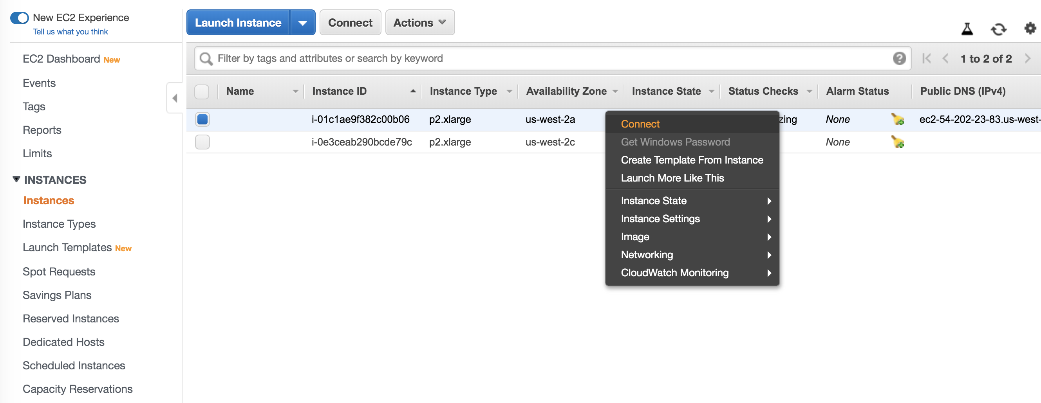
AWS

Slide 11
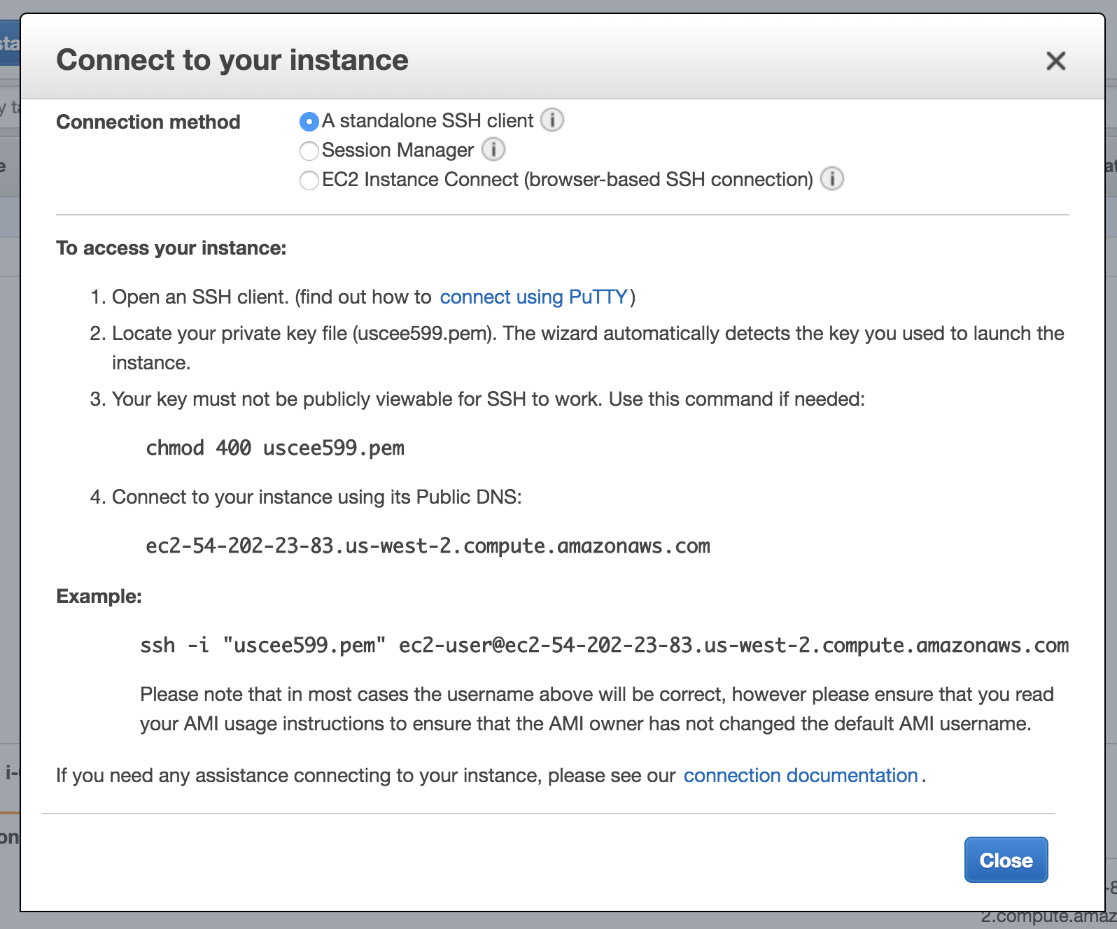
AWS

Slide 12
AWS
AWS EC2 instance types https://aws.amazon.com/ec2/instance-types/
Pricing https://aws.amazon.com/ec2/pricing/on-demand/

Slide 13
SSH and SCP
SSH (Secure Shell) is a protocol that allows secure connections between computers.
ssh -i <key> username@ip_address
SCP (Secure Copy Protocol) is a means of securely transferring computer files between computers.
scp -i <key> local_file username@ip_address:remote_destination
scp -i <key> -r local_folder username@ip_address:remote_destination

Slide 14

Cyberduck (cloud storage browser)
Provides GUI for scp
Easy drag and drop
https://cyberduck.io/

Slide 15
Setting up Environment
conda create -n new_env python=3.7 anaconda
source activate new_env
pip install tensorflow

Slide 16
View and Set Tensorflow with GPU
Run python:
from tensorflow.python.client import device_lib
print(device_lib.list_local_devices())
Set GPU
import os
os.environ['CUDA_DEVICE_ORDER']='PCI_BUS_ID'
os.environ['CUDA_VISIBLE_DEVICES']=‘0’
Note that it may be faster on a CPU if it doesn’t involve CNN.
os.environ['CUDA_VISIBLE_DEVICES']=‘’ # Don’t use GPU

Slide 17
Viewing Files and Directories
ls: list your files in the current directory
ls -l: list your files in the current directory in long format
ls -a: list your files including hidden ones
pwd: present working directory
mkdir <dir_name>: make a new directory
mkdir -p <dir_name>: make a new directory (no error if it exists)
cd <dir_name>: go to directory
cd .. : go to one level higher
cd ~ : go to home directory
cd / : go to root directory

Slide 18
Move, Copy and Delete
mv filename1 filename2: Rename a file
mv filename dir_name: Move file to a directory
cp filename1 filename2: Copy a file with a new name
cp filename dir_name: Copy a file to a directory
cp -r dir_name1 dir_name2: Copy entire folder
rm filename: Delete a file
rm -r dir_name: Delete everything inside the folder

Slide 19
tmux sessions
tmux: Creates a session that runs on remote machine
Remains working even you lost ssh connection
https://tmuxcheatsheet.com/
Basic
tmux: new session
tmux ls: list all tmux session
tmux a: attach to latest entered session
tmux a -t <number> : attach to session number
ctrl + b, then d: detach from current session
ctrl + d: kill current session

Slide 20
More on Unix/Linux Commands
Lots of online resources:
https://www.unixtutorial.org/basic-unix-commands
https://www.guru99.com/must-know-linux-commands.html
http://mally.stanford.edu/~sr/computing/basic-unix.html

Slide 21
More on Unix/Linux Commands
vi (or vim) text editor
vi filename: open a file, if it doesn’t exist, create a new file
Inside the editor:
i: insert mode
ESC, then :w ENTER: save file
ESC, then :wq ENTER: save and quit vi

Slide 22
More on Unix/Linux Commands
wc [-l] filename: word count of file, option -l shows number of lines
head [-n] filename: show first n lines
tail [-n] filename: show last n lines
cat filename: print full file
grep [options] pattern [filename/dir]: print lines matching a pattern

Slide 23
More on Unix/Linux Commands
Standard input, standard output and standard error
Check: http://www.learnlinux.org.za/courses/build/shell-scripting/ch01s04.html
Basics:
> : stdout (write)
>> : stdout (append)
< : stdin
Example: ls -al > list.txt

