Slide 1
Introduction to Linux Systems Package Management
Chia-Heng Tu
Dept. of Computer Science and Information Engineering
National Cheng Kung University
Fall 2024

Slide 2
Lab
Install ROS
ROS Noetic for Ubuntu 20.04
ROS2 Humble for Ubuntu 22.04
ROS2 Jazzy for Ubuntu 24.04

Slide 3
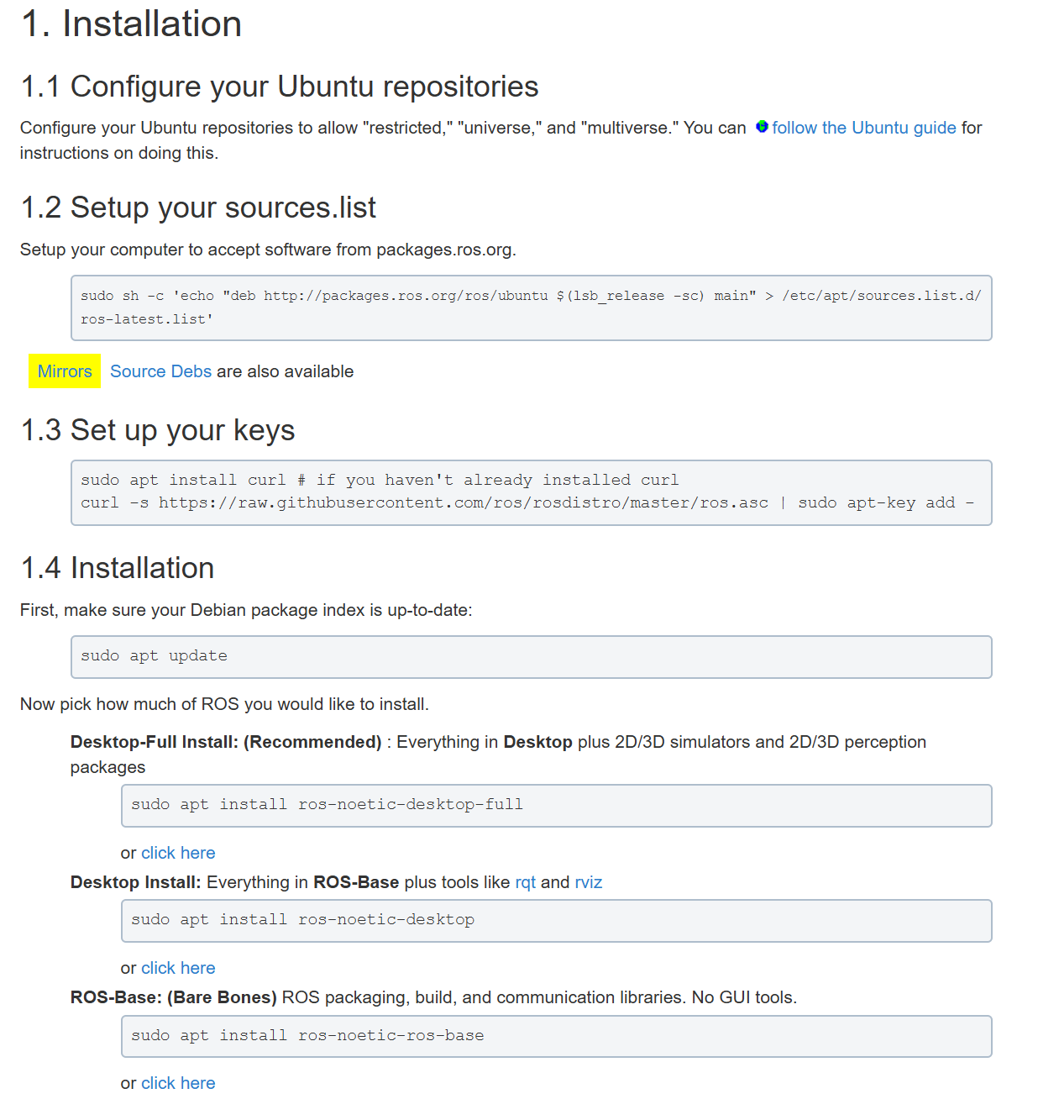
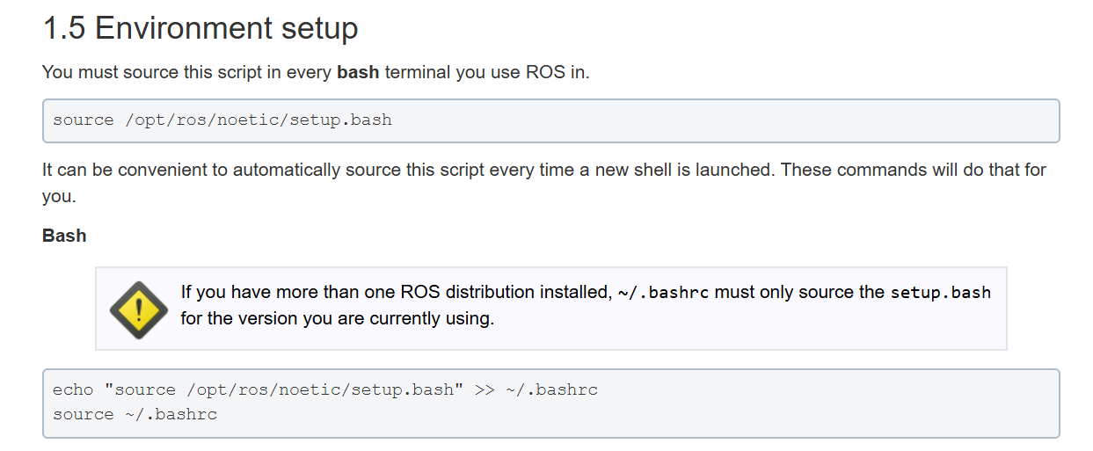
Distribution: Noetic → Ubuntu 20.04
https://wiki.ros.org/noetic/Installation/Ubuntu
ros package可以選擇desktop或base安裝，這次的lab請同學安裝desktop-full的版本，安裝內容較大安裝過程可能也會比較久，所以請同學注意自己的硬碟容量

Slide 4
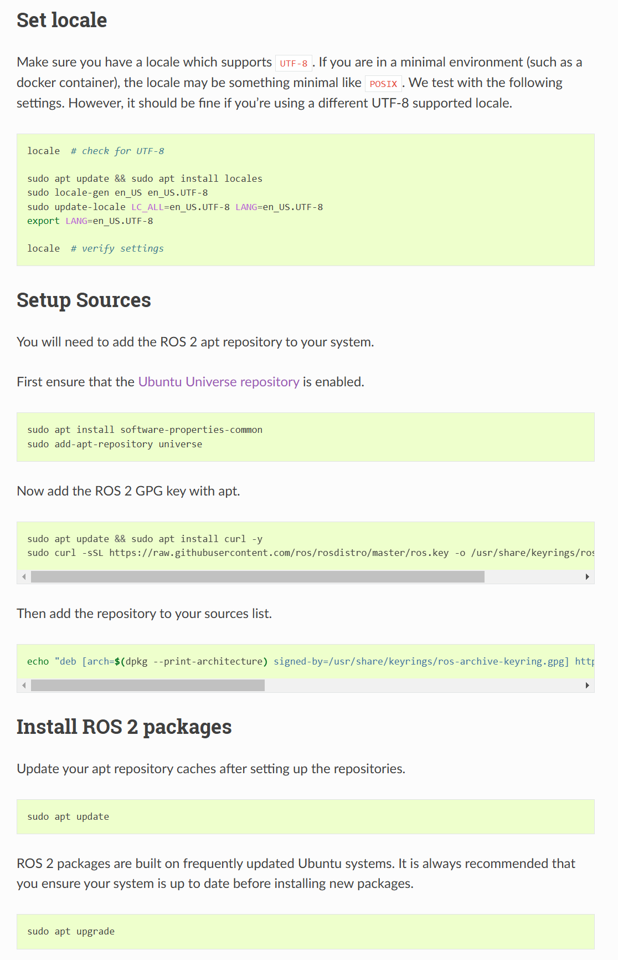
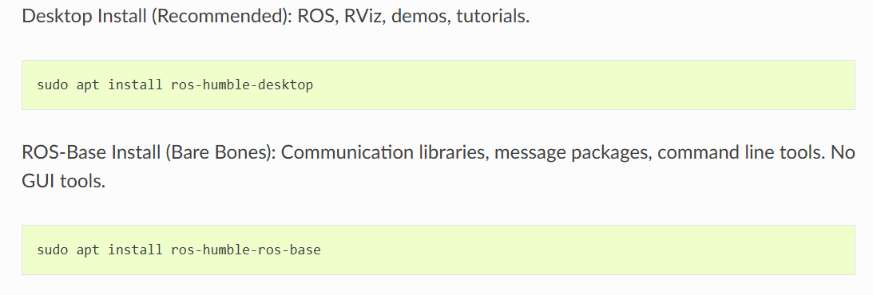
Distribution: Humble → Ubuntu 22.04
https://docs.ros.org/en/humble/Installation/Ubuntu-Install-Debs.html
ros package可以選擇desktop或base安裝，這次的lab請同學安裝desktop的版本，安裝內容較大，過程可能也比較久，所以請同學注意自己的硬碟容量

Slide 5
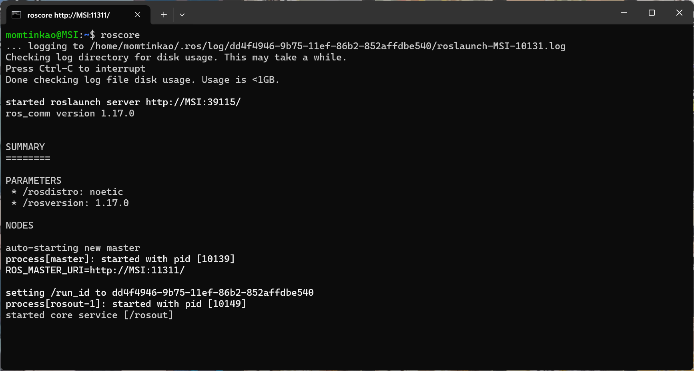
Demo1(If you use ROS1 distribution)
1. Change your primary prompt and extend with your student ID.
2. Run “roscore” on the terminal and screenshot.
3. Upload the screenshot to moodle.

Slide 6
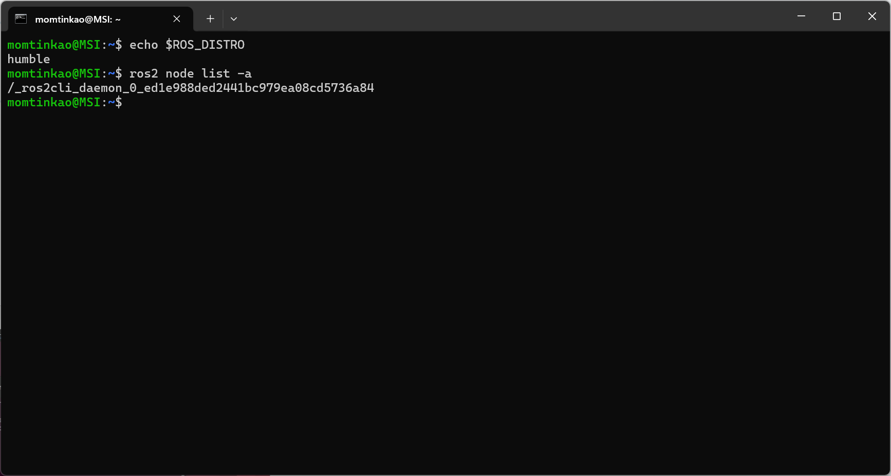
Demo2(If you use ROS2 distribution)
1. Change your primary prompt and extend with your student ID.
2. 截圖須包含
echo $ROS_DISTRO輸出及
ros2 node list -a輸出
3. 上傳截圖至moodle

Slide 7
QUESTIONS

