Slide 1
Introduction to Linux Systems Process Management
Chia-Heng Tu
Dept. of Computer Science and Information Engineering
National Cheng Kung University
Fall 2024

Slide 2
Lab: Jobs Control
Launch 3 vim in background.
Let the first one execute foreground and exit
Kill one of the processes
Use pstree to observe current bash
Hint: echo $$ to acquire current bash pid

Slide 3

Execute Vim in background

Slide 4
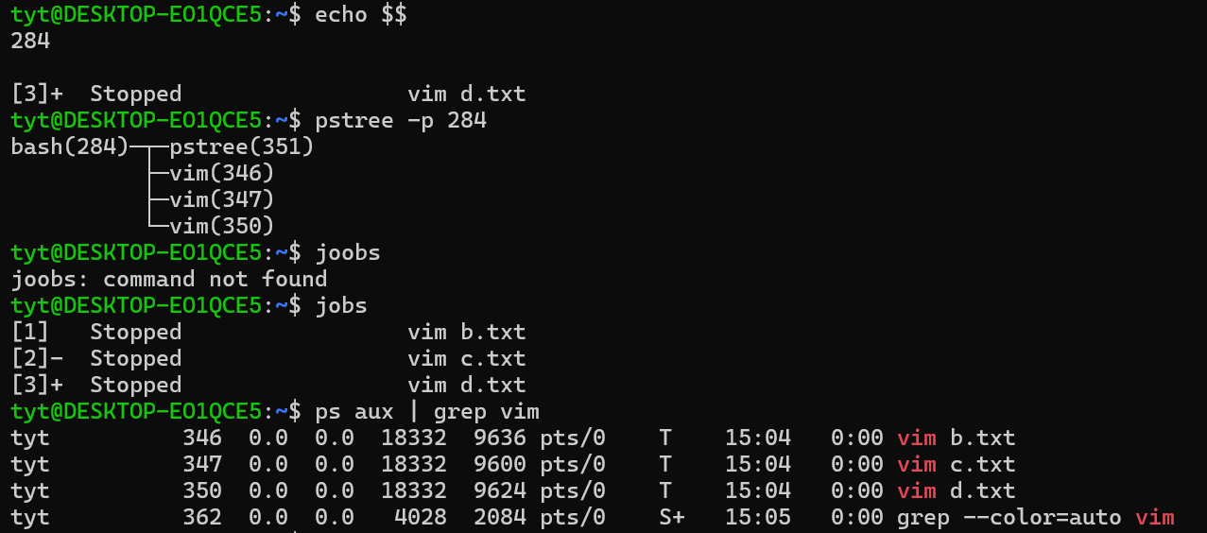
Observe and manage processes (1)

Slide 5
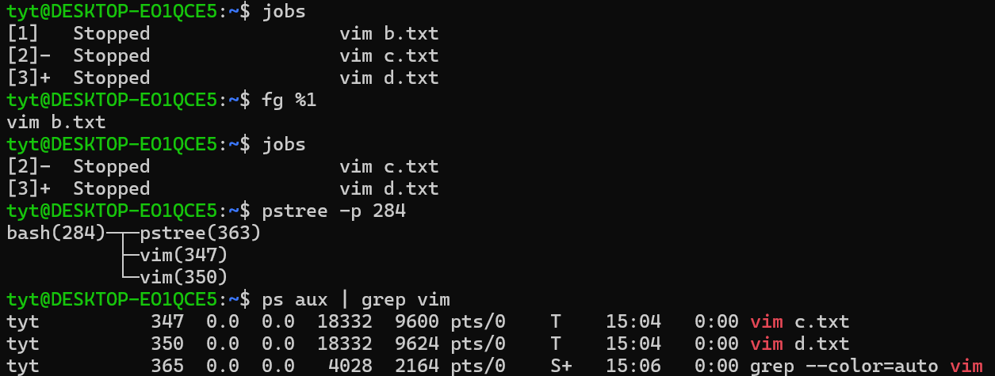
Observe and manage processes (2)

Slide 6
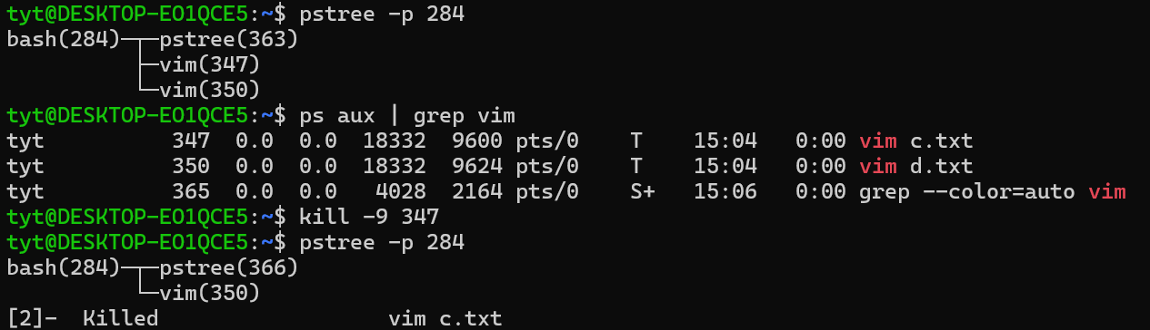
Kill the process

Slide 7
Demo
截圖檢查項目:
透過 pstree 或 jobs 展示有 3 個 vim 在背景執行
使用 kill 和 fg 來結束其中 2 個 vim processes
(kill 和 fg 指令需各使用一次)
3. 透過 pstree 或 jobs 展示剩 1 個 vim 在背景執行
繳交方式：截圖上傳至 moodle，須包含以上三樣檢查項目

Slide 8
THANKS

