Slide 1
Introduction to Linux Systems VIM and tmux
Chia-Heng Tu
Dept. of Computer Science and Information Engineering
National Cheng Kung University
Fall 2024
Lab3: Install vim plugins and work with quickfix window

Slide 2
Lab
Install plugin manager “vim-plug” and gcc
Use vim-plug to install plugins
Work with quickfix window

Slide 3
Install packages
$ sudo apt update
$ sudo apt upgrade
$ sudo apt install git curl vim-gtk3
* Install gcc
$ sudo apt install build-essential
$ gcc --version

Slide 4
Install plugin manager “vim-plug”
$ curl -fLo ~/.vim/autoload/plug.vim --create-dirs https://raw.githubusercontent.com/junegunn/vim-plug/master/plug.vim
Ref: junegunn/vim-plug

Slide 5
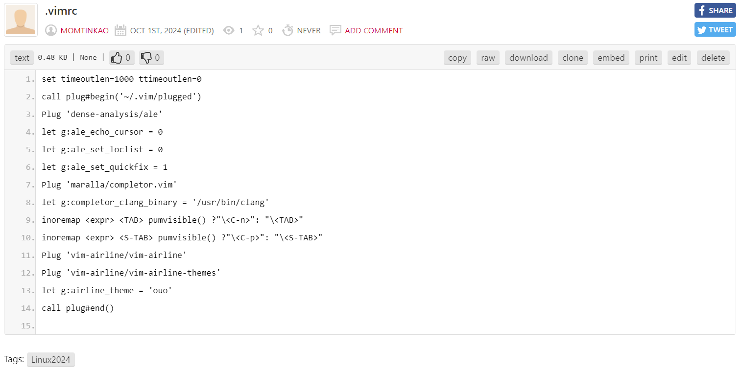
Use vim-plug to install plugins
1. Open .vimrc to copy the content from the files
2. Edit the .vimrc file
$ vim ~/.vimrc
Paste the content
:wq
3. Install Plugins
$ vim ~/.vimrc
:PlugInstall
:qa
shll command
command-line mode in vim

Slide 6
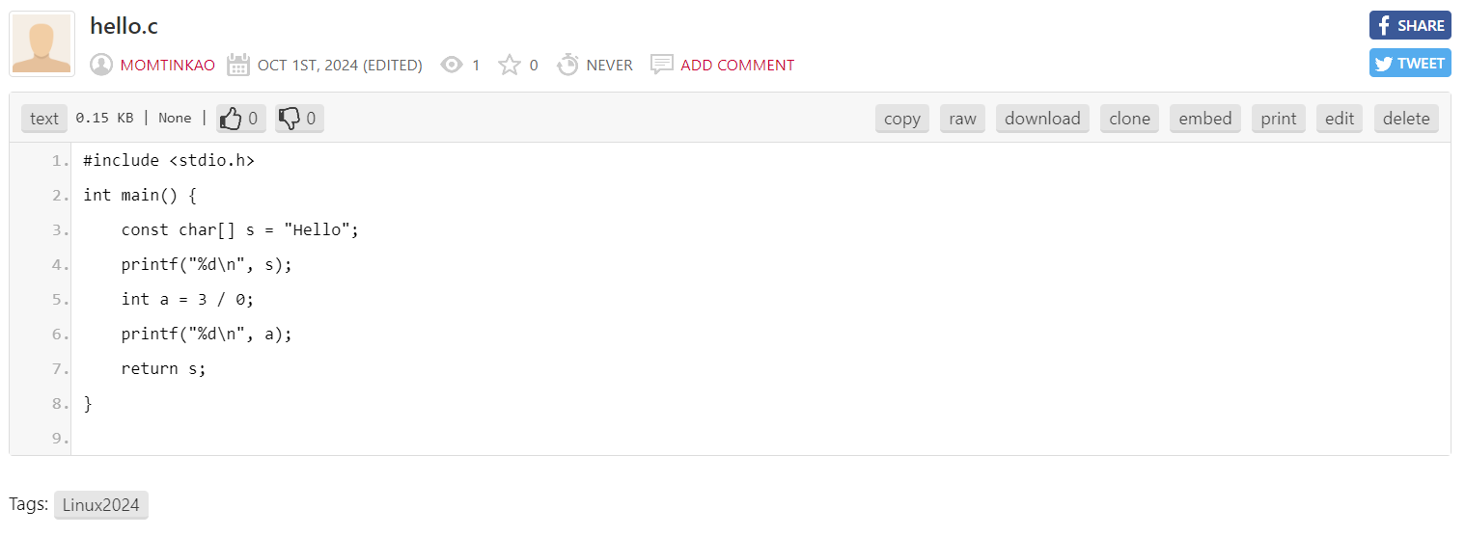
Write a C program
Open hello.c to copy the content from the files
$ vim hello.c
Paste the content

Slide 7
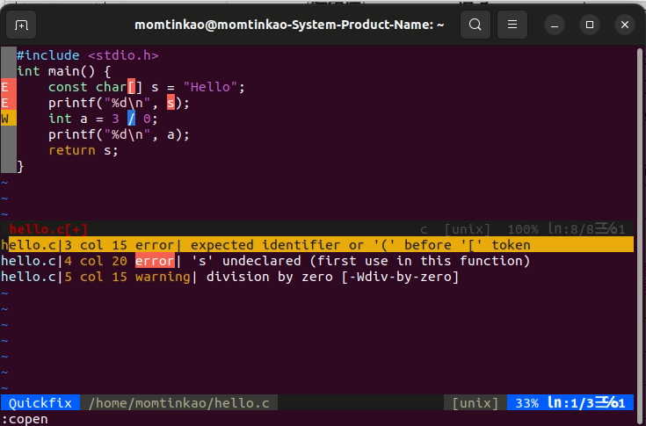
Work with quickfix window
:copen
:q
:cw
Use j, k to move in quickfix window then use “enter”
Use ctrl-w w to switch between two windows
Fix all errors and warnings then use “:cw”
:copen " Open the quickfix window :ccl " Close it
:cw " Open it if there are "errors", close it otherwise (some people prefer this)
:cn " Go to the next error in the window
:cp " Go to the previous error in the window
:cnf " Go to the first error in the next file
:.cc " Go to error under cursor (if cursor is in quickfix window)
https://stackoverflow.com/a/1747286/6734174

Slide 8
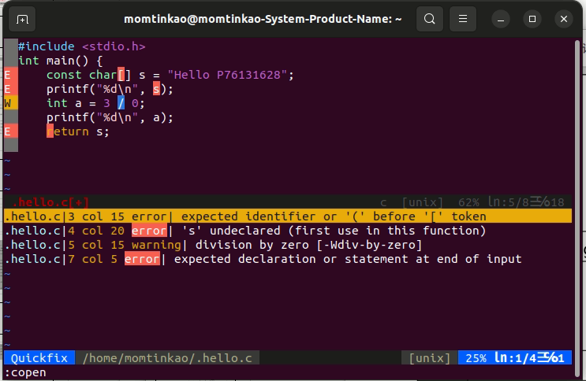
Demo (submit to moodle)
用 vim 開啟本 lab3 提供的 hello.c 並打開 quickfix window，
將圖中的 "Hello" 後方加上你的學號，例如 "Hello F12345678"
並將截圖上傳至 Moodle。需有 error message 來呈現有安裝 Plugins。

Slide 9
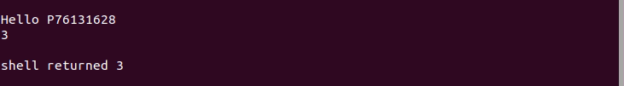
Compile and execute the C program (Optional)
:! gcc % && ./a.out(在vim裡)
Your student ID

Slide 10
QUESTIONS

